Slide 1
Default BLM Strategic Analysis
BLM (Business Leadership Model) Five Looks Analysis
Target Operator
Market
Analysis Period
Report Date
Lifecell Ua
Ukraine
CQ4_2025
2026-02-15
01 Trends (PEST) | 02 Market/Customer ($APPEALS) | 03 Competition (Porter) | 04 Self (BMC) | SWOT Synthesis | 05 Opportunities (SPAN

Slide 2
Report Contents
TABLE OF CONTENTS
01
Executive Summary
Key findings and recommendations
02
Look at Trends
PEST Framework — macro environment
03
Look at Market
$APPEALS — market changes & customer needs
T
Tariff Analysis
Pricing comparison — mobile, fixed & convergence
04
Look at Competition
Porter's Five Forces — competitive landscape
05
Look at Self
BMC + Capability — internal assessment
06
SWOT Synthesis
Strengths, Weaknesses, Opportunities, Threats
07
Look at Opportunities
SPAN Matrix — opportunity selection
Summary & Provenance
2
08
Conclusions and data sources

Slide 3
Data Quality Overview
DATA QUALITY
Total Data Points
High Confidence
Medium Confidence
Low/Estimated
20
0
0
20
0%
Unique Sources: 0
Data Conflicts: 0
Coverage: Partial
Key Message: 20 data points tracked, 0 high-confidence (0%
3

Slide 4
Executive Summary
Trends
Macro environment: Favorable. Key opportunities: Regulatory Environment, National Digital Strategy. Key risks: Regulatory Environment, War infrastructure damage: 4,300+ base stations destroyed since 2022 Industry is in late growth phase. (+6.5% YoY (CQ2_2025 -> CQ4_2025)
Market/Customer
Ukraine telecom market totals UAH 19.9B in quarterly revenue; gaps in Social/Brand; Market presents a balanced mix of opportunities and challenges.
Competition
In a 3-player market with medium competition intensity, Kyivstar leads with 49% revenue share. Target operator holds 19% share. Strongest competitive force: Existing Competitors.
Self Assessment
Ranked #3 of 3 operators in market; revenue UAH 3,800M; EBITDA margin 55.8%; stable but facing challenges; key strength: Price Competitiveness; key challenge: Brand Strength; Management outlook: FY2023 revenue UAH 11.7B (+24.4%), EBITDA UAH 6.81B (margin 58.2%), net profit UAH 2.57B. Mobile subs 9.9M (3-month active). ARPU UAH 110.9 (+21.2% YoY). FY2024 estimated ~UAH 14B.
SWOT
SWOT analysis identifies 3 strengths, 9 weaknesses, 4 opportunities, and 8 threats. The recommended strategic posture is cautious (WT-dominant).
Opportunities
SPAN matrix positions 23 opportunities: 2 grow/invest, 14 acquire skills, 3 harvest, 4 avoid/exit. Focus resources on the 2 grow/invest items for maximum strategic impact.
Key Message: Five Looks analysis completed — see details in following sections
4

Slide 5
01 Look at Trends
PEST Framework — Macro Environment

Slide 6
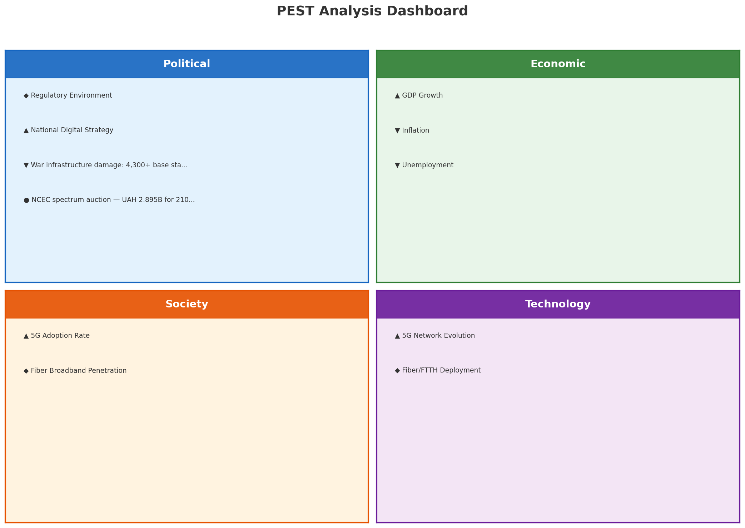
PEST Analysis Dashboard
MACRO ENVIRONMENT
Key Message: Macro environment: Favorable. Key opportunities: Regulatory Environment, National Digital Strategy. Key risks: Regulatory Environment, War infrastructure damage: 4,300+ base stations destroyed since 2022.
6

Slide 7
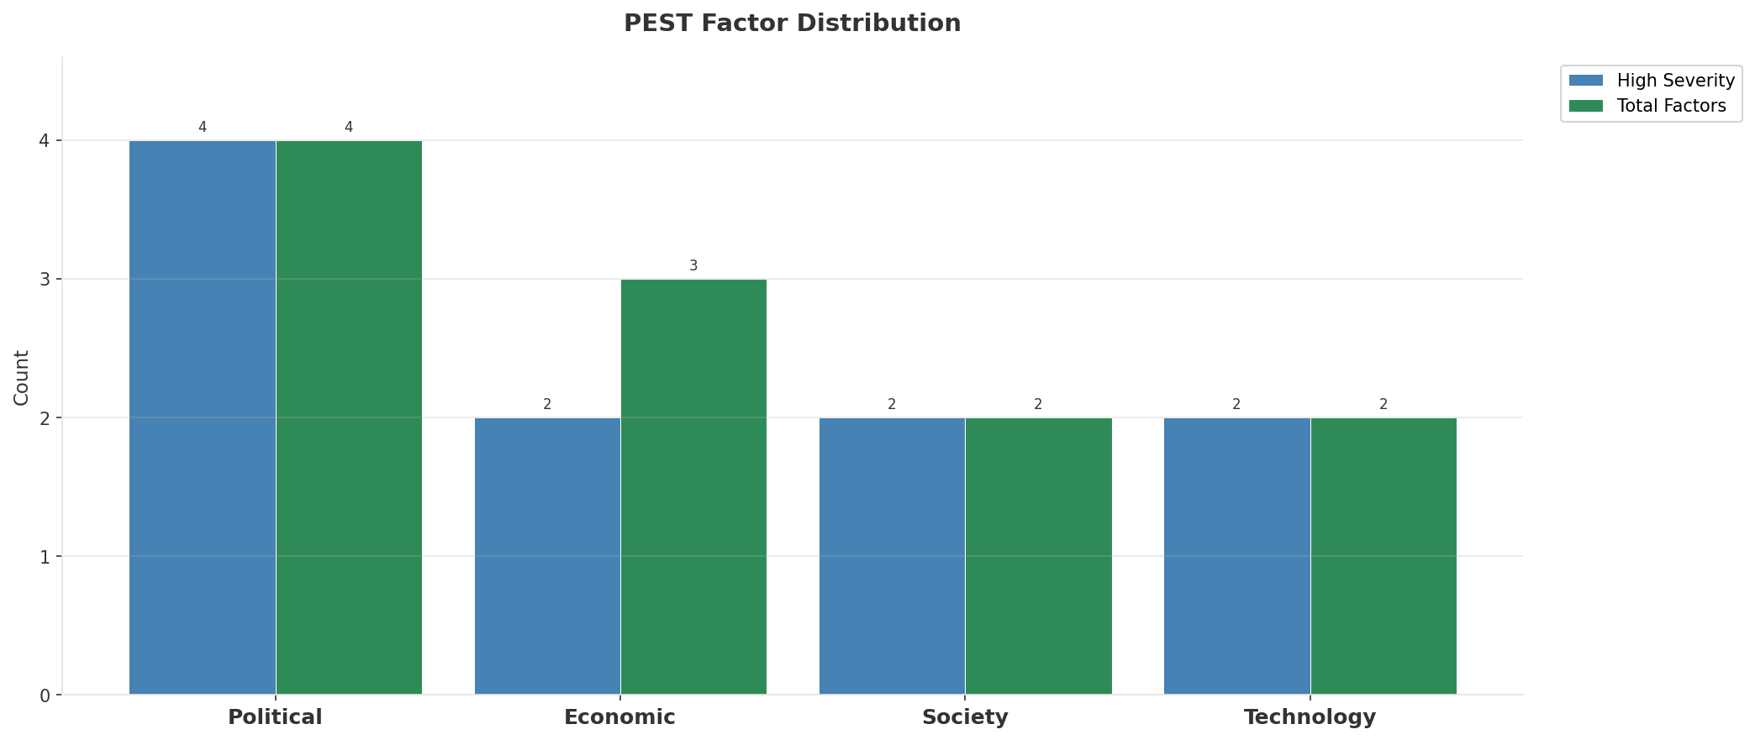
Industry Environment
INDUSTRY ANALYSIS
Market Size
Growth Rate
Concentration
Lifecycle
UAH 19.9B (quarterly, CQ4_2025
+6.5% YoY (CQ2_2025 -> CQ4_2025
CR4 = 100% (Kyivstar: 49.1%, Vodafone Ukraine: 31.8%, lifecell (DVL Group): 19.1%
late_growth
• New Business Models:
• FWA (Fixed Wireless Access) as fiber alternative
• Network-as-a-Service for enterprise verticals
• Wholesale/MVNO partnerships for coverage monetization
• Technology Revolution:
• 5G SA enabling network slicing and enterprise services
• AI/ML for network optimization and customer experience
• Open RAN for vendor diversification and cost reduction
Key Message: Macro environment: Favorable. Key opportunities: Regulatory Environment, National Digital Strategy. Key risks: Regulatory Environment, War infrastructure damage: 4,300+ base stations destroyed since 2022 Industry is in late growth phase. (+6.5% YoY (CQ2_2025 -> CQ4_2025)
7

Slide 8
Value Transfer Trends
VALUE MIGRATION
• Value shifting from voice/SMS to data and digital services
• B2B/ICT growing faster than consumer segment
• Fiber displacing copper and cable broadband
Key Message: Macro environment: Favorable. Key opportunities: Regulatory Environment, National Digital Strategy. Key risks: Regulatory Environment, War infrastructure damage: 4,300+ base stations destroyed since 2022 Industry is in late growth phase. (+6.5% YoY (CQ2_2025 -> CQ4_2025)
8

Slide 9
02 Look at Market
$APPEALS — Market Changes & Customer Needs

Slide 10
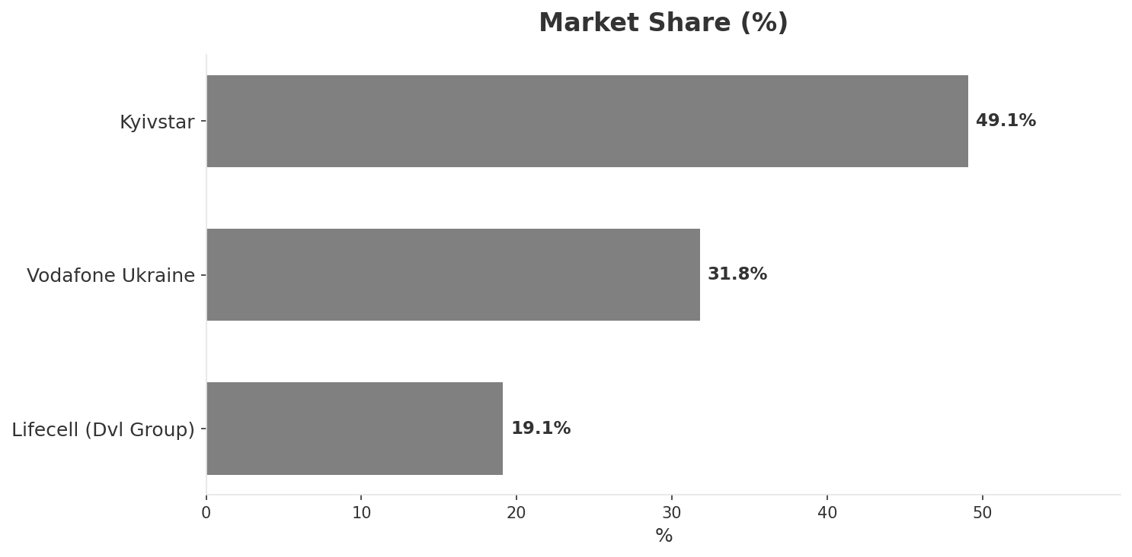
Market Change Panorama
MARKET OVERVIEW
Total Revenue (€M
Mobile Subs (K
Broadband Subs (K
Operators
19,910
50,100
5,200
3
Market Changes:
• Kyivstar EBITDA margin improvement: 60.4% vs 57.3% (+3.1pp
• Vodafone Ukraine revenue growth 9.3% YoY
• lifecell (DVL Group) revenue increase 5.6% QoQ (UAH 3,800M vs UAH 3,600M
• lifecell (DVL Group) revenue growth 24.6% YoY
Key Message: Ukraine telecom market totals UAH 19.9B in quarterly revenue; gaps in Social/Brand; Market presents a balanced mix of opportunities and challenges.
10

Slide 11
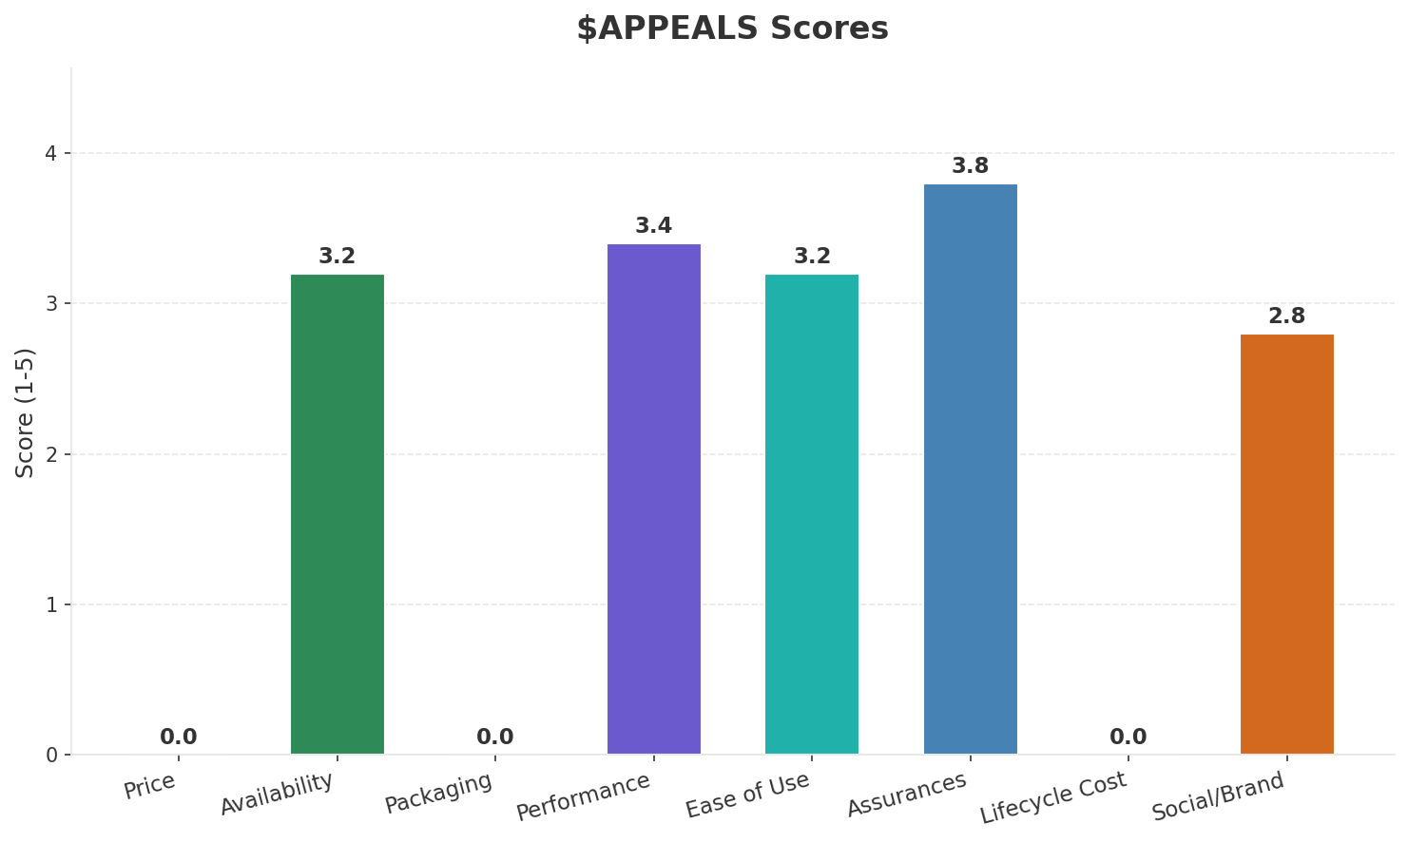
Customer Segments
SEGMENTATION
Consumer Urban Connected
Trend: stable
Needs: Reliable connectivity despite wartime infrastructure damage, Affordable converged fixed-mobile bundles
Consumer Price-Sensitive / Prepaid
Trend: stable
Needs: Ultra-affordable prepaid data connectivity, Resilient connectivity during power outages
Consumer Displaced / Refugee
Trend: stable
Needs: Easy number portability and activation in new locations, Affordable roaming for those displaced abroad
Enterprise & Government
Trend: stable
Needs: Resilient communications infrastructure for businesses, Cloud and cybersecurity services (heightened need
Key Message: Ukraine telecom market totals UAH 19.9B in quarterly revenue; gaps in Social/Brand; Market presents a balanced mix of opportunities and challenges.
11

Slide 12
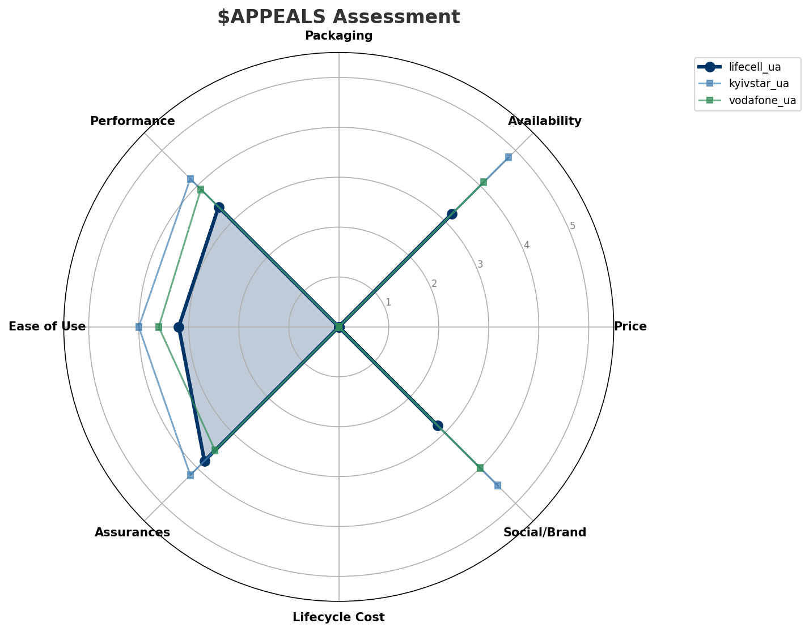
$APPEALS Assessment
CUSTOMER NEEDS
Key Message: Ukraine telecom market totals UAH 19.9B in quarterly revenue; gaps in Social/Brand; Market presents a balanced mix of opportunities and challenges.
12

Slide 13
Customer Value Migration
VALUE MIGRATION
Value migration trending upward: customers willing to pay more for premium connectivity and convergent bundles. Focus on upselling and cross-selling opportunities.
Opportunities:
Threats:
• lifecell (DVL Group) revenue increase 5.6% QoQ (UAH 3,800M vs UAH 3,600M
• lifecell (DVL Group) revenue growth 24.6% YoY
• Kyivstar EBITDA margin improvement: 60.4% vs 57.3% (+3.1pp
• Vodafone Ukraine revenue growth 9.3% YoY
• Kyivstar lists on NASDAQ as KYIV — first Ukrainian company on US exchange
Key Message: Ukraine telecom market totals UAH 19.9B in quarterly revenue; gaps in Social/Brand; Market presents a balanced mix of opportunities and challenges.
13

Slide 14
Tariff Analysis
Mobile, Fixed & Convergence Pricing Landscape

Slide 15
Fixed & Convergence Pricing Landscape
DSL / CABLE / FIBER / FMC BUNDLES
Key Message: Fixed and convergence pricing overview
15

Slide 16
03 Look at Competition
Porter's Five Forces — Competitive Landscape

Slide 17

Porter's Five Forces
COMPETITIVE FORCES
Overall Intensity: MEDIUM
Key Message: In a 3-player market with medium competition intensity, Kyivstar leads with 49% revenue share. Target operator holds 19% share. Strongest competitive force: Existing Competitors.
17

Slide 18
Competitor Analysis: Vodafone Ua
COMPETITOR DEEP DIVE
Revenue
EBITDA
Margin
Capex/Rev
€6,340M
€3,070M
48.4%
25.2%
+9.8% YoY
Strengths
Weaknesses
• Brand Strength: score 80 (market avg 75
• Enterprise Solutions: score 70 (market avg 77
Strategy: Market share expansion (investing for growth); subscriber acquisition focus
Key Message: Competitor analysis: Vodafone Ua
18

Slide 19
Competitor Analysis: Kyivstar Ua
COMPETITOR DEEP DIVE
Revenue
EBITDA
Margin
Capex/Rev
€9,770M
€5,900M
60.4%
27.8%
+11.8% YoY
Strengths
Weaknesses
• Brand Strength: score 90 (market avg 75
• Customer Service: score 80 (market avg 72
• Digital Experience: score 82 (market avg 76
• Distribution: score 92 (market avg 77
• Price Competitiveness: score 65 (market avg 73
Strategy: Market share expansion (investing for growth); subscriber acquisition focus; strong B2B/enterprise push
Key Message: Competitor analysis: Kyivstar Ua
19

Slide 20
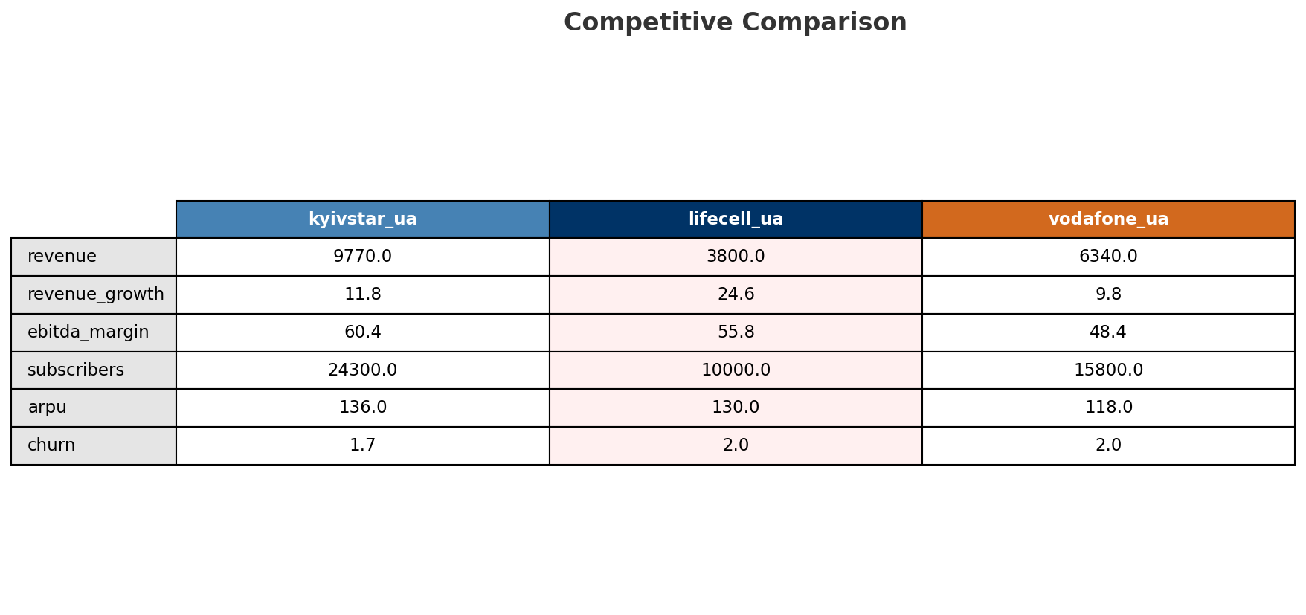
Competitive Landscape Summary
COMPETITION
Key Message: In a 3-player market with medium competition intensity, Kyivstar leads with 49% revenue share. Target operator holds 19% share. Strongest competitive force: Existing Competitors.
20

Slide 21
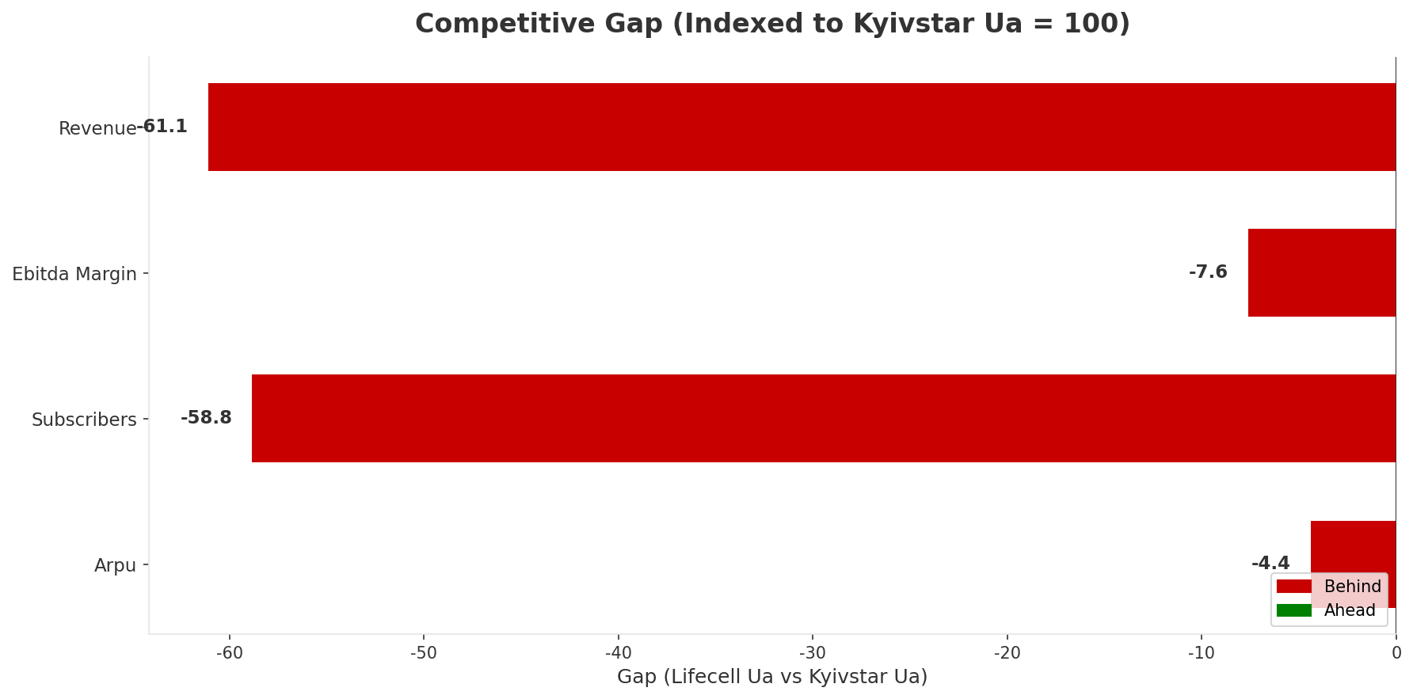
Gap Analysis: Lifecell Ua vs Kyivstar Ua
COMPETITIVE GAP
Key Message: Gap analysis vs market leader Kyivstar Ua
21

Slide 22
New Entrants Threat
MARKET ENTRY
• Entry barriers: High barriers: spectrum licensing, massive capex for network build, regulatory approvals, established brand loyalty
Key Message: New entrants threat level: low
22

Slide 23
04 Look at Self
BMC + Capability Assessment

Slide 24
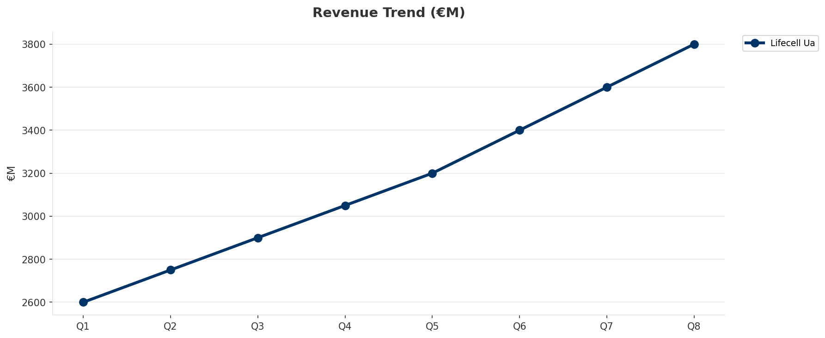
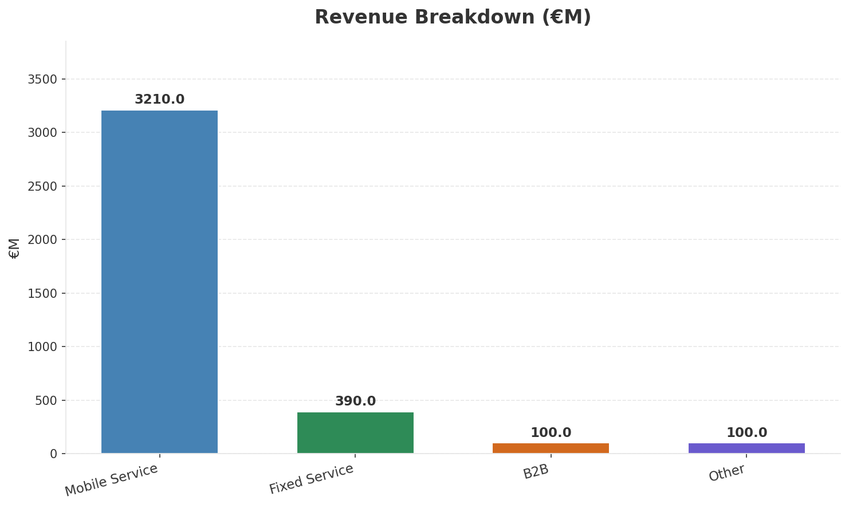
Operating Health Check
FINANCIAL HEALTH
Revenue
EBITDA
EBITDA Margin
Capex/Rev
€3,800M
€2,120M
55.8%
19.7%
+24.59% YoY
+18.4% YoY
CAGR: +24.2% | Accelerating Growth
Key Message: Ranked #3 of 3 operators in market; revenue UAH 3,800M; EBITDA margin 55.8%; stable but facing challenges; key strength: Price Competitiveness; key challenge: Brand Strength; Management outlook: FY2023 revenue UAH 11.7B (+24.4%), EBITDA UAH 6.81B (margin 58.2%), net profit UAH 2.57B. Mobile subs 9.9M (3-month active). ARPU UAH 110.9 (+21.2% YoY). FY2024 estimated ~UAH 14B.
24

Slide 25
Market Share Evolution
REVENUE SHARE TREND
Kyivstar
Vodafone Ukraine
lifecell (DVL Group
49.1% #1
31.8% #2
19.1% #3
-0.9pp losing
-1.5pp losing
+2.4pp gaining
Market Concentration: HHI 3,786 (Highly Concentrated) | CR3: 100.0% | Trend: Fragmenting
Subscriber share: Mobile: 20.0% (+0.5pp) | Broadband: 76.9% (-3.4pp
Key Message: Revenue share: 19.1% (#3); gaining (+2.4pp); market is highly concentrated (HHI 3,786); fragmenting.
25

Slide 26
Momentum Dashboard
MULTI-QUARTER TREND ANALYSIS
Revenue
EBITDA
Margin
+24.2% CAGR
+20.9% CAGR
-2.7% CAGR
Accelerating Growth (54/100
Accelerating Growth (40/100
Accelerating Decline (39/100
Key Message: Dominant momentum: Accelerating Growth — based on 3 KPI trend analyses
26

Slide 27
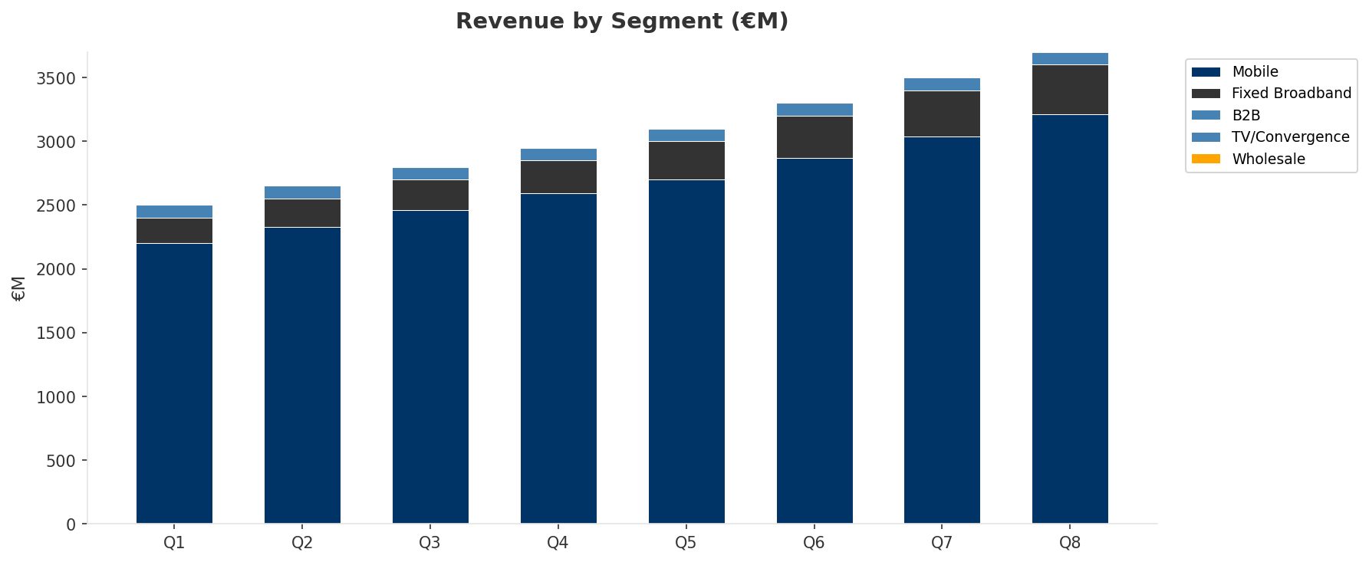
Revenue Composition Trend
SEGMENT REVENUE MIX OVER TIME
Key Message: Growing: Mobile, Fixed Broadband
27

Slide 28
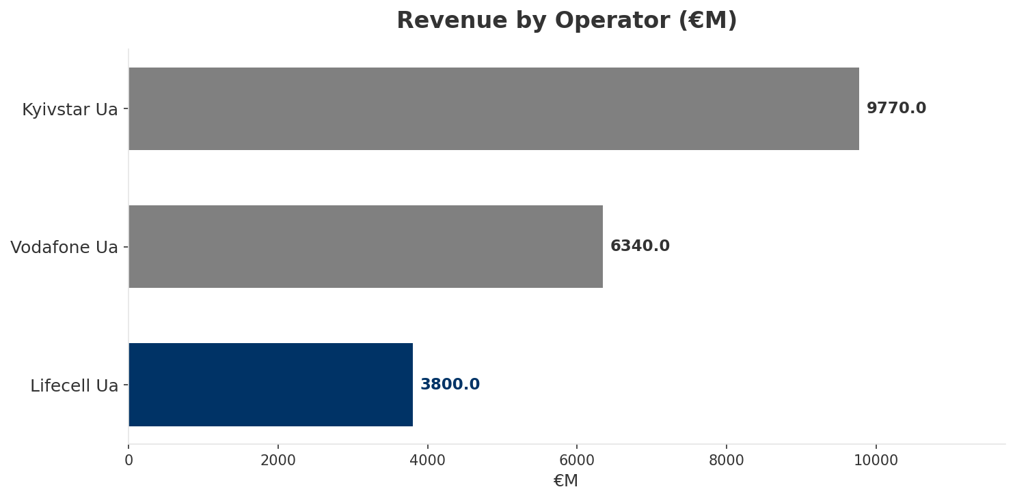
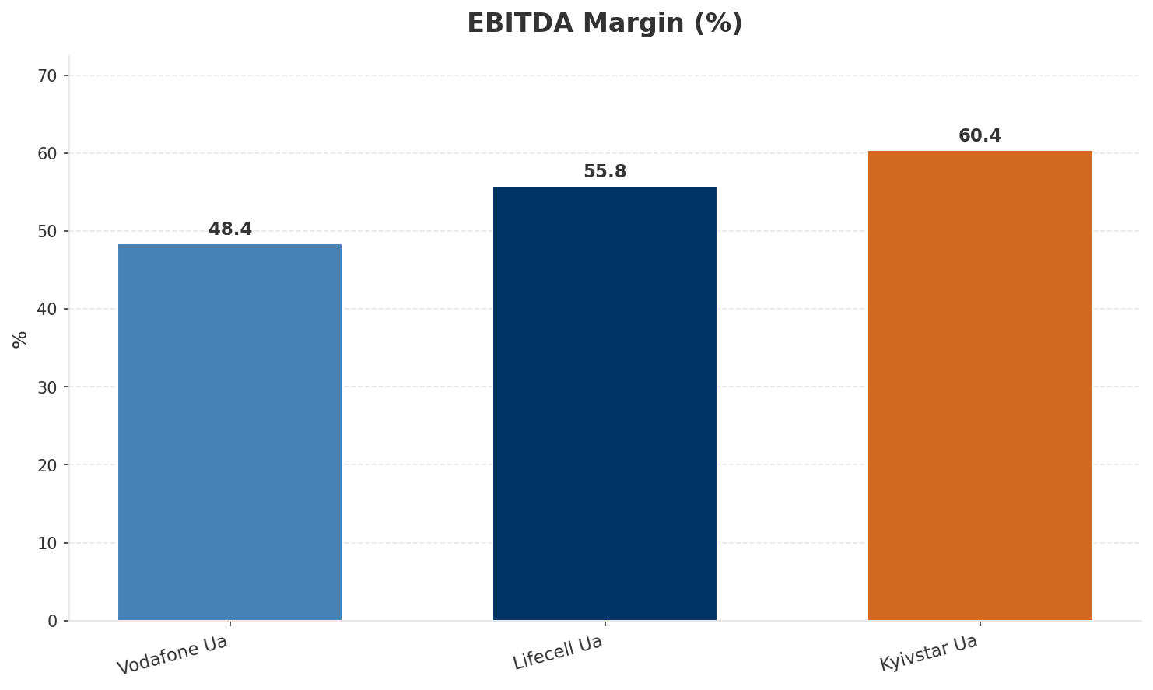
Revenue Comparison
COMPETITIVE BENCHMARKING
Key Message: Revenue and margin benchmarking across operators
28

Slide 29
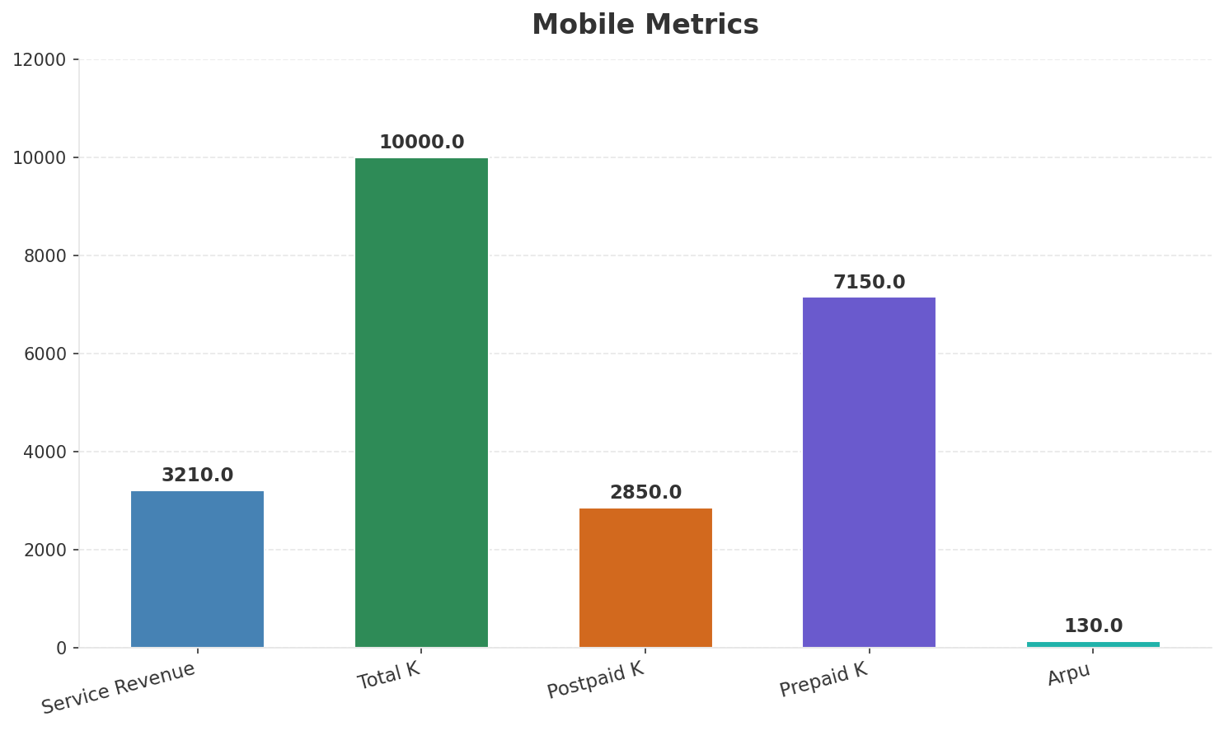
Segment Analysis: Mobile
SEGMENT PERFORMANCE
Service Revenue
Service Growth Pct
Total K
Postpaid K
€3,210M
23.9%
€10,000M
€2,850M
Health: STRONG
• revenue: improving
• subscribers: stable
• arpu: improving
• FY2023 revenue UAH 11.7B (+24.4%), EBITDA UAH 6.81B (margin 58.2%), net profit UAH 2.57B. Mobile subs 9.9M (3-month active). ARPU UAH 110.9 (+21.2% YoY). FY2024 estimated ~UAH 14B.
• revenue increased 5.6% QoQ
• arpu increased 4.0% QoQ
Key Message: Mobile service revenue at 3,210M; up 23.9% YoY; ARPU 130.0
29

Slide 30
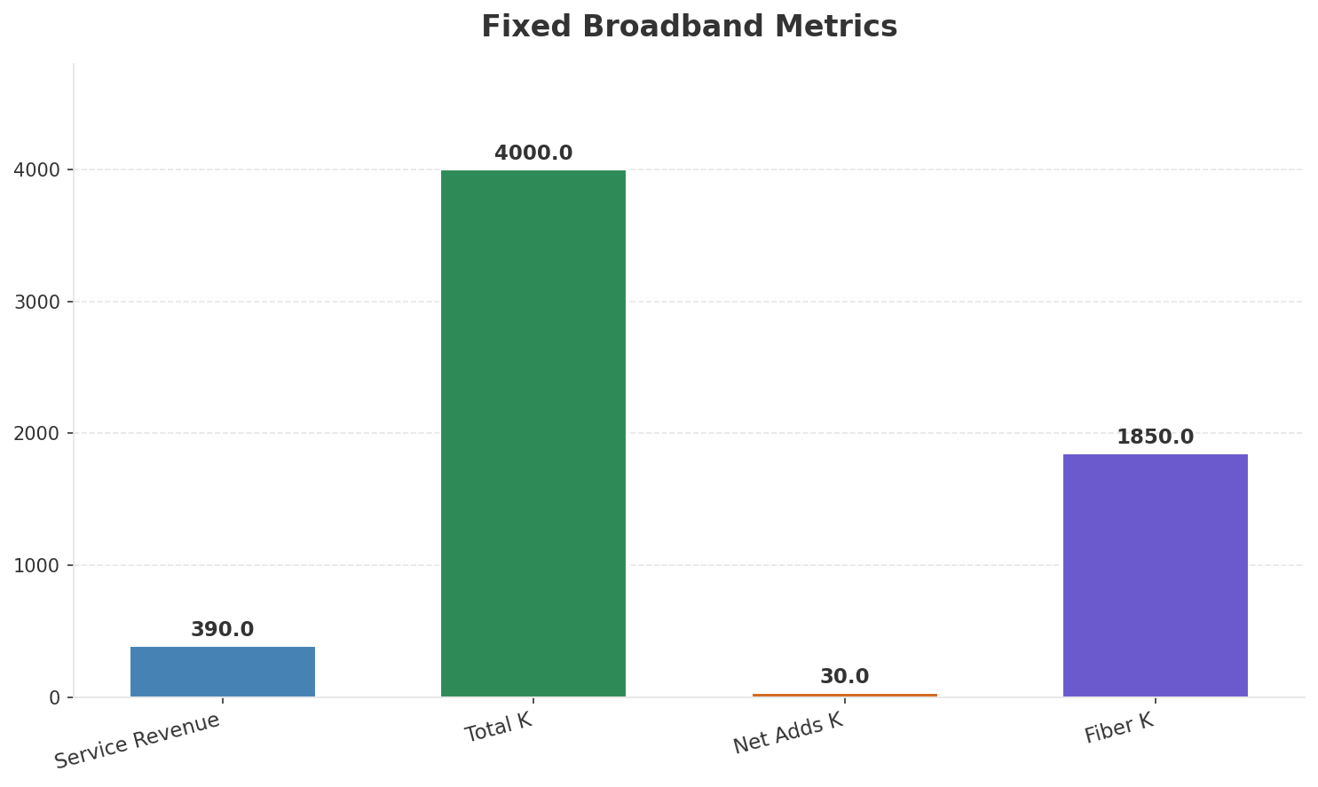
Segment Analysis: Fixed Broadband
SEGMENT PERFORMANCE
Service Revenue
Service Growth Pct
Total K
Net Adds K
€390M
50.0%
€4,000M
30
Health: STRONG
• revenue: improving
• subscribers: stable
• arpu: stable
• NJJ acquisition completed Sep 2024 for $524M. Merging with Datagroup-Volia (#1 fixed ISP, 4M HH). EBRD/IFC $435M financing secured. Plans: 10,000+ km fiber, 1,000+ new base stations. Creating Ukraine'
• revenue increased 8.3% QoQ
Key Message: Fixed service revenue 390.0M; growth +50.0% YoY; Fiber subs 1850K
30

Slide 31
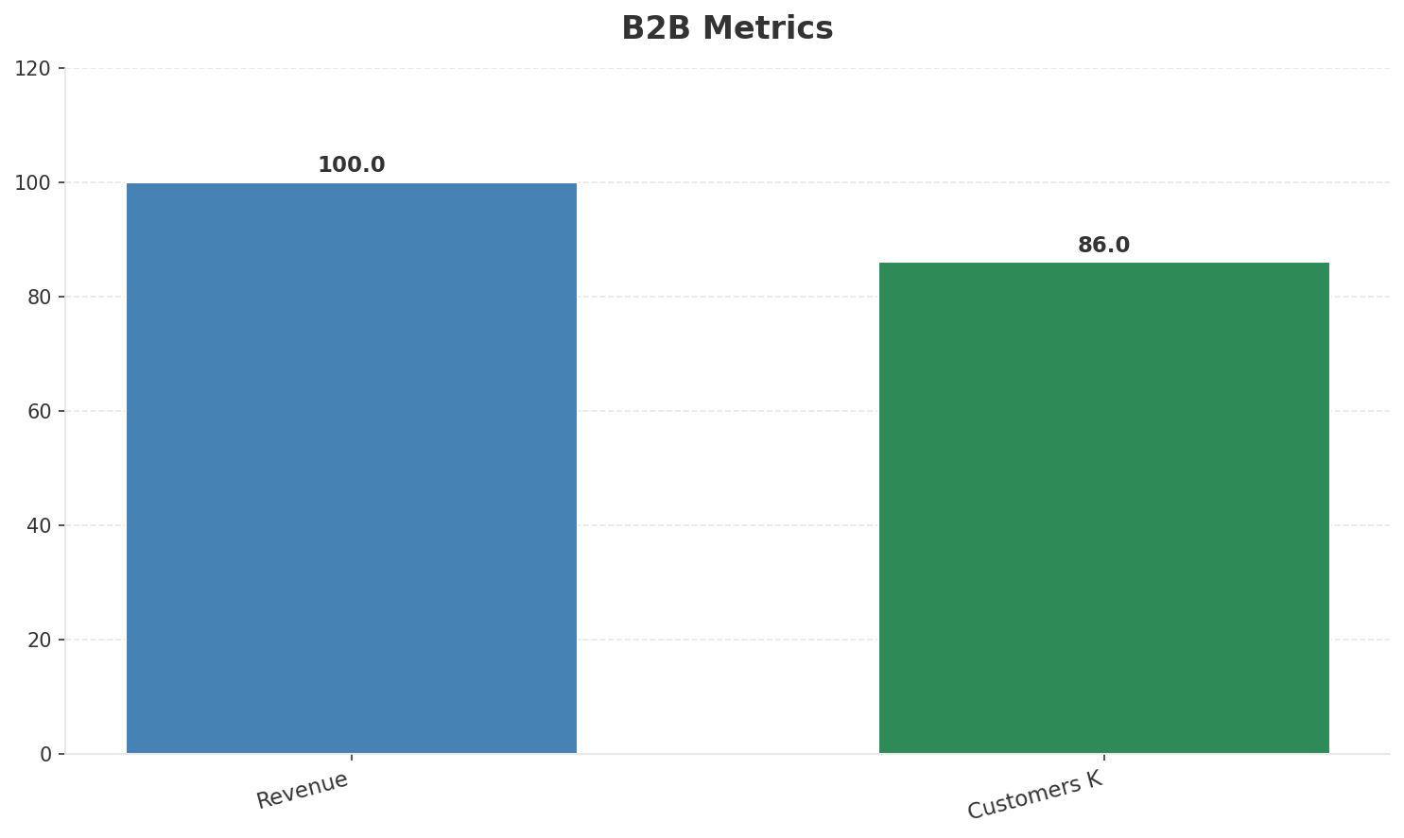
Segment Analysis: B2B
SEGMENT PERFORMANCE
Revenue
Growth Pct
Customers K
Share Of Revenue Pct
€100M
None
86
2.6%
Health: STABLE
• revenue: stable
• customers: improving
• customers increased 2.4% QoQ
Key Message: B2B revenue 100.0M; 2.6% of total revenue
31

Slide 32
Segment Analysis: TV/Convergence
SEGMENT PERFORMANCE
Revenue
Total K
Net Adds K
Fmc Total K
None
€1,250M
None
None
Health: STABLE
• revenue: stable
• subscribers: stable
• fmc_subscribers: stable
Key Message: TV subscribers 1250K
32

Slide 33
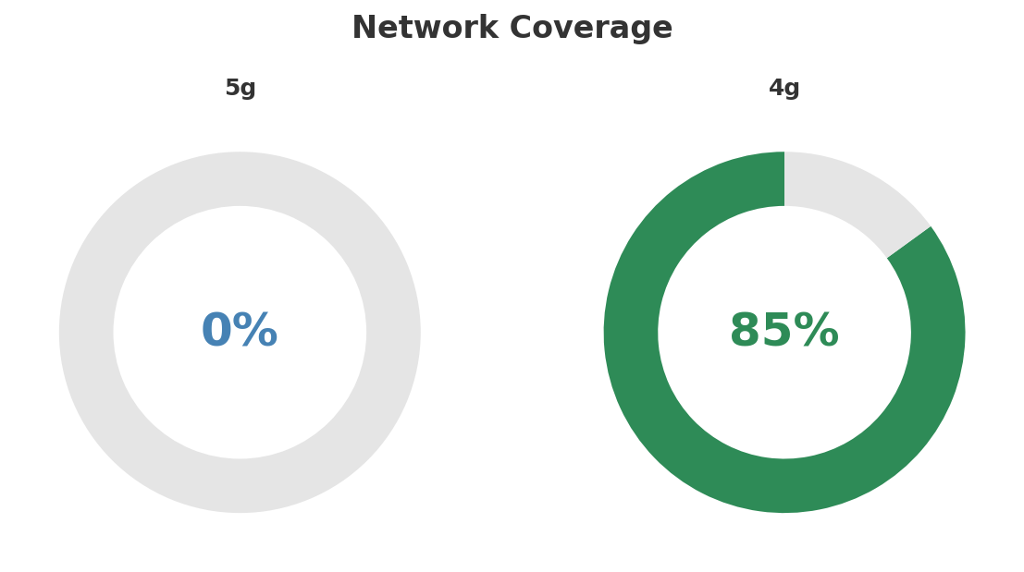
Network Analysis
INFRASTRUCTURE
Technology Mix:
Investment Direction: increasing
• Mobile Vendor: Mixed
• Spectrum Mhz: 110
• Fixed Network: Datagroup-Volia fiber/cable ~4M HH
• Base Stations On Fiber: 350
Key Message: Network infrastructure and coverage assessment
33

Slide 34

Business Model Canvas
BMC
Key Message: Business model canvas overview
34

Slide 35
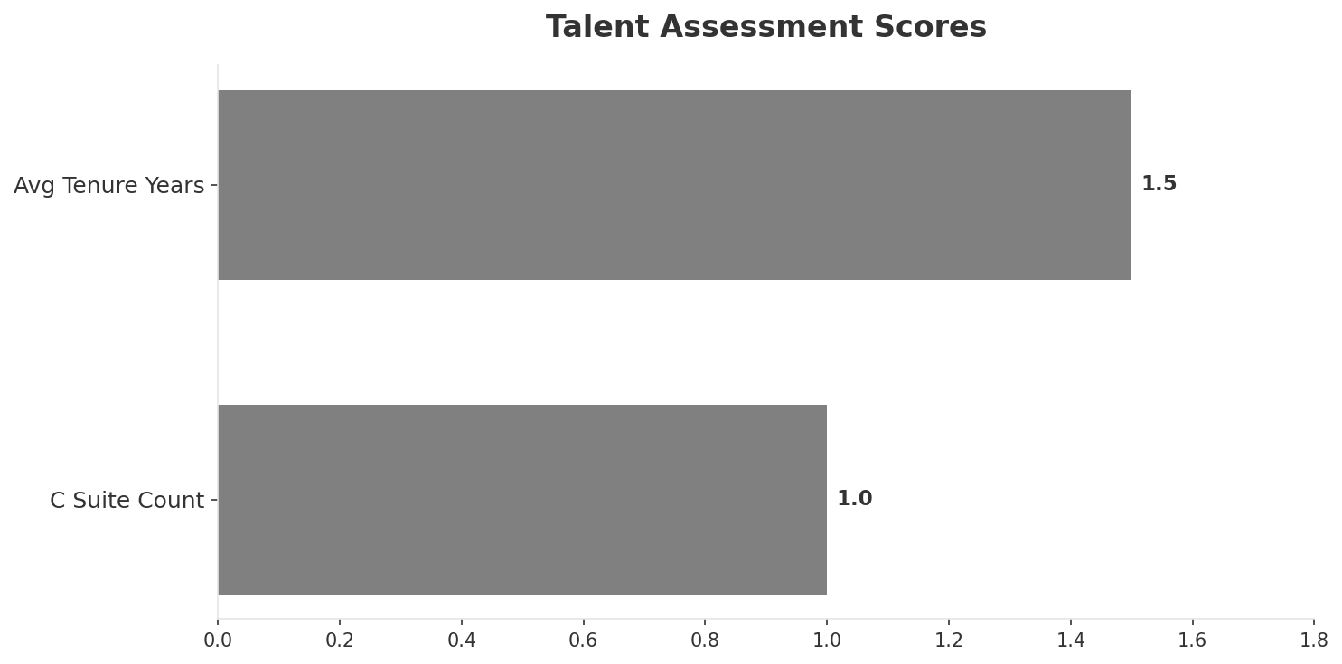
Organization & Talent
PEOPLE & CULTURE
Employees
C Suite Count
Avg Tenure Years
Key Leaders
5,100
1
1.5
['Mykhailo Shelemba (CEO (DVL Group))']
Organization Culture:
Leadership in transition (avg tenure <1.5 years); Transforming under Western ownership. Investment-focused despite wartime. Convergence-oriented. NJJ bringing Iliad Group operational know-how.
Leadership Changes:
• Mykhailo Shelemba: (
Key Message: Organization and talent assessment
35

Slide 36
Strengths, Weaknesses & Exposure Points
SELF ASSESSMENT
Strengths
Weaknesses
Exposure Points
• Price Competitiveness: score 82 (market avg 73
• Strong EBITDA margin at 55.8%
• Revenue on growth trajectory
• Brand Strength: score 55 (market avg 75
• Customer Service: score 65 (market avg 72
• Digital Experience: score 70 (market avg 76
• Distribution: score 60 (market avg 77
• Network Coverage: score 65 (market avg 81
• Network Quality: score 68 (market avg 77
• Active wartime environment with ongoing infrastructure damage: Network outages, tower destruction, power grid attacks
• Smallest mobile operator integrating newly acquired Datagroup-Volia: Complex integration during wartime conditions
Key Message: Ranked #3 of 3 operators in market; revenue UAH 3,800M; EBITDA margin 55.8%; stable but facing challenges; key strength: Price Competitiveness; key challenge: Brand Strength; Management outlook: FY2023 revenue UAH 11.7B (+24.4%), EBITDA UAH 6.81B (margin 58.2%), net profit UAH 2.57B. Mobile subs 9.9M (3-month active). ARPU UAH 110.9 (+21.2% YoY). FY2024 estimated ~UAH 14B.
36

Slide 37
SWOT Synthesis
Strengths, Weaknesses, Opportunities & Threats

Slide 38
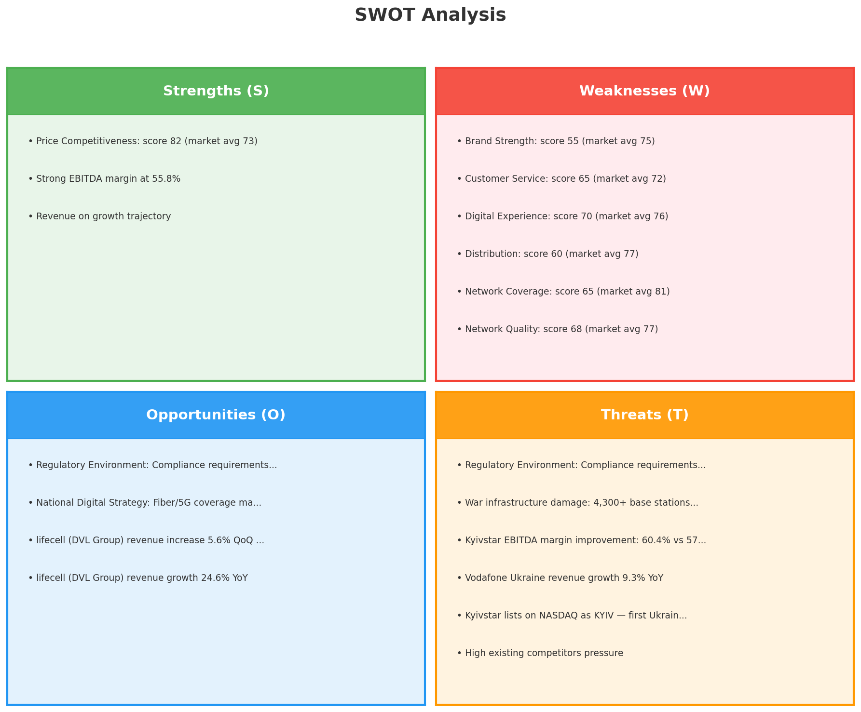
SWOT Analysis
STRATEGIC SYNTHESIS
SO:
Leverage 'Price Competitiveness: score 82 (market avg 73)...
WO:
Address weakness 'Brand Strength: score 55 (market avg 75...
ST:
Use strength 'Price Competitiveness: score 82 (market avg...
WT:
Mitigate weakness 'Brand Strength: score 55 (market avg 7...
Key Message: SWOT analysis identifies 3 strengths, 9 weaknesses, 4 opportunities, and 8 threats. The recommended strategic posture is cautious (WT-dominant).
38

Slide 39
05 Look at Opportunities
SPAN Matrix — Opportunity Selection

Slide 40
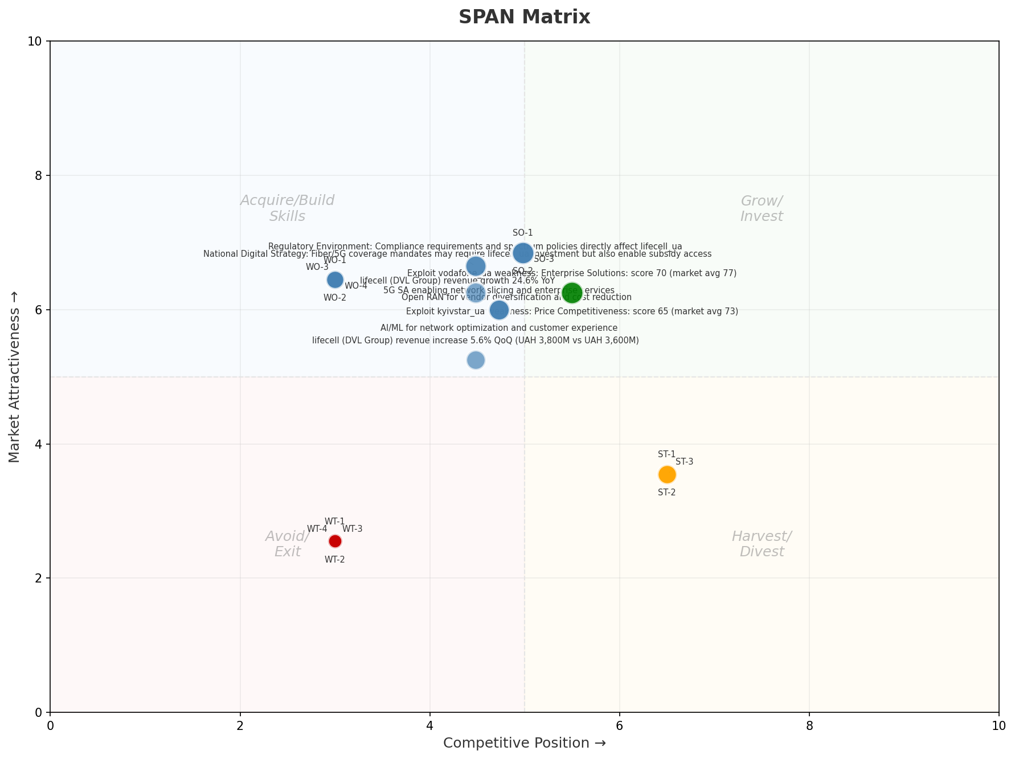
SPAN Matrix — Opportunity Positioning
OPPORTUNITY MAP
Key Message: SPAN matrix positions 23 opportunities: 2 grow/invest, 14 acquire skills, 3 harvest, 4 avoid/exit. Focus resources on the 2 grow/invest items for maximum strategic impact.
40

Slide 41
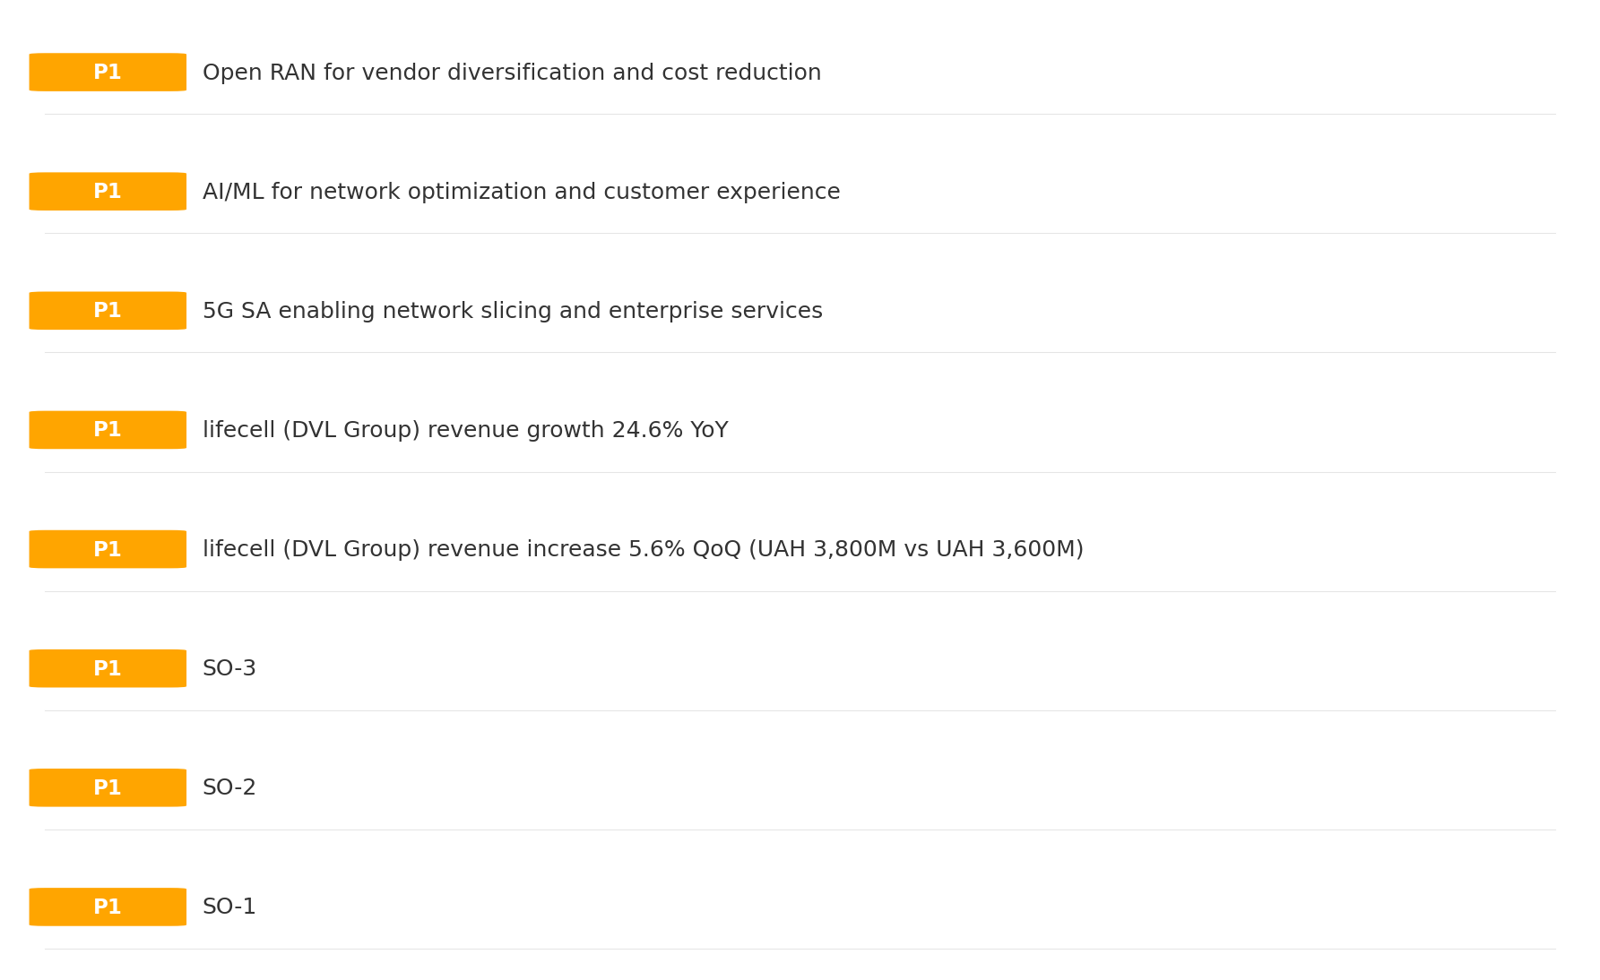
Opportunity Priority Ranking
PRIORITIES
Key Message: SPAN matrix positions 23 opportunities: 2 grow/invest, 14 acquire skills, 3 harvest, 4 avoid/exit. Focus resources on the 2 grow/invest items for maximum strategic impact.
41

Slide 42
Opportunity Details
DEEP DIVE
P1
SO-1
Market: N/A | Window:
Leverage 'Price Competitiveness: score 82 (market avg 73)' to capture the opportunity of 'Regulatory Environment: Compliance requirements and spectrum policies directly affect lifecell_ua'.
P1
SO-2
Market: N/A | Window:
Leverage 'Strong EBITDA margin at 55.8%' to capture the opportunity of 'National Digital Strategy: Fiber/5G coverage mandates may require lifecell_ua investment but also enable subsidy access'.
P1
SO-3
Market: N/A | Window:
Leverage 'Revenue on growth trajectory' to capture the opportunity of 'lifecell (DVL Group) revenue increase 5.6% QoQ (UAH 3,800M vs UAH 3,600M)'.
P1
lifecell (DVL Group) revenue increase 5.6% QoQ (UAH 3,800M vs UAH 3,600M
Market: N/A | Window:
lifecell (DVL Group) revenue increase 5.6% QoQ (UAH 3,800M vs UAH 3,600M
Key Message: SPAN matrix positions 23 opportunities: 2 grow/invest, 14 acquire skills, 3 harvest, 4 avoid/exit. Focus resources on the 2 grow/invest items for maximum strategic impact.
42

Slide 43
Three Decisions
Strategy — Key Tasks — Execution

Slide 44
Decision 1: Define Strategy
CAUTIOUS
As The Squeezed Middle: differentiate and grow through focused investment in competitive advantages
P0
P0
P1
P1
Growth Strategy
Competitive Strategy
Transformation Strategy
Customer Strategy
Focused growth in high-momentum segments: Mobile, Fixed Broadband, B2B
Differentiate on quality and innovation to justify premium positioning
Accelerate fiber transition — converged network as competitive moat
Optimize value extraction in stable segments: TV/Convergence, Wholesale
- Grow Mobile, Fixed Broadband, B2B above market rate
- Improve segment profitability
- Improve NPS by 5 points
- Launch 2+ differentiating services
- Fiber homepass coverage +20%
- FMC bundle attach rate 50%+
- Upsell rate +10% in TV/Convergence, Wholesale
- Cross-sell convergence bundles
Key Message: As The Squeezed Middle, the strategic posture is Cautious. As The Squeezed Middle: differentiate and grow through focuse
44

Slide 45
Decision 2: Define Key Tasks
3 P0 (IMMEDIATE), 1 P1 (1-2 YEARS), 1 P2 (3-5 YEARS
P0
Network
Accelerate Fixed Network Upgrade
Homepass coverage +15% | Speed tier upgrades
Drive DOCSIS/Fiber rollout to increase homepass and improve quality scores
P0
Business
Accelerate Mobile Growth
Mobile revenue +10% YoY | Market share gain
Mobile at €3,210M showing strong momentum — invest to scale
P0
Business
Accelerate Fixed Broadband Growth
Fixed Broadband revenue +10% YoY | Market share gain
Fixed Broadband at €390M showing strong momentum — invest to scale
P1
Customer
Customer Experience Enhancement
NPS +5 points | First-call resolution rate 80%+
Improve digital touchpoints and service resolution to boost NPS
P2
Efficiency
Operational Efficiency & Automation
Process automation 30%+ | Cost-to-serve reduction
EBITDA margin 55.8% — maintain through smart automation and resource reallocatio
Key Message: 5 critical tasks: 3 P0 (immediate), 1 P1 (1-2 years), 1 P2 (3-5 years
45

Slide 46

Decision 3: Define Execution
QUARTERLY ROADMAP & GOVERNANCE
Governance
Strategic Traps to Avoid
- Monthly Progress Review (Monthly
x Enter a price war
- Quarterly Strategic Checkpoint (Quarterly
x Attempt premium repositioning
- Mid-Year Strategic Adjustment (Semi-annual
x Delay core transformation
Key Risks & Mitigation
! Resource constraints delay P0 initiatives -- Ring-fence P0 budgets; establish escalation path for blockers
Key Message: Execute with discipline: monthly reviews, quarterly checkpoints, annual refresh
! Macro-economic slowdown reduces consumer spending -- Prepare value-tier offerings; shift mix toward B2B resilience
46

Slide 47
Analysis Summary
KEY TAKEAWAYS
01 Trends
Macro environment: Favorable. Key opportunities: Regulatory Environment, National Digital Strategy. Key risks: Regulatory Environment, War infrastructure damage: 4,300+ base stations destroyed since 2022 Industry is in late growth phase. (+6.5% YoY (CQ2_2025 -> CQ4_2025)
02 Market
Ukraine telecom market totals UAH 19.9B in quarterly revenue; gaps in Social/Brand; Market presents a balanced mix of opportunities and challenges.
03 Competition
In a 3-player market with medium competition intensity, Kyivstar leads with 49% revenue share. Target operator holds 19% share. Strongest competitive force: Existing Competitors.
04 Self
Ranked #3 of 3 operators in market; revenue UAH 3,800M; EBITDA margin 55.8%; stable but facing challenges; key strength: Price Competitiveness; key challenge: Brand Strength; Management outlook: FY2023 revenue UAH 11.7B (+24.4%), EBITDA UAH 6.81B (margin 58.2%), net profit UAH 2.57B. Mobile subs 9.9M (3-month active). ARPU UAH 110.9 (+21.2% YoY). FY2024 estimated ~UAH 14B.
SWOT
SWOT analysis identifies 3 strengths, 9 weaknesses, 4 opportunities, and 8 threats. The recommended strategic posture is cautious (WT-dominant).
05 Opportunities
SPAN matrix positions 23 opportunities: 2 grow/invest, 14 acquire skills, 3 harvest, 4 avoid/exit. Focus resources on the 2 grow/invest items for maximum strategic impact.
Key Message: Complete Five Looks analysis — see opportunity priorities for next steps
47

Slide 48
Data Provenance
SOURCES & METHODOLOGY
No provenance data recorded for this analysis
Key Message: All data points are traceable to original sources
48

Slide 49
Thank You
BLM Five Looks Strategic Analysis

