Slide 1
Accelerating Tensorflow* on Modern Intel Architectures
10 September, 2017 @ AIM2017 Workshop
Guozhong Zhuang

Slide 2
Acknowledgement
Evarist M Fomenko
Mukesh Gangadhar
Jing Huang
Deepthi Karkada
Young Jin Kim
Srihari Makineni
Dmitri Mishura
Karthik Raman
Vivek V Rane
Michael Riera
Dmitry Sergeev
Vamsi Sripathi
Bhavani Subramanian
Lakshay Tokas
Antonio C Valles
Elmoustapha Ould-Ahmed-Vall
(Senior Principal Engineer)
Mahmoud Abuzaina
AG Ramesh
Niranjan Hasabnis
Md Faijul Amin
Jayaram Bobba
Roman S Dubtsov

Slide 3
Agenda
Optimizations
  Operator-level optimizations in TensorFlow* for Intel® Architectures
    Intel® MKL integration
    Limitation of operator-level optimizations
  Graph-level optimizations in TensorFlow* for Intel® Architectures
    Data layout conversion optimization
    Node merging optimization
    Memory allocation
    Load balancing
  Default graph-level optimizations offered in Google’s TensorFlow*

Slide 4
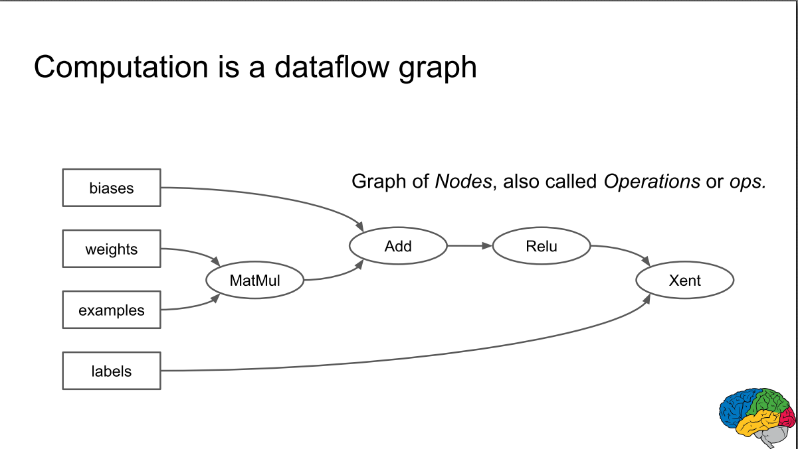
Operator-level optimization
Intel® MKL has optimized common set of primitives
Call Intel® MKL API for executing Tensorflow operation (MKL integration)
  Link: Which optimizations are in MKL ?
Limitation: operators do not know surrounding operators (context) leading to some redundant computations

Slide 5
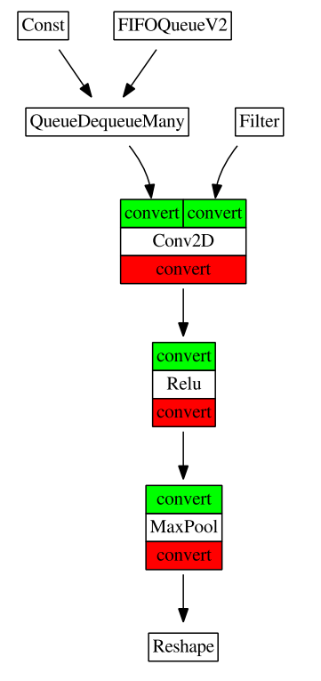
Operation-level optimizations may not remove redundant conversions
class MklConv2DOp : public OpKernel {
    void Compute (OpKernelContext* context) override {
    const Tensor& tf_input = context->input(0);
    const Tensor& tf_filter = context->input(1);
    Tensor* output = context->allocate_output(..);
    mkl_input = convert_to_mkldnnlayout(tf_input);
    mkl_filter = convert_to_mkldnnlayout(tf_filter);
    mkl_output = mkldnn_conv2d_fwd(mkl_input, mkl_filter,…);
    *output = convert_to_tflayout(mkl_output);
    }
    };
Graph optimizations address the limitations of operation-level optimizations.

Slide 6
Tensorflow* Operations optimized for Intel® Architectures
Forward | Backward
Conv2D | Conv2DGrad
Relu | ReluGrad
MaxPooling | MaxPoolingGrad
AvgPooling | AvgPolingGrad
LRN | LRNGrad
FusedBatchNorm | FusedBatchNormGrad
MutMul | TransposeCpu
Identity | Reshape
MklToTF (convert)
Source: https://github.com/tensorflow/tensorflow/tree/master/tensorflow/core/kernels (mkl_*.cc)

Slide 7
Graph optimizations

Slide 8
Graph optimizations in TensorFlow* for Intel® Architectures
Process complete data-flow graph and have complete view of the operations and their context.
Per cross-operation optimizations
Graph optimizations
  Data layout conversion optimizations
  Node merging (also called as Fusion)
  Memory allocation
  Load balancing

Slide 9
Data Layout Conversion Optimization

Slide 10
Data layout conversion optimization
Layout conversions are expensive data shuffling operations.
The challenge is how to avoid unnecessary conversions
Optimizations:
  Find out sub-graphs that contain all operators supported by Intel® MKL.
  Then introduce layout conversions on the boundary of the subgraphs.

Slide 11
Data Layout Has Big Impact on Performance - example
Data Layouts impacts performance
  Sequential access to avoid gather/scatter
  Have iterations in inner most loop to ensure high vector utilization
  Maximize data reuse; e.g. weights in a convolution layer
Converting to/from optimized Layout is sometimes less expensive than operating on unoptimized Layout
21 | 18 | 32 | 6 | 3
1 | 8 | 0 | 3 | 26
40 | 9 | 22 | 76 | 81
23 | 44 | 81 | 32 | 11
5 | 38 | 10 | 11 | 1
21 | 18 | … | 1 | .. | 8 | 92 | ..
8 | 92 | 37 | 29 | 44
11 | 9 | 22 | 3 | 26
3 | 47 | 29 | 88 | 1
15 | 16 | 22 | 46 | 12
29 | 9 | 13 | 11 | 1
For some operations, the following may be a better data layout
21 | 8 | 18 | 92 | .. | 1 | 11 | ..

Slide 12
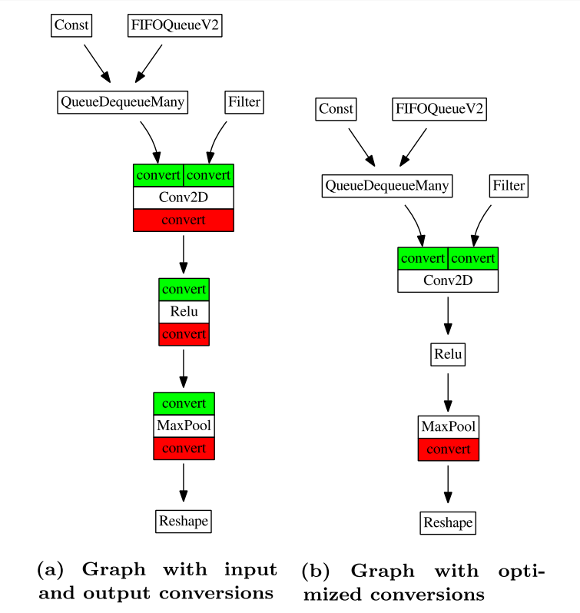
Data layout conversion optimization - Example

Slide 13
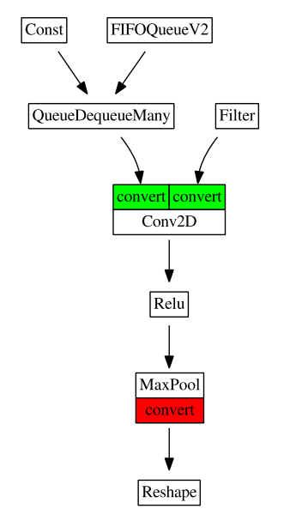
Data layout conversion optimization implementation
Optimization requires propagating Intel® MKL layout to the next layer
TensorFlow* already propagates output tensor to next layer.
Earlier implementation used extra field in Tensor class to piggyback on output tensor.

Slide 14
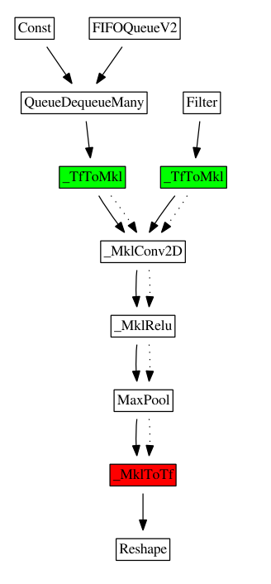
Layout conversion optimization
Based on Google’s suggestions, our current implementation emits Intel® MKL layout as an extra output tensor.
Every operator that is supported via Intel® MKL API gets 2*n inputs and produces 2*m outputs, where n is original number of inputs and m is original number of outputs.
E.g., if X = Conv2D(A, B) was earlier operator, then X, X_mkl = _MklConv2D(A, B, A_m, B_m)is a new operator.
MKL-ML layout is serialized into a byte stream, and transferred as tensor of uint8 type.

Slide 15
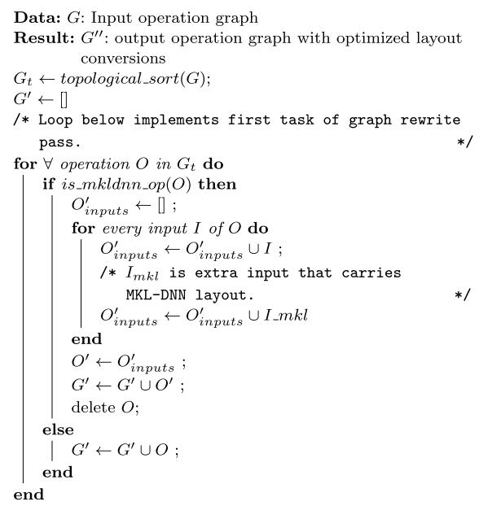
Need for graph rewrite pass
Tensorflow operators have fixed number of inputs and outputs.
  Conv2D takes 2 inputs and produces 1 output.
  We want Conv2D to accept 4 inputs and produce 2 output.
  That is why we need new Conv2D operator (_MklConv2D).
Question: Who will replace Conv2D with _MklConv2D?
Answer: A graph pass that will rewrite operators into MKL operators.
File: core/graph/mkl_layout_pass.cc

Slide 16
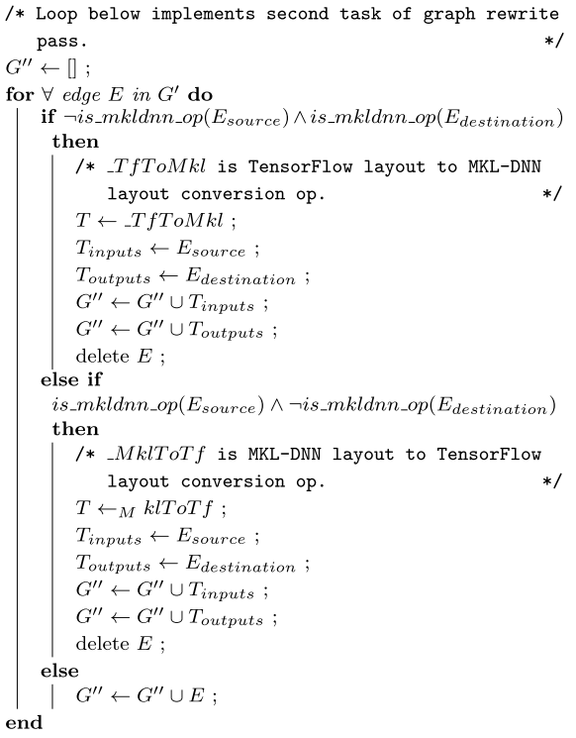
What about TfToMkl and MklToTf ops?
There is a separate graph pass that inserts
  TfToMkl op on edge between TF op -> Mkl op
  MklToTf op on edge between Mkl op -> Tf op
File: core/graph/mkl_tfconversion_pass.cc

Slide 17
Node fusion optimization

Slide 18
Fusion optimization
Identify common pattern of operators that arise in most deep learning models
Merge matching subgraph for the pattern to produce smaller graph nodes
Currently, we merge Conv2D+Bias to new node _MklConv2DWithBias.
Implementation
  Perform in the same graph rewrite pass that rewrites nodes for data layout conversion optimization

Slide 19
Conv2D and BiasAdd: Merge process
Gradient op
input
Filter
input
Filter
Bias
Conv2D
Bias
Conv2DWithBias
BiasAdd
Forward Pass
Backward Pass
ReluGrad
ReluGrad
Conv2DBackpropInput
Conv2DBackpropFilter
BiasAddGrad
Conv2DBackpropInput
Conv2DBackpropFilter
Conv2DBackpropBias
Before Merge
After Merge

Slide 20
Memory allocation

Slide 21
Optimization: memory allocation
Most NN operators allocate huge chunk of memory (Conv2D ~ hundred of MBs)
Default CPU allocator in TensorFlow -> frequent allocs/deallocs of huge chunk of memory -> frequent mmap/unmap -> unnecessary page clears
We developed Custom Pool Allocator using existing Pool allocator.
  Allocator holds on to released memory rather than releasing to OS directly.
  Code: tensorflow/core/common_runtime/mkl_cpu_allocator.h

Slide 22
Load balancing

Slide 23
Thread pool and parallelism
Operator graph in Tensorflow is a data-flow graph.
It offers excellent opportunity for exploiting parallelism between operators.
Tensorflow also has parallelism within operators.
Thread pool parameters:
  Inter_op_parallelism_threads = max number of operators that can be executed in parallel
  Intra_op_parallelism_threads = max number of threads to use for executing an operator
  MKL operators controlled using OMP_NUM_THREADS. So OMP_NUM_THREADS is conceptually same as intra_op_parallelism_threads.

Slide 24
Problem with current threading model & solution
Problem:
  Number of threads to execute a model:
inter_op_parallelism_threads * intra_op_parallelism_threads
  Incorrect setting of inter_op_parallelism_threads and intra_op_parallelism_threads can lead to over- or under-subscription, leading to poor performance.
Solution:
  We have manually explored settings for inter_op, intra_op and OMP_NUM_THREADS to get best performance for topologies optimized so far.
  Code: No changes to Tensorflow code; changes to Python model files.

Slide 25
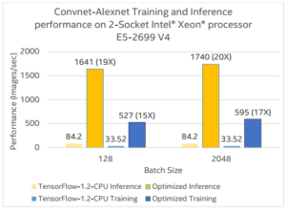
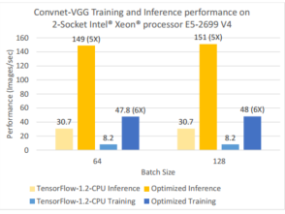
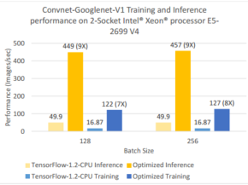
Optimized Tensorflow Performance on
Intel® Xeon® processor

Slide 26
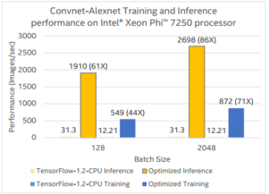
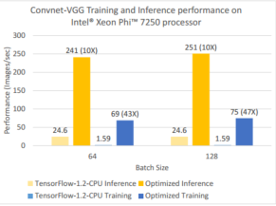
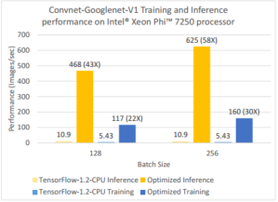
Optimized Tensorflow Performance on
Intel® Xeon Phi® processor

Slide 27
Summary
TensorFlow* is widely used DL and AI framework
  It has been slow on CPU until now
Significant performance gains from optimization on modern Xeon and Xeon Phi processors
Traditional optimization techniques: vectorization, parallelization, cache blocking, etc.
Unique performance challenges: data layout, hyper parameters, inter/intra layer parallelization, etc.
Call to action:
  Latest TensorFlow includes Intel® optimizations
  Use the right configuration, building and best parameter settings
  Orders of magnitude higher performance for inference and training

Slide 28
Legal Disclaimers
Intel processor numbers are not a measure of performance. Processor numbers differentiate features within each processor family, not across different processor families: Go to: Learn About Intel® Processor Numbers http://www.intel.com/products/processor_number
Some results have been estimated based on internal Intel analysis and are provided for informational purposes only. Any difference in system hardware or software design or configuration may affect actual performance.
Software and workloads used in performance tests may have been optimized for performance only on Intel microprocessors. Performance tests, such as SYSmark and MobileMark, are measured using specific computer systems, components, software, operations and functions. Any change to any of those factors may cause the results to vary. You should consult other information and performance tests to assist you in fully evaluating your contemplated purchases, including the performance of that product when combined with other products.
Intel does not control or audit the design or implementation of third party benchmarks or Web sites referenced in this document. Intel encourages all of its customers to visit the referenced Web sites or others where similar performance benchmarks are reported and confirm whether the referenced benchmarks are accurate and reflect performance of systems available for purchase.
Relative performance is calculated by assigning a baseline value of 1.0 to one benchmark result, and then dividing the actual benchmark result for the baseline platform into each of the specific benchmark results of each of the other platforms, and assigning them a relative performance number that correlates with the performance improvements reported.
SPEC, SPECint, SPECfp, SPECrate, SPECpower, SPECjbb, SPECompG, SPEC MPI, and SPECjEnterprise* are trademarks of the Standard Performance Evaluation Corporation. See http://www.spec.org for more information.
TPC Benchmark, TPC-C, TPC-H, and TPC-E are trademarks of the Transaction Processing Council. See http://www.tpc.org for more information.
No computer system can provide absolute reliability, availability or serviceability. Requires an Intel® Xeon® processor E7-8800/4800/2800 v2 product families or Intel® Itanium® 9500 series-based system (or follow-on generations of either.) Built-in reliability features available on select Intel® processors may require additional software, hardware, services and/or an internet connection. Results may vary depending upon configuration. Consult your system manufacturer for more details.
For systems also featuring Resilient System Technologies: No computer system can provide absolute reliability, availability or serviceability. Requires an Intel® Run Sure Technology-enabled system, including an enabled Intel processor and enabled technology(ies). Built-in reliability features available on select Intel® processors may require additional software, hardware, services and/or an Internet connection. Results may vary depending upon configuration. Consult your system manufacturer for more details.
For systems also featuring Resilient Memory Technologies: No computer system can provide absolute reliability, availability or serviceability. Requires an Intel® Run Sure Technology-enabled system, including an enabled Intel® processor and enabled technology(ies). built-in reliability features available on select Intel® processors may require additional software, hardware, services and/or an Internet connection. Results may vary depending upon configuration. Consult your system manufacturer for more details.

Slide 29
Optimization Notice
Optimization Notice
Intel's compilers may or may not optimize to the same degree for non-Intel microprocessors for optimizations that are not unique to Intel microprocessors. These optimizations include SSE2, SSE3, and SSSE3 instruction sets and other optimizations. Intel does not guarantee the availability, functionality, or effectiveness of any optimization on microprocessors not manufactured by Intel. Microprocessor-dependent optimizations in this product are intended for use with Intel microprocessors. Certain optimizations not specific to Intel microarchitecture are reserved for Intel microprocessors. Please refer to the applicable product User and Reference Guides for more information regarding the specific instruction sets covered by this notice. Notice revision #20110804

