Slide 1
Flexible On-chip Memory Architecture for DCNN Accelerators Arash A. Mazreah and Lizhong Chen Oregon State University September 10, 2017

Slide 2
Outline
Current Trends and Challenges in the Processing in Deep Convolutional Neural Networks
Modern FPGA-Based DCNN Accelerators and Static Bank Assignment
Flexible On-chip Memory Architecture
On-chip Memory Bank Management
Evaluation and experimental results
Conclusion

Slide 3
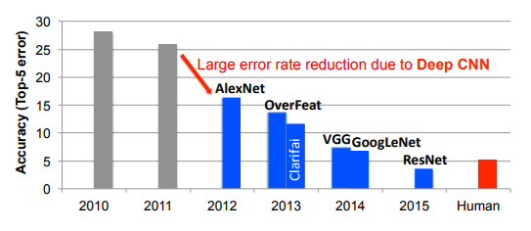
Current Trends in Deep Convolutional Neural Networks (DCNNs)
Depth of Convolution Neural Networks (CNNs) increases for higher performance in different machine learning tasks.
Convolutional Neural Network | Number of CNN layers
AlexNet | 5
Network-in-Network | 12
VGG-16 | 16
GoogLeNet | 22
ResNet-50 | 50
Incpection-ResNet-V2 | 96
ResNet-151 | 151
Low
Accuracy
High
["Efficient Processing of Deep Neural Networks: A Tutorial and Survey“ available on arXiv]

Slide 4
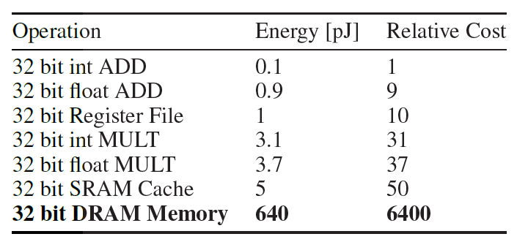
Feature map memory Traffic in DCNNs
Convolution Neural Network | Number of CNN layers | Total Number of multiply-accumulate operations in one forward pass | Total number weights for all layers | Total number output feature map pixels for all layers | Accuracy (object recognition)
AlexNet | 5 | 1,140 M | 62.4 M | 2.4 M | 19.7%
Network-in-Network | 12 | 1,100 M | 7.6 M | 4 M | 19%
VGG-19 | 16 | 15,470 M | 138.3 M | 29.0 M | 8.1%
GoogLeNet | 22 | 1,600 M | 7.0 M | 10.4 M | 9.2%
ResNet-50 | 50 | 3,870 M | 25.6 M | 46.9 M | 7%
Incpection-ResNet-V2 | 96 | 9,210 M | 31.6 M | 74.5 M | 4.9%
[D. Gschwend. Zynqnet: An FPGA-accelerated embedded convolutional neural network, Master’s thesis, ETH-Zurich, 2016]
DCNNs become very computation and memory intensive as they evolve to deeper structures.
Access to external memory is expensive
Energy table for 45nm CMOS process [S. Hang et al, NIPS 2015]

Slide 5
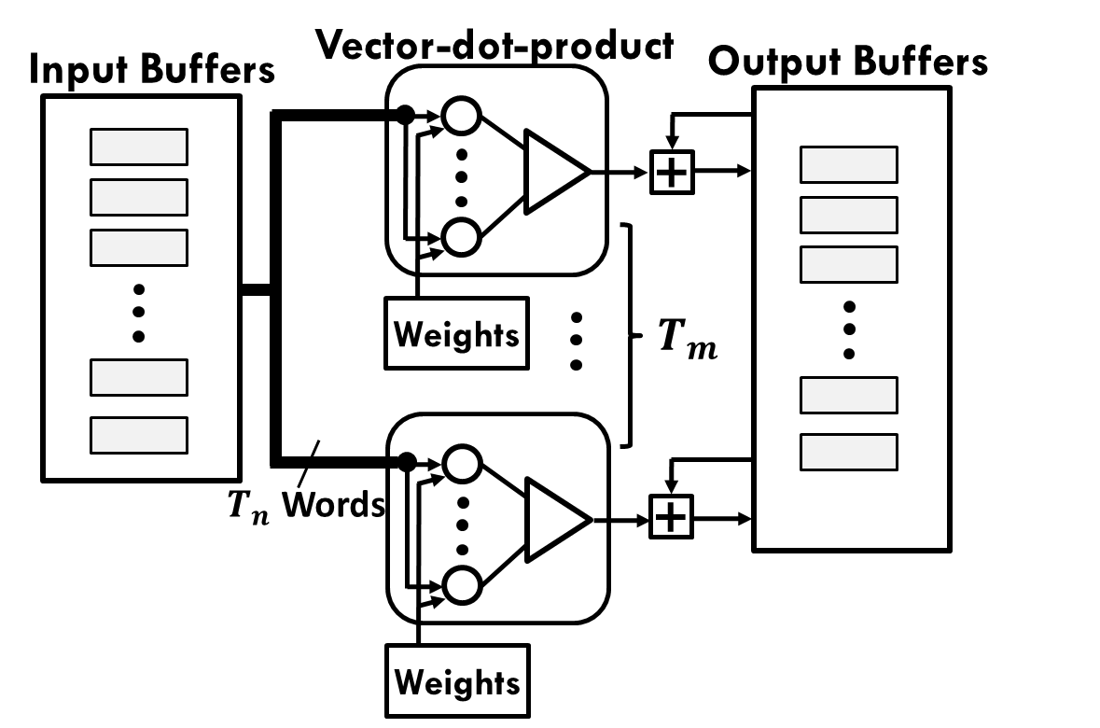
Modern FPGA-Based DCNN Accelerators
Modern FPGA-based DCNN Acceleration System use a convolution layer processor (CLP) to evaluate the CNN layers sequentially
Modern DCNN accelerators are based on the spatial architecture
The granularity of PEs: simple multiplier and adder (fine-grained) to a vector-dot-product (coarse-grained)
Acceleration Request
Host CPU
PE array
Interrupt Request
Accelerator
On-Chip Buffers
Data, Address, and Control Bus
External Memory
Hide the external memory communication latency:
Two sets are used in the ping-pong manner

Slide 6
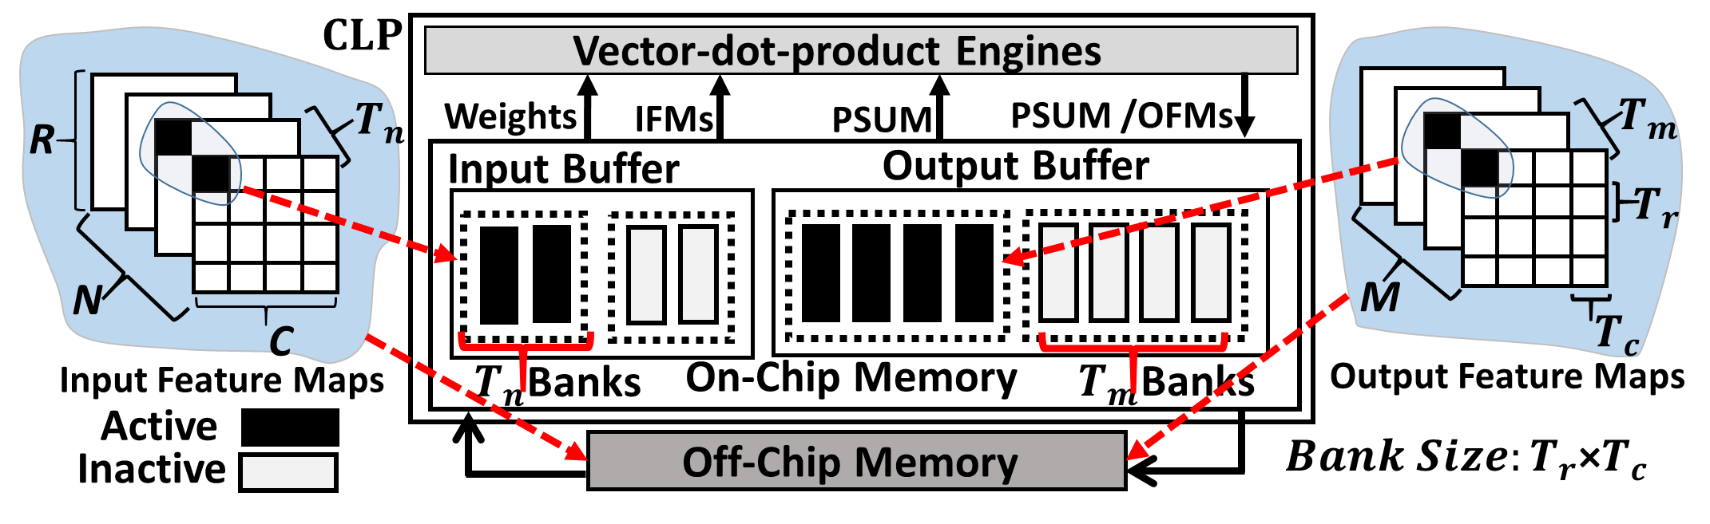
The Tiling Technique
The tiling technique is often used on feature maps to reduce the requirement for on-chip memory
Each feature map is tiled by a factor of T_{r} and T_{c} in the row and the column
T_{n} is the tiling factor on the N input feature maps, and T_{m} is the tiling factor on M output feature maps

Slide 7
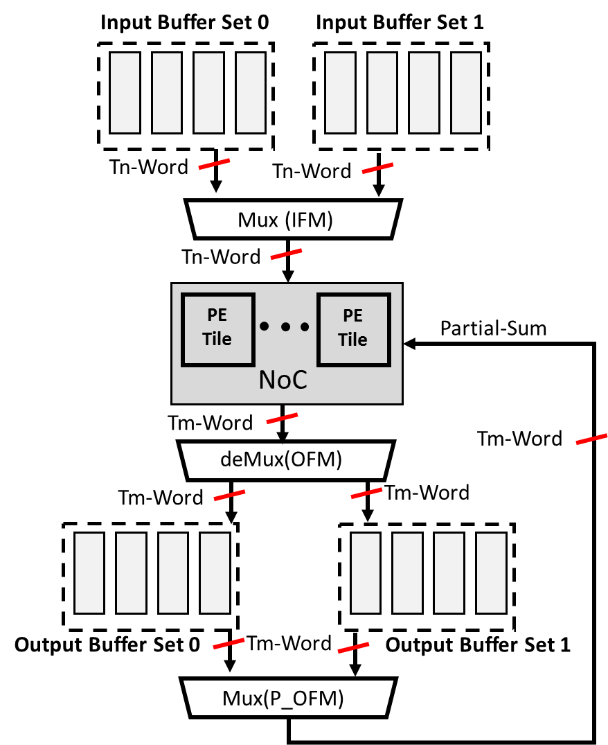
Static Bank Assignment
The bank assignment in the CLP is static: Each bank is used either as input buffer or output buffer.
Baseline Datapath
Static Bank Assignment Consequences
Limits the reuse opportunity of the output feature maps
Forces the CLP with a single layer dataflow to write back the output feature maps during the processing transition
Even when fused-CNN dataflow is used, the accelerator still suffers from the static memory bank assignment problem.

Slide 8
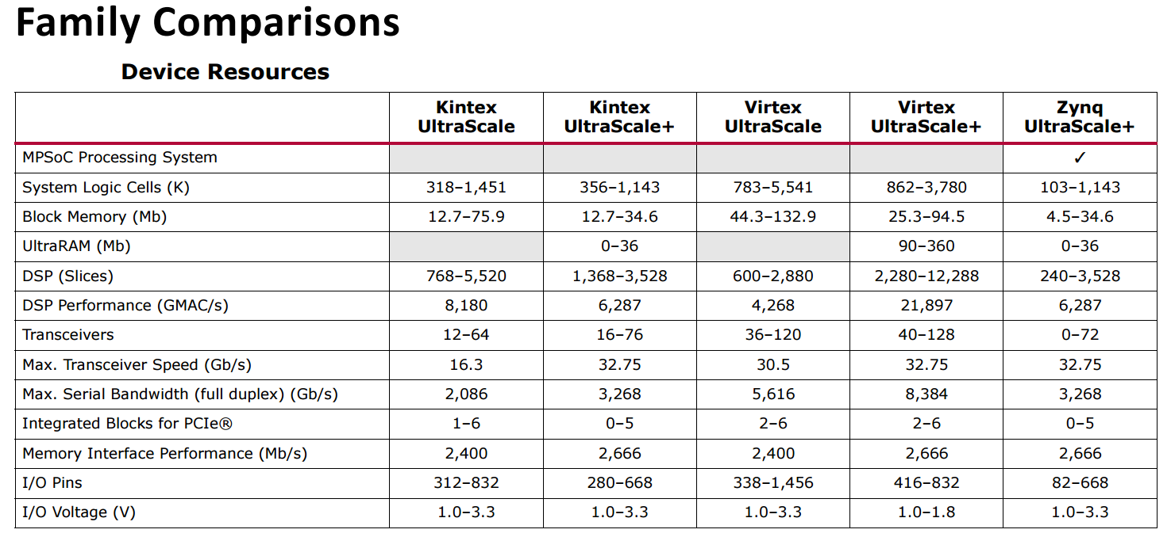
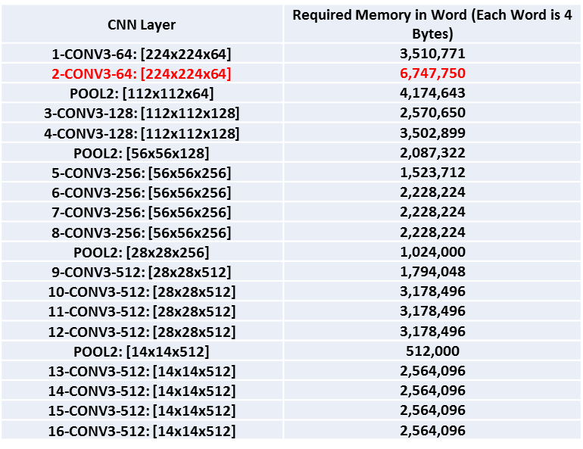
Static Bank Assignment
Previously, Reusing output feature maps has negligible performance and energy benefits due to the small size of on chip memory on FPGA chips.
Enough on-chip memory to accommodate considerable portion of a CNN layer
In some cases the whole of a CNN layer
28MB
>
14MB-57MB on-chip RAM
VGG-E Network
MEM=IFM + Weights + OFM
[Xilinx UltraScale Architecture and Product Data Sheet: Overview, Feburary 2017]

Slide 9



Flexible On-chip Memory Architecture
Each memory bank can be used as an input bank and an output bank
The on-chip OFM reuse for the next layer processing without additional on-chip data movement
2×(Tn+Tm)-Words
$T_{m}$ Words
Crossbar
+
PSUM
2×(Tn+Tm)-Words
Weights
Crossbar
$T_{n}$ Words
OFM/PSUM
Crossbar
+
$T_{m}$ Words
2×(Tn+Tm) Banks
IFM
Weights

Slide 10



On-chip Memory Bank Management
The Basic Idea
Alternate Processing Direction
Use the output feature maps of Layer i for input feature maps of Layer i+1
IFMs
CNN layer i
CNN layer i+1
OFMs
IFMs Layer i
OFMs Layer i
OFM Layer i =IFMs Layer i+1
OFMs Layer i+1
Start Point
Start Point
End Point
Start Point
End Point
End Point
$$T_{m}$$
$$T_{n}$$
Start Point
End Point
r
n, m
c
c
Processing Direction (Up-Counting )
Processing Direction
(Down-Counting)
r
$$T_{m}→ T_{n}$$
n, m

Slide 11
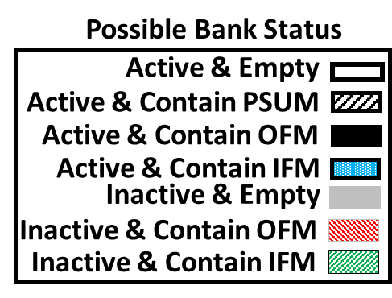
On-chip Memory Bank Management Example
In this Example : Layer i+1 : N=8, and M=4 T_{n}=2 and T_{m}=4
At the end of layer i processing four OFMs of layer i remain on-chip which they can be reused as the IFMs for layer i+1
In
1
Out
In
Out
Discard
Crossbars
Crossbars
PE array
PE array
Exchange
OFM Computation
In
2
Out
In
3
Out
Crossbars
Crossbars
PE array
PE array
Exchange
OFM Computation
5
In
4
Out
Off-Chip Memory
In
Out
Crossbars
Crossbars
PE array
PE array

Slide 12
Evaluation
CNN Layers Architectures
Target Platform Specifications
Optimization Program
Baseline and proposed Accelerators in and HLS C++
<Tn,Tm,Tc,Tr>
Models for Execution Cycles, DSP and on-Chip Memory Usage
Vivado HLS
Synthesizable Verilog

Slide 13
Implementation details
Accelerator
MicroBlaze Soft Core Processor
AXI4-lite bus
Accelerator
DDR3-4
Memory Bank
PE Tile
PE Tile
Tm
Memory Bank
AXI4-OFM
Accelerator
NoC
AXI4-IFM
Output buffers
AXI Interconnect (bus)
Accelerator
PE Tile
PE Tile
Memory Controller
AXI4-Weights
Memory Bank
Tn
AXI4-Shortcuts
Memory Bank
Accelerator
Input buffers

Slide 14
Challenges in the on-chip OFMs reuse implementation: Memory Bank Tracking
State-of-the-art implementations of the CLP use High-Level Synthesis (HLS)
The “DATAFLOW” directive is used for implementing the ping-pong operation
In flexible on-chip memory, the CLP should be able to keep track of individual banks during the ping-pong operation.
In the implementation of the CLP with the flexible on-chip memory instead of relying on the “DATAFLOW” directive for the ping-pong operation, a new tracking scheme of individual memory banks should be used
Bank Tracking Arrays
Tm-Entries
Tn-Entries
Indexes of Active output Bank
Indexes of Active input Bank
Indexes of Inactive output Bank
Indexes of Inactive input Bank

Slide 15
32-bit Floating-Point Arithmetic
We run ResNet-152 on the Virtex UltraScale+ VU9P FPGA.
Accelerators comparison for ResNet-152
Accelerator Type | Tn | Tm | Frequency (MHZ) | Memory Bandwidth (GB/s) | Throughput (cycles per Image)
Baseline | 8 | 128 | 100 | 10.4 | 12,641,195
Flexible | 8 | 128 | 100 | 10.4 | 12,830,812
FPGA resource usage
Accelerator (Tn, Tm) | URAMs | BRAM18K | DSP Slices | FFs | LUTs
Baseline (8,128) | 512 | 2,294 | 5,461 | 693,247 | 523,789
Flexible (8,128) | 256 | 2,176 | 5,627 | 719,904 | 540,803
Available | 960 | 4,318 | 6,840 | 2,364,480 | 1,182,240
16% lower feature map traffic,
A significant reduction in URAM usage (and some reduction in BRAM usage), with only slight increased use of DSPs, LUTs, and FFs.

Slide 16
Scalability of Flexible On-Chip Memory in 32-bit floating point arithmetic
Networks are selected in order to show the advantage of the proposed design as deeper networks are used, a more advanced FPGA chip (VU13P FPGA) is targeted.
Normalized off-chip feature map traffic in FP32
As deeper networks are used to meet the accuracy requirement, the proposed design will likely be more effective to reduce the off-chip traffic
50% reduction in the feature map traffic for VGGNet-E, 23% reduction in the usage of BRAMs in 16-bit fixed-point arithmetic

Slide 17
Conclusion
Static Memory Bank Assignment limits the output feature maps reuse in the convolution layer processor (CLP)
We proposed a flexible on-chip memory architecture to facilitate the output feature maps reuse as input feature maps for the next layer processing
We proposed a bank management scheme for the flexible on-chip memory architecture. This scheme is based on maximizing the feature map reuse during the computational transition from one CNN layer to the next CNN layer.
The proposed on-chip memory architecture with its management scheme can reduce the CNN feature map traffic by 40% for a deep network such as ResNet-152 in 32-bit floating point, and 50% for shallow network such as VGGNet-E in a compact data type (16-bit fixed point)

Slide 18
Thank you!

