Slide 1


Layer-wise Performance Bottleneck Analysis of Deep Neural Networks
Hengyu Zhao, Colin Weinshenker*, Mohamed Ibrahim*,
Adwait Jog*, Jishen Zhao
University of California Santa Cruz, *The College of William and Mary
The First International Workshop on Architectures for Intelligent Machines
Notes:
Thanks for introduction. Hi everyone, let’s start my presentation now. This work is collaborated with Professor Adwait Jog from The College of William and Mary. And my advisor Professor Jishen Zhao. I am Hengyu Zhao, the first author of this work.

Slide 2

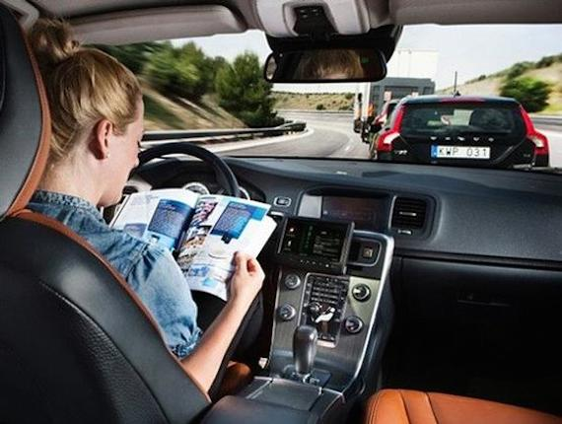

Notes:
As we all known, deep learning neural networks have applied to many areas. Such as facial recognition, alphago intelligent machine, and unmanned driving technology. Deep learning technologies are changing our world and life styles.

Slide 3
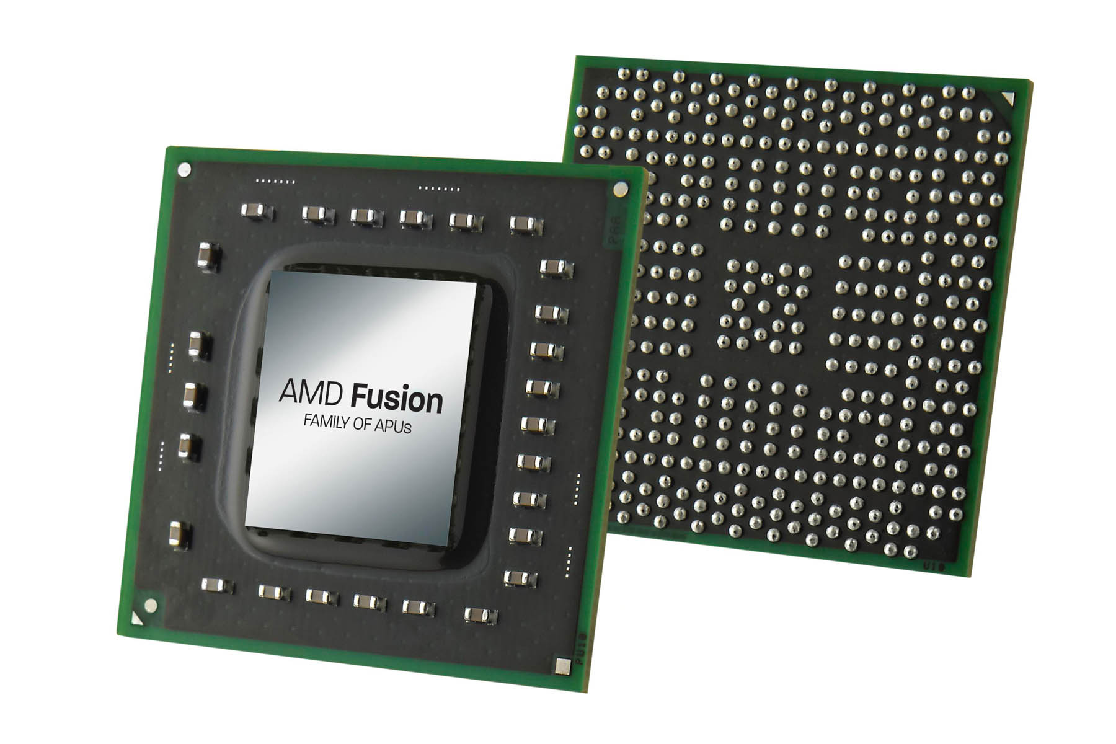
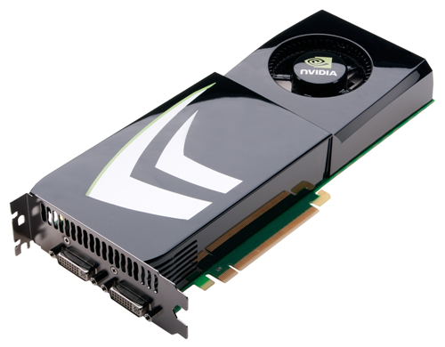

Training
Notes:
Nvidia, Intel and AMD all develop products to do Deep neural networks training. But running Deep neural networks training on graphic cards is a most common way now.

Slide 4
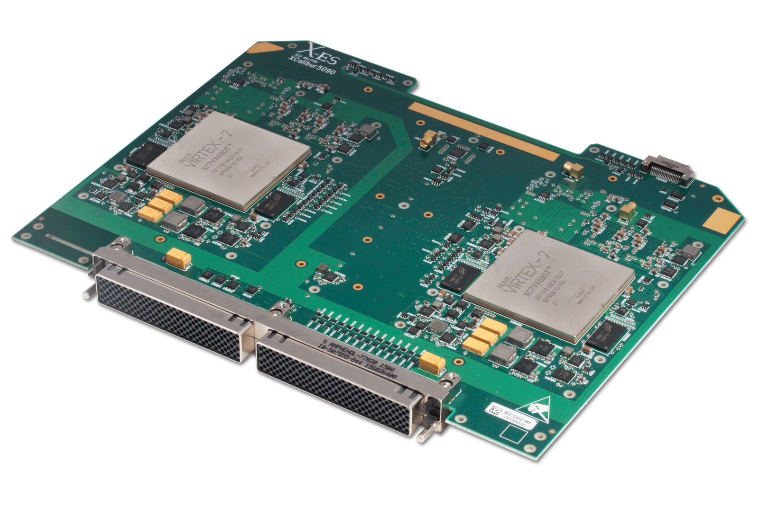

Inference
This work focuses on TRAINING.

Slide 5
ImageNet Large Scale Visual Recognition Challenge Recent Winners
Modern neural networks go deeper!
AlexNet: 8 layers: 2012
VGG: 16 or 19 layers: 2014
GoogleNet: 22 layers: 2014
ResNet: 152 layers: 2015
Notes:
Here are several ImageNet Large Scale Visual Recognition Challenge Recent Winners. We can see that the trend of development of neural networks is that modern neural networks go deeper.

Slide 6
Challenges With Deeper Model and Large Batch
Notes:
More layers also bring many issues. Deeper DNNs cost much more hardware resource, like VGG in this figure. Batch size is the volume of input data in training. Increasing batch size is a good way to improve training efficiency. When batch size reaches 256, the memory consumption will be very huge. Simgle GPU cannot afford the requirement.

Slide 7
Problem
Larger models need more powerful new architecture!
Notes:
Then the problem comes.

Slide 8
Motivation
To build new powerful systems, we need to address the compute and memory bottlenecks in deep learning.
Notes:
Also we may ask this question:

Slide 9
Our Work
We build a layer-wise model for training VGG-16 and AlexNet on GPUs.
We identify GPU performance bottlenecks in compute and cache resources, by characterizing the performance and data access behaviors of AlexNet and VGG-16 models in a layer-wise manner.

Slide 10
Background

Slide 11
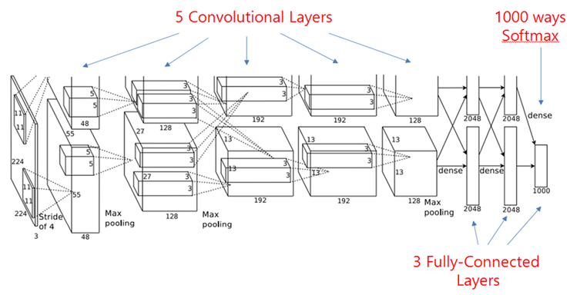
Machine Learning
Feature extraction layers that extract input features, and most operations are convolutions.
Classification layers that analyze features and classify input images into groups, like fully connected layers.
AlexNet
Notes:
This is the architecture of AlexNet. The layers can be divided into two groups. Then we will do a layer-wise profiling according to different type layers.

Slide 12
Forward propagation
Forward propagation
Compute each layer’s feature map with input, which is the output of last layer.
Backward propagation
Compute the gradient map with the loss produced by loss function.
Update weights.
Backward propagation

Slide 13
GPU Architecture
…
SM
SM
SM
…
L1
L1
L1
L2 Cache
Memory
Notes:
Here is a general GPU architecture: L1 cache is private and L2 cache is shared by multiple processors.

Slide 14
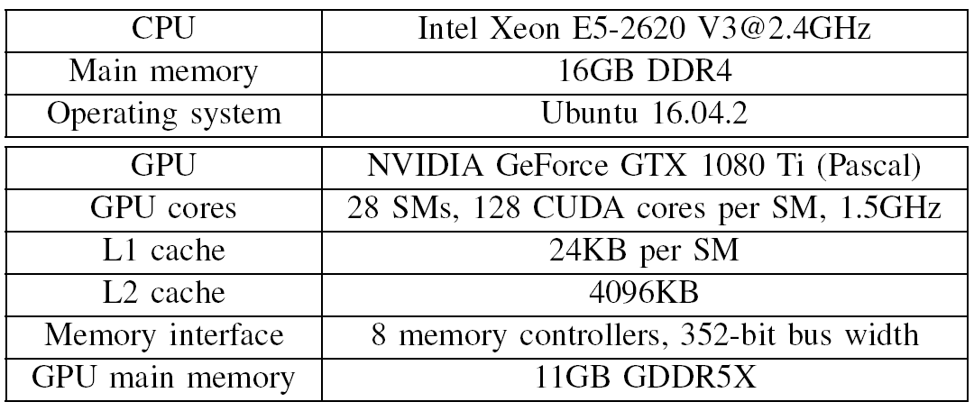
Experiment Setup
Models: AlexNet and VGG-16
Dataset: ImageNet
Framework: Caffe

Slide 15
Real Machine Characterization
Execution time and Instruction
L1 Cache
L2 Cache
Memory

Slide 16
Real Machine Characterization
Execution time & Stall time
10
1
Why?
Convolutional layers are more compute intensive.
Notes:
First,
convolutional (CONV) layers execute for much longer time
than fully connected (FCN) layers. Second, CONV interlayers
dominate the execution time of all CONV layers;
these inter-layers also execute more instructions than other
layers (Figure 5(a), Figure 6(a)). Third, execution time and
instruction count increases as we increase the batch size from
32 to 256. Finally, with both CONV and FCN layers, the
execution time of backpropagation can be over 2 of forward
propagation.

Slide 17
Execution time & Stall time
Normalized
Stall Time
CONV inter-layers cost much more stall time.
Notes:
First,
convolutional (CONV) layers execute for much longer time
than fully connected (FCN) layers. Second, CONV interlayers
dominate the execution time of all CONV layers;
these inter-layers also execute more instructions than other
layers (Figure 5(a), Figure 6(a)). Third, execution time and
instruction count increases as we increase the batch size from
32 to 256. Finally, with both CONV and FCN layers, the
execution time of backpropagation can be over 2 of forward
propagation.

Slide 18
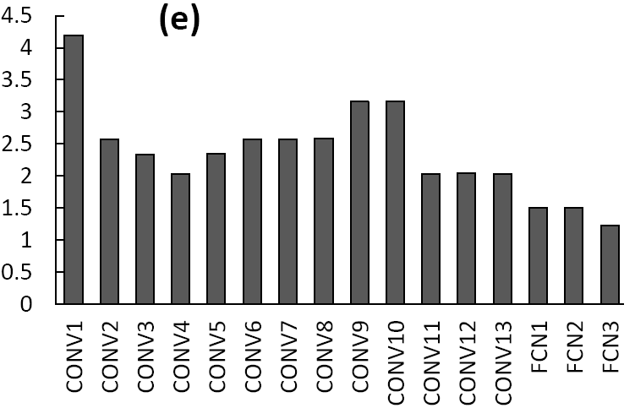
Backpropagation to forward propagation computation latency ratio with a 256 batch size in AlexNet and VGG-16
Computation Latency Ratio
Why?
Backward propagation takes most execution time.

Slide 19
Execution instruction: AlexNet
(a)
(b)
Notes:
CONV inter layers are compute intensive. Memory access is the major operations in DNNs training.

Slide 20
Execution instruction: VGG-16
(a)
(b)
Data access is performance critical to both CONV inter-layers and FCN layers.

Slide 21
L1 cache: AlexNet
Their working set does not fit in L1 caches.
They have low data access locality (our later evaluation on L2 access behavior demonstrates that this is not the case).
(a)
(b)
Notes:
This observation
is consistent with the long data access stall time of these
layers. The reason can be either or both of the two: a) their
working set does not fit in L1 caches; b) they have low data
access locality (our later evaluation on L2 access behavior
demonstrates that this is not the case). Third, CONV input
layer (CONV1) has a high L1 hit rate, but L1 hit rate drops
in as CONV layers get deeper. Finally, L1 throughput and
hit rate appear stable across various batch sizes with CONV

Slide 22
L1 cache: VGG-16
(a)
(b)
FCN layers have higher L1 cache throughput.

Slide 23
CONV inter-layers yield much higher hit rates in the 4MB L2 cache than the 24KB L1 caches.
L2 cache: AlexNet
(a)
(b)
(c)
(d)
The execution time of FCN layers is much shorter than CONV layers, so the throughput is higher.

Slide 24
L2 cache: VGG-16
(a)
(b)
Notes:
We also profile vgg-16. the results are consistent with alexnet.

Slide 25
L2 cache: VGG-16
As such, these layers have sufficient locality, especially with read requests, if the GPU can integrate large caches to accommodate their working set.
(c)
(d)

Slide 26
Memory: AlexNet
(a)
(b)

Slide 27
Memory: VGG-16
CONV inter-layers have much higher memory write throughput, because they have lower L2 write hit rates.
FCN layers have much higher memory read throughput, because they have lower L2 read hit rates.
(a)
(b)
Notes:
The results of vgg-16 have the similar shape with alexnet.

Slide 28
Conclusion
The execution time of convolutional inter-layers dominates the total execution time. In particular, backpropagation of these inter-layers consumes significantly longer execution time than forward propagation.
The working set of convolutional inter-layers does not fit in L1 cache, while convolutional input layer can exploit L1 cache sufficiently.
Interconnect network can also be a performance bottleneck that substantially increase GPU memory bandwidth demand.

Slide 29
Thank you.

