Slide 1
Optimizing NeoN deep learning framework for Intel architectures
Wei Wang, Peng Zhang, Jayaram Bobba, Dawn Stone, Menglin Wu, Xiaohui Zhao, Mingfei Ma, Wenting Jiang, Jason Ye, Huma Abidi, Jennifer Myers, Hanlin Tang, Evren Tumer
AIM 2017 - September 10, 2017 – Portland, Oregon, USA

Slide 2
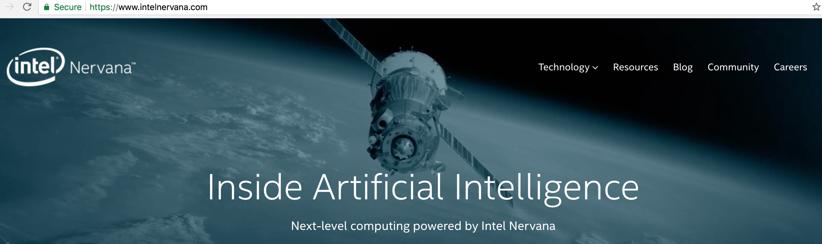
Motivation
Nervana Systems neon product delivered better than cuDNN* performance for many Neural Nets (https://github.com/soumith/convnet-benchmarks)
Nervana Systems acquired by Intel in 2016
Default NumPy CPU backend is slow!
*Other names and brands may be claimed as the property of others.

Slide 3
Intel® Math Kernel Library/Deep Neural Networks
Intel counterpart of cuDNN*, the driving force of all Intel optimized frameworks
OpenMP Threading and Vectorization (e.g. AVX512)
AlexNet, Visual Geometry Group (VGG), GoogLeNet, and ResNet
Primitives include convolution, inner product, pooling, normalization, and activation, both forward and backward propagation
*Other names and brands may be claimed as the property of others.

Slide 4
Major Tasks for Optimization
Develop C library: Implement Neural Network layer Ops based on MKL routines
Design MKL backend as Python interface for C lib
Make necessary tensor/data layout modifications and remove unnecessary tensor layout conversions
Enable merged models with both the CPU and MKL Ops

Slide 5
Dynamic C library for MKL Ops (libmklEngline.so)
Op | C file | Model
Convolution | conv.c | AlexNet, GoogLeNet, ResNet
Pooling | pooling.c | AlexNet, GoogLeNet, ResNet
ReLU | relu.c | AlexNet, GoogLeNet, ResNet
BatchNorm | batchNorm.c | ResNet
MergeSum | concat.c | ResNet
MergeBoradCast | concat.c | GoogleNet

Slide 6
Python Interface of MKL Op
C Kernel
if type(self.be) == NervanaMKL:
self.fprop_MKLDNN(inputs)
else:
#original CPU Op codes
ctypes.cdll (libmklEngine.so)
Input
Python
Interface
Output
MKL Op

Slide 7
Python Interface of MKL Ops
MKL Ops | Python file
Pooling | nervanamkl.py
Convolution | layer_mkl.py
BatchNorm | layer.py
ReLU | activation.py
MergeSum, MergeBroadcast | container.py

Slide 8
Tensor Modification
When the two Ops are on different backend, explicit/implicit conversion/initialization is required.
New Tensor class. Non-MKL and MKL tensor.
One typical execution flow:
CPUBuffer
NULL
MKL
OP
CPUBuffer
MKLBuffer
MKL
OP
CPUBuffer
MKLBuffer
CPU OP
CPUBuffer
NULL

Slide 9
Tensor Modification – CPU Ops
1) CPU Ops fed with non-MKL Tensors
Nothing different and nothing to do.
2) CPU Ops fed with MKL Tensors
An explicit conversion/clean step is necessary
def bprop(self, error):
self.be.convert(error) #transfer MKL buffer to CPU buffer, if has MKL buffer
error.cleanMKL() #make MKL buffer NULL so that it is now a Non-MKL buffer
…
self.deltas.cleanMKL() #deltas is shared with other Op, may be a MKL tensor.

Slide 10
Tensor Modification – MKL Tensor Fed to Unsupported/CPU Ops
Unoptimized/CPU Ops | file
SkipNode, Linear, Bias, LRN, DropOut | layer.py
Softmax | activtion.py
Deconv | layer_mkl.py

Slide 11
Tensor Modification – MKL Tensor Fed to MKL Op
NUMPY buffer is ignored and MKL buffer is processed.
C kernel of MKL Op
CPUBuffer
MKLBuffer
MKL
Execute
CPUBuffer
MKLBuffer

Slide 12
Tensor Modification – Non-MKL Tensor Fed to MKL Op
An implicit initialization/conversion step is implemented in C. NUMPY content is convert into MKL buffer before real execution.

Slide 13
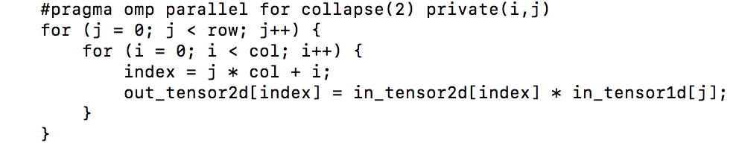
Elementwise Ops
Rewrote elementwise Ops in C to speed up with OpenMP pragma
Examples: tensor broadcast [add/sub/mult/div]

Slide 14
Optimization Results
1. Throughput improvement from the baseline implementation
2. Throughput improvement from Broadwell to Skylake architecture
3. Comparison with Intel-optimized Caffe Deep Learning framework

Slide 15
Machine Configuration
Dual-socket 22-core Intel Xeon E5-2699 v4 CPU, 2.2GHz (Broadwell)
OMP_NUM_THREADS=44
2. Dual-socket 28-core Intel Xeon Platinum, 2.5GHz (Skylake)
OMP_NUM_THREADS=56

Slide 16
Optimization Results: Optimized vs. Non-optimized
As much as 98X faster training throughput with MKL optimized neon version on the Broadwell system

Slide 17
Optimization Results: Skylake vs. Broadwell
neon on the Skylake as much as 1.9X better training throughput than the Broadwell

Slide 18
Optimization Results: neon vs. Intel-Caffe
Optimized neon as much as 98% of Intel-Caffe performance on the Skylake

Slide 19
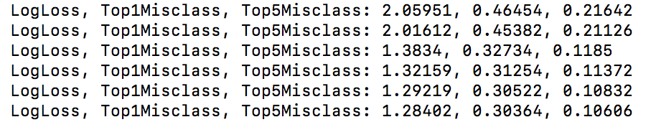
Convergence Results
SOTA accuracy
ResNet-50 (on-going, 48 epochs, top-1: 70.43%, top-5: 90% )
Partial Convergence Proof for almost all examples
Training certain epochs and evaluate the metrics like training cost

Slide 20
Future Work
DeepSpeech2 Performance
BiBNRNN Layers optimization
Single-Shot Detection and also VGG
Conv + Bias Fusion
Ngraph(https://github.com/NervanaSystems/ngraph)
Graph Optimizations
Multi-node Support
Multi-architecture (Backend)
Multi-framework (Frontend)

Slide 21
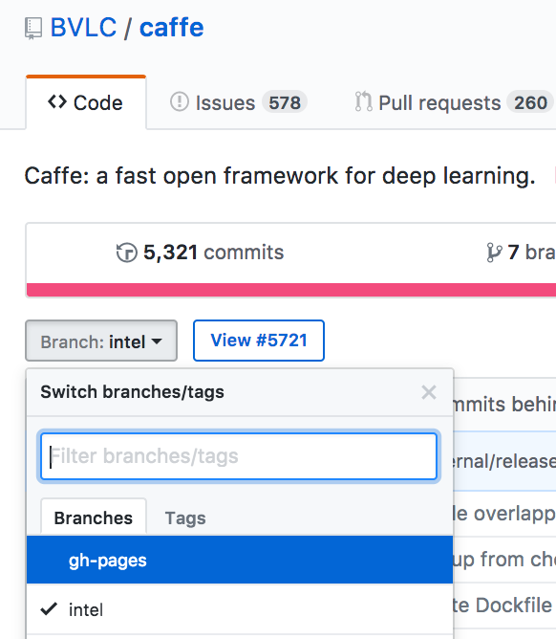
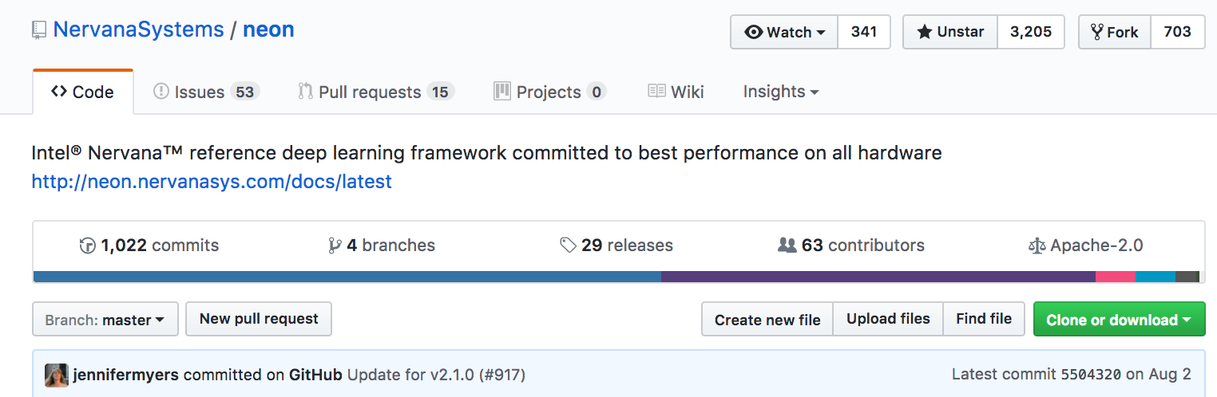
Intel Optimized …
Caffe*
https://github.com/intel/caffe
BVLC Caffe intel branch
neon
https://github.com/NervanaSystems/neon
TensorFlow*
https://github.com/tensorflow/tensorflow
“Accelerating TensorFlow on Modern Intel Architectures” to be presented by Guozhong Zhuang @3:15pm
*Other names and brands may be claimed as the property of others.

Slide 22
Intel Optimized …
Chainer*
https://github.com/intel/chainer
BVLC Caffe intel branch
Torch*
https://github.com/intel/torch
Theano*
https://github.com/intel/Theano
*Other names and brands may be claimed as the property of others.

Slide 23
Legal Disclaimers
Intel processor numbers are not a measure of performance. Processor numbers differentiate features within each processor family, not across different processor families: Go to: Learn About Intel® Processor Numbers http://www.intel.com/products/processor_number
Some results have been estimated based on internal Intel analysis and are provided for informational purposes only. Any difference in system hardware or software design or configuration may affect actual performance.
Software and workloads used in performance tests may have been optimized for performance only on Intel microprocessors. Performance tests, such as SYSmark and MobileMark, are measured using specific computer systems, components, software, operations and functions. Any change to any of those factors may cause the results to vary. You should consult other information and performance tests to assist you in fully evaluating your contemplated purchases, including the performance of that product when combined with other products.
Intel does not control or audit the design or implementation of third party benchmarks or Web sites referenced in this document. Intel encourages all of its customers to visit the referenced Web sites or others where similar performance benchmarks are reported and confirm whether the referenced benchmarks are accurate and reflect performance of systems available for purchase.
Relative performance is calculated by assigning a baseline value of 1.0 to one benchmark result, and then dividing the actual benchmark result for the baseline platform into each of the specific benchmark results of each of the other platforms, and assigning them a relative performance number that correlates with the performance improvements reported.
SPEC, SPECint, SPECfp, SPECrate, SPECpower, SPECjbb, SPECompG, SPEC MPI, and SPECjEnterprise* are trademarks of the Standard Performance Evaluation Corporation. See http://www.spec.org for more information.
TPC Benchmark, TPC-C, TPC-H, and TPC-E are trademarks of the Transaction Processing Council. See http://www.tpc.org for more information.
No computer system can provide absolute reliability, availability or serviceability. Requires an Intel® Xeon® processor E7-8800/4800/2800 v2 product families or Intel® Itanium® 9500 series-based system (or follow-on generations of either.) Built-in reliability features available on select Intel® processors may require additional software, hardware, services and/or an internet connection. Results may vary depending upon configuration. Consult your system manufacturer for more details. For systems also featuring Resilient System Technologies: No computer system can provide absolute reliability, availability or serviceability. Requires an Intel® Run Sure Technology-enabled system, including an enabled Intel processor and enabled technology(ies). Built-in reliability features available on select Intel® processors may require additional software, hardware, services and/or an Internet connection. Results may vary depending upon configuration. Consult your system manufacturer for more details. For systems also featuring Resilient Memory Technologies: No computer system can provide absolute reliability, availability or serviceability. Requires an Intel® Run Sure Technology-enabled system, including an enabled Intel® processor and enabled technology(ies). built-in reliability features available on select Intel® processors may require additional software, hardware, services and/or an Internet connection. Results may vary depending upon configuration. Consult your system manufacturer for more details.

Slide 24
Optimization Notice
Optimization Notice
Intel's compilers may or may not optimize to the same degree for non-Intel microprocessors for optimizations that are not unique to Intel microprocessors. These optimizations include SSE2, SSE3, and SSSE3 instruction sets and other optimizations. Intel does not guarantee the availability, functionality, or effectiveness of any optimization on microprocessors not manufactured by Intel. Microprocessor-dependent optimizations in this product are intended for use with Intel microprocessors. Certain optimizations not specific to Intel microarchitecture are reserved for Intel microprocessors. Please refer to the applicable product User and Reference Guides for more information regarding the specific instruction sets covered by this notice. Notice revision #20110804

Slide 26
Backup – Multinode Related Work
Facebook*
Large Batch Size (8K) ResNet-50 1Hour
IBM*
Large Batch Size (8K) ResNet-50 50 min
Intel (and collaborators)
Large Batch Size (12K) ResNet-50 in 40 minutes with OPA+KNL (https://blog.surf.nl/en/imagenet-1k-training-on-intel-xeon-phi-in-less-than-40-minutes/)
Deep Learning at 15PF: Supervised and Semi-Supervised Classification for Scientific Data (Intel Caffe on ~9600 KNL)
*Other names and brands may be claimed as the property of others.

