Slide 1
Ckan develop

Slide 2

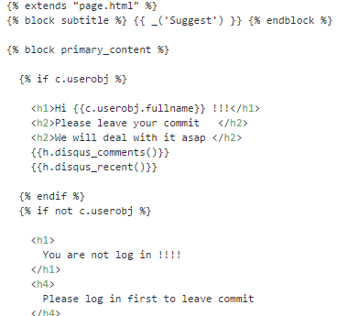
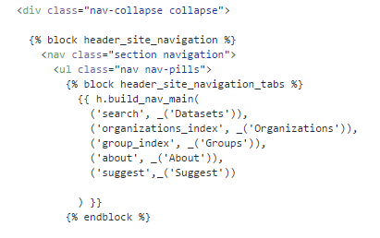
1. 橫幅
vim /usr/lib/ckan/default/src/ckan/ckan/templates/home/suggest.html
vim /usr/lib/ckan/default/src/ckan/ckan/templates/header.html

Slide 3
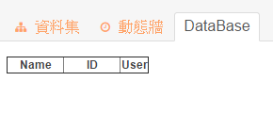
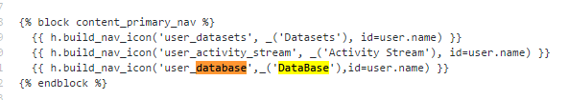

1.1 登入後，使用者頁面
/usr/lib/ckan/default/src/ckan/ckan/templates/user/read_base.html
/usr/lib/ckan/default/src/ckan/ckan/templates/user/db_search.html
read_base.html
read_base.html

Slide 4
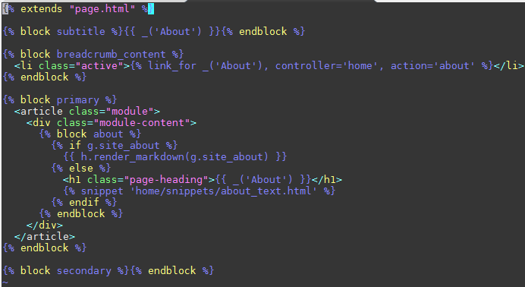
1.2 修改 about us
/usr/lib/ckan/default/src/ckan/ckan/templates/home/about.html

Slide 5
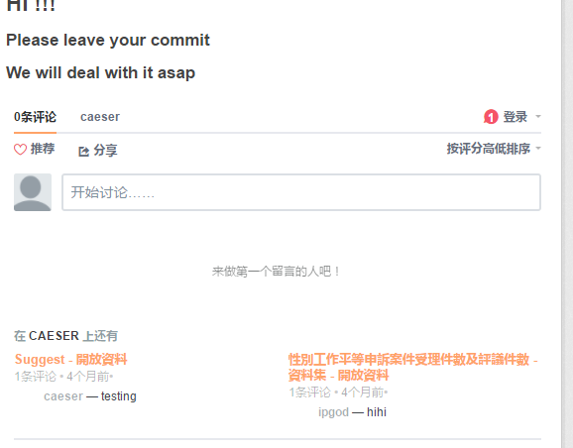
2. 留言板

Slide 6

3. 新增button (外部連結)
/usr/lib/ckan/default/src/ckanext-caeser_method/ckanext/caeser_method/plugin.py
/usr/lib/ckan/default/src/ckanext-caeser_method/setup.py
/usr/lib/ckan/default/src/ckan/ckan/config/routing.py
/usr/lib/ckan/default/src/ckan/ckan/controllers/user.py
/usr/lib/ckan/default/src/ckan/ckan/templates/header.html
/usr/lib/ckan/default/src/ckan/ckan/templates/home/suggest.html
/usr/lib/ckan/default/src/ckan/ckan/controllers/package.py
/usr/lib/ckan/default/src/ckan/ckan/controllers/home.py
/usr/lib/ckan/default/src/ckan/ckan/templates/snippets/add_button.html
/usr/lib/ckan/default/src/ckan/ckan/templates/package/resource_read.html

Slide 7
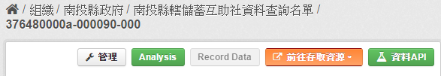
4. 新增button (內部helper function)

Slide 8
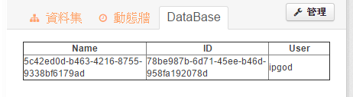
5. 記錄到 db

