Slide 1
Kafka Standalone Indexer Design

Slide 2
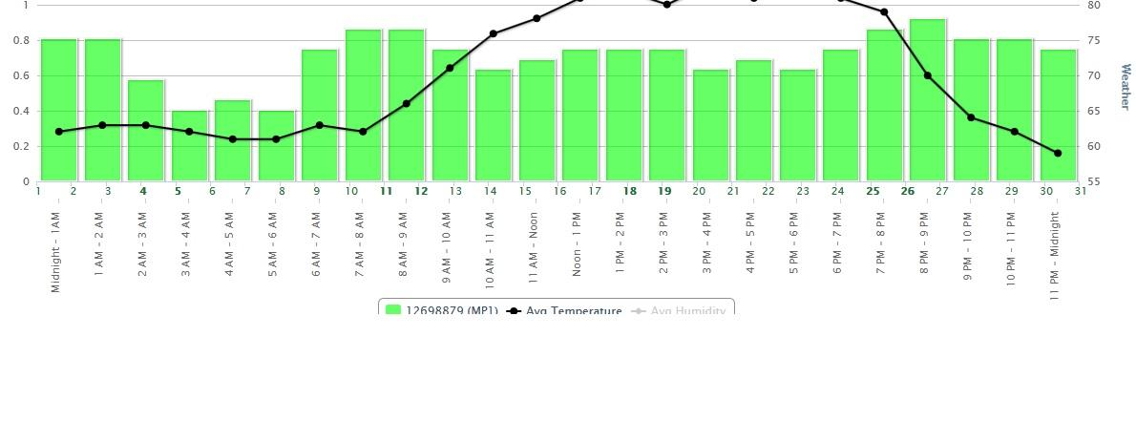
Kafka topic ‘topic1’
partitions
p1
p2
pN
kafka_indexer.properties
firstPartition = p1
lastPartition = pN
kafkaFetchSizeMinBytes=31457280
reads events from kafka in kafkaFetchSizeMinBytes batches
kafka_indexer app
consumer threads
t1
t2
tN
configured by
bulk-indexes into ES
Dashboard/UI
ElasticSearch
queries data

