Slide 1
Visualizing NOAA Climate Data
Myranda Shirk (they/she)
Senior Data Scientist and Lecturer
Vanderbilt University
9/30/2026

Slide 2



About Me…
Lecturer / DS at VU College of Connected Computing
Former Data Scientist at NOAA NCEI, Archive Branch
  Data engineering
  Cloud computing
  Machine learning and AI
Former NASA Intern

Slide 3
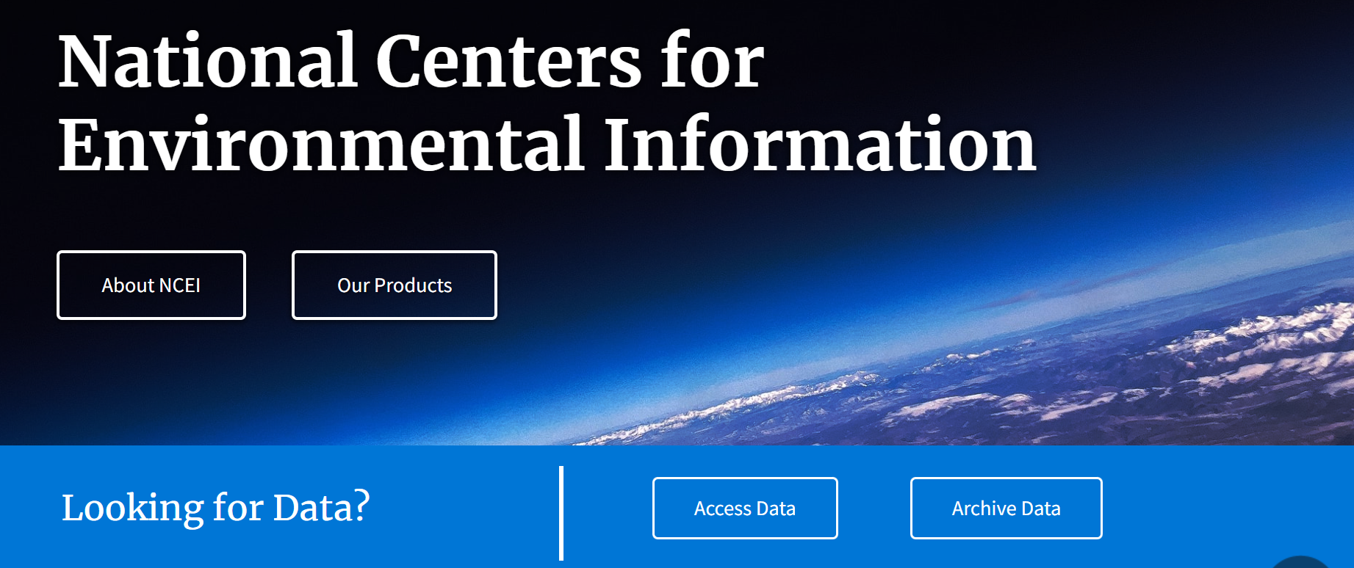
What is NCEI?
National Centers for Environmental Information
Hosts and provides access to one of the most significant archives on Earth
US leading authority for environmental data
“From the bottom of the ocean to the surface of the sun!”

Slide 4
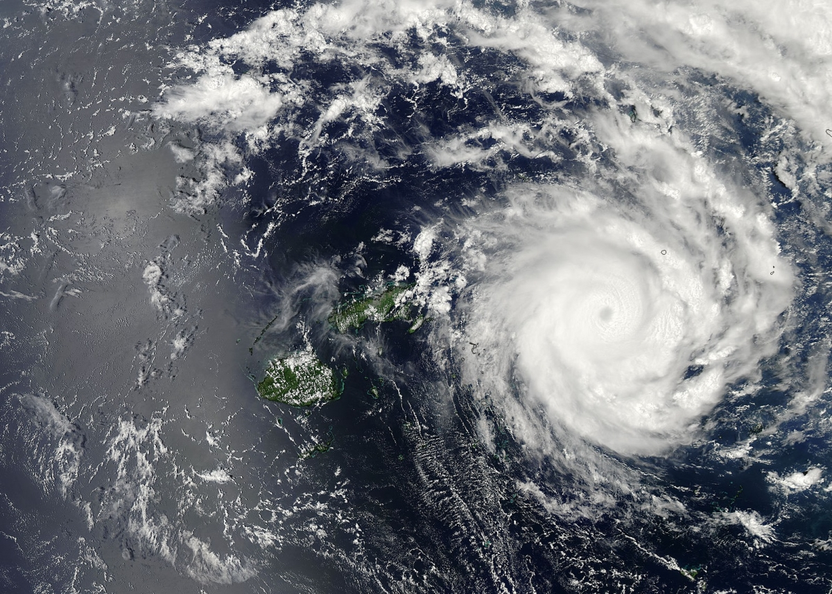
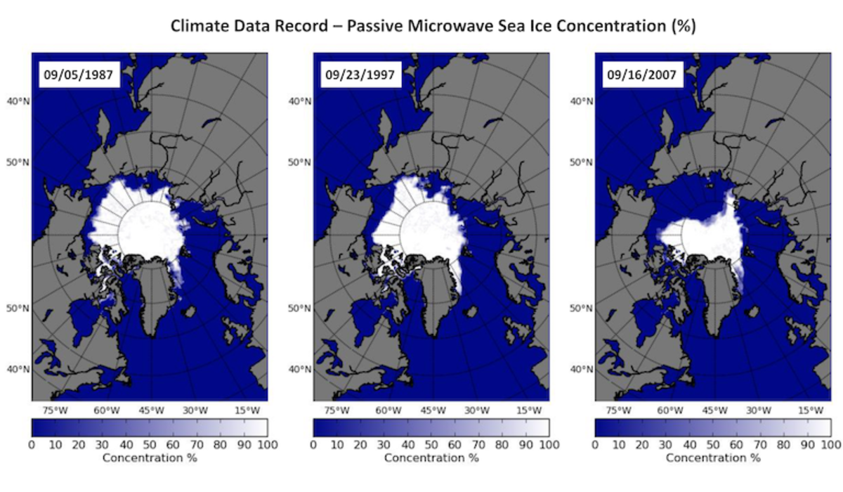
What can you do with climate data?
Visualize
  Ocean/Land surface temperature
  Ocean currents
  Natural disasters
Analyze
  Human impact
  Sea ice concentration
  Vegetation cover
Make predictions
  Weather
  Drought
  Floods

Slide 5
Storing Climate Data
Great for maps!
NetCDF: gridded data
  .nc
  Stores data in a matrix of longitude and latitude
  Separate matrix for each time step
  Called “stacks” or “layers”
NetCDF file contains its own metadata
  Variable names and definitions, units of measurement, etc.
Support mathematical operations, such as:
  Addition, subtraction, scalar multiplication

Slide 6
Using NetCDF in R
RNetCDF library
  Read, write, and create NetCDF files
Useful functions
  open.nc() - open a NetCDF file
  var.get.nc()- get data from a specific variable
  close.nc()- close the NetCDF file
NetCDF tools for other languages
  Python: NetCDF4, xarray, numpy
  CLI/Bash: CDO

Slide 7
Accessing Climate Data
Direct Download
  Visiting data.noaa.gov and downloading data yourself
  Takes up memory on your computer
Data Server
  Data hosted on a server at NOAA
  Accessible via code
Cloud Streaming
  Accessing data from a cloud server (AWS, Google Cloud, Microsoft Azure)
  Streams data from cloud provider (may need cloud account)

Slide 8
Accessing Climate Data
Direct Download
  Visiting data.noaa.gov and downloading data yourself
  Takes up memory on your computer
Data Server
  Data hosted on a server at NOAA
  Accessible via code
Cloud Streaming
  Accessing data from a cloud server (AWS, Google Cloud, Microsoft Azure)
  Streams data from cloud provider (may need cloud account)
Common for Environmental Scientists

Slide 9
NOAA Data Servers
THREDDS (Thematic Real-time Environmental Distributed Data Services)
  Web-facing directory containing dataset collections
  Accessible via many web protocols (we will use OPENDAP)
    Allows you to load data directly into your program
  View NOAA THREDDS catalog at ncei.noaa.gov/thredds/catalog.html

Slide 10
Putting it all together!
The Plan:
Load a NetCDF file from THREDDS into R notebook
Explore the NetCDF data
Plot the data to create a map

Slide 11
Demo: Visualizing Ocean Temperatures in R
GitHub Repo

Slide 12
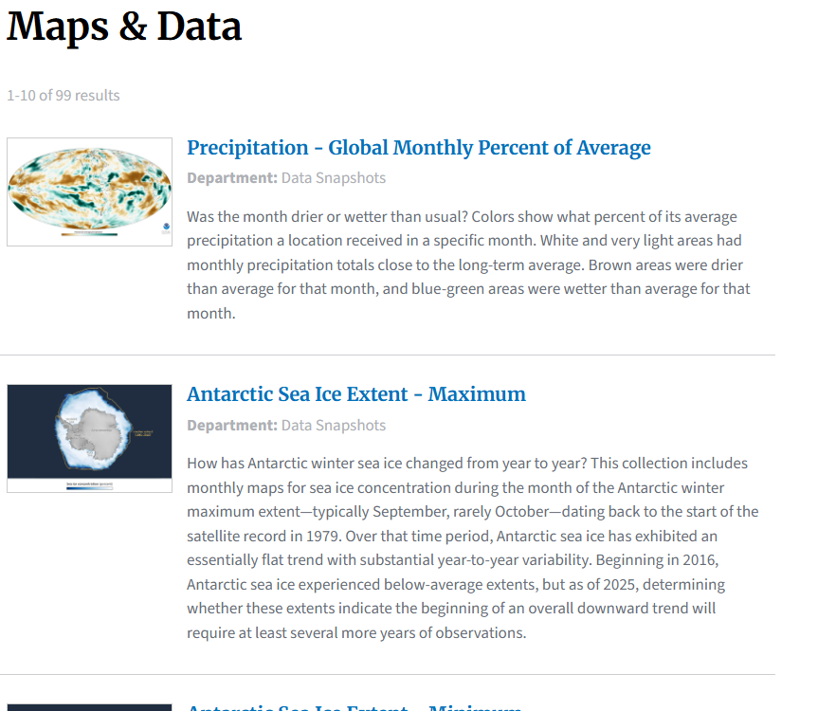
How Does Data Shape Our World?
Climate.gov
  Taken down in 2025
Climate.us
  Built by ex-NOAA employees
  “successor” to climate.gov
We can only study what we can access

Slide 13
Work for NOAA?
(or NASA or USGS…etc)
usajobs.gov has many student opportunities

Slide 14

Myranda Shirk
myranda.shirk@vanderbilt.edu

