Slide 1

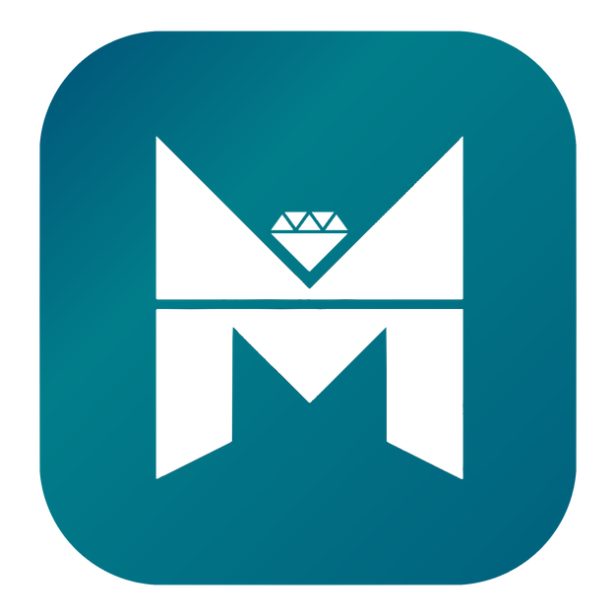
myra

Slide 2
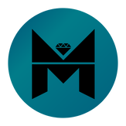
MYRA
Myra is a structure that aims to provide a unique experience to the users by integrating current technologies into the blockchain. Myra is a token because it belongs to a smart contract. Assets referred to as coins are those that have their own blockchain networks. MYRA aims to expand the usage areas of MYR worldwide by breaking new ground with its decentralized social media platform project. MYRA will expand its usage areas by producing projects in all areas of technology, without being bound by restrictions, and will grow in many sectors such as Blockchain and SocialFi.

Slide 3
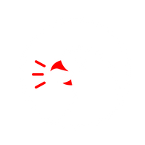
MYRA
BLABBER
MYRA’s first project is BLABBER. With Blabber application, you are very close to the world of cryptocurrency. Blabber is a Blockchain-based and decentralized social media project. On Blabber, our users can freely share their thoughts, events, current news, and developments in the crypto world. Our users who want to use our platform professionally can earn money through Blabber by paying with MYR tokens, introduce their current posts to the world by opening a tag, and advertise. Blue Tick and Golden Tick in Blabber were developed for our professional users. Blab is what users can share their thoughts, photos, videos and various things on Blabber applıcatıon. Users can comment on shared Blabs in the Blabber applıcatıon.

Slide 4
MYRA
MYRA’s roadmap is long and reliable, designed with detailed thought. Since the day it was founded, MYRA has carried out many steps that are reliable, durable and thought out down to the smallest detail. Before our smart contract was published, our technical team created the infrastructure and design of our first project, Blabber. We then implemented Blabber and created our smart contract. After MYR, our token, was created, we organized a reward marketing, namely Airdop and Bounty event, to introduce MYR to the whole world. In order to increase the reliability of our token, we published our Audit Report from ContractWolf. By increasing our collaborations, we were listed on CoinGecko, one of the world’s leading cryptocurrency platforms, and enabled our users to follow the latest developments about MYRA. We are organizing 25% discounted token event for our users by holding a Public Sale in Bsclaunch on November 24, 2023. MYR will continue to be listed on many centralized exchanges with which we subsequently discussed and agreed.

Slide 5
MYRA
Token Name: MYRA
Symbol: MYR
CONTRACT ADDRESS(BSC): 0xef33fd3d46C3EFa1804b513e3dDb7FdFf215DeF1
Total Supply: 10.000.000.000
Decimal: 18
Reserve constitutes 20% of the project. 2,000,000,000 MYR tokens are reserved for Reserve. Development For Ecosystem constitutes 10% of the project. 1,000,000,000 MYR tokens are reserved for Development For Ecosystem. Marketing constitutes 10% of the project. 1,000,000,000 MYR tokens are reserved for Marketing. Team constitutes 10% of the project. 1,000,000,000 MYR tokens are reserved for Team. Partnership constitutes 10% of the project. 1,000,000,000 MYR tokens are reserved for the Partnership. Corporate Structuring constitutes 5% of the project. 500,000,000 MYR tokens are reserved for Corporate Structuring.

Slide 6

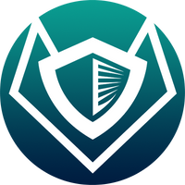
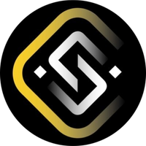

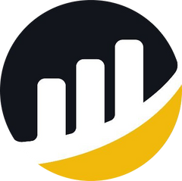
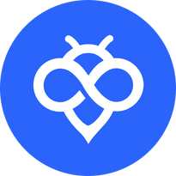
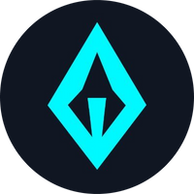
partnershıps

Slide 7
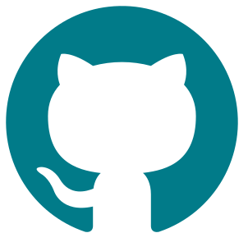

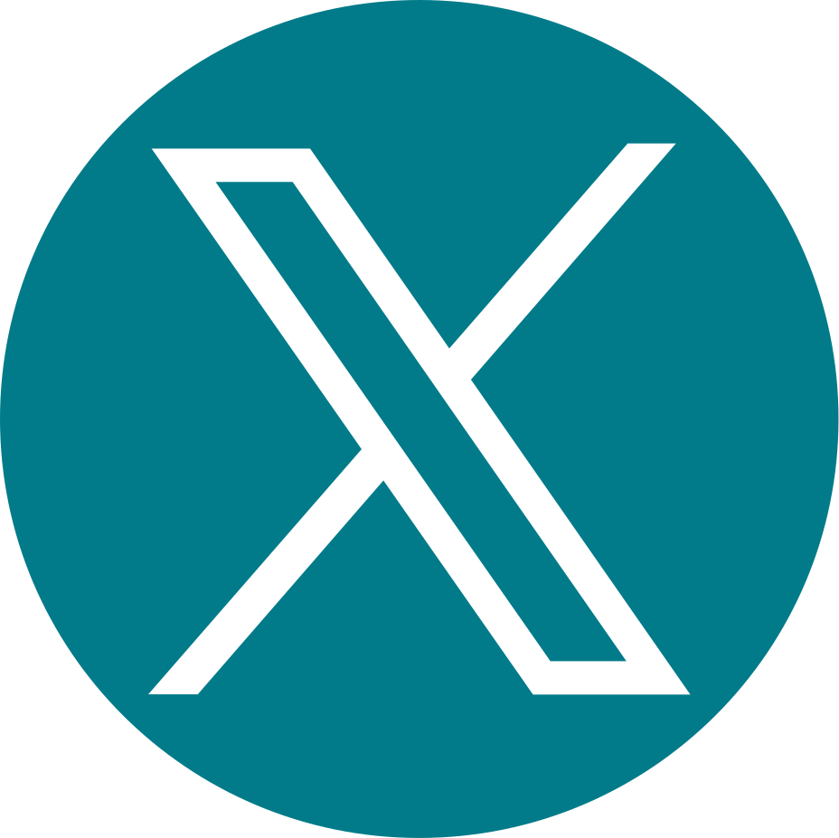
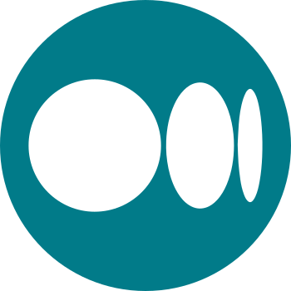
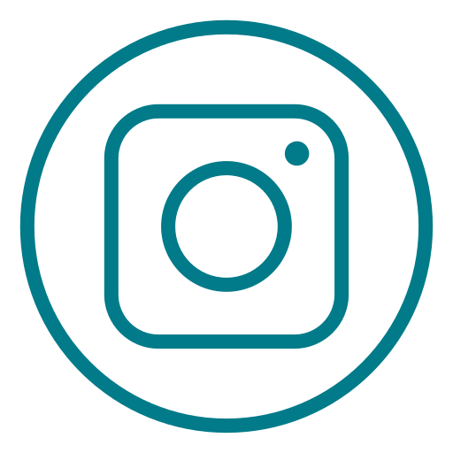
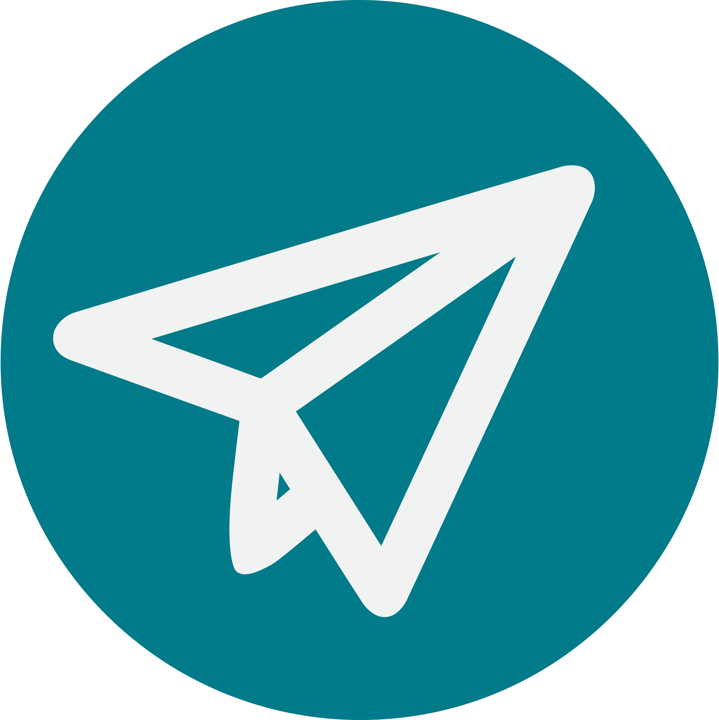


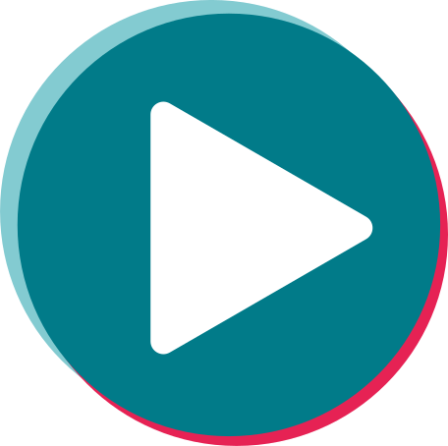
Socıal medıa

