Slide 1
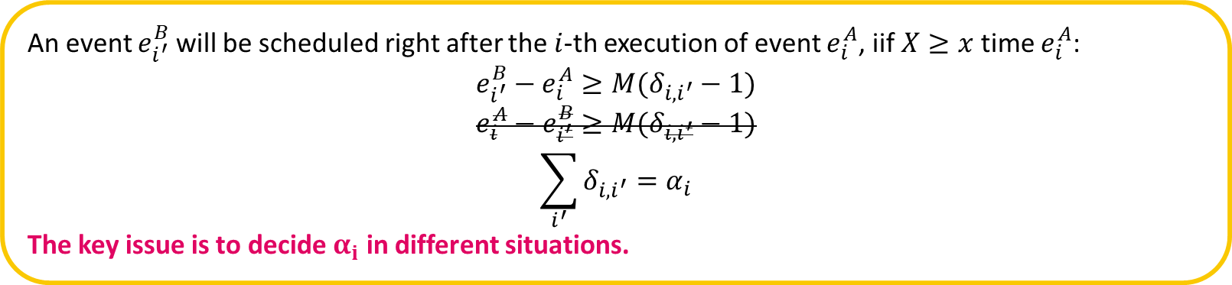
Elementary ERG is used to generate MP models:
every vertex contains only at most one state variable change.
every edge condition consists of only two arithmetic expressions connected by a relational operator.
An event $e_{i^{′}}^{B}$ will be scheduled right after the $i$-th execution of event $e_{i}^{A}$, iif $X≥x$ time $e_{i}^{A}$:
$$e_{i^{′}}^{B}−e_{i}^{A}≥M(δ_{i,i^{′}}−1)$$
$$e_{i}^{A}−e_{i^{′}}^{B}≥M(δ_{i,i^{′}}−1)$$
$$\sum_{i^{′}}{δ_{i,i^{′}}}=α_{i}$$
The key issue is to decide $α_{i}$ in different situations.

Slide 2
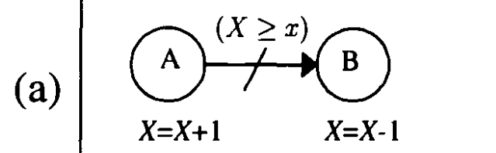
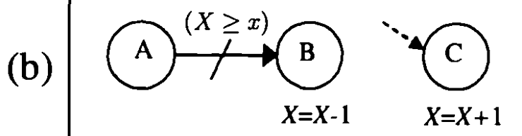
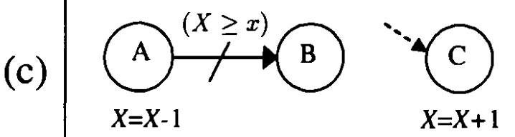
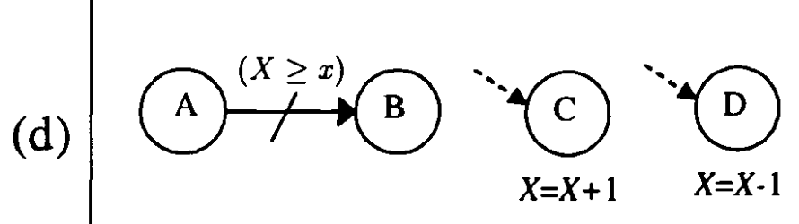
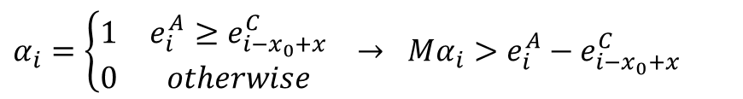
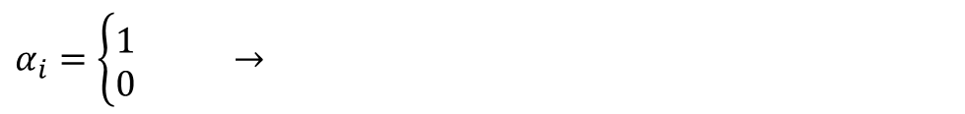
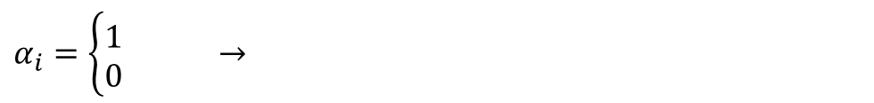

$$α_{i}=\left\{\begin{matrix}1 & e_{i}^{A}<e_{i+x_{0}−x+1}^{B} \\ 0 & otherwise\end{matrix}\right. →Mα_{i}≥e_{i+x_{0}−x+1}^{B}−e_{i}^{A}$$
$α_{i}=\left\{\begin{matrix}1 & \\ 0 & \end{matrix}\right. →$
$α_{i}=\left\{\begin{matrix}1 & e_{i}^{A}≥e_{i−x_{0}+x}^{C} \\ 0 & otherwise\end{matrix}\right. → Mα_{i}>e_{i}^{A}−e_{i−x_{0}+x}^{C}$
$α_{i}=\left\{\begin{matrix}1 & \\ 0 & \end{matrix}\right. →$

Slide 3
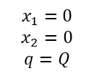
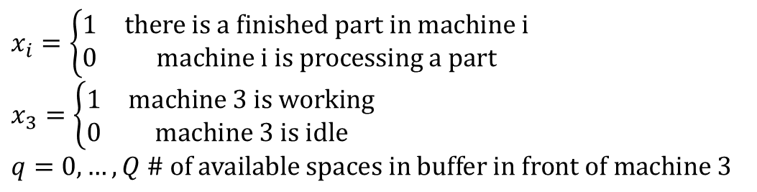





















$$t_{1}$$
Finish 1
Depart 1
$$(x_{1}≥1)$$
$$x_{1}++$$
$$(q≥1)$$
$$x_{1}−−$$
$$q−−$$
$$(q≤Q−1)$$
$$t_{1}$$
$$x_{1}=0$$
$$x_{2}=0$$
$$q=Q$$
$$(q≥Q−1)$$
Run
$$x_{2}≥1$$
$$q≥1$$
Start 3
Finish 3
$$t_{3}$$
$$x_{3}++$$
$$q++$$
$$x_{3}−−$$
$$t_{2}$$
$$(q≥Q−1)$$
Finish 2
Depart 2
$$(q≥1 \&$$
$$x_{1}≤0)$$
$$x_{2}−−$$
$$q−−$$
$$x_{2}++$$
$$(x_{1}≤0\&$$
$$x_{2}≥1)$$
$$t_{2}$$
$x_{i}=\left\{\begin{matrix}1 & there is a finished part in machine i \\ 0 & machine i is processing a part\end{matrix}\right.$
$x_{3}=\left\{\begin{matrix}1 & machine 3 is working \\ 0 & machine 3 is idle\end{matrix}\right.$
$q=0,…,Q$ $\# of available spaces in buffer in front of machine 3$

Slide 4
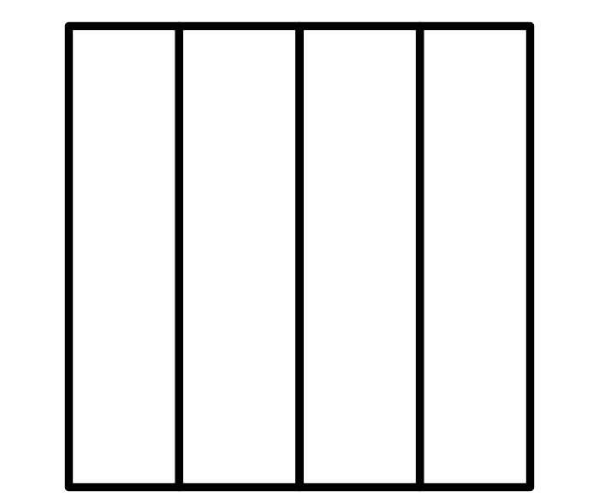





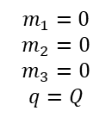



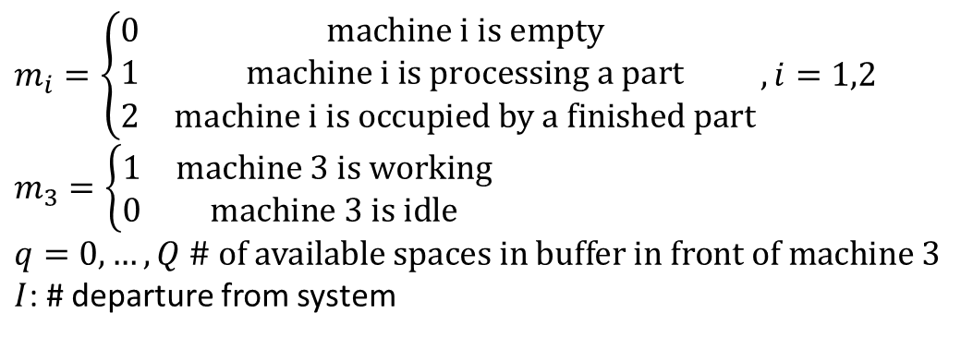





$$t_{1}$$
Finish 1
Depart 1
$$(m_{1}≥1)$$
$$m_{1}++$$
$$(q≥1)$$
$$m_{1}−−$$
$$q−−$$
$$(q≤Q−1)$$
$$t_{1}$$
$$m_{1}=0$$
$$m_{2}=0$$
$$m_{3}=0$$
$$q=Q$$
$$(q≥Q−1)$$
Run
$$x_{2}≥1$$
$$q≥1$$
Start 3
Finish 3
$$m_{3}−−$$
$$I++$$
$$t_{3}$$
$$m_{3}++$$
$$q++$$
$$t_{2}$$
$$(q≥Q−1)$$
$$(I≥N)$$
Finish 2
Depart 2
$$(q≥1 \&$$
$$m_{1}≤0)$$
End
$$m_{2}++$$
$$m_{2}−−$$
$$q−−$$
$$(m_{1}≤0\&$$
$$m_{2}≥1)$$
$$∞$$
$$t_{2}$$
$m_{i}=\left\{\begin{matrix}0 & machine i is empty \\ 1 & machine i is processing a part \\ 2 & machine i is occupied by a finished part\end{matrix}\right., i=1,2$
$m_{3}=\left\{\begin{matrix}1 & machine 3 is working \\ 0 & machine 3 is idle\end{matrix}\right.$
$q=0,…,Q$ $\# of available spaces in buffer in front of machine 3$
$I$: # departure from system
1
$$Q$$
3
$$∞$$
2
Machine 1 has higher priority in releasing a job compared with machine 2.

Slide 5
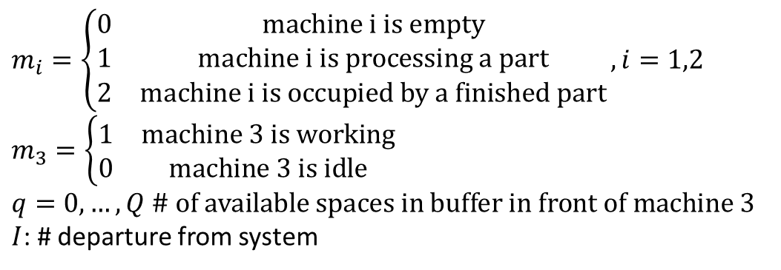
$$∞$$
$m_{i}=\left\{\begin{matrix}0 & machine i is empty \\ 1 & machine i is processing a part \\ 2 & machine i is occupied by a finished part\end{matrix}\right., i=1,2$
$m_{3}=\left\{\begin{matrix}1 & machine 3 is working \\ 0 & machine 3 is idle\end{matrix}\right.$
$q=0,…,Q$ $\# of available spaces in buffer in front of machine 3$
$I$: # departure from system
1
$$Q$$
3
$$∞$$
3
2
Machine 1 has higher priority in releasing a job compared with machine 2.

Slide 6
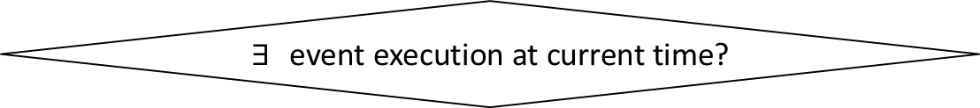
Initialize state variables, global clock, event list
Advance global clock as the execution time of the earliest event in the event list
External loop
$∃$ event execution at current time?
No
Yes
Internal loop
Execute an event and change state
Schedule new events
Exit condition?
No
Yes
Exit

Slide 7


Finish 1
Depart 1
Start 2
Depart 2
$$∞$$
$$b$$
1
2

Slide 8


$$∞$$
$$∞$$
1
2

Slide 9








$Buffer$ 1
$Machine$ 1
$$∞$$
1
$Buffer$ 3
3
$Machine$ 3
$$∞$$
2
$Buffer$ 2
$Machine$ 2

Slide 10














$$p_{1}$$
$$t$$
$$p_{2}$$
$$p_{1}$$
$$\tilde{t}$$
$$p_{t}$$
$$\overline{t}$$
$$p_{2}$$
$$2$$
$$3$$
$$2$$
$$1$$
$$1$$
$$3$$

Slide 11
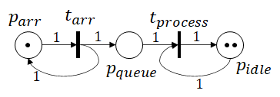
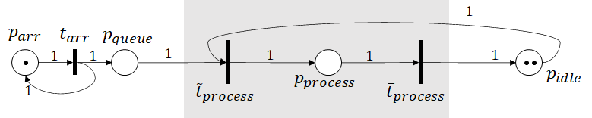

Slide 12








$$queue≥1$$
$$τ(arr)$$
Run
Arr
Start proc
Fin proc
$$idle≥1$$
$$τ(proc)$$
$$queue=0$$
$$idle=2$$
$$queue=queue+1$$
$$idle=idle−1$$
$$queue=queue−1$$
$$idle=idle+1$$

