Slide 1
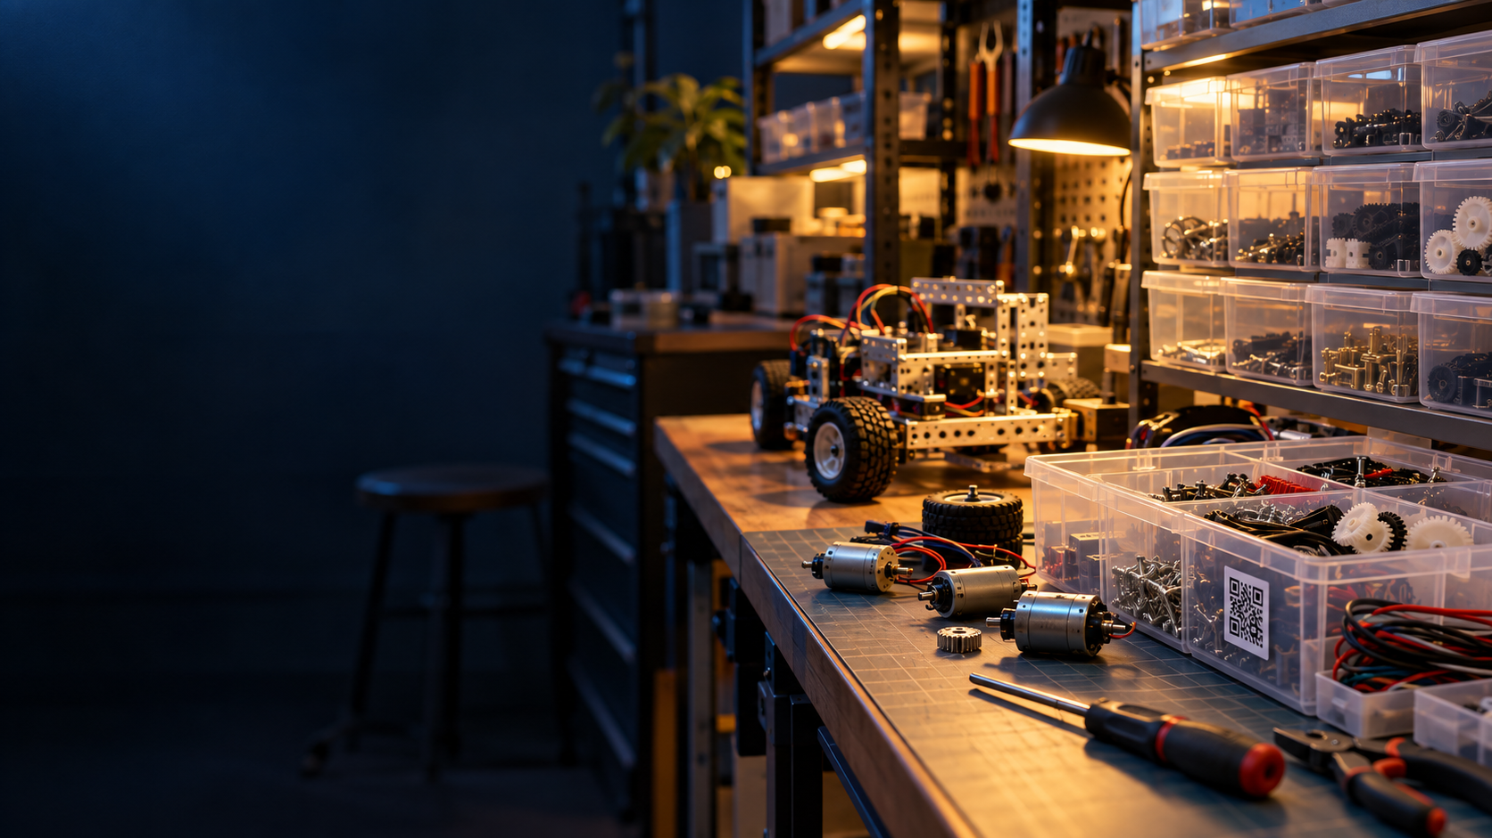
NUS ROBOMASTER CLUB
Parts Store
Checkout
QR labels and a Telegram Mini App record where parts go across the store, robots and members.
PROJECT OVERVIEW · OCTOBER 2026
Notes:
Sources: docs/README.md; docs/tele-qr/idea.md; docs/tele-qr/HOW_TOs/features.md. The workshop image is AI-generated and illustrative, not a photo of the club store.

Slide 2
A checkout becomes a location record
BORROW
RETURN
01
Scan bin or page labels
Select from current holdings. No rescan needed.
Telegram keeps the scanner open as parts enter one cart.
02
Choose the destination
Review quantities and assign the parts to a robot or member.
The same movement ledger powers holdings by robot or member, stocktake and admin reports.
03
Submit once
One transaction writes the stock movements to the ledger.
Notes:
Sources: docs/tele-qr/HOW_TOs/features.md; docs/tele-qr/flows.md; docs/tele-qr/architecture.md; src/app/api/store/cart/submit/route.ts. A page-level group code lets a member choose an item such as a resistor value after scanning.

Slide 3
Rollout status
The catalog is live and the core checkout workflow is built.
567
314
18
products imported
serialized units
review questions open
Verified on phones
Before club rollout
Continuous QR scanning works on real devices.
Resolve inventory questions, onboard members, place labels and finish production phone and bot checks.
STATUS AS OF 4 OCT 2026
Notes:
Sources: docs/data-cleaning.md (567 imported products, 314 asset units, 18 open review items as of 2026-10-04); docs/tele-qr/checkpoint.md (continuous scanning passed on real devices on 2026-09-13); docs/tele-qr/HOW_TOs/features.md and docs/tele-qr/qa-checklist.md (remaining operational and production QA gaps). Status reflects repository documentation, not a fresh live database audit.

