Slide 1
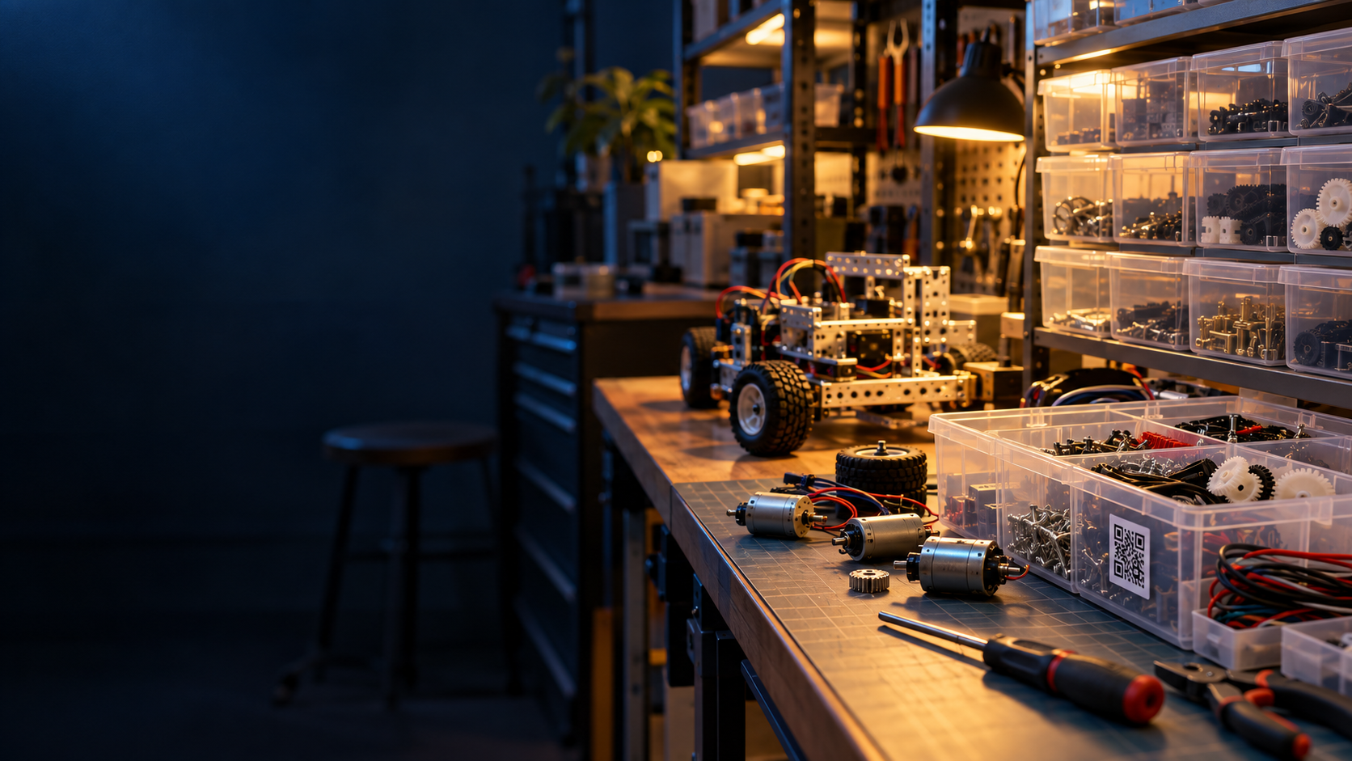
NUS ROBOMASTER PARTS STORE
Slow checkout makes
stock harder to track
Search bars and forms take time at the shelf. Some members skip checkout, leaving a large catalog harder to manage.
PARTS STORE CHECKOUT
Notes:
Presenter cue: Start with the experience of someone grabbing a part during a busy build. The existing search and form checkout takes enough time that members may skip it. This creates gaps in the inventory record. Source for the problem framing: user-provided project brief, 2026-10-05. Cover photo is AI-generated and illustrative, not a photo of the actual store. Pitch structure informed by Stanford GSB Think Fast, Talk Smart: https://www.gsb.stanford.edu/insights/how-think-faster-talk-smarter-masterclass-matt-abrahams

Slide 2
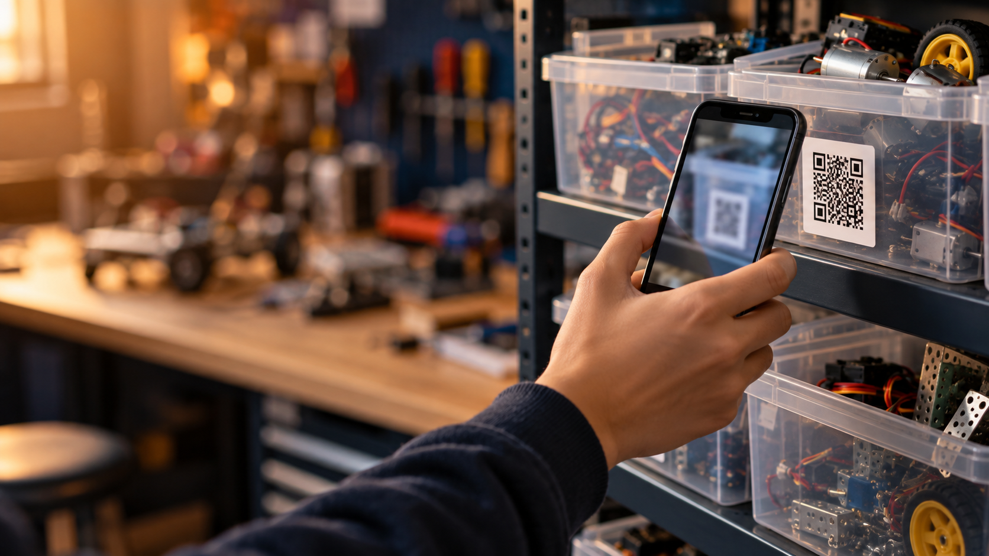
THE SOLUTION
Scan at the shelf.
Keep moving.
Scan a bin QR, add parts in Telegram, choose where they go, and finish checkout.
The inventory record updates as parts move between the store, robots and members.
Returns use a holdings checklist.
Notes:
Presenter cue: Demonstrate the two outcomes together: less effort for the member and an updated location record for the store. The Telegram Mini App supports QR scanning, a cart, destination selection, and checklist returns. Sources: docs/tele-qr/HOW_TOs/features.md; docs/tele-qr/flows.md; src/app/store/page.tsx. Image is AI-generated and illustrative, not an actual app screenshot.

Slide 3
Software complete. Manual rollout pending.
16
high-priority questions about expensive items must be resolved first
No recount, review or QR label placement has been completed yet.
Members cannot use the checkout system until that hands-on work is done.
CURRENT STATUS · OCTOBER 2026
Notes:
Presenter cue: Be explicit about readiness. The software implementation is finished, but no manual recount, review, or QR labeling has been done, so the system is not usable yet. The 16 high-priority expensive-item questions are the immediate review set. Source: user-provided project status, 2026-10-05. Repository context: docs/tele-qr/checkpoint.md and docs/data-cleaning.md.

Slide 4
Launch expensive items first
01
Review the 16 questions and recount expensive stock
02
Attach QR labels and test checkout on those items
03
Expand the QR rollout to the remaining catalog
Next step: schedule the first store review and recount session.
Notes:
Presenter cue: The request is to start the physical preparation, beginning with the most valuable parts. Resolve their questions, count what is actually present, then attach QR labels and test the live flow before expanding. Source: user-provided rollout plan, 2026-10-05. Call-to-action framing informed by Stanford GSB Think Fast, Talk Smart: https://www.gsb.stanford.edu/insights/lean-messaging-how-simple-messages-really-stick

