Slide 1
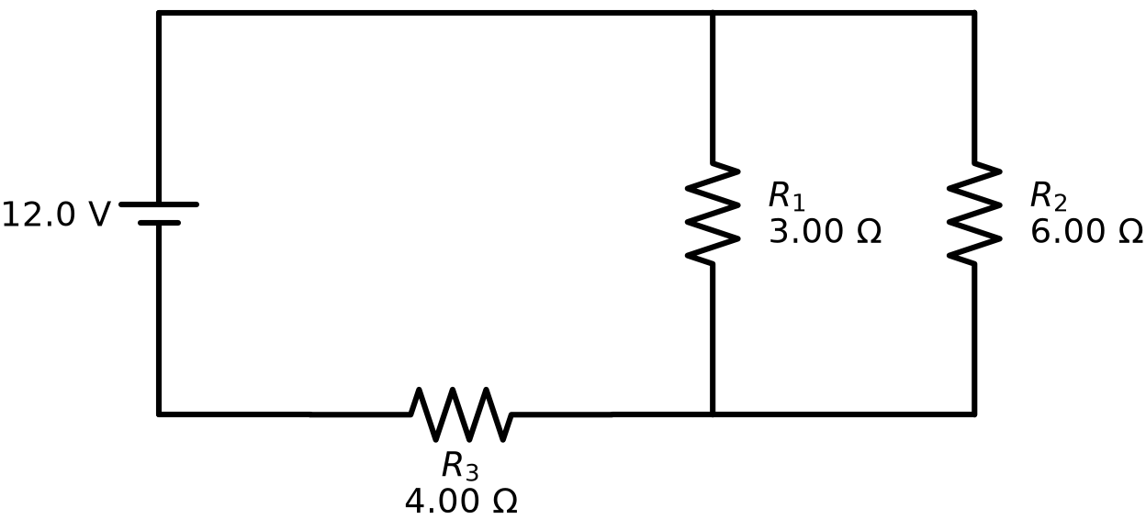
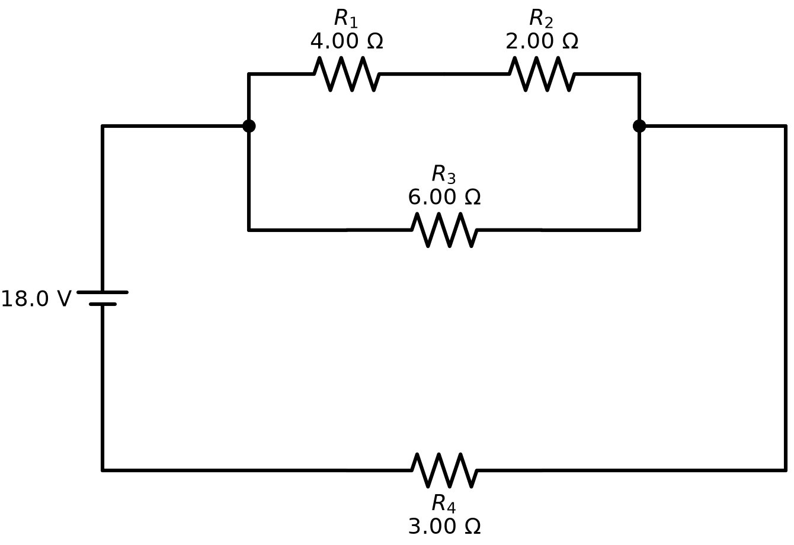
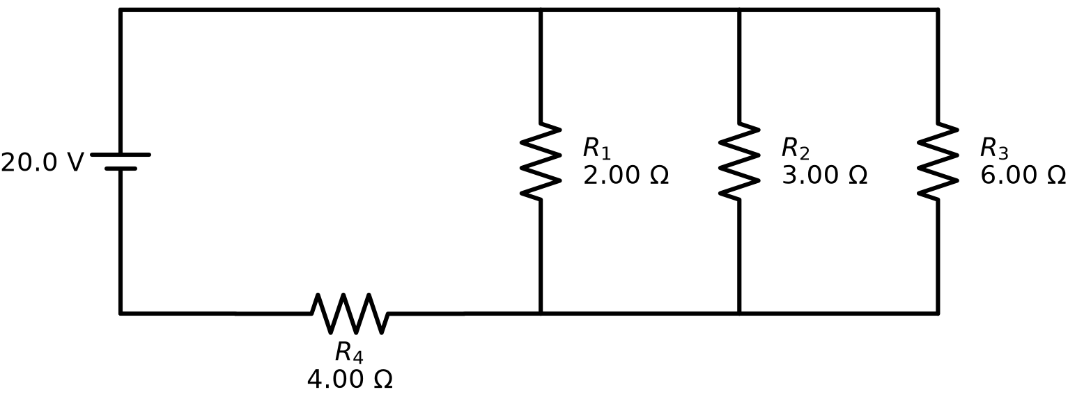
What “isomorphic” means — and why it is built for the student
1 More than new numbers
Three items from the bank — same question, three different reduction paths
Same circuit with different values is not a variation — students pattern-match the one solution path.
2 A different solution
At least one reduction step must differ. Redrawing, reordering or renaming parts changes nothing.
3 || 6 + 4
(4 + 2) || 6 + 3
2 || 3 || 6 + 4
parallel pair, then series
series pair inside a parallel
three-way parallel, then series
3 Same objective, same difficulty
Same question, same number of steps. A 2-step and a 5-step circuit are not isomorphs.
Built with the student in mind
One difficulty per bank every item reduces in exactly 3 steps
Every item a new path canonical-shape check: same shape = same problem
Why it matters. Each student draws one random item for the same exam slot. Below the floor the draw is pointless; above the ceiling it is unfair. Isomorphic is the band where the draw is both meaningful and fair.
Wrong answers are real mistakes each distractor is computed from one named error
One drawing style, clean arithmetic the only thing that varies is the physics
Notes:
Isomorphic is Zhongzhou Chen's term: a bank of problems that test the same objective with variations that change the solution, not only the numbers. The three criteria give a floor (more than numbers; a different solution) and a ceiling (same difficulty). The use case is a random draw per student for one exam slot, which is only fair inside that band. For resistor networks, an isomorph is a different series-parallel topology asked the same way at the same number of steps.

Slide 2
How the code works — every number computed, none guessed
Input scheme
Chen's loop
Enumerate
Critic (script)
Circuit engine
Bank + PDF
what circuits,
how many, difficulty
sidecar: target,
accepted / rejected
every shape in the
band, values by seed
parse · solve · shape
· steps · ranges
figure, numbers,
worked solution
computed distractors;
Chen's template
Zhongzhou Chen's method and scripts, used in place
circuit-diagram-skill (deterministic engine)
circuit-bank glue (deterministic)
34
distinct 3-step shapes
with 4–6 resistors
30
items in the bank —
30 of those 34
0
rejections, one pass;
no LLM anywhere
=
same input + seed →
same bank, byte for byte
One item, four computed options
What the critic rejects (reasons written to Chen's sidecar)
0.92 A adds all resistors in series
does not parse / solve “The circuit line ends too early…”
2.67 A sums reciprocals, forgets to invert
same canonical shape 6 || 3 + 4 and 2 || 4 + 5 ≡ 3 || 6 + 4
1.33 A reports one branch current
value out of range “R1 = 50 Ω is outside resistor_range [1, 24]”
2.00 A correct: 3 ‖ 6 = 2 Ω; + 4 = 6 Ω; 12 / 6
wrong difficulty “5 reduction steps; this bank wants 3”
Notes:
Chen's generate-critique-count loop runs unchanged (scenario_list.py). Two of his agents are replaced because circuits can be enumerated and verified: the proposer is an enumerator over all series-parallel shapes in the difficulty band, and the critic is a script that parses, solves, canonicalises the shape, counts reduction steps and checks ranges. The circuit engine (circuit-diagram-skill) produces every figure, number and worked solution; distractors are recomputed from named student mistakes. 34 shapes exist at 3 steps with 4-6 resistors; the bank uses 30 of them; same input and seed regenerate the identical bank.

