Slide 1
How the circuit bank works
Isomorphic DC-circuit problem banks — what “isomorphic” means, why they are built for fairness to the student, and how the code produces 30 variations with every number computed, not guessed.
Myrla Phillippe · research group · October 2026
Notes:
Take Zhongzhou Chen's isomorphic-bank method, feed it a domain where the scenario is a circuit topology that a computer can enumerate and verify, and let a deterministic circuit engine do everything numerical. The result: every item has a different solution path, the same difficulty, computed wrong answers, and an answer key that regenerates byte for byte.

Slide 2
What “isomorphic” means here
1 More than new numbers
A band with a floor and a ceiling
“Same circuit, new values” is not a variation — students pattern-match the one solution path.
Below the floor
same circuit, new numbers
everyone has the same problem — the draw is pointless
2 A different solution
At least one reduction step must differ. Redrawing, reordering or renaming parts changes nothing.
In the band
different reduction path, same work
the draw is meaningful and fair
3 Same objective, same difficulty
Same question, same number of steps. A 2-step and a 5-step circuit are not isomorphs.
Above the ceiling
different difficulty or objective
one student's exam is harder — the draw is unfair
Chen's repository: problems that test the same learning objectives “with variations that change the solution and not only the numbers”, drawn at random so no two students get the same item.
Use case: each student draws one random item for the same exam slot.
Notes:
The word is Chen's. His three criteria give a floor (more than numbers; a different solution) and a ceiling (same difficulty). The use case is a random draw per student for one exam slot, which is only fair inside that band.

Slide 3
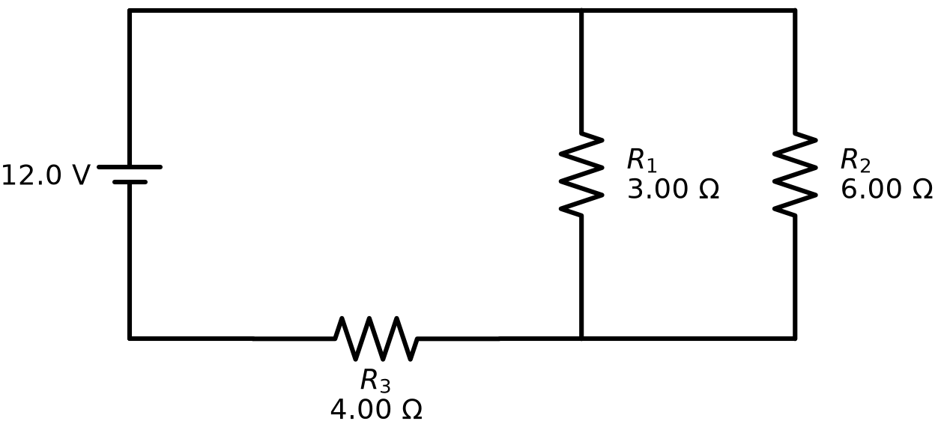
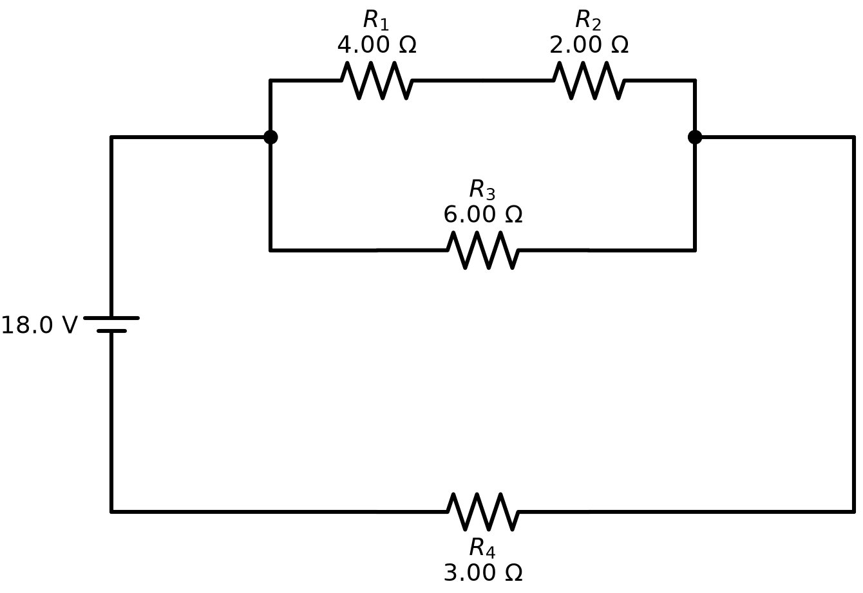
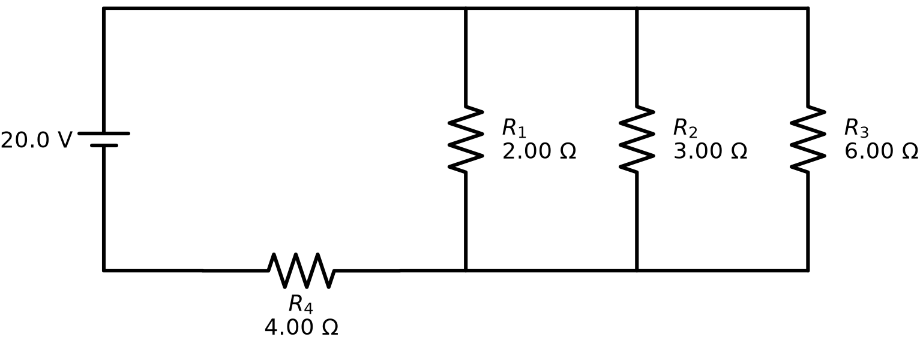
Three real isomorphs — same question, three reduction paths
3 || 6 + 4
(4 + 2) || 6 + 3
2 || 3 || 6 + 4
parallel pair, then series
series pair inside a parallel, then series
three-way parallel, then series
12 V → 2.00 A
18 V → 3.00 A
20 V → 4.00 A
For a resistor network, an isomorph is a different series-parallel topology — a different sequence of reductions — asked the same way. None of these can be solved by remembering another.
Notes:
Three items from the first bank. The lingo line under each figure is the whole source of the item: parse it and you get the figure, the numbers and the worked solution. Three different reduction sequences; three different answers.

Slide 4
Built with the student in mind
Design choice
What the student experiences
How it is enforced
One difficulty per bank
Your drawn problem takes the same number of steps (3) with the same number of resistors (5–6) as your neighbour's.
reduction_steps: 3, resistors 5–6 — the critic rejects anything else
Every item a different path
You cannot pass by memorising last year's problem.
canonical-shape check: same shape = same problem
Wrong answers are real mistakes
Three options are the numbers one specific error each produces; a fifth sits near the largest so a lone big value is no giveaway.
distractors.py re-solves the circuit as a mistaken student would, then adds a decoy near the largest
Honest sizes
A 144 A distractor is what the mistake really gives.
deliberately not capped
One drawing style
The figure never changes style between items.
layout: ladder for the whole bank
Clean arithmetic
Every intermediate resistance is a whole or half ohm.
enumerator accepts only such value sets; pool ≤ 12 Ω
A worked solution for every item
Feedback shows every reduction step and a per-resistor table.
written by the circuit engine into the bank
Notes:
Every row is a guarantee the student gets, and the right column is where in the code it is enforced. None of them depends on an LLM behaving well.

Slide 5
Wrong answers are computed, not invented
0.92 A
all_series
adds every resistor as if in series: 12 / (3 + 6 + 4)
2.67 A
no_invert
sums the reciprocals of the parallel pair but forgets to invert: 1/3 + 1/6 = 0.5 “Ω”
1.33 A
branch_current
reports the current through R1 (one branch) instead of the total
2.40 A
decoy
0.9 × the largest option — so the lone large value is not a giveaway by size
12 V battery · 3 || 6 + 4 · find the total current
2.00 A
correct
3 ‖ 6 = 2 Ω, + 4 = 6 Ω, 12 V / 6 Ω
Fallbacks (series_as_parallel, all_parallel, first_only) are used only when a value collides. Option order rotates per item; the mistake behind each option is written into the answer key.
Notes:
distractors.py re-walks the same circuit tree the way a mistaken student would. Each wrong option therefore names a misconception. The 'honest size' decision: a huge distractor is what the mistake gives, and its implausibility is itself feedback.

Slide 6
The three pieces
Isomorphic-bank method
circuit-diagram-skill
circuit-bank skill
Zhongzhou Chen
Myrla Phillippe
this project
The definition; an input scheme; a generate → critique → count loop with a target, accepted/rejected lists with reasons and a 5-pass cap (scenario_list.py); the bank YAML template and folder convention.
A small language — circuit lingo: (4 + 2) || 6 + 3 — a parser, a series/parallel solver with worked steps, and a Schemdraw figure generator. Same text in → same figure, numbers and solution out.
Runs Chen's loop for circuits: an enumerator proposes every shape in the difficulty band; a script critic replaces his LLM critic; the circuit engine replaces his sympy stage; computed distractors; bank YAML + PDF.
AI inside: his critic and scenario writer are LLM agents. His docs: numbers, wording, figures “not generated yet”.
AI inside: none. An LLM may only translate an unreadable sentence into lingo; it never invents circuits.
AI inside: none by default. An LLM proposer exists as an opt-in (generator: llm) for comparison.
Notes:
Chen's repository separates tooling from banks. Our output follows his template and folder convention, so a circuit bank sits beside his mechanics banks without translation. The hand-off between creation and use is the bank YAML.

Slide 7
The pipeline — whose work each stage is
Input scheme
Chen's loop
Enumerate
Critic (script)
Circuit engine
Bank + PDF
what circuits, how many,
difficulty, ranges, seed
sidecar: target, pass count,
accepted / rejected + reasons
every shape in the band;
values from a pool by seed
parse · solve · canonical shape
· reduction steps · ranges
figure (Schemdraw), numbers,
worked solution
computed distractors;
Chen's YAML template; PDF
Zhongzhou Chen's method and scripts, run in place
circuit-diagram-skill — deterministic engine
circuit-bank glue — deterministic
What flows between the stages
circuit-input.yaml the recipe — n_scenarios, difficulty band, value ranges, seed, bank id
circuit-input.scenarios.yaml Chen's sidecar — the accepted lingo list, the source of truth the bank regenerates from
agent2.json the candidates for one pass — the same JSON whether the enumerator or an LLM wrote them
<bank_id>.yaml + figures/ + .pdf the product — importable bank, one figure per item, printable worksheet with answer key
Notes:
Colour shows whose work each stage is. The loop and the sidecar are Chen's scripts, unmodified. The proposer and critic are our scripts. The circuit engine is the circuit-diagram-skill. The LLM appears nowhere unless generator: llm is chosen.

Slide 8
One run — the 30-item bank
Input (excerpt)
What the critic checks, and the reason it writes
name: Series-parallel resistor networks: total current
n_scenarios: 30
bank_id: PHY2-DC-SPRTC3-10292026
question_type: multiple_choice layout: ladder
resistor_range: [1, 24] voltage_range: [6, 36]
min_resistors: 5 max_resistors: 6
reduction_steps: 3
generator: enumerate seed: 0
parses and solves
“circuit-diagram-skill rejects it: The circuit line ends too early…”
new canonical shape (+ ask)
“same solution path (S(P(R,R),R)) as an accepted scenario: 3 || 6 + 4”
values in range
“outside the input's ranges: R1 = 50 Ω is outside resistor_range [1, 24]”
Enumerator output (one of 30)
source: 9 V
circuit: (6 + 4) || (9 + 6)
ask: total current
difficulty
“5 reduction steps; this bank wants 3 (same difficulty for every item)”
This run: Chen's validate_input.py ok · receive → needed 30 · enumerator wrote 30 · critic kept 30, rejected 0 · 30 items, 0 failures · PDF built.
Notes:
The number of items lives in the input file, never in a chat message — one of Chen's rules we kept. The enumerator writes the same JSON an LLM proposer would, so add_lingo.py and the critic run unchanged. Because the enumerator never proposes a duplicate or an invalid circuit, the critic is a safety net here: 30 of 30 kept in one pass.

Slide 9
Where the AI is — and is not
Stage
Chen's pipeline
This pipeline
Describe the problem family
human writes the input
human writes the input
Propose variations
LLM writes prose scenarios
enumeration of every shape in the band (LLM opt-in)
Judge variations
LLM critic
script: parse, solve, shape, steps, ranges
Equations / numbers
sympy from LaTeX; random numbers “not yet”
circuit engine, deterministic
Figures
not generated
Schemdraw, from the same lingo
Wrong answers
—
computed from named mistakes
Wording
not generated
fixed template from the engine
Reproducibility. Same input + same seed → the same 30 scenarios. Same sidecar → the same bank, byte for byte (verified). The sidecar is the source of truth; YAML, figures and PDF are derived.
Notes:
When the LLM proposer is used, correctness is unchanged — the critic and the engine do not care who wrote the string — but the set of shapes differs from run to run and completeness is not assured. That mattered once we fixed one difficulty: finding all 30 shapes is a job for enumeration.

Slide 10
Difficulty has a ceiling
30
distinct 3-step shapes with 5–6 resistors (34 with 4–6). The bank uses every one of the 30
Fixing difficulty = fixing the step count. one reduction step per group collapsed
The set is finite and small. 2, 4, 10, 24, 66 shapes for 2–6 resistors — the classic series-parallel sequence
Wanting more at one difficulty means allowing more resistors, not inventing shapes — and that is a different difficulty
Enumeration, not guessing. an LLM finding all 30 within 5 passes is unlikely; the enumerator lists every one
Notes:
The counts come from enumerating series-parallel trees with alternating series/parallel nodes. At exactly three steps there are 34 shapes with four to six resistors and exactly 30 with five to six; the bank uses every one of those 30, so the arithmetic load is also held in a narrow band. The first bank mixed 2 to 5 steps — structurally isomorphic, but not fair as a random draw.

Slide 11
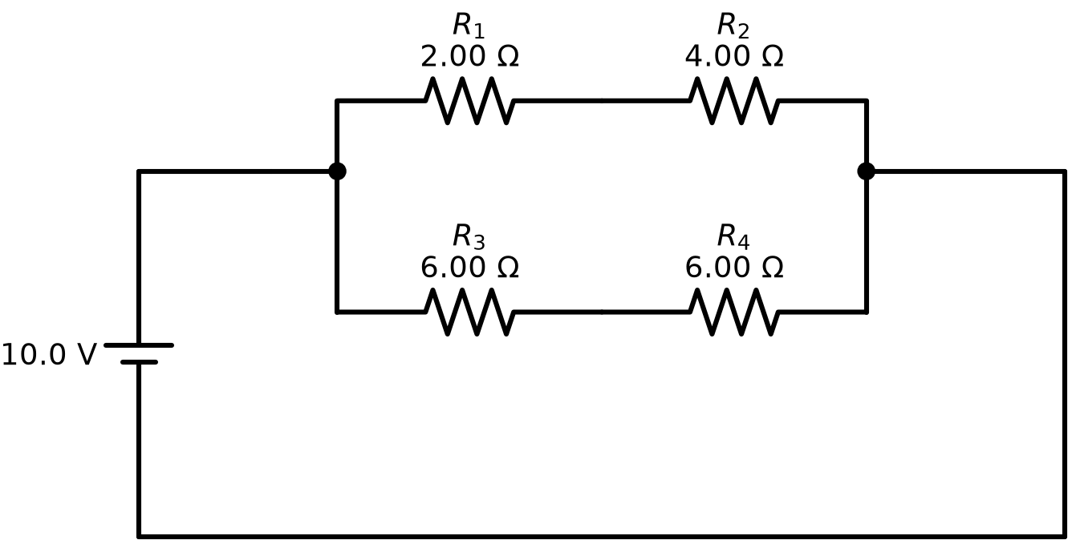
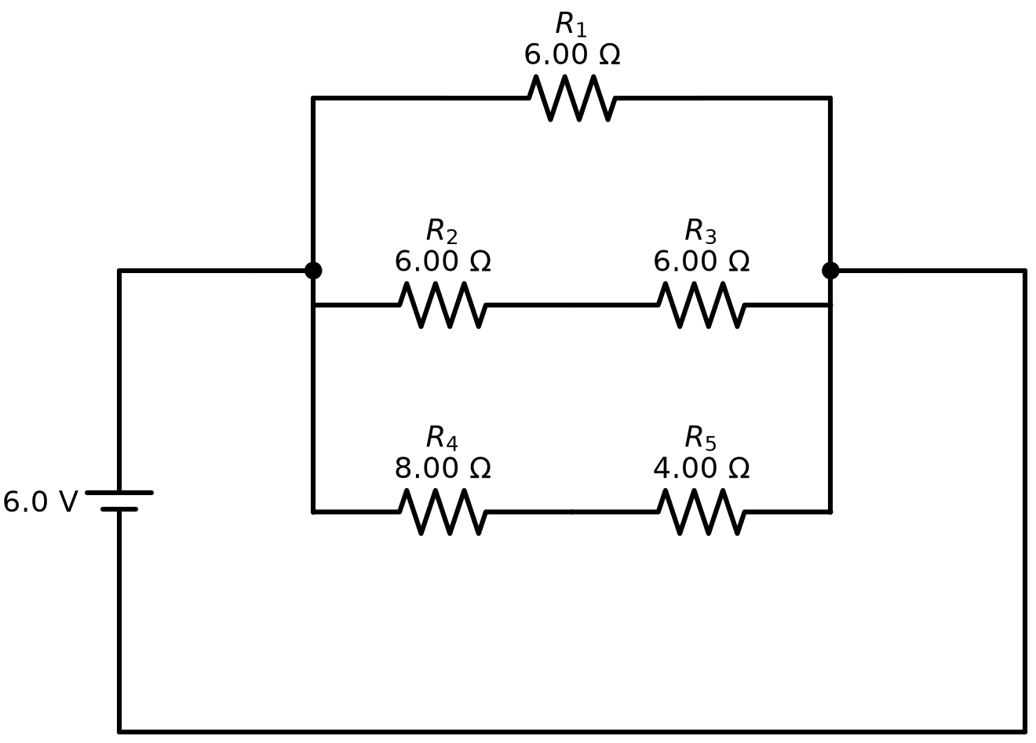
Results and verification
PHY2-DC-SPRTC-10222026
PHY2-DC-SPRTC3-10292026
10 items
30 items
mixed difficulty, 2–5 steps
proposer: LLM
0 rejections — 10 distinct shapes
answers: several repeat
one difficulty: exactly 3 steps, 5–6 resistors
proposer: enumerator
0 rejections — all 30 shapes
answers: all distinct
Three independent checks
Chen's own validate_input.py accepts the circuit input scheme — no missing fields
Regeneration every item re-parsed and re-solved; the bank rebuilt from its sidecar is byte-identical
Critic log every shape unique with exactly 3 steps — 30 kept, 0 rejected, in one pass
Notes:
Both banks are published in Chen's folder convention in the circuit-banks repository with status: ready. The first bank is kept as a contrast: structurally isomorphic, mixed difficulty.

Slide 12
Limits and next steps
Canvas import (QTI)
Not produced. Chen's bank folders ship a QTI zip from an external converter. A deterministic QTI 2.1 exporter for multiple-choice-with-image is a well-scoped next step.
Varying the unknown
Fixed to “total current”. Chen's input has unknown_rotation for this but it is not implemented yet; our critic already treats a different ask as a different problem.
Number randomisation per student
Not done (also “not yet” in Chen's docs). Isomorphism is carried by the topology; numbers are fixed per item.
Distractor magnitude
Left honest, no cap — one option can be 100× the answer. A documented design choice.
Licensing
Chen's repo is CC BY-NC 4.0 and private; the skill that embeds one of his scripts is private too. The public circuit-banks repo holds only our output.
Notes:
The nearest next step is a QTI exporter, which would make this the only one of the three pieces that produces the Canvas file directly. Varying the unknown is an input-file change plus wording.

