Slide 1

Predicting Box Office Gross with Regression
Project Luther – Max Kneissl

Slide 2
Ambition: Predict Domestic Total Gross (Log) before movies go to the screen
Production
Distribution
Release
Available information
Movie characteristics
Distribution information
Box-Office Revenues

Slide 3
Predictive power of regression model depends on point in time
Production
Distribution
Release
100%
Adj.
R2
27%
92%
No of theaters
29%
No of Countries
23%
35%
12%
Rating
Genre

Slide 4
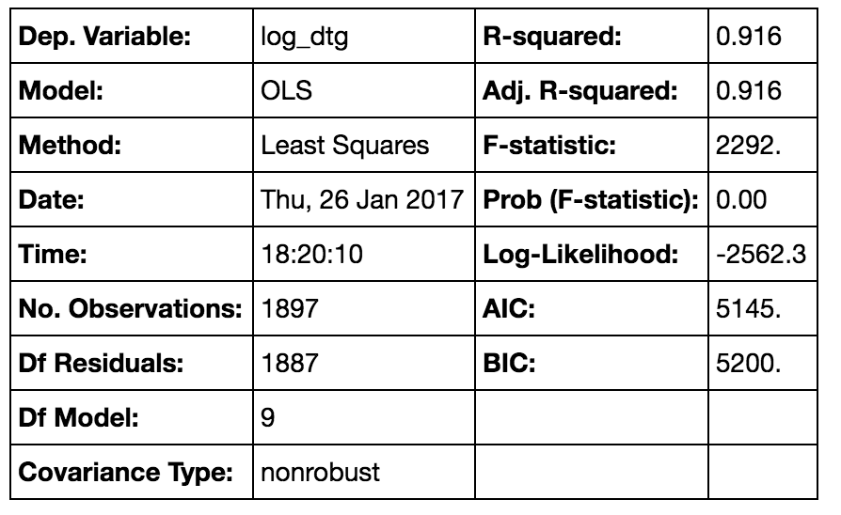
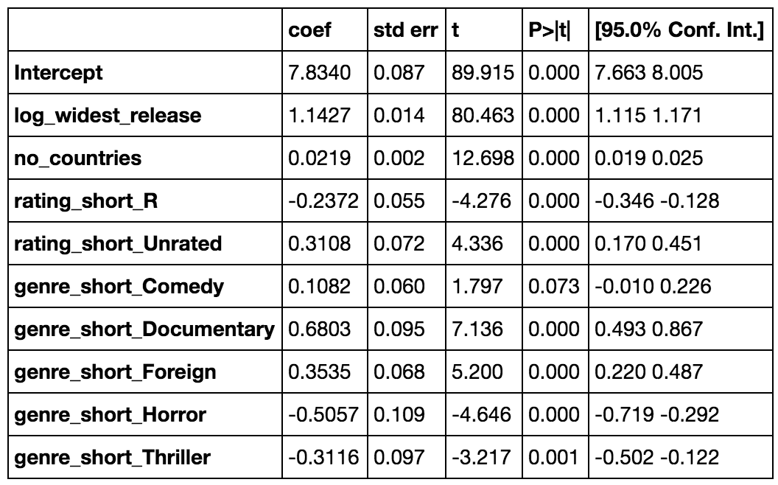
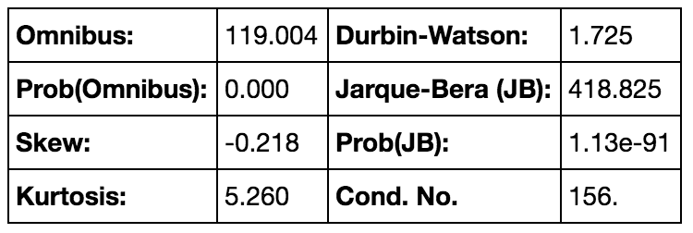
Regression summary

Slide 5
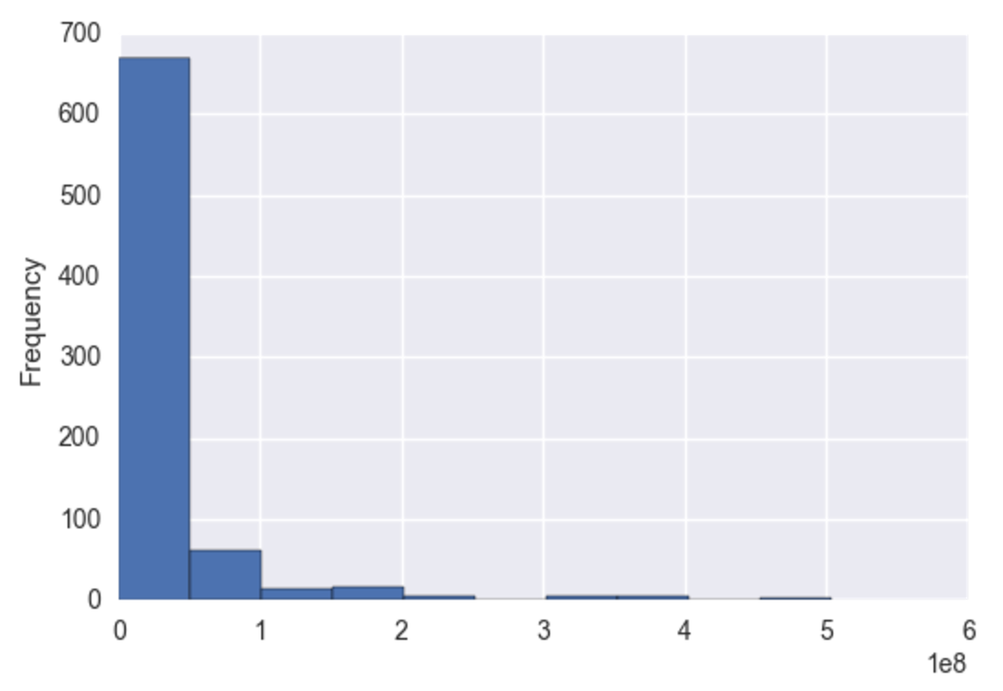
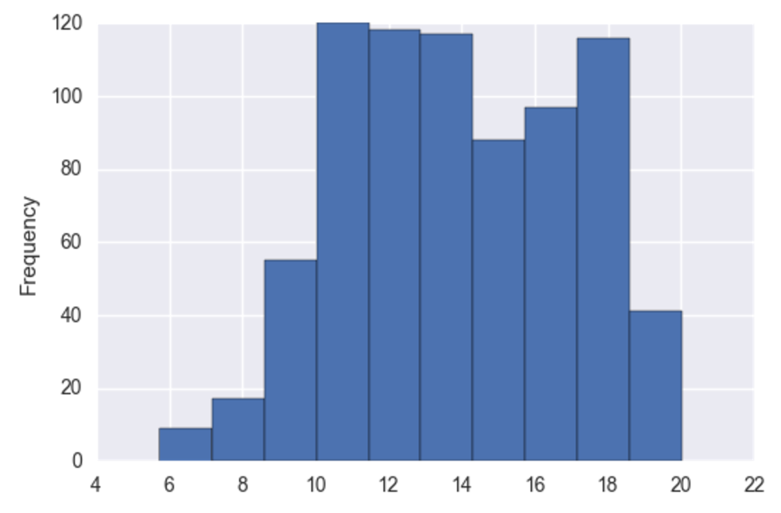
Log Domestic Total Gross yields much higher R2 compared to
Domestic Total Gross
Log Domestic Total Gross

Slide 6
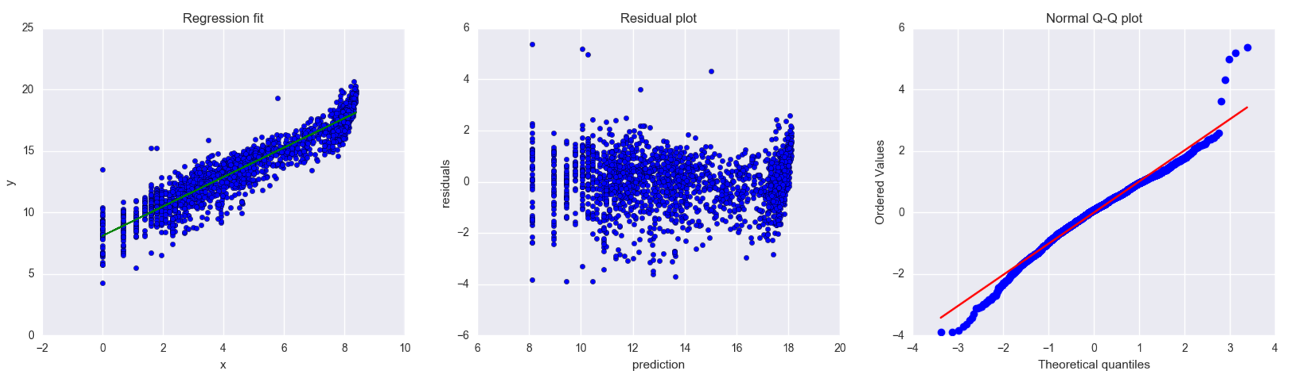
Test of assumptions: Evenly distributed errors
Signs of heteroscedasticity

Slide 7
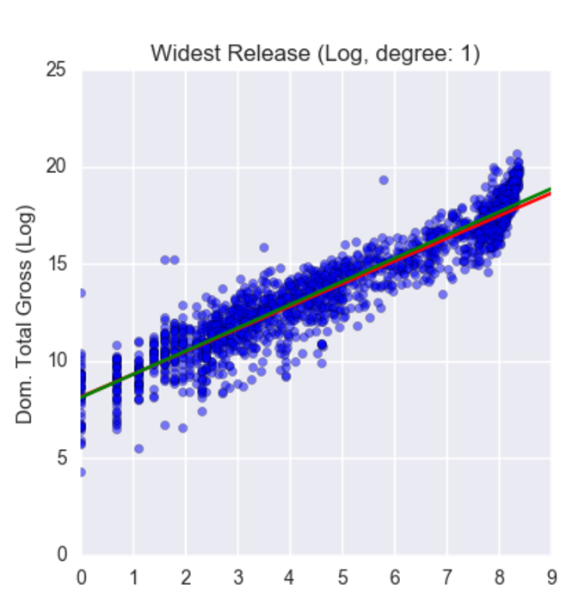
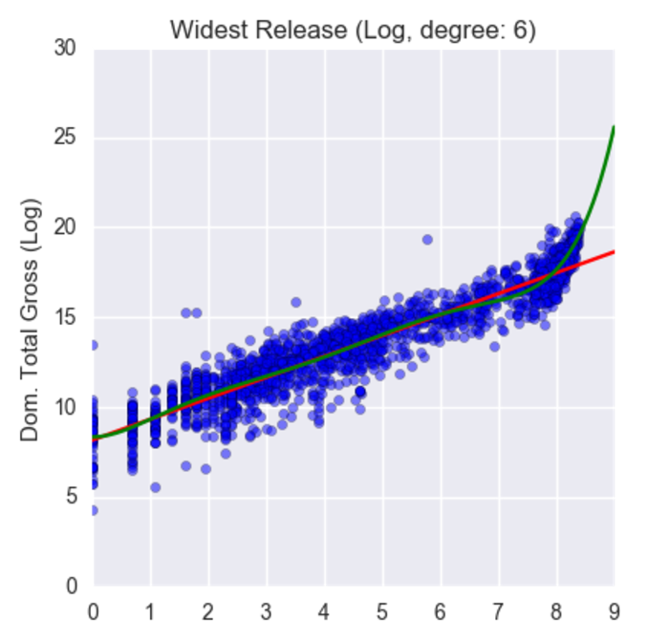
Investigation of polynomial to reduce heteroscedasticity
Polynomial of 1st degree
Polynomial of 6st degree

Slide 8
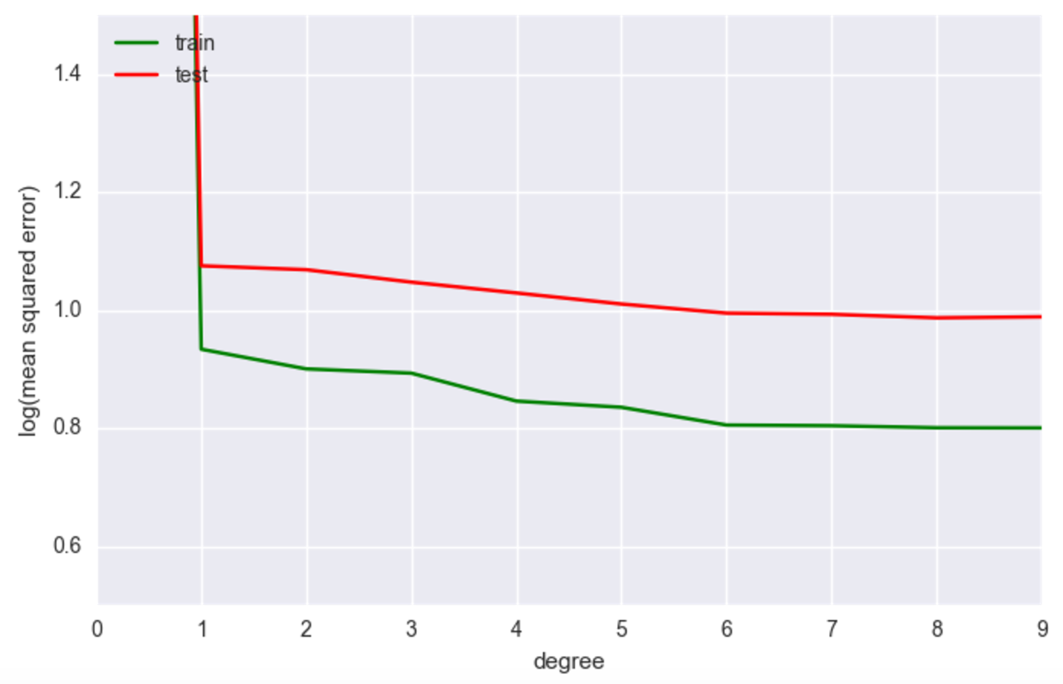
Polynomial of 6th degree reduces train and test MSE ...

Slide 9
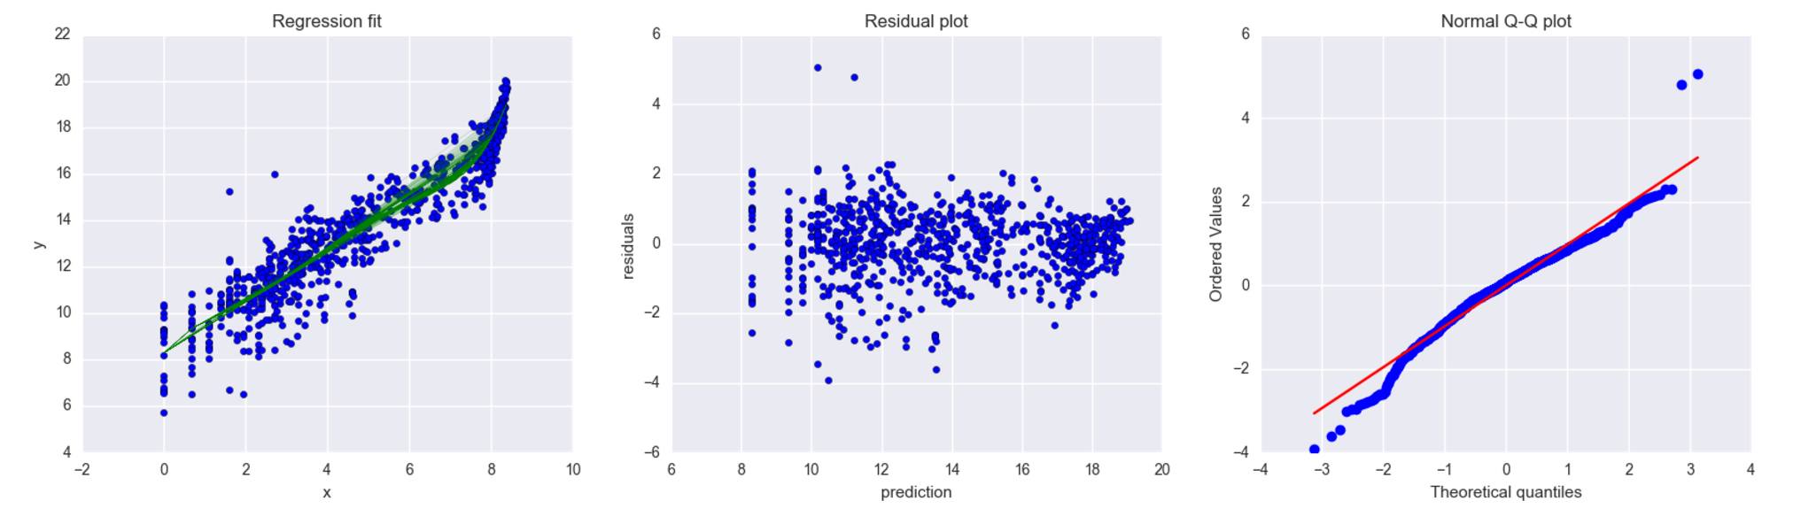
... And partially addresses heteroscedasticity
Heteroscedasticity reduced by some degree

Slide 10
Next steps
Include Budget feature
Account for inflation

Slide 11
Appendix

Slide 12
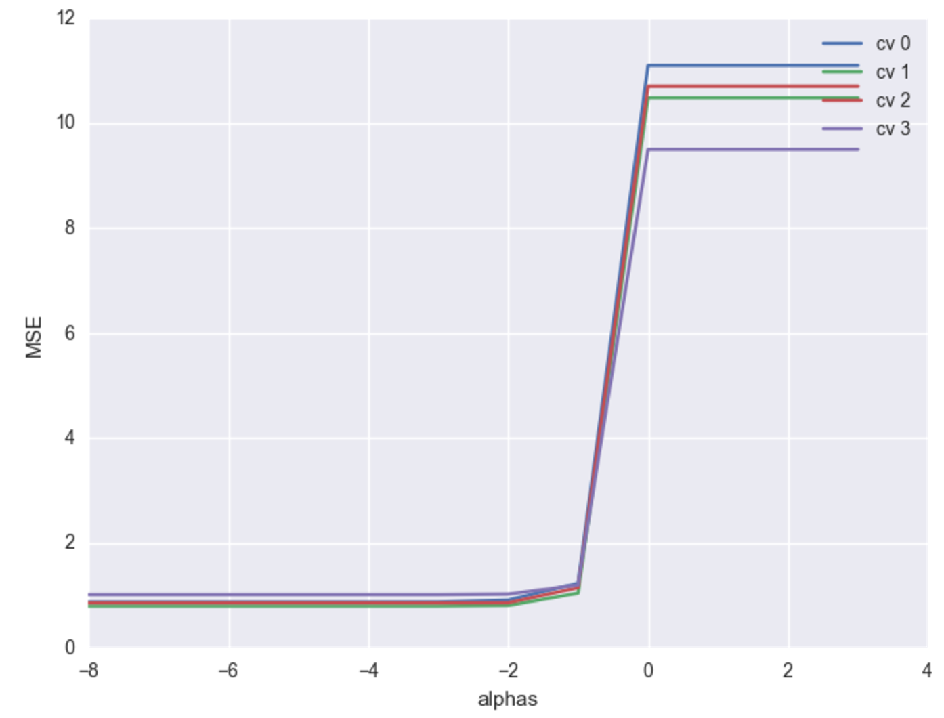

Slide 13
Reduction of features
[('log_widest_release', 9.497092252756822),
('no_countries', 1.6337230127885245),
('genre_short_Documentary', 0.41716882094926205),
('genre_short_Foreign', 0.27252009988141485),
('rating_short_Unrated', 0.20371139294698914),
('genre_short_Comedy', 0.0043052106959832193),
('runtime_mins', 0.0),
('rating_short_PG13', -0.0),
('genre_short_Adventure', -0.0),
('genre_short_Animation', -0.0),
('genre_short_Concert', 0.0),
('genre_short_Crime', 0.0),
('genre_short_Drama', 0.0),
('genre_short_Family', 0.0),
('genre_short_Fantasy', -0.0),
('genre_short_Historical_Epic', -0.0),
('genre_short_Musical', -0.0),
('genre_short_Romance', -0.0),
('genre_short_Sci_Fi', 0.0),
('genre_short_War', -0.0),
('genre_short_Western', 0.0),
('genre_short_Thriller', -0.1989960630528097),
('rating_short_R', -0.22082926760776836),
('genre_short_Horror', -0.26197005363749637)]
[('log_widest_release', 9.5721548681752164),
('no_countries', 1.5041173738806621),
('genre_short_Comedy', 0.33466594236243957),
('rating_short_R', 0.28016371150188246),
('genre_short_Documentary', 0.23369955977522219),
('rating_short_Unrated', 0.20389476560157394),
('genre_short_Foreign', 0.17566264669369627)]

