Slide 1
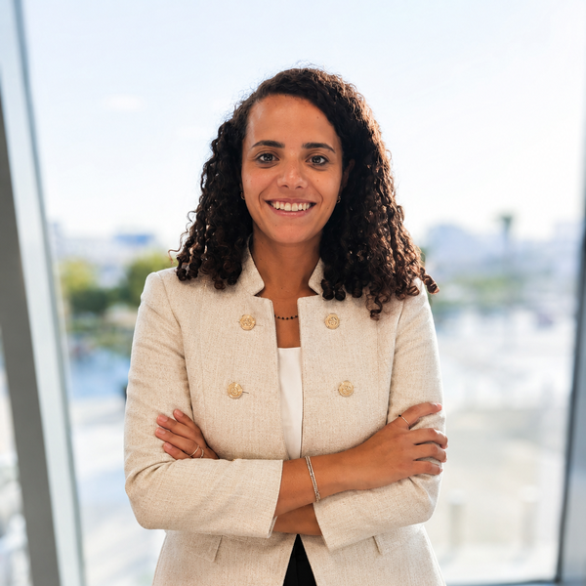
ACCOUNT MANAGER
Myrna
Gamal Fahim
Senior Sales Development Executive · SAP
MEA North · Enterprise Clients
I want to own a client relationship completely.
To be the person they call, the person they trust,
and the person who makes them successful.
10+
Years enterprise client experience
3
Markets: Egypt, South Africa, Morocco
200+
Partners built from ground up at IBM
myrna.gamal@aucegypt.edu · linkedin.com/in/myrna-gamalfahim · Cairo, Egypt
Prepared for the Account Manager Role

Slide 2
CAREER JOURNEY
Built on owning relationships.
Every role built on one thing: earning the trust of the person across the table and making them successful.
Core Skills
APR 2025 — PRESENT
Senior Sales Development Executive
Team Leadership & Mentorship
SAP · Cairo, Egypt
Senior SDE at SAP driving enterprise pipeline across Egypt. Senior stakeholder engagement, structured outreach, and close collaboration with AEs to move opportunities from first meeting to signed deal. Currently serving as team leader for MEA North.
Enterprise Account Management
Salesforce & CRM Governance
Team Leader · MEA North
Stakeholder Engagement
FEB 2022 — APR 2025
Data & AI Technical Sales Specialist
Pipeline & Revenue Strategy
IBM · Cairo, Egypt
Owned the full technical sales cycle for enterprise clients. Built ROI models, delivered executive-level demos and POCs. Became the trusted advisor for IBM business partners across Egypt, South Africa, and Turkey on all things Data & AI.
AI-Led Selling
APR 2017 — FEB 2022
IBM Cloud Developer Advocate Manager
IBM · Cairo, Egypt
Led a team of Developer Advocates across MEA. Drove 40% increase in active engagement and personally secured 200+ new startup partners. Built C-level relationships that shaped cloud adoption strategies region-wide.
Team Manager · Developer Advocacy
BSc Computer Science, AUC (GPA 3.8) · MBA, Edinburgh Business School (ongoing) · Summer Abroad: UC Berkeley

Slide 3
ACHIEVEMENT I'M PROUD OF
Hitting target twice. The second time before I even had a full year.
SAP · MEA North · 2025
140%
◆ 100% in year one
Full target delivered with only 8 months in role, new market and new product portfolio
of sales target this year at SAP.
100% the year before, joining
4 months into the cycle.
◆ 140% this year
Exceeded target while simultaneously taking on team leadership for MEA North
"I don't wait for conditions to be perfect. I build the conditions."
◆ AI-powered prospecting
Used AI to identify the right accounts and personas, turning cold outreach into precision targeting
◆ Lead and deliver
Hit personal targets while leading the MEA North SDE team, proving I can do both at once

Slide 4
VALUE TO THIS ROLE
I don't just manage accounts. I build the system that makes account management work.
Every point below is grounded in something I have actually done.
Client Ownership & Cadence
Trusted Advisor, Not Just a Vendor
AI-Led Selling
Owned enterprise relationships end-to-end at IBM and SAP: first call to executive review. 140% this year, 100% last year joining 4 months late. I know how to sustain a healthy account rhythm across a complex portfolio.
My strongest relationships are built on genuine understanding of the client's business and pressures. At IBM I became the go-to advisor for partners across three markets. Clients come back because they trust me.
I build AI into how I work as infrastructure. AI tools help me identify the right accounts and personas, prioritise outreach, and build prospecting applications. It is how I compete at 140%.
Partner Ecosystem
Senior Stakeholder Engagement
Salesforce & Pipeline Governance
Built and maintained partner relationships throughout my career — from 200+ startup partners in IBM's Global Entrepreneur Program to strategic alliances at SAP. I know how to activate a network to open doors and co-sell.
From CTOs at IBM to C-suite at SAP. Executive-level relationships across Egypt, South Africa, and Morocco. I communicate with clarity, adapt to the room, and earn trust quickly.
Running pipeline management in Salesforce at SAP. Data hygiene matters. A CRM nobody trusts is just admin overhead. I make it a decision-making tool.

Slide 5
“
When I look back at what I'm most proud of, it's never just the number. It's the client who called me first when something went wrong. The partner who trusted me with their roadmap. The relationship that outlasted the deal. That's what I want to build here. At depth, over time.
— Myrna Gamal Fahim
I want to go deeper, not just wider.
The best account managers are obsessed with client success.
I've spent 10 years building pipeline and winning new business. Now I want to go deeper: own a portfolio of clients over time, understand their business fully, and become the person they rely on. That is a different and harder skill. I'm ready for it.
I don't just want to retain accounts. I want clients to grow, to refer others, to say this firm understands them. That obsession with genuine client success (not just contract renewal) is what I bring to this role.
Day 1
30 Days
90 Days
6 Months
Listen & map
Audit & diagnose
Embed & deliver
Measure & grow
Understand the client landscape, team dynamics, and existing rhythms
Salesforce data quality, reporting cadence, stakeholder coverage
Structured account cadence in place, first client value report delivered
Visible uplift in feedback volumes, pipeline accuracy, on-time reporting
Thank you. I welcome the opportunity to discuss how my background can contribute as your next Account Manager.

