Slide 1
TUGAS BESAR
DATA MINING

Slide 2
KLASIFIKASI
https://github.com/myrnanvia/Tugas-Besar.git
DATASET LENSES DARI UCI MACHINE LEARNING

Slide 3
ANGGOTA
Destra Fajrul Ramadhan
3311901061
github.com/Destra0512
Resky Aria Munanda
3311901076
github.com/Resky1210
Myrna Novia
3311901082
github.com/myrnanvia

Slide 4
Attribute Information:
Attribute Information: -- 3 Classes
1 : the patient should be fitted with hard contact lenses,
2 : the patient should be fitted with soft contact lenses,
3 : the patient should not be fitted with contact lenses.
age of the patient: young, pre-presbyopic, presbyopic
spectacle prescription: myope, hypermetrope
astigmatic: no, yes
tear production rate: reduced, normal

Slide 5
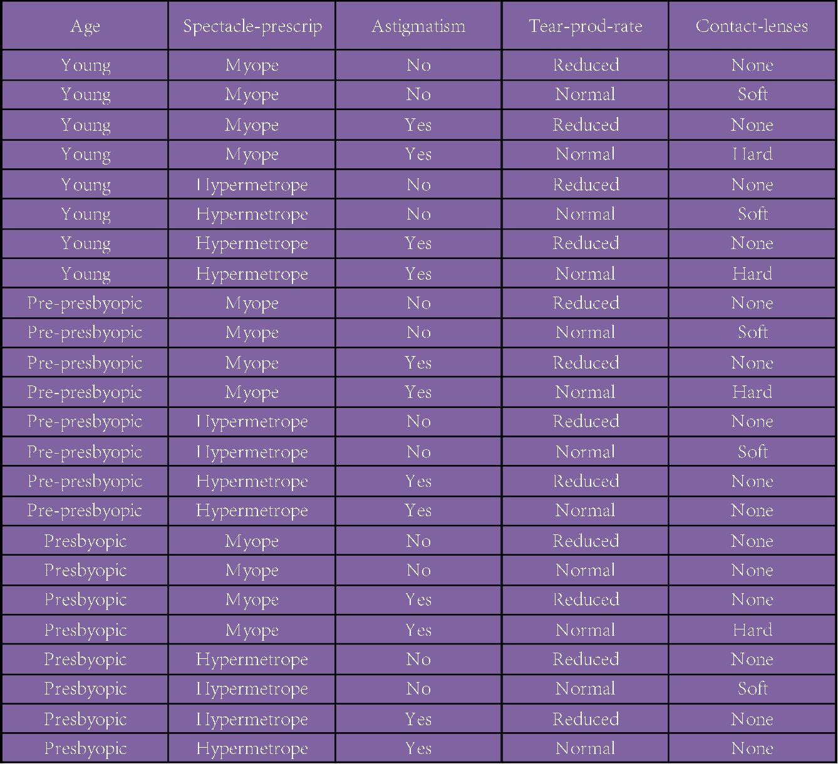
DATASET
Dataset lenses dari UCI Machine Learning

Slide 6
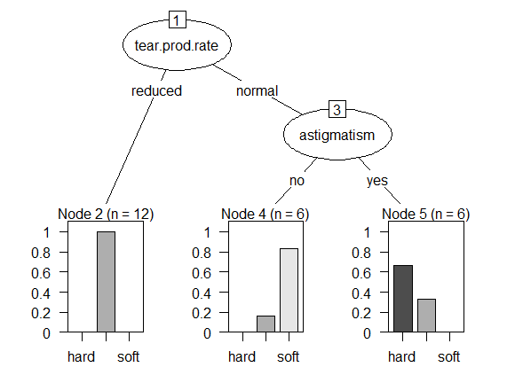
HASIL

Slide 7
Rules
If astigmatism = no
and tear-prod-rate = normal
and spectacle-prescrip = hypermetrope then soft
If astigmatism = no
and tear-prod-rate = normal
and age = young then soft
If age = pre-presbyopic
and astigmatism = no
and tear-prod-rate = normal then soft
If astigmatism = yes
and tear-prod-rate = normal
and spectacle-prescrip = myope then hard
If age = young
and astigmatism = yes
and tear-prod-rate = normal then hard
If tear-prod-rate = reduced then none
If age = presbyopic
and tear-prod-rate = normal
and spectacle-prescrip = myope
and astigmatism = no then none
If spectacle-prescrip = hypermetrope
and astigmatism = yes
and age = pre-presbyopic then none
If age = presbyopic
and spectacle-prescrip = hypermetrope
and astigmatism = yes then none
Rules yang dihasilkan

Slide 8
TERIMA KASIH

