Slide 1

Content-Based Image Retrieval (CBIR) with Deep Learning
Lampros Lountzis

Slide 2
Table of Contents
INTRODUCTION
The problem
Challenges deep-dive
SEARCH ENGINE
IR system architecture
CIFAR-10 data
Elasticsearch search engine
Bag of Visual Words

Slide 3
INTRODUCTION

Slide 4


The problem
Problem statement
Context
Although we communicate in a variety of ways with each other, our favorite way to do so is via the written word.
However, when you think, do you think in words or images ?
Pictures sometimes are easier to recognize and process than words. What is more, they can be a way of communicating something that’s impossible to verbalize, like thoughts, feelings, memories.
So, how can we improve information retrieval and accessibility via images ?
Content-Based Image Retrieval is, the problem of searching for digital images in large databases based on their contents, rather than the metadata (keywords, tags, etc.), using computer vision techniques.
Computer Vision deals with how computers can gain high-level understanding from digital images or videos.
Deep learning is concerned with algorithms inspired by the structure and function of the brain.

Slide 5
Challenges deep-dive
Challenge 1
Challenge 2
Challenge 3
Image data:
What are the attributes of the images (e.g., size, color-space, format) ?
What kind of objects and how many of these objects do the images contain ?
Is the search engine topic specific or is it a general-purpose IR system ?
Retrieval method:
The method is heavily dependent on the techniques of computer vision (classification, object detection, etc.), that are used to extract information from images.
Should we use machine learning methods or deep learning models ?
What kind of features should we extract ?
Performance:
The IR system’s performance is dependent on the computer vision method used to extract visual information.
How do we measure the IR systems performance ?
The search engine’s efficiency is also affected by the libraries and tools used for IR and CV.

Slide 6
SEARCH ENGINE

Slide 7
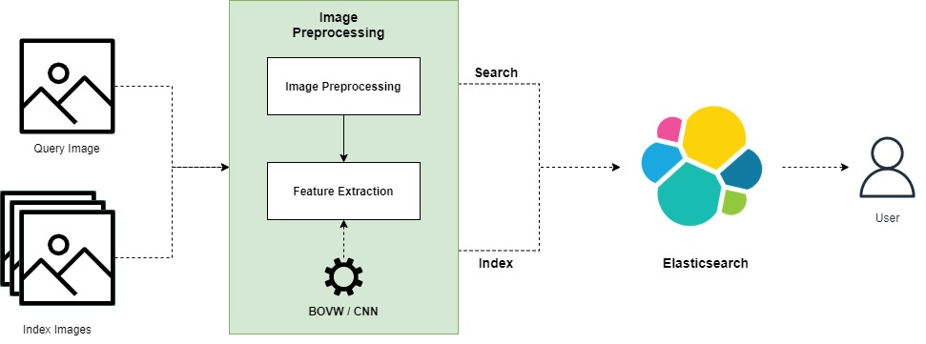
IR system architecture

Slide 8
CIFAR-10 data
We’re using the CIFAR-10 corpus (by Alex Krizhevsky, Vinod Nair, and Geoffrey Hinton) which consists of image data, about 50000 training images and 10000 test images.
Each image is a 32x32 color image.
The dataset contains 10 classes, namely airplane, automobile, bird, cat, deer, dog, frog, horse, ship, truck.
The classes are completely mutually exclusive (e.g. there is no overlap).
We consider the training images as index images, meaning that these will be indexed in our IR system. In the same manner, we consider the test images as query images.
The query relevance is defined as follows: each query image (test image) is related with a set of indexed images (training images) where the relevance relationship depends on the class label.
For example, a query image that is a car is associated with indexed images that belong to the car class.

Slide 9
Elasticsearch search engine
The Information Retrieval system (search engine) was created using the Elasticsearch service, in Python.
Queries and Documents
The image document and queries consist of the following fields: id, filename, path (absolute path to file), features (dense vector of image features as found by the underlying computer vision model) .
The image documents are retrieved and ranked using the features vector. In order to accomplish this, we compare the image-query feature vector with the image-document feature vector using the cosine similarity. Specifically
cosineSimilarity(query.features, doc.features) + 1.0
where we add 1.0 to the cosine similarity to prevent the score from being negative.
Elasticsearch configuration
We configure the Elasticsearch client to run on localhost (port 9200) with a timeout of 60sec and retry on timeout.
We create only one node per cluster, since this is not a system ready for production.

Slide 10
Elasticsearch search engine
We have decided to not create any replicas for the indexes, since this is a demo application.
Each index is distributed in 30 shards (each shard is an instance of a Lucene index, that indexes and handles queries for a subset of the data in an Elasticsearch cluster) so that we can handle the big volume of the CIFAR-10 data.
We gain better performance in indexing and searching operations.
The mapping for the image-documents that the indexes can handle, consists of the fields of the documents and queries that we have described before. The only field that can be used for retrieval is “features” which is of dense vector type and the dimensions are dependent on the CV method. However, the size of the dense vector is always smaller than 2048 since this is the maximum size Elasticsearch can handle.
Evaluation
To evaluate our IR system, we have used the trec_eval tool and its metrics.
Specifically, the search engine is evaluated on the top 100 retrieved image documents, and we consider the mean average precision (MAP).

Slide 11
BAG OF VISUAL WORDS

