Slide 1
Test project for CI/CD Architecture
Theme: CI/CD Pipeline for simple application
Purpose:
Automation process integration and
deployment of software during development

Slide 2
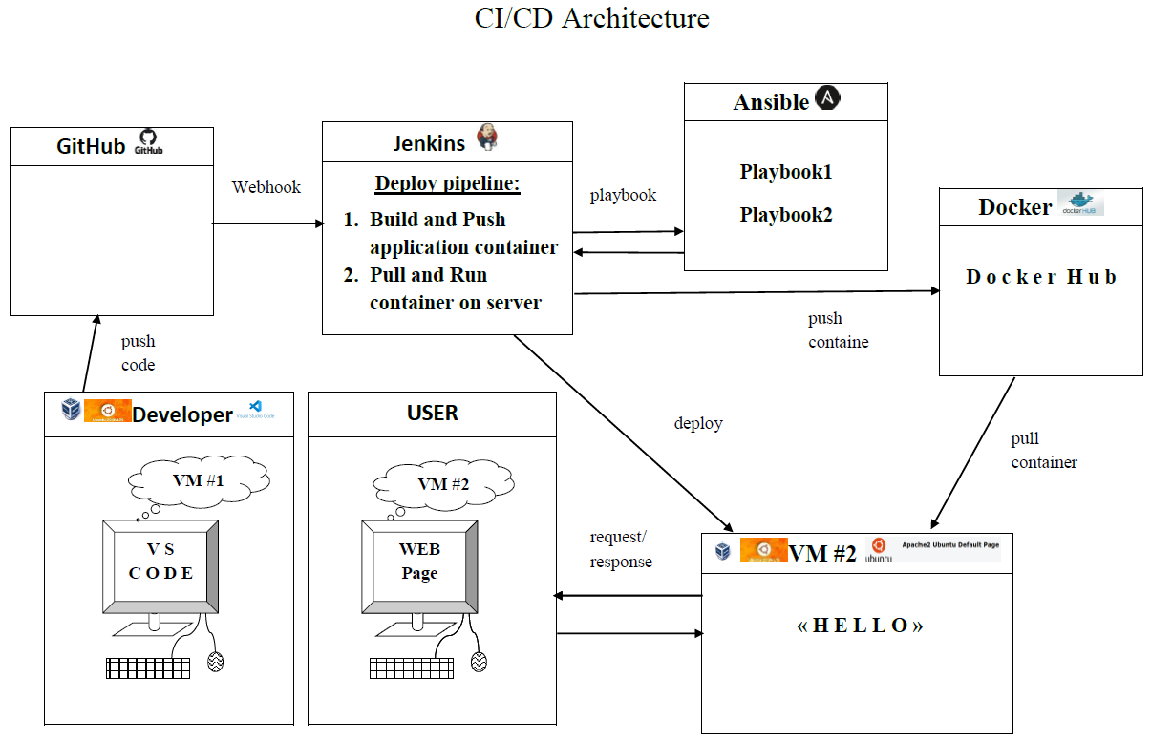

Slide 3
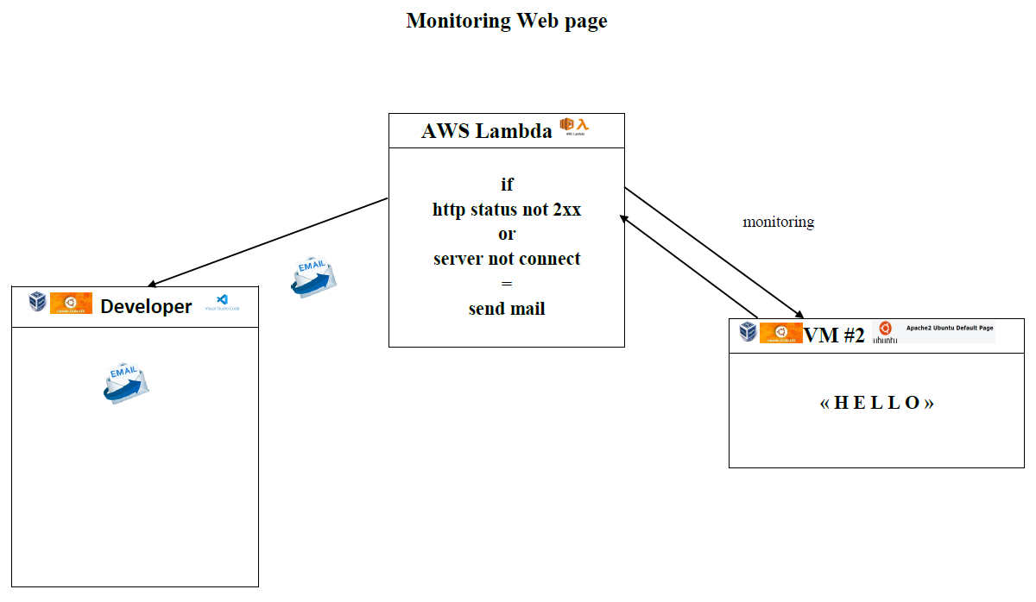

Slide 4
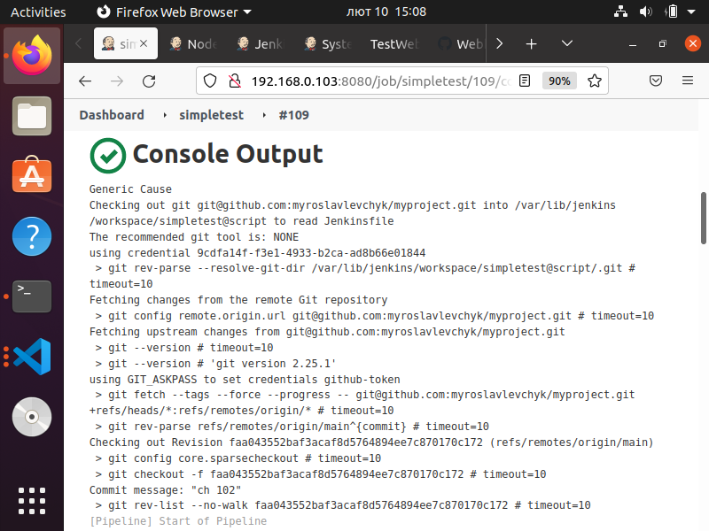
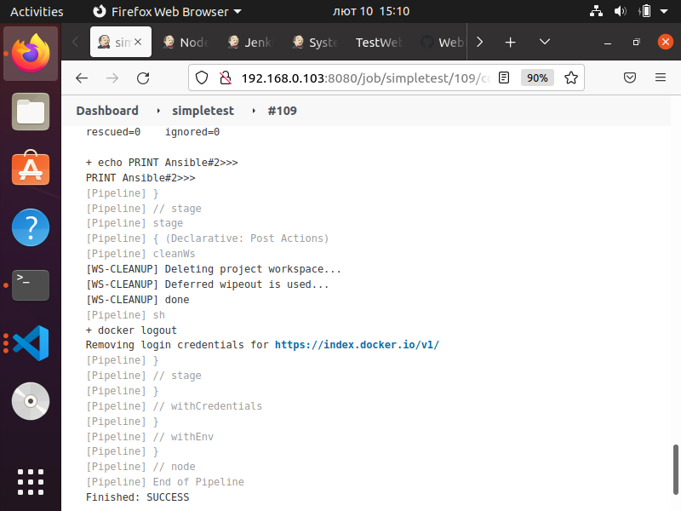

Slide 5
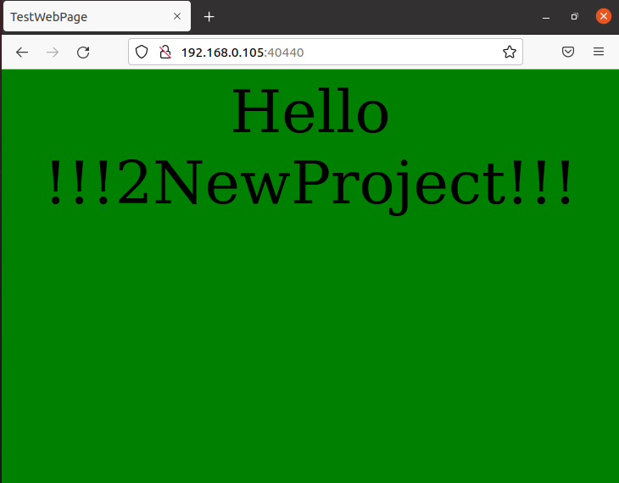

Slide 6
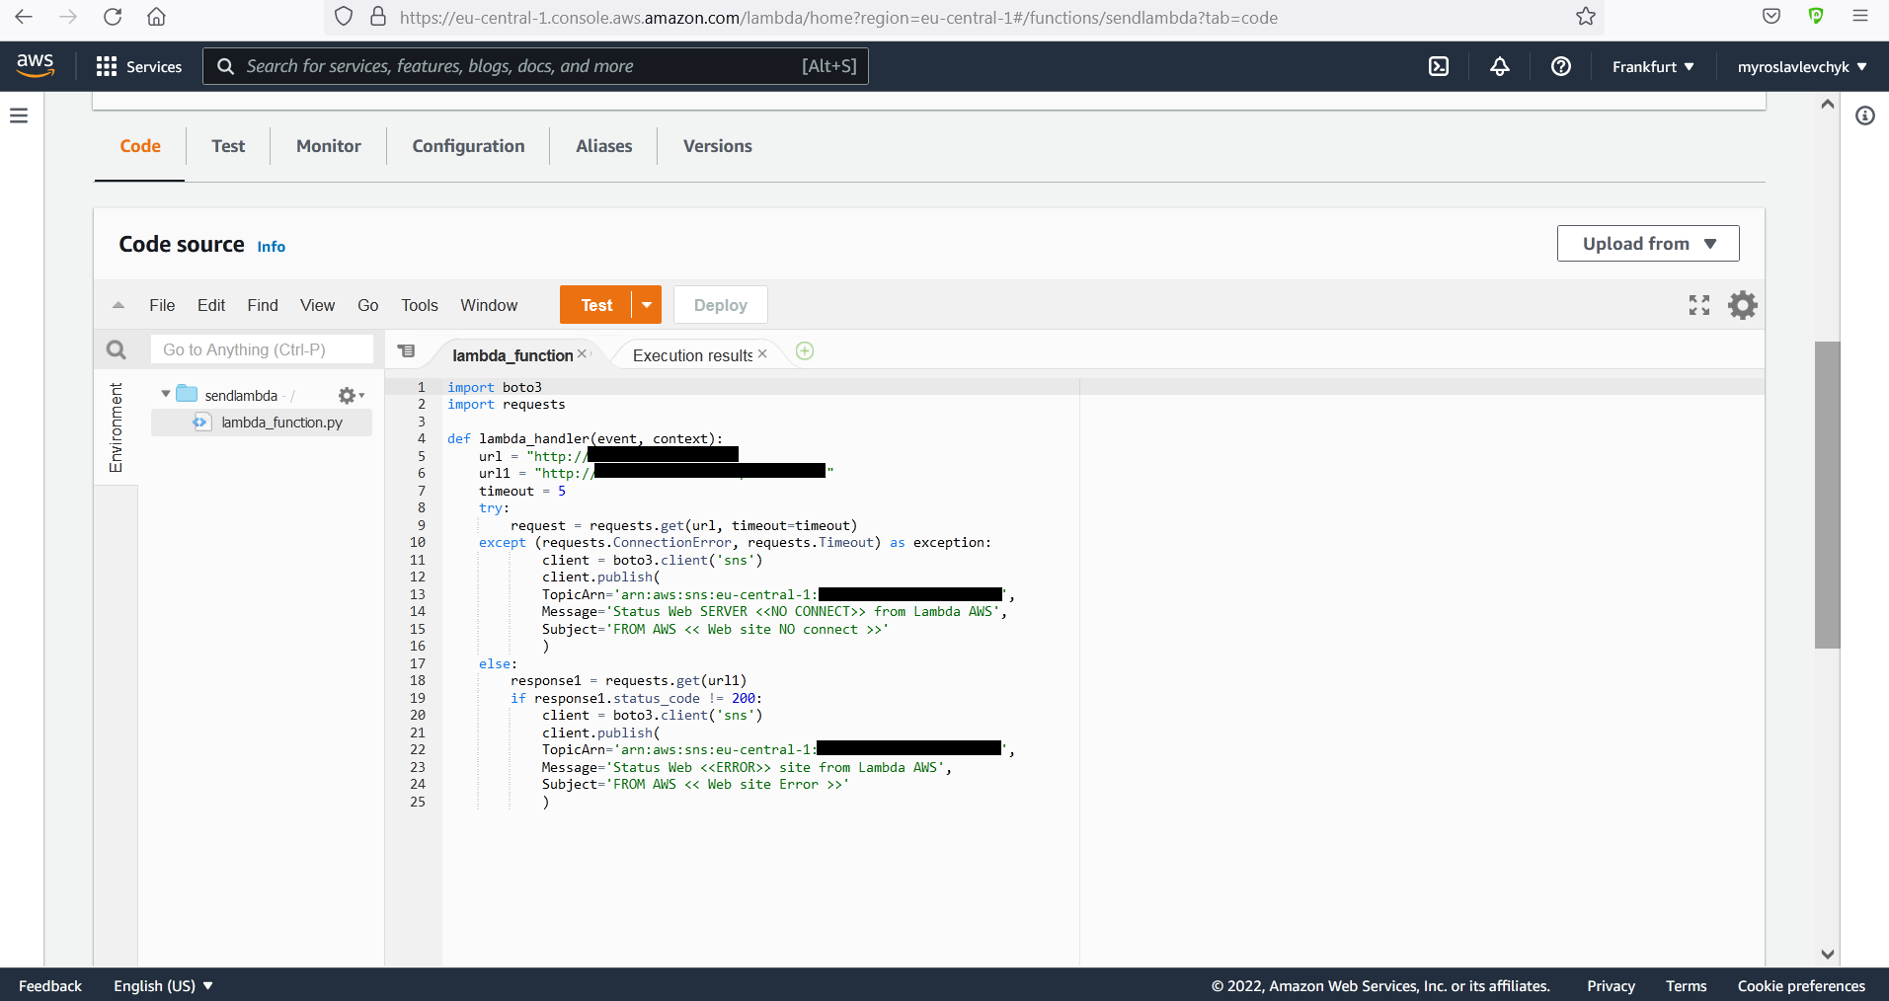

Slide 7
