Slide 1

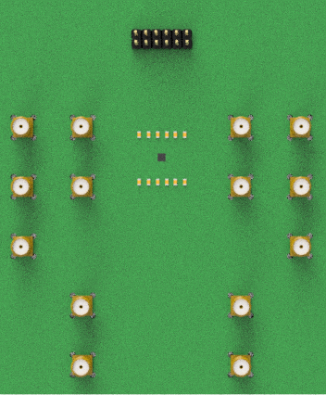

Universal-RF-PCB
Jiaqi Wang
Institut für CMOS Design
Technische Universität Braunschweig

Slide 2
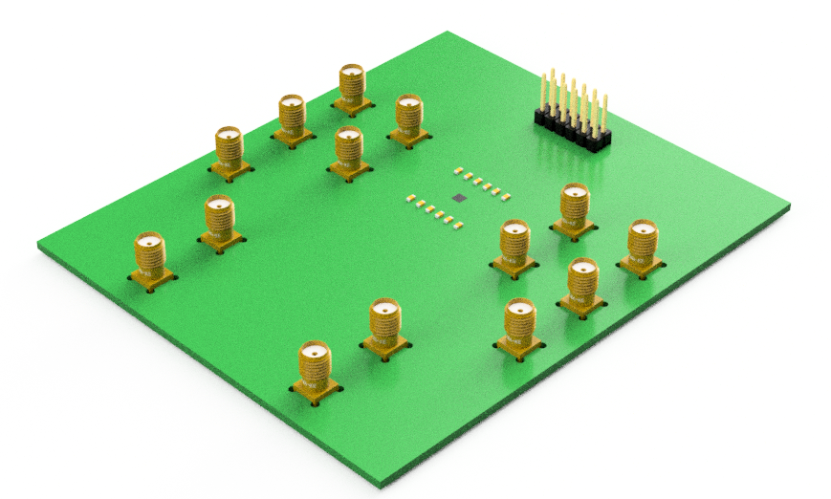
Overview of the borad
2mm x 2mm Chip
2 x 6 DC with 100nF Cap
4 Single RF
2 Differential

Slide 3
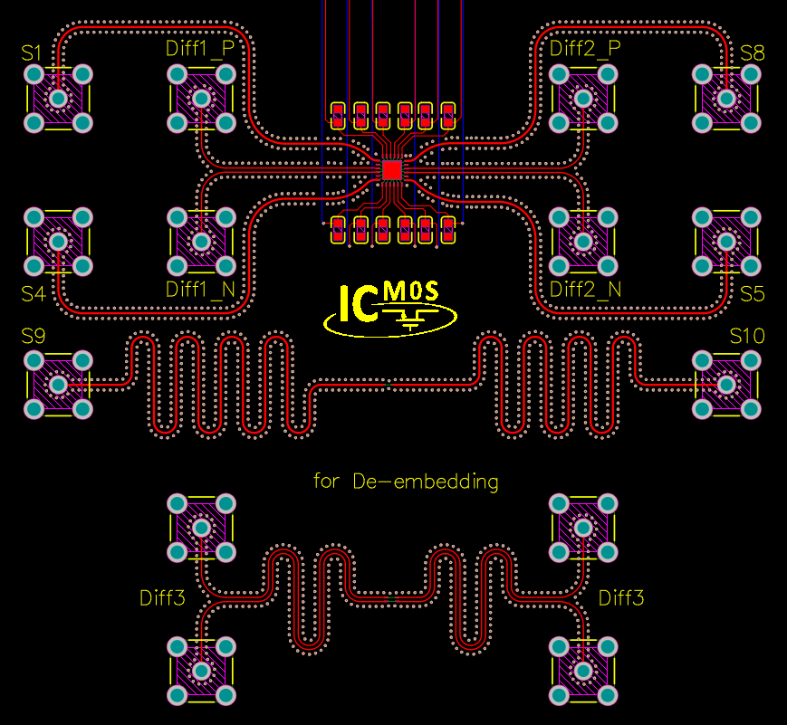
Circuit Architecture
S1, S4, S5, S8
used for Single RF(50 Ω)
Diff1, Diff2
used for Diff RF(100 Ω)
S9, S10, Diff3
used for Deembedding

Slide 4
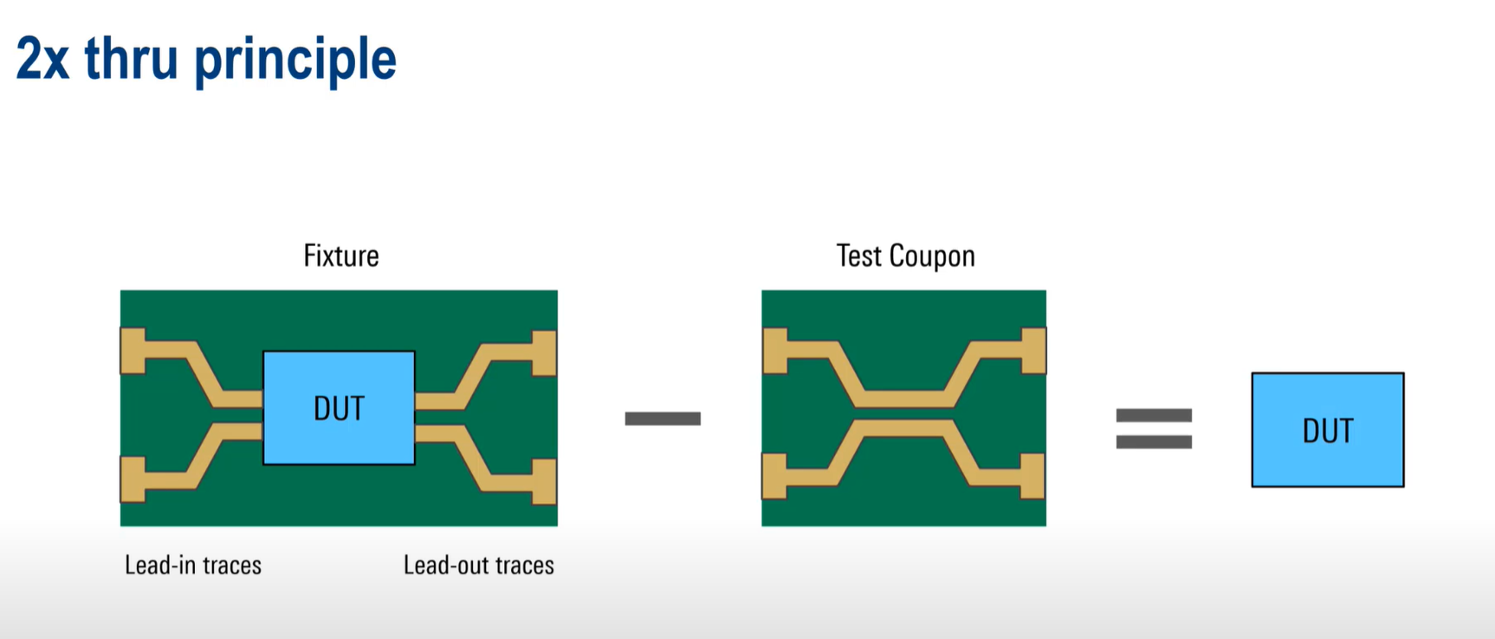
Deembedding

Slide 5
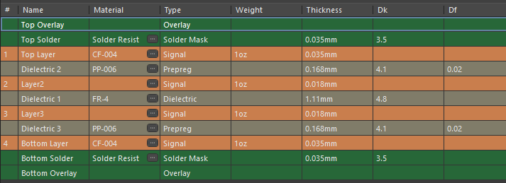
Layer Stack
4L-H01 (Rogers 4350B - 168µm core / FR4)

Slide 6
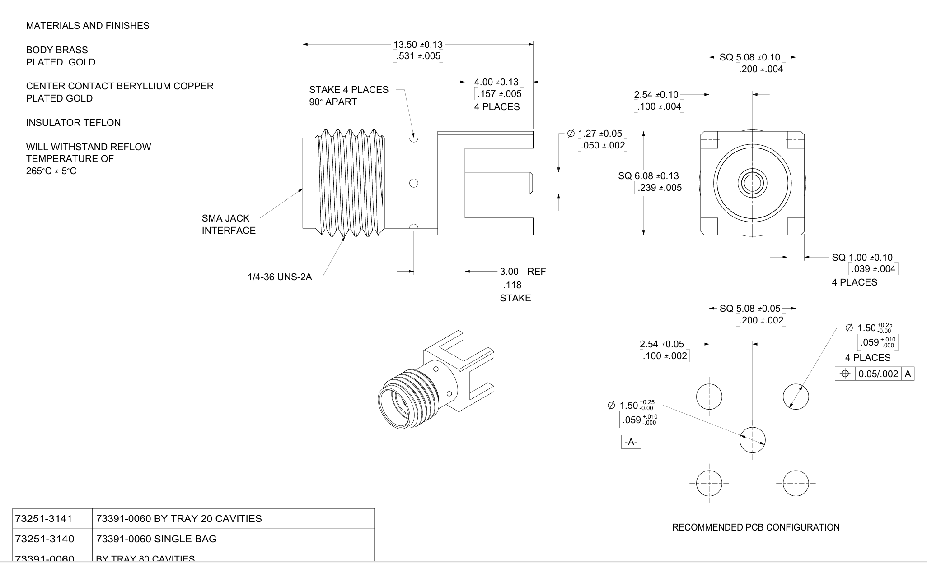
SMA Connector Details
Center to Center 15mm

