Slide 1
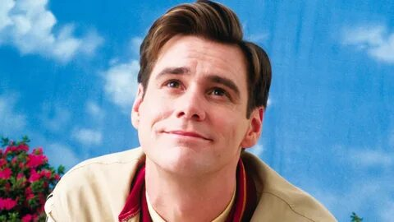
Truman show
My fav movie

Slide 2
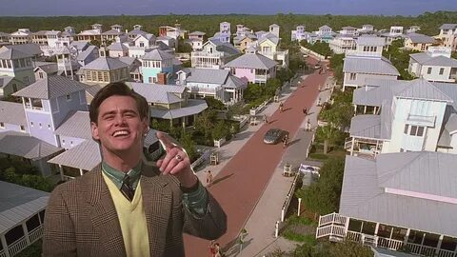
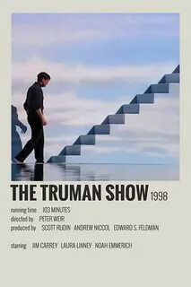
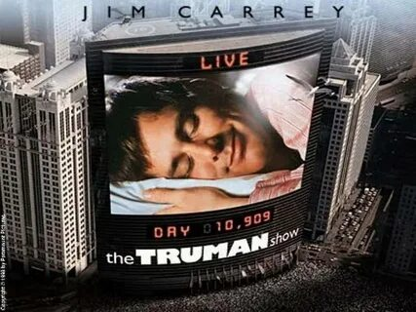
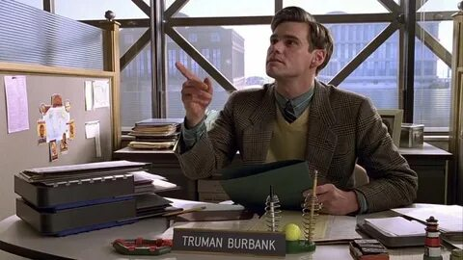
Welcome to The Truman Show, a reality show running 24 hours a day, 7 days a week,
without commercial breaks for 30 years! This is the most popular series in the history
of world TV. No special effects, no fake emotions - life is in front of you as it
is.
Truman Burbank is the star of this show, even though he doesn't know it himself, but everything that surrounds him
- his whole world is just a giant TV studio, crammed with TV cameras, scenery and
actors playing their role all their lives. Truman is real..

Slide 3
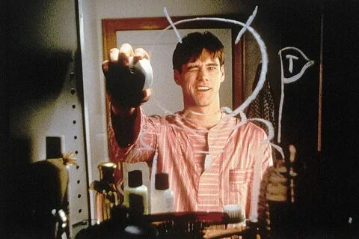
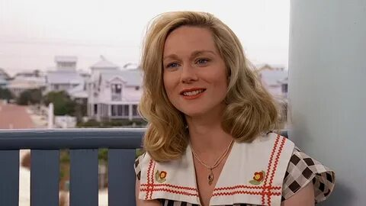
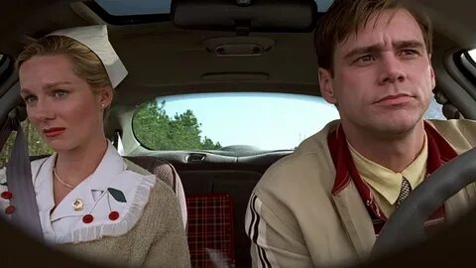
Truman Burbank has a very ordinary life: a wife, a house, an office. Having passed the thirty
-year mark, the hero begins to reflect more and more on his fate. By chance, he
meets Sylvia, who tells the man the truth: everything around is part of the show, a game,
and he is an actor who does not know about it. Burbank refuses to believe it, but
that's exactly the situation. Various inconsistencies and incidents convince the hero that the girl is right.

Slide 4

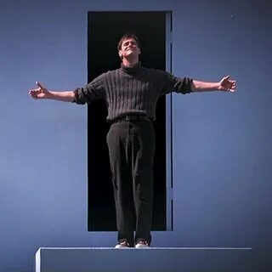
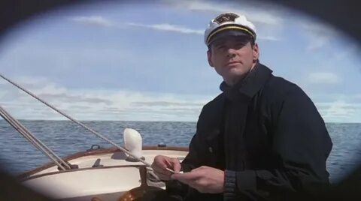
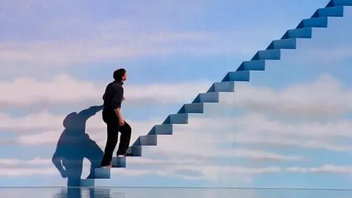
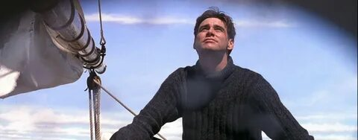
Having managed to trick the cameras, Truman goes to the yacht. The film crew directs all
the actors to search for the fugitive, but it is impossible to find him in the dark. Then director Christophe
decides to turn on "day". Persuasion, orders, and even an almost real storm do not
help bring the hero back. Soon the boat stops at the painted horizon.

Slide 5
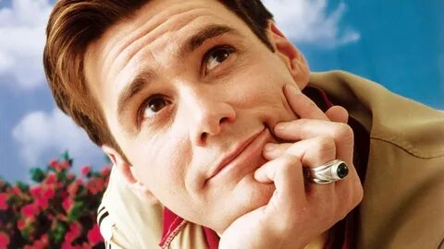
And what happened to the unfortunate Truman
when he was told that his whole life was a show?! Even the sea, even the sun in
his city, are artificial. And the sky on the horizon turned
out to be painted. His parents are actors. The "best friend" is given a text
that he dictates to Truman. He's trapped. He's a toy. When watching
, you live the whole movie with Truman, and it seems to me that
this is exactly what every director wants. And whether to be in Truman's place or not
is up to everyone to decide.

Slide 6
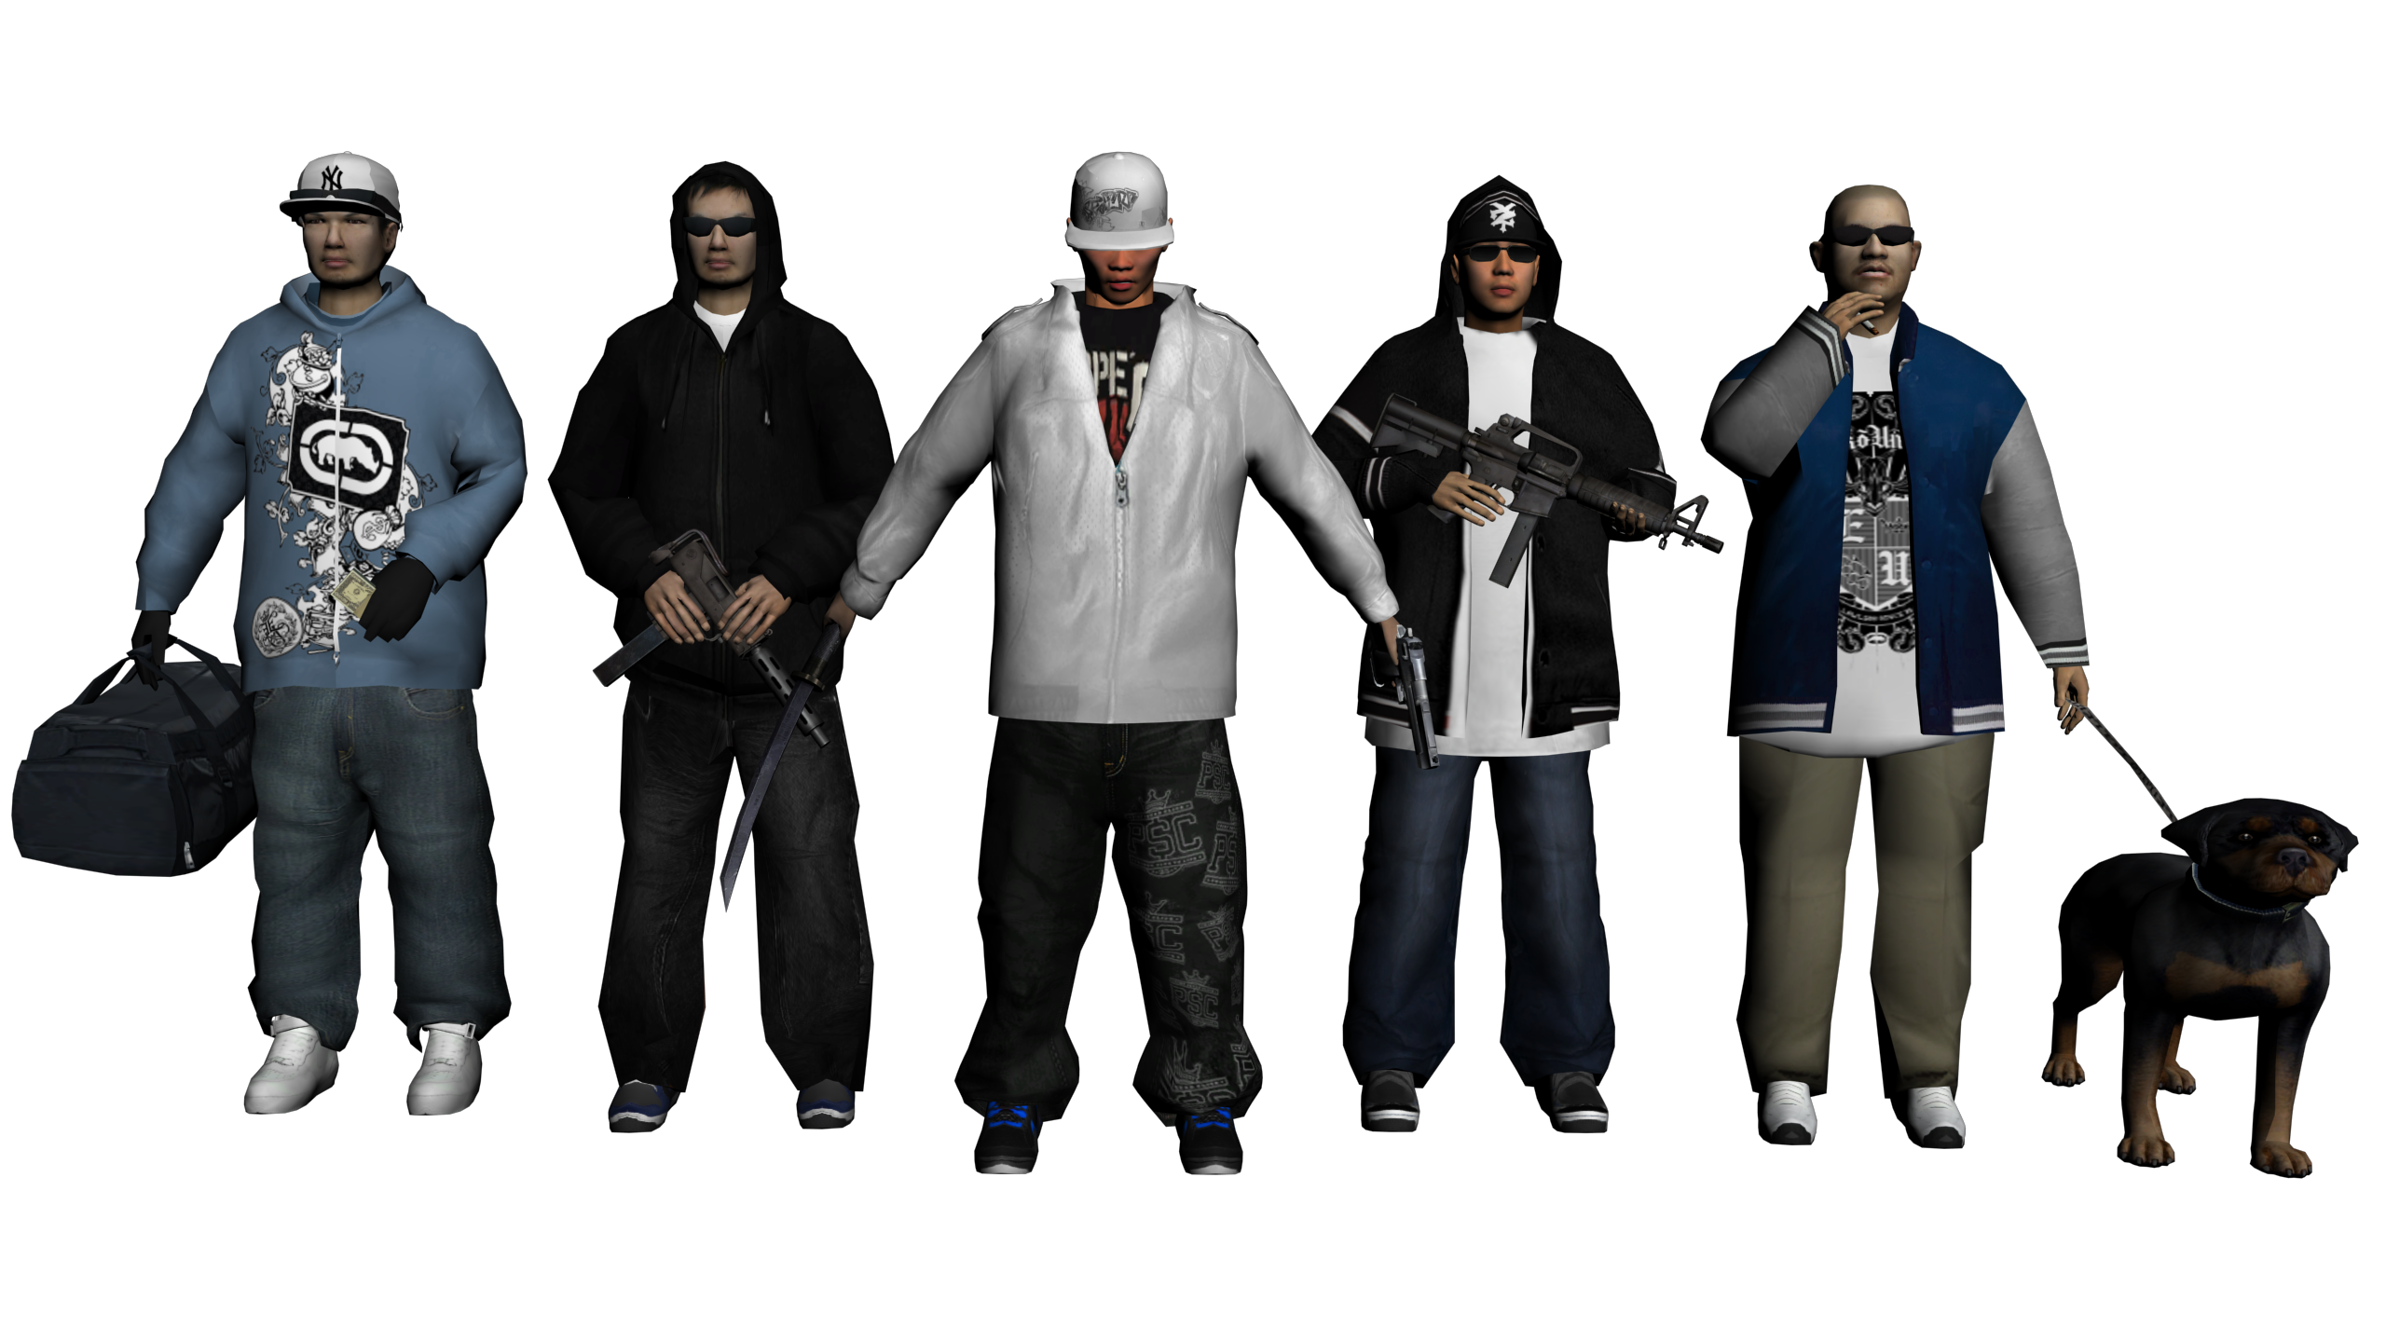
Thanks for attention

