Slide 1
Bluestock Mutual Fund Capstone
Final analytics narrative across ETL, EDA, performance, investor behavior, and dashboarding
Deliverables: report, deck, clean scripts, README, and zip submission
Prepared for myself-archita/Bluestock-Project
01

Slide 2
Problem & Objective
What the analysis answers
Measure downside risk with historical VaR and CVaR for all schemes.
Track whether 90-day rolling Sharpe stays strong over time.
Understand investor cohorts, SIP continuity, and at-risk behavior.
Translate analytics into a simple risk-appetite recommender.
Project objective
Turn raw mutual fund and investor data into a decision-ready analytics pack that can support product, risk, and investor-facing review.
02

Slide 3
Data Sources
Core datasets used in the capstone
Dataset | Purpose
nav_history_cleaned.csv | Daily NAV series used for returns, VaR/CVaR, and Sharpe calculations
fund_master_cleaned.csv | Scheme metadata, category, and risk grade
investor_transactions_cleaned.csv | Transaction-level investor behavior
portfolio_holdings.csv | Sector weights used for HHI concentration
rolling_sharpe.csv | Precomputed 90-day rolling Sharpe series
investor_cohort_analysis.csv | Cohort summary by first transaction year
The same processed tables also power the PDF report and the final recommender.
03

Slide 4
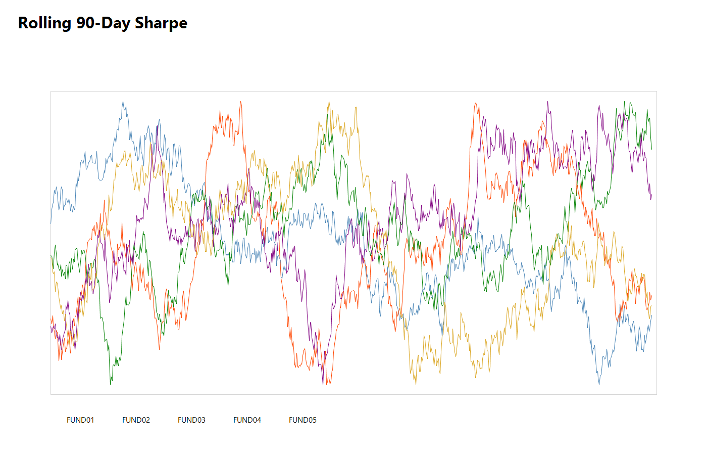
Architecture
ETL to analytics flow
Raw CSVs
ETL scripts
Processed data
Outputs
Cleaning and normalization
Metric computation
Notebook insights
PDF + PPTX publishing
04

Slide 5
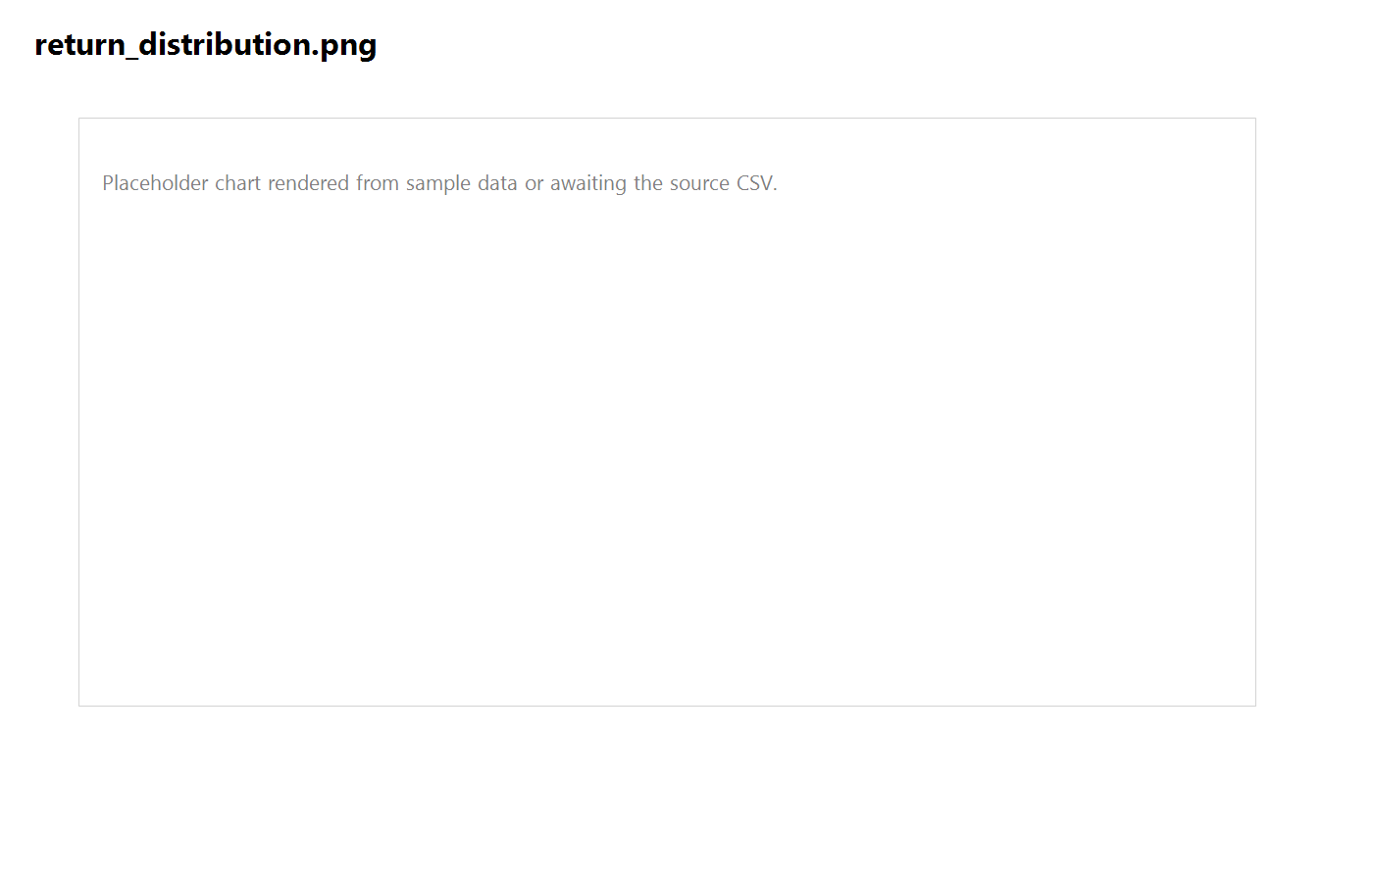
EDA Highlight 1
Fund risk distribution
Return distributions are visibly spread, showing that tail-risk matters for scheme selection.
Negative tails are meaningful enough that VaR and CVaR add value beyond average return.
FUND22 is the worst 95% VaR scheme in the processed results.
05

Slide 6
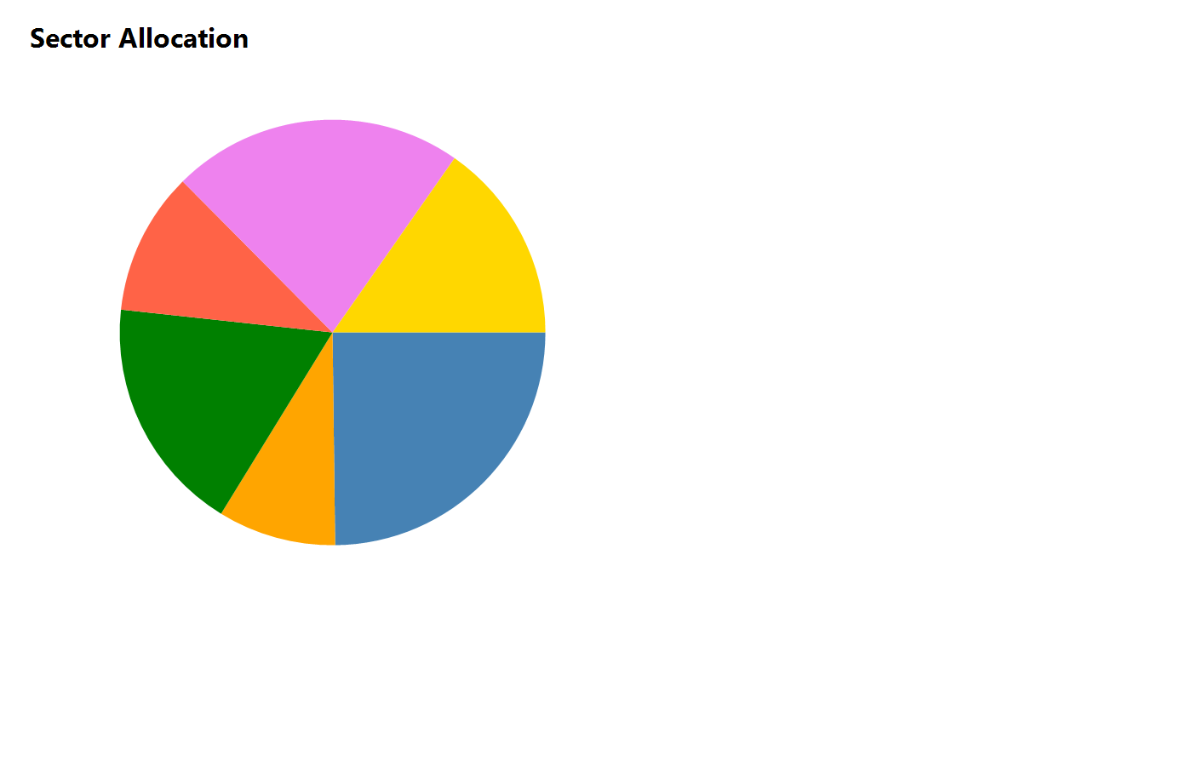
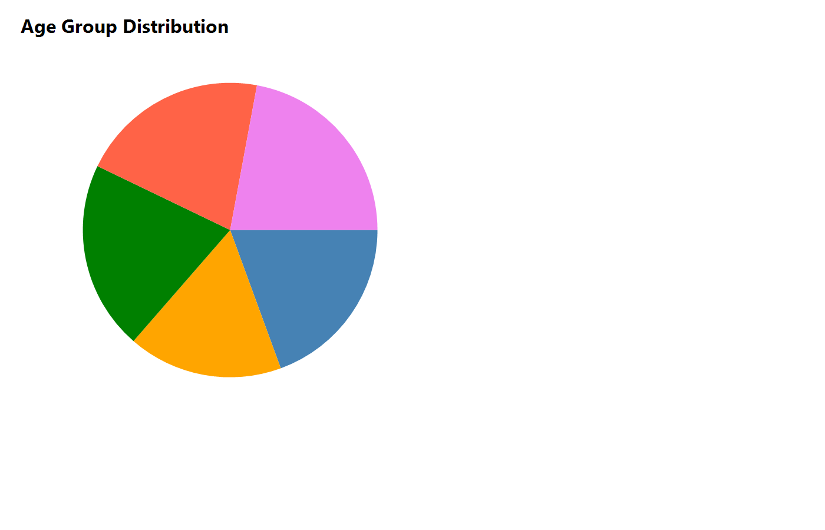
EDA Highlight 2
Investor segmentation and concentration
Equity concentration is moderate by HHI.
Investor age and geography views can support segmentation.
The main behavioral story is not a crisis; it is consistency.
06

Slide 7
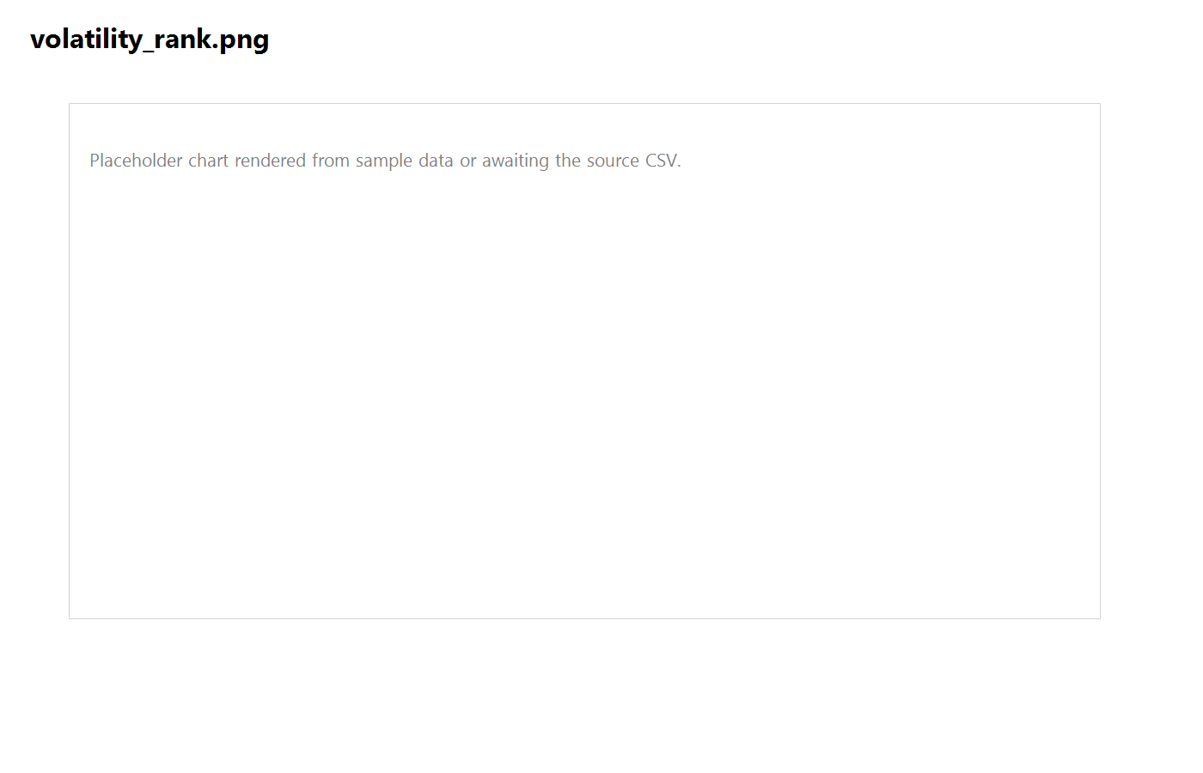
Performance Metrics
VaR / CVaR and scheme ranking
Top tail-risk schemes | VaR 95% | CVaR 95%
FUND22 | -1.8455% | -2.2950%
FUND23 | -1.7809% | -2.1218%
FUND19 | -1.7532% | -2.2384%
FUND35 | -1.7386% | -2.1213%
FUND11 | -1.7300% | -2.1423%
VaR identifies the threshold loss; CVaR describes the expected loss beyond that threshold.
07

Slide 8
Performance Metrics
Rolling Sharpe over time
Top rolling Sharpe consistency belongs to FUND17 and FUND30.
The chart helps separate persistent skill from short-term spikes.
Rolling windows are more informative than a single endpoint statistic.
08

Slide 9
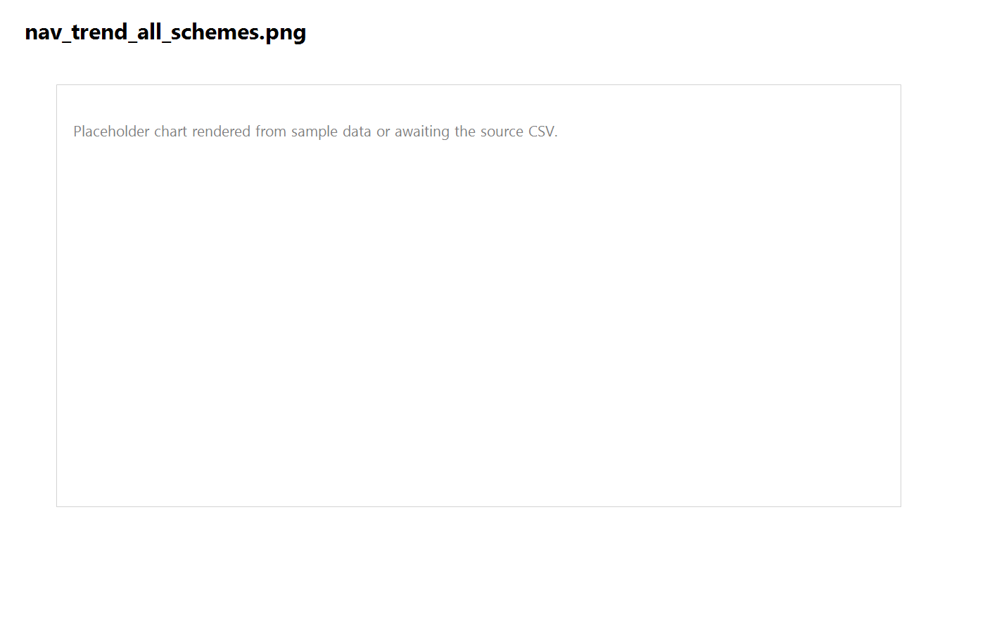
Dashboard Screenshot
NAV trend and benchmark overlay
09

Slide 10
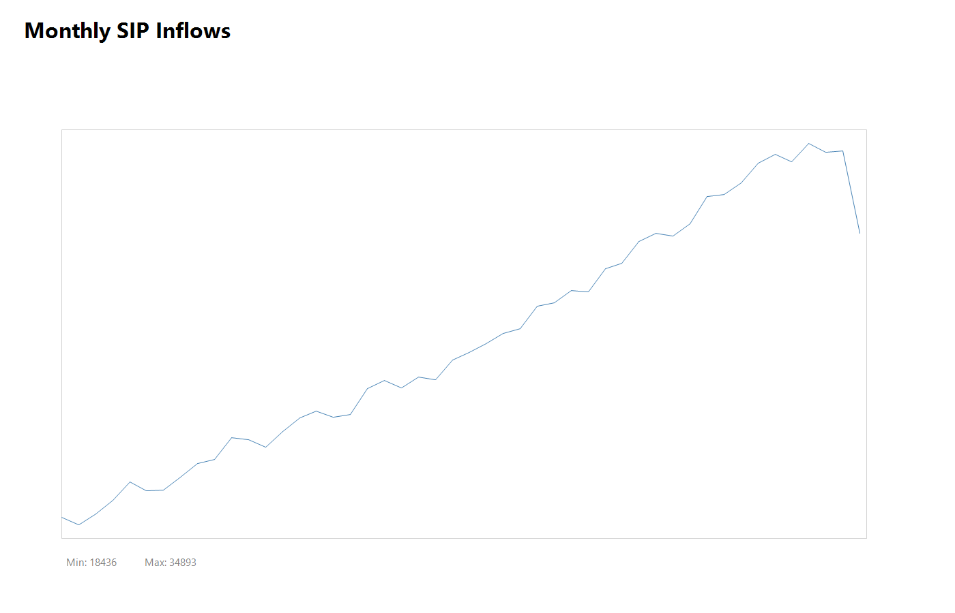
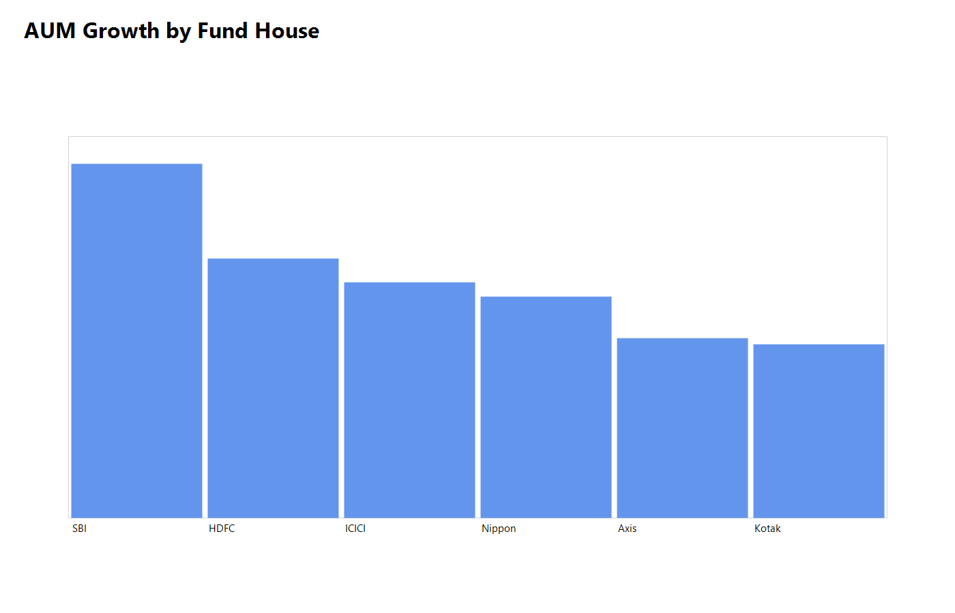
Dashboard Screenshot
SIP inflow and fund house growth
10

Slide 11
Key Findings
What matters most
Tail-risk is concentrated in a handful of funds, with FUND22 the most exposed.
Investor capital is most heavily represented in the 2025 cohort.
SIP continuity is healthy across the analyzed groups and no at-risk flag appears in the summary.
Equity sector concentration is moderate rather than extreme.
The report package is now organized for handoff and submission.
11

Slide 12
Thank You
Bluestock Mutual Fund Capstone ? final submission ready
12

