Slide 1
Tính ổn định HTĐKTĐ gián đoạn 14th Lecture, 9th Dec 2023 3rd September 2023
Giảng viên/Instructor:
Trung tá, ThS. Nguyễn Ngọc Hưng
Mobile Phone: 0968354050
Email: hungtd@mta.edu.vn

Slide 2
Mục đích, Yêu cầu
Mục đích
Determine the input-output stability of a z-transfer function.
Determine the asymptotic stability of a z-transfer function.
Determine the internal stability of a digital feedback control system.
Determine the stability of a z-polynomial using the Routh-Hurwitz criterion.
Determine the stability of a z-polynomial using the Jury criterion.
Determine the stable range of a parameter for a z-polynomial.
Determine the closed-loop stability of a digital system using the Nyquist criterion.
Determine the gain margin and phase margin of a digital system.
Yêu cầu
Chú ý nghe giảng
Làm lại các ví dụ và tự thực hiện các bài tập về nhà.
Sử dụng máy tính và matlab để kiểm chứng lý thuyết

Slide 3
Nội dung bài học
Khái niệm về tính ổn định
Mối quan hệ vị trí điểm cực và tính ổn định
Các điều kiện ổn định
Cách xác định tính ổn định hệ thống

Slide 4
Nội dung bài học
Khái niệm về tính ổn định
Mối quan hệ vị trí điểm cực và tính ổn định
Các điều kiện ổn định
Cách xác định tính ổn định hệ thống

Slide 5
Definitions of stability
Asymptotic stability
Marginal stability
Input-output stability
Notes:
4.1 Definitions of stability The most commonly used definitions of stability are based on the magnitude of the system response in the steady state. If the steady-state response is unbounded, the system is said to be unstable. In this lecture, we discuss two stability definitions that concern the boundedness or exponential decay of the system output. The first stability definition considers the system output due to its initial conditions. To apply it to transfer function models, we need the assumption that no pole-zero cancellation occurs in the transfer function.

Slide 6
Asymptotic stability
Asymptotic stability: Response due to any initial conditions decays to zero asymptotically in the steady state
min
0
max

Slide 7
Marginal stability
Marginal stability: response due to any initial conditions remains bounded but does not decay to zero
max
0

Slide 8
Unstable stability
min
0
max

Slide 9
Bounded-Input-Bounded-Output (BIBO) Stability
BIBO stability: Response due to any bounded input remains bounded
Notes:
Input: u(k)
Output: y(k)

Slide 10
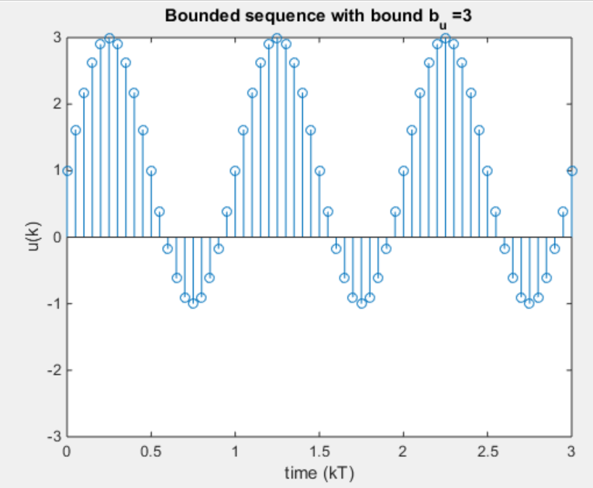
Bounded-Input-Bounded-Output (BIBO) Stability
% MATLAB
close all, clear all, clc;
t = 0:3/60:3;
y =2*sin(2*pi*t);
y_add_offset = y+1;
stem(t,y_add_offset)
title('Bounded sequence with bound b_u=3');
xlabel('time (kT)');
ylabel('u(k)');
axis([0 3 -3 3]);

Slide 11
Nội dung bài học
Khái niệm về tính ổn định
Mối quan hệ vị trí điểm cực và tính ổn định
Các điều kiện ổn định
Cách xác định tính ổn định hệ thống

Slide 12
Stable z-domain pole locations (1)
The sampled exponential and its z-transform
Time sequence for large k
Any time sequence
(4.6)
Notes:
The locations of the poles of the system z-transfer function determine the time response. The implications of this fact for system stability are now examined more closely

Slide 13
Stable z-domain pole locations (2)
Bounded sequence: if its poles lie in the closed unit disc (i.e., on or inside the unit circle) and decays exponentially if its poles lie in the open unit disc (i.e., inside the unit circle) due to any bounded input remains bounded
Image
z-plane
unstable
real
Stable
Notes:
Note 1: Note that the case of repeated poles on the unit circle corresponds to an unbounded time sequence (see, for example, the transform of the sampled ramp)
Note 2: the preceding conclusion is valid for complex as well as real-time sequences, we will generally restrict our discussions to real-time sequences. For real-time sequences, the poles and partial fraction coefficients in Eq. (4.6) are either real or complex conjugate pairs.

Slide 14
Nội dung bài học
Khái niệm về tính ổn định
Mối quan hệ vị trí điểm cực và tính ổn định
Các điều kiện ổn định
Cách xác định tính ổn định hệ thống

Slide 15
Stability conditions
Asymptotic stability
BIBO stability
Internal stability
Notes:
The derivation of conditions for asymptotic and BIBO stability based on transfer function models. It is shown that, in the absence of pole-zero cancellation, conditions for BIBO stability and asymptotic stability are identical

Slide 16
Asymptotic stability (1)
Theorem 4.1
Asymptotic stability: In the absence of pole-zero cancellation, an LTI digital system is asymptotically stable if its transfer function poles are in the open unit disc and marginally stable if the poles are in the closed unit disc with no repeated poles on the unit circle
Proof
LTI system
Điều kiện ban đầu

Slide 17
Asymptotic stability (2)
Proof
Using the z-transform of the output, we observe that the response of the system due to the initial conditions with the input zero
N(z) is a polynomial dependent on the initial conditions
Hàm ảnh Y(z) có các đặc điểm sau:
+ transfer function zeros arise from transforming the input terms, they have no influence on the response due to the initial conditions
+ The denominator of the output z-transform is the same as the denominator of the z-transfer function in the absence of pole-zero cancellation
+ the poles of the function Y(z) are the poles of the system transfer function
Notes:
Theorem 4.1 applies even if pole-zero cancellation occurs, provided that the poles that cancel are stable. This follows from the fact that stability testing is essentially a search for unstable poles, with the system being declared stable if none are found. Invisible but stable poles would not lead us to a wrong conclusion. However, invisible but unstable poles would

Slide 18
Asymptotic stability (3)
The output due to the initial conditions is bounded for system poles in the closed unit disc with no repeated poles on the unit circle. It decays exponentially for system poles in the open unit disc (i.e., inside the unit circle)
Examples
% Asymtotic Stablily
syms z;
%% Ha
Ha = 4*(z-2)/((z-2)*(z-0.1));
y = iztrans(Ha)
%% Hb
Hb = 4*(z-0.2)/((z-0.2)*(z-0.1));
y = iztrans(Hb)
%% Hc
Hc = 5*(z-0.3)/((z-0.2)*(z-0.1));
y = iztrans(Hc)
%% Hd
Hd = 8*(z-0.2)/((z-0.1)*(z-1));
y = iztrans(Hd)
Notes:
Theorem 4.1 can only be used for transfer functions (a) and (b) if their poles and zeros are not canceled. Ignoring the zeros, which do not affect the response to the initial conditions, (a) has a pole outside the unit circle and the poles of (b) are inside the unit circle. Hence, (a) is unstable, whereas (b) is asymptotically stable.
Theorem 4.1 can be applied to the transfer functions (c) and (d). The poles of (c) are all inside the unit circle, and the system is therefore asymptotically stable. However, (d) has one pole on the unit circle and is only marginally stable

Slide 19
BIBO stability
BIBO stability concerns the response of a system to a bounded input
The response of the system to any input is given by the convolution summation
(4.7)
h(k) - the impulse response sequence
Notes:
Note: It may seem that a system should be BIBO stable if its impulse response is bounded. To show that this is generally false. Chứng minh ở slide kế tiếp (nếu thời gian cho phép) còn không, chỉ nói đến đây

Slide 20
BIBO stability
Let the impulse response of a linear system be bounded and strictly positive with lower bound bh₁ and upper bound bh₂
Reapply to (4.7)
which is unbounded as k tiến đến vô cùng nếu tác động đầu vào là tín hiệu bị chặn được xác định như sau:
Notes:
Chứng minh nhận định sai

Slide 21
BIBO stability
Theorem 4.2
A discrete-time linear system is BIBO stable if and only if its impulse response sequence is absolutely summabled, that is,
(4.10)
Proof
1. Necessity (only if) To prove necessity by contradiction
2. Sufficiency (if) To prove sufficiency, we assume that (4.10) is satisfied and then show that
the system is BIBO stable
Notes:
Điều kiện cần chứng minh bằng phản chứng
Điều kiện đủ chứng minh bằng logic
Có thời gian, chứng minh ở 2 slides kế tiếp

Slide 22
BIBO stability
Proof
1. Necessity (only if) Ta chứng minh bằng phản chứng.
Giả sử hệ thống ổn định BIBO, song không thoả mãn (4.10)
Chọn tín hiệu đầu vào có dạng
The corresponding output is
which is unbounded as
Mâu thuẫn với giả thiết là hệ ổn định BIBO

Slide 23
BIBO stability
Proof
2. Sufficiency (if)
To prove sufficiency, we assume that (4.10) is satisfied and then show that the system is BIBO stable
The inequality
Rõ ràng ta thấy bị chặn.

Slide 24
BIBO stability
Theorem 4.3
A discrete-time linear system is BIBO stable if and only if the poles of its transfer function lie inside the unit circle
Proof
Necessity (only if):
+ The impulse response and transfer function shows that the impulse response is bounded if the poles of the transfer function are in the closed unit disc and decays exponentially if the poles are in the open unit disc.
+ It has already been established that systems with a bounded impulse response that does not decay exponentially are not BIBO stable. Thus, for BIBO stability, the system poles must lie inside the unit circle
Notes:
Applying (4.6) to the impulse response and transfer function shows that the impulse response is bounded if the poles of the transfer function are in the closed unit disc and decays exponentially if the poles are in the open unit disc. It has already been established that systems with a bounded impulse response that does not decay exponentially are not BIBO stable. Thus, for BIBO stability, the system poles must lie inside the unit circle.

Slide 25
BIBO stability
Proof
2. Sufficiency (if): assume an exponentially decaying impulse response (i.e., poles inside the unit circle). Let A_{r} be the coefficient of largest magnitude and |p_{s}|<1 be the system pole of largest magnitude in (4.6). Then the impulse response (assuming no repeated poles for simplicity) is bounded by

Slide 26
BIBO stability
Ví dụ 4.2: FIR
Investigate the BIBO stability of the class of systems with the impulse response
where K is a finite constant.
Solution
The impulse response satisfies
FIR systems are all BIBO stable
Notes:
This is the class of finite impulse response (FIR) systems (i.e., systems whose impulse response is nonzero over a finite interval). Thus, we conclude that all FIR systems are BIBO stable

Slide 27
BIBO stability
Ví dụ 4.3
Investigate the BIBO stability
Notes:
+ After pole-zero cancellation, the transfer functions (a) and (b) have all poles inside the unit circle and are therefore BIBO stable
+ The transfer function (c) has all poles inside the unit circle and is stable; (d) has a pole on the unit circle and is not BIBO stable

Slide 28
BIBO stability
Kết luận
+ BIBO and asymptotic stability are equivalent and can be investigated using the same tests (no zero-pole cancelation)
Image
z-plane
unstable
real
Stable
Notes:
The preceding analysis and examples show that for LTI systems, with no pole-zero cancellation, BIBO and asymptotic stability are equivalent and can be investigated using the same tests. Hence, the term stability is used in the sequel to denote either BIBO or asymptotic stability with the assumption of no unstable pole-zero cancellation. Pole locations for a stable system (inside the unit circle) are shown in Fig. 4.2.

Slide 29
Internal stability
the stability of the closed-loop transfer function is not always sufficient for proper system operation because some of the internal variables may be unbounded
In a feedback control system, it is essential that all the signals in the loop be bounded when bounded exogenous inputs are applied to the system
+
+
+
-
Notes:
+ we have only considered stability as applied to an open-loop system. For closed-loop systems, these results are applicable to the closed-loop transfer function
+

Slide 31
Internal stability
+
+
+
-
It is not sufficient to prove that the output of the controlled system Y is bounded for bounded reference input R because the controller output U can be unbounded.
The system output must be bounded when a different input is applied to the system namely, in the presence of a disturbance
Notes:
+ we have only considered stability as applied to an open-loop system. For closed-loop systems, these results are applicable to the closed-loop transfer function
+

Slide 32
Internal stability
+
+
+
-
Notes:
+ we have only considered stability as applied to an open-loop system. For closed-loop systems, these results are applicable to the closed-loop transfer function
+

Slide 33
Internal stability
Internal stability: If all the transfer functions that relate system inputs (R and D) to the possible system outputs (Y and U) are BIBO stable, then the system is said to be internally stable.
The stability of the closed-loop transfer function is not always sufficient for proper system operation because some of the internal variables may be unbounded
In a feedback control system, it is essential that all the signals in the loop be bounded when bounded exogenous inputs are applied to the system
Notes:
+ we have only considered stability as applied to an open-loop system. For closed-loop systems, these results are applicable to the closed-loop transfer function
+ In addition, the system output must be bounded when a different input is applied to the system - namely, in the presence of a disturbance

Slide 34
Internal stability
Theorem 4.3
The system is internally stable if and only if all its closed-loop poles are in the open unit disc.
Proof
1. Necessity (only if)
we write C(z) and G_{ZAS}(z)
Notes:
If the system is internally stable, then the four transfer functions in (4.11) have no poles on or outside the unit circle. Because of the factorization of (4.12) is coprime, the polynomial DCDG þ NCNG has no zeros that cancel with all four numerators. Thus, the polynomial has no zeros on or outside the unit circle

Slide 35
Internal stability
Theorem 4.4
The system is internally stable if and only if all its closed-loop poles are in the open unit disc.
Proof
2. Sufficiency (if)
It is evident that if the characteristic polynomial D_{C}D_{G} + N_{C}N_{G}
has no zeros on or outside the unit circle, then all the transfer functions are asymptotically stable and the system is internally stable

Slide 36
Internal stability
Theorem 4.5
The system is internally stable if and only if the following two conditions hold:
1. The characteristic polynomial 1 +C(z)G_{ZAS}(z) has no zeros on or outside the unit circle.
2. The loop gain C(z)G_{ZAS}(z) has no pole-zero cancellation on or outside the unit circle
Proof
1. Necessity (only if)
2. Sufficiency (if)

Slide 37
Internal stability
Proof
Necessity (only if)
+ Condition 1 is clearly necessary by Theorem 4.4.
+ Necessity of condition 2 (chứng minh phản chứng)
the characteristic polynomial

Slide 38
Internal stability
Proof
Necessity (only if)
the characteristic polynomial
We assume that there exists which is a zero of D_{C}D_{G} as well as a zero of N_{C}N_{G}
Then clearly Z₀ is also a zero of the characteristic polynomial D_{C}D_{G} +N_{C}N_{G}, and the system is unstable
This establishes the necessity of condition 2

Slide 39
Internal stability
Proof
Sufficiency (if)
+ By Theorem 4.4, condition 1 implies internal stability unless unstable pole-zero cancellation occurs in the characteristic polynomial 1 + C(z)G_{ZAS}(z). We therefore have internal stability if condition 2 implies the absence of unstable pole-zero cancellation.
+ If the loop gain C(z)G_{ZAS}(z) =N_{C}N_{G}/D_{C}D_{G} has no unstable pole-zero cancellation, then 1+C(z)G_{ZAS}(z)=[D_{C}D_{G} + N_{C}N_{G}]/D_{C}D_{G} does not have unstable pole-zero cancellation, and the system is internally stable.

Slide 40
Stability Condition
Example 4.3
1. Xác định G_{ZAS}(z) với T = 0.1
2. Kiểm tra tính ổn định internal stability của hệ thống

Slide 41
Stability Condition
Example 4.3
1. Xác định G_{ZAS}(z) với T = 0.1
Condition 2 of Theory 4.5
Notes:
+ The system appears to be asymptotically stable with all its poles inside the unit circle + the system is not internally stable there is a pole of 1.334

Slide 42
Nội dung bài học
Khái niệm về tính ổn định
Mối quan hệ vị trí điểm cực và tính ổn định
Các điều kiện ổn định
Cách xác định tính ổn định hệ thống

Slide 43
Stability determination
Using Numerical Method ( MATLAB)
Tiêu chuẩn Routh-Hurwitz
Tiêu chuẩn Jury
Tiêu chuẩn Nyquist

Slide 44
Stability determination
Using Numerical Method ( MATLAB)
Tiêu chuẩn Routh-Hurwitz
Tiêu chuẩn Jury
Tiêu chuẩn Nyquist

Slide 45
Using Numerical Method (MATLAB)
clear all, close all, clc
pole(gd); % if using transfer function
roots(gd.den); % using polynomial
abs(pole(gd) % Calculate magnitude of all roots
abs(roots(gd)) % Calculate magnitude of all roots

Slide 46
Stability determination
Using Numerical Method ( MATLAB)
Tiêu chuẩn Routh-Hurwitz
Tiêu chuẩn Jury
Tiêu chuẩn Nyquist

Slide 47
Tiêu chuẩn Routh-Hurwitz
Phép biến đổi song tuyến tính
Tiêu chuẩn ổn định đại số

Slide 48
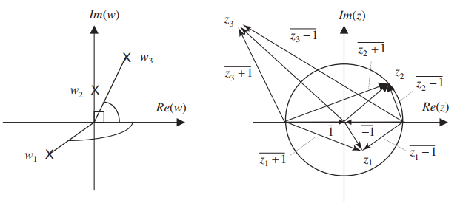
Phép biến đổi song tuyến tính
The angle of w after bilinear transformation is
Notes:
+ the angle of w is of a magnitude greater than 90 degrees, which corresponds to points in the LHP
+ For a point on the unit circle, the angle is +, - 90 degrees, which corresponds to points on the imaginary axis
+ points outside the unit circle, the magnitude of the angle is less than 90 degrees, which corresponds to points in the RHP

Slide 49
Tiêu chuẩn ổn định Routh-Hurwitz
For the general z-polynomial, we have the transform pair
Notes:
The bilinear transformation allows the use of the Routh-Hurwitz criterion for the investigation of discrete-time system stability

Slide 50
Tiêu chuẩn ổn định Routh-Hurwitz
The Routh-Hurwitz approach becomes progressively more difficult as the order of the z-polynomial increases
For high-order polynomials, a symbolic manipulation package can be used to perform the necessary algebraic manipulations
Notes:
The bilinear transformation allows the use of the Routh-Hurwitz criterion for the investigation of discrete-time system stability

Slide 51
Tiêu chuẩn ổn định Routh-Hurwitz
Ví dụ 4.5: Xác định tính ổn định
1. Đa thức bậc nhất
2. Đa thức bậc hai
Lời giải: Tìm nghiệm của phương trình và xác định điều kiện để biên độ <1
1. Đa thức bậc nhất
2. Đa thức bậc hai
Notes:
+ it is not easy to determine the stability of the second-order polynomial by solving for its roots.
+ Substituting the bilinear transformation in the second-order polynomial gives

Slide 52
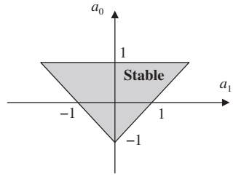
Tiêu chuẩn ổn định Routh-Hurwitz
Using bilinear transformation: for 2nd order equation
Apply Routh- Hurwitz for w
Notes:
Without loss of generality, the coefficient a₂ can be assumed to be unity, and the stable parameter range can be depicted in the a₀ versus a₁ parameter plane

Slide 53
Stability determination
Using Numerical Method ( MATLAB)
Tiêu chuẩn Routh-Hurwitz
Tiêu chuẩn Jury
Tiêu chuẩn Nyquist

Slide 54
Tiêu chuẩn ổn định Jury
It is possible to investigate the stability of z-domain polynomials directly
Jury test for real coefficients
Schur-Cohn test for complex coefficients
The Jury test Procedure
Theorem 4.6
The Jury test Procedure
Notes:
+ These tests involve determinant evaluations as in the Routh-Hurwitz test for s-domain polynomials but are more time-consuming.
+ the roots of the polynomial are inside the unit circle if and only if (Jury)

Slide 55
Jury Test Procedure
the roots of the polynomial are inside the unit circle if and only if

Slide 56
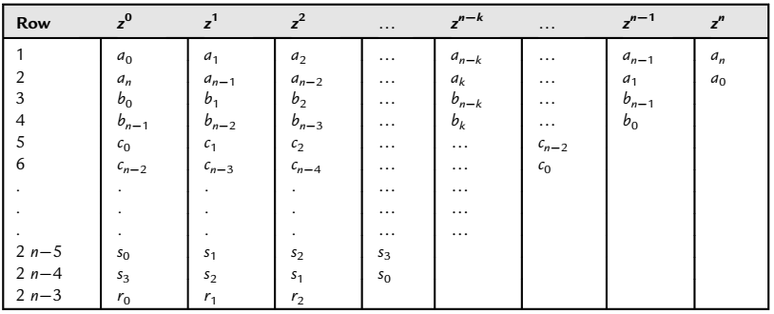
Jury Test Procedure
Jury table

Slide 57
Jury Test Procedure
The entries of the table are calculated as follows:

Slide 58
Jury Test Procedure
The first row of the Jury table is a listing of the coefficients of the polynomial F(z) in order of increasing power of z.
The number of rows of table 2 n3 is always odd, and the coefficients of each even row are the same as the odd row directly above it with the order of the coefficients reversed
There are n + 1 conditions in (4.22) that correspond to the n+1 coefficients of F(z)
Condition 3 through n + 1 of (4.22) are calculated using the coefficient of the first column of the Jury table together with the last coefficient of the preceding row. The middle coefficient of the last row is never used and need not be calculated
Conditions 1 and 2 of (4.22) are calculated from F(z) directly. If one of the first two conditions is violated, we conclude that F(z) has roots on or outside the unit circle without the need to construct the Jury table or test the remaining conditions

Slide 59
Jury Test Procedure
Condition 3 of (4.22), with a_{n}= 1, requires the constant term of the polynomial to be less than unity in magnitude. The constant term is simply the product of the roots and must be smaller than unity for all the roots to be inside the unit circle.
Condition (4.22) reduce to conditions (4.19) and (4.20) for first and second-order systems, respectively, where the Jury table is simply one row
For higher-order systems, applying the Jury test by hand is laborious, and it is preferable to test the stability of a polynomial F(z) using a computer-aided design (CAD) package
If the coefficients of the polynomial are functions of system parameters, the Jury test can be used to obtain the stable ranges of the system parameters

Slide 60
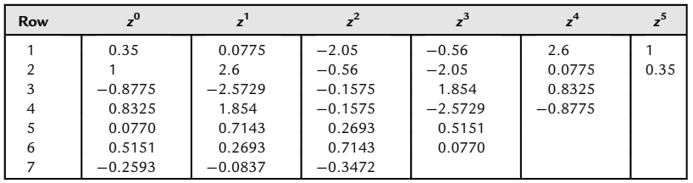
Jury Test Procedure
Example 4.6

Slide 61
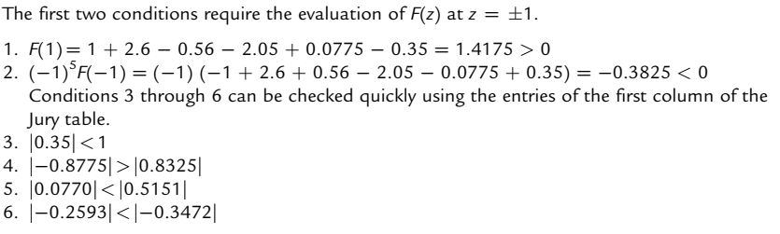
Jury Test Procedure
Example 4.6
Notes:
Conditions 2, 5, and 6 are violated, and the polynomial has roots on or outside the unit circle. In fact, the polynomial can be factored
+ a root at 2.5 outside the unit circle. Note that the number of conditions violated is not equal to the number of roots outside the unit circle and that condition 2 is sufficient to conclude the instability of F(z)

Slide 62

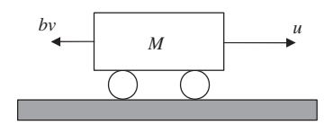

Jury Test Procedure
Example 4.7
Find the stable range of the gain K for the unity feedback digital cruise control system
DAC and ADC if the sampling period is 0.02s
G_{ZAS}(z)
a. Find the transfer function for analog subsystem ADC and DAC
DAC
Plant
ADC
+
ZOH
T=.02
-
b. Find the stable range of the gain K
Notes:
Y(z) ---- v(t)
E(z) ----- u(t)

Slide 63
Jury Test Procedure
Example 4.7
a. The transfer function for analog subsystem ADC and DAC is
b. Find stable Range of K
clear all, close all, clc;
s = tf('s');
sys = K/(s+3);
T = 0.02;
sys_d = c2d(sys,T,'zoh')

Slide 64

Jury Test Procedure
Example 4.8
Find the stable range of the gain K for the unity feedback digital cruise control system
DAC and ADC if the sampling period is 0.05s
G_{ZAS}(z)
a. Find the transfer function for analog subsystem ADC and DAC
DAC
Plant
ADC
+
ZOH
T=.05
b. Find the stable range of the gain K
-
Notes:
Y(z) ---- y(t)
E(z) ----- u(t)

Slide 65
Jury Test Procedure
Example 4.4
a. The transfer function for analog subsystem ADC and DAC is
clear all, close all, clc;
s = tf('s');
K=1
sys = 10*K/(s*(s+3));
T = 0.02;
sys_d = c2d(sys,T,'zoh')

Slide 66

Jury Test Procedure
Example 4.8
b. Find stable Range of K

Slide 67
Stability determination
Using Numerical Method ( MATLAB)
Tiêu chuẩn Routh-Hurwitz
Tiêu chuẩn Jury
Tiêu chuẩn Nyquist

Slide 68
Tiêu chuẩn Nyquist
The Nyquist criterion allows us to answer two questions:
1. Does the system have closed-loop poles outside the unit circle?
2. If the answer to the first question is yes, how many closed-loop poles are outside the unit circle?
The Nyquist criterion is particularly useful in situations where the frequency response can be obtained experimentally and used to obtain a polar or Nyquist plot.
The closed-loop characteristic polynomial
1. zeros of the p_{cl}(z) are the closed-loop poles
2. poles of the p_{cl}(z) are the open-loop poles
Notes:
The Nyquist criterion allows us to answer two questions:
1. Does the system have closed-loop poles outside the unit circle?
2. If the answer to the first question is yes, how many closed-loop poles are outside the
unit circle?

Slide 69
Tiêu chuẩn Nyquist
Problem Statement:
We assume that we are given the number of open-loop poles outside the unit circle (P). We need to find the number of closed-loop poles outside the unit circle (Z)
Nguyên lý góc quay
Tiêu chuẩn Nyquist
Phase and magnitude margin
Notes:
To determine Z, we use some simple results from complex analysis. We first give the following definition.

Slide 70
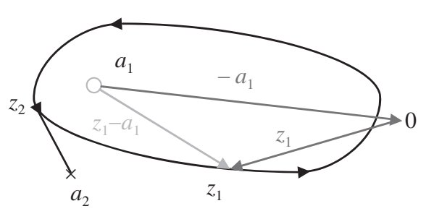
Nguyên lý góc quay
Contour: A contour is a closed directed simple (does not cross itself) curve
1. In the complex plane the vector connecting any point a to a point z is the vector (z-a)
2. The net angle change for the vector (z-a) as the point z traverses the contour in the shown (counterclockwise) direction by determining the net number of rotations of the corresponding vector
3. The point a1 - which is inside the contour- that the net rotation is one full turn (2π radians)
4. The point a2 - which is outside the contour- The net rotation is zero ( 0 radians)
5. If the point in question corresponds to a zero, then the rotation gives a numerator angle; if it is a pole, we have a denominator angle
Notes:
The net angle change for a rational function is the change in the angle of the numerator minus the change in the angle of the denominator. So for Fig. 4.6, we have one counterclockwise rotation because of a1 and no rotation as a result of a2 for a net angle change of one counterclockwise rotation. Angles are typically measured in the counterclockwise direction and we count clockwise rotations as negative

Slide 71
Nguyên lý góc quay
The net angle change for a rational function is the change in the angle of the numerator minus the change in the angle of the denominator
we have one counterclockwise rotation because of a₁ and no rotation as a result of a₂ for a net angle change of one counterclockwise rotation. Angles are typically measured in the counterclockwise direction and we count clockwise rotations as negative
Re-statements: how to determine the number of zeros of a rational function in a specific region; given the number of poles

Slide 72
Nguyên lý góc quay
Select a closed contour surrounding the region.
Compute the net angle change for the function as we traverse the contour once.
The net angle change or number of counterclockwise rotations N is equal to the number of closed-loop poles inside the contour Z_{in} minus the angle of open-loop poles inside the contour P_{in}, that is, the number of counterclockwise encirclements of the origin is given by

Slide 73
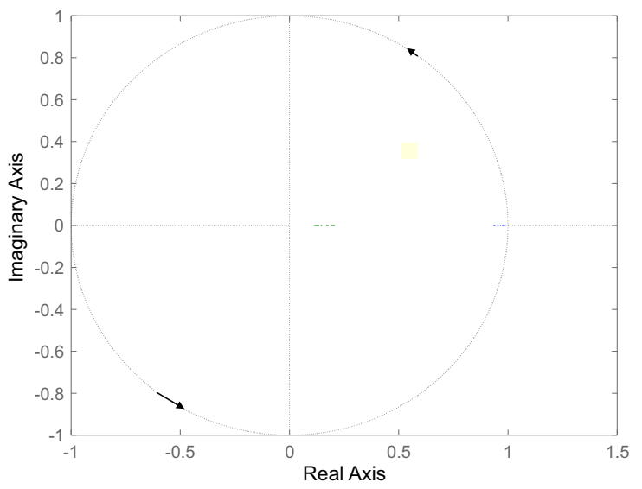
Tiêu chuẩn ổn định Nyquist
To use this to determine closed-loop stability, we need to count the closed-loop poles outside the unit circle.(an nth order system)
The stability contour is the unit circle and is traversed in the counterclockwise direction

Slide 74
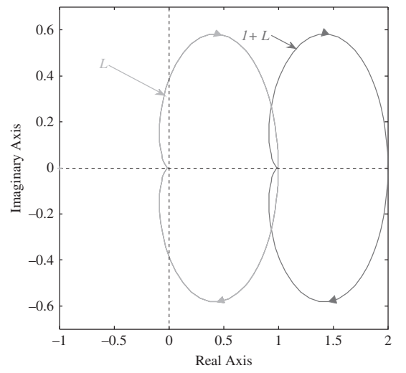
Tiêu chuẩn ổn định Nyquist
The value of the loop gain on the unit circle is L(e^{jωT}) (ωT = [-π,π])
Because the order of the numerator is equal to that of the denominator or less, points on the large circle map to zero or to a single constant value
Note that traversing the contour counterclockwise implies increasing ω and following the direction typically shown on Nyquist plots
We can simplify the test by plotting L(e^{jωT}) as we traverse the contour and then counting its encirclements of the point (-1, j0)
Notes:
+The values obtained for negative frequencies L(e^{jωT}) are simply the complex conjugate of the values L(e^{jωT}) and need not be separately calculated.
+ this is equivalent to plotting p_{cl}(z) and counting encirclements of the origin (0,0)

Slide 75
Tiêu chuẩn ổn định Nyquist
Theorem 4.7
Let the number of counterclockwise encirclements of the point (1, j0) for a loop gain L(z) when traversing the stability contour be N (i.e., N for clockwise encirclements), where L(z) has P open-loop poles inside the contour. Then the system has Z closed-loop poles outside the unit circle with Z given by
Z = (-N) + P
Hệ quả
An open-loop stable system is closed-loop stable if and only if its Nyquist plot does not encircle the point (1, j0) (i.e., if N = 0)

Slide 76
Tiêu chuẩn ổn định Nyquist
Theorem 4.7
Although counting encirclements appears complicated, it is actually quite simple using the following recipe:
Starting at a distant point, move toward the point (1, 0).
Count all lines of the stability contour crossed. Count each line with an arrow pointing from your left to your right as negative and every line with an arrow pointing from your right to your left as positive.
The net number of lines counted is equal to the number of clockwise encirclements of the point (1, 0).

Slide 77
Tiêu chuẩn ổn định Nyquist
Special Case: Open-loop system has poles on unit Circle
=> the contour passes through poles and the test fails
We modify the contour to avoid these open-loop poles
The contour includes an additional circular arc of infinitesimal radius

Slide 78
Tiêu chuẩn ổn định Nyquist
The most common case is a pole at unity
The value of the transfer function on the circular arc is approximately given by
A net denominator angle change of mπ radians (counterclockwise) (i.e., m half circles). The net angle change for the quotient on traversing the small circular arc is thus mπ radians (clockwise). For a type m system, the Nyquist contour will include m large clockwise semicircles
Notes:
ε - là đường kính cung tròn, giá trị vô cùng bé

Slide 79
Tiêu chuẩn ổn định Nyquist
Example 4.9
A linearized model of a furnace
In heating phase
G_{ZAS}(z)
DAC
Plant
ADC
+
ZOH
T=.01
-
clear all, close all, clc;
s = tf('s');
sys = 1/(s^2+3*s+1);
T = 0.01;
sys_d = c2d(sys,T,’zoh’)

Slide 80
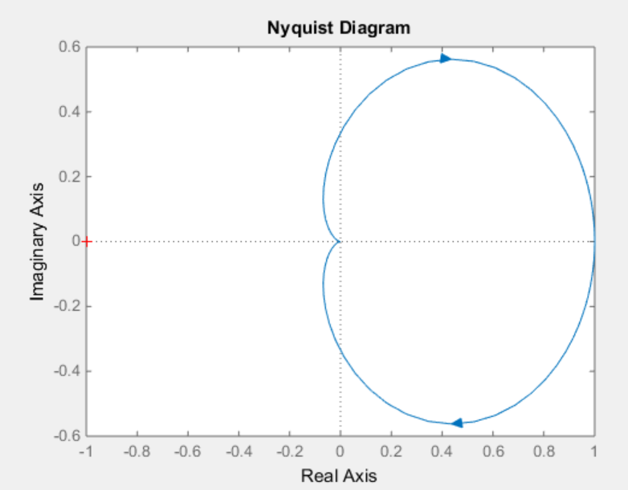
Tiêu chuẩn ổn định Nyquist
nyquist(sys_d)
Example 4.9
+ N = 0 - the Nyquist plot does not encircle the point (1, j0)
+ P = 0 - the open-loop transfer function has no unstable poles
Z = 0 - the system is closed-loop stable

Slide 81
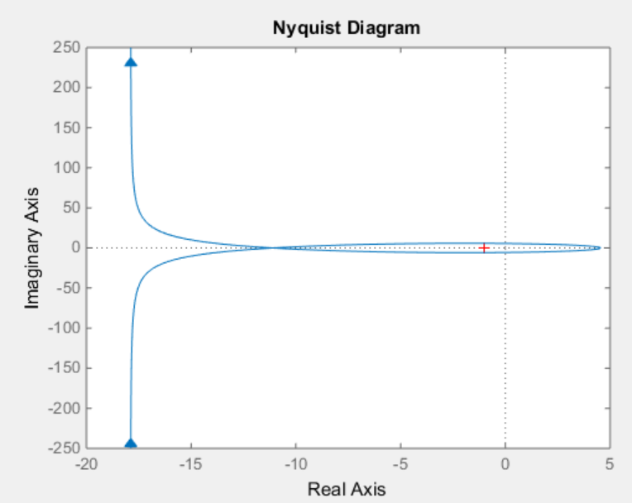
Tiêu chuẩn ổn định Nyquist
Example 4.10: The stability of the type-1 transfer function
clear all, close all, clc;
T = 0.01;
sys_d = tf(10,[1 -1.1 1],T)
nyquist(sys_d)
+ The Nyquist contour has two clockwise encirclements (N = -2)
Z = 2 - the system is closed-loop unstable

Slide 82
Phase and Gain Margin
the stability of a mathematical model is not sufficient to guarantee acceptable system performance
We therefore need to determine how far the system is from instability. This degree of stability is known as relative stability
we restrict it to open-loop stable systems where zero encirclements guarantee stability. For open-loop stable systems that are nominally closed-loop stable, the distance from instability can be measured by the distance between the set of points of the Nyquist plot and the point (1, j0)
The distance = magnitude distance + angular distance
Notes:
+ In practice, the stability of a mathematical model is not sufficient to guarantee acceptable system performance or even to guarantee the stability of the physical system that the model represents
+ This is because of the approximate nature of mathematical models and our imperfect knowledge of the system parameters

Slide 83
Phase and Gain margin
Gain margin: The gain margin is the gain perturbation that makes the system marginally stable.
Phase margin: The phase margin is the negative phase perturbation that makes the system marginally stable
+
Gain disturbance
-
Phase disturbance

Slide 84
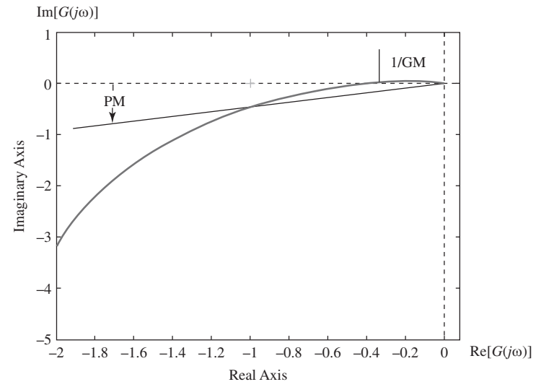
Phase and Gain Margin
The MATLAB commands for obtaining frequency response plots
nyquist(gd) % Nyquist Plot
bode(gd) % Bode Plot
Gain and Phase margins
[GM, PM] = margin(gd); % find Margin
On Nyquist and Bode plot, can select option

Slide 85
Phase and Gain margin
G_{ZAS}(z)
Example 4.11
actuator
DAC
Plant
ADC
+
ZOH
T=.01
K
-

Slide 86
Phase and Gain margin
Example 4.11
clear all; close all; clc;
T = 0.01;
z = tf('z',T);
K=1;
Ga_d = 0.9516/(z-0.9048);
Gzas_d = 10^-5*(4.95*z+4.901)/(z^2-1.97*z+0.9704)
L_d = K*Ga_d*Gzas_d;
[GM,PM] = margin(L_d)
GM =
3.5699
PM =
46.3442
Notes:
The closed-loop system is stable.

Slide 87
Phase and Gain margin
Example 4.11
clear all; close all; clc;
T = 0.01;
z = tf('z',T);
K=5;
Ga_d = 0.9516/(z-0.9048);
Gzas_d = 10^-5*(4.95*z+4.901)/(z^2-1.97*z+0.9704)
L_d = K*Ga_d*Gzas_d;
[GM,PM] = margin(L_d)
GM =
0.7140
PM =
-9.0842
Notes:
The closed-loop system is unstable.

Slide 88
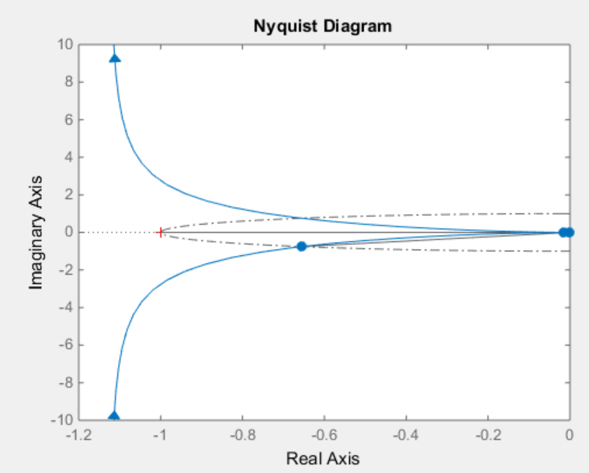
Phase and Gain Margin
Example 4.12
Determine the closed-loop stability of the digital control system for the position control system with analog transfer function (T=0.01)
GM =
60.3028
PM =
48.9872
close all; clear all; clc
G = tf(10,[1 3 0]);
T = 0.01;
G_d = c2d(G,T,'zoh');
[GM, PM] = margin(G_d)
nyquist(G_d)
Notes:
The closed-loop system is stable.

Slide 89
Summary
Determine the input-output stability of a z-transfer function.
Determine the asymptotic stability of a z-transfer function.
Determine the internal stability of a digital feedback control system.
Determine the stability of a z-polynomial using the Routh-Hurwitz criterion.
Determine the stability of a z-polynomial using the Jury criterion.
Determine the stable range of a parameter for a z-polynomial.
Determine the closed-loop stability of a digital system using the Nyquist criterion.
Determine the gain margin and phase margin of a digital system.

Slide 90
Quy ước về biểu diễn mã nguồn
Mã nguồn được để trong ô có màu vàng, mã nguồn thay thế dược để trong ô màu xanh
Phiên bản đầu tiên
Phiên bản thay thế
int fact_do(int x)
{
int result = 1;
do {
result *= x;
x = x-1;
} while (x > 1);
return result;
}
int fact_goto(int x)
{
int result = 1;
loop:
result *= x;
x = x-1;
if (x > 1)
goto loop;
return result;
}

Slide 91
Nội dung bài học
Liệt kê nội dung, đến nội dung nào thì in đậm nội dung đó
Chủ đề 1
Chủ đề 2
Chủ đề 3
Chủ đề 4

Slide 92
Section Template

Slide 93
Mục đích, Yêu cầu
Mục đích, yêu cầu
Mục đích
Yêu cầu

Slide 94
Nội dung chính
Liệt kê nội dung, đến nội dung nào thì in đậm nội dung đó
Chủ đề 1
Chủ đề 2
Chủ đề 3
Chủ đề 4

Slide 95
Template cho khais nieemj
Internal stability: If all the transfer functions that relate system inputs (R and D) to the possible system outputs (Y and U) are BIBO stable, then the system is said to be internally stable.C

Slide 96
Nội dung chính
Liệt kê nội dung, đến nội dung nào thì in đậm nội dung đó
Chủ đề 1
Chủ đề 2
Chủ đề 3
Chủ đề 4

