Slide 1

Zomato Restaurant Analysis
Arvind
Chaurasiya

Slide 2
About company
Zomato is a leading food-tech company that connects users with restaurants for dining, delivery, and table reservations.
Initially a restaurant discovery platform, it evolved into a comprehensive service catering to both customers and restaurant partners.
The company enables users to browse menus, read reviews, order food, and even book tables, simplifying the dining experience.
Over time, Zomato expanded its operations to multiple countries, offering diverse cuisine options and supporting local food businesses.
Competing with major players in the industry, Zomato continues to innovate by improving accessibility, affordability, and food quality, making it a key player in the online food ecosystem

Slide 3
Business problem statement
Zomato expansion team is focused on identifying high-potential markets and driving the successful launch of new restaurant locations across strategic geographies. The core objective of this initiative is not just to increase footprint, but to build profitable, sustainable outlets that align with customer demand patterns and local market dynamics.
The task involves developing data-driven strategies and actionable recommendations for opening new restaurants.

Slide 4
Data Overview
The dataset includes two tables—RawData and Country Description—containing a total of 22 combined attributes, Those are:
Restaurant ID
Restaurant Name
CountryCode
City
Address
Locality
Locality Verbose
Longitude
Lattitude
Cuisines
Currency
Has_Table_booking
Has_Online_Delivery
Is_Delivering_now
Switch_to_order_menu
Price_Range
Votes
Average_cost_for_two
Rating
Date_key_opening

Slide 5
Approach
Data Cleaning
Handled missing values, checked duplicates & format
Transformation
Extracted date components, mapped country codes, unified currency to INR.
Analysis
Used Excel functions & pivot tables; aggregated by country, year & rating; examined impact of online delivery & table booking on ratings.
Visualization
Applied conditional formatting; created charts & dashboards for insights.

Slide 6
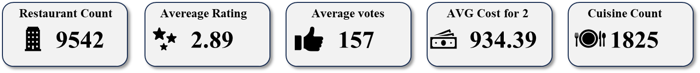
Objective Key Metrics
There are 9542 restaurants represented in the data .
These restaurants serve 1825 different cuisines.
The overall average rating across all the restaurant is 2.9.
The average number of votes received per restaurant across the dataset is 156.
The Average Cost for 2 for as per the entire dataset is Rs.934.39.

Slide 7
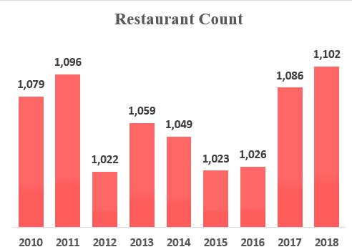
Year-wise Restaurant Count
The average number of restaurants opened per year for the last 8 years is 1061.
However, 2018 has the most restaurants opened i.e. 1102 and 2012 has the least opening of restaurants with 1022.
There is an increase of 2.13% on restaurants opened from the year 2010 to 2018.

Slide 8
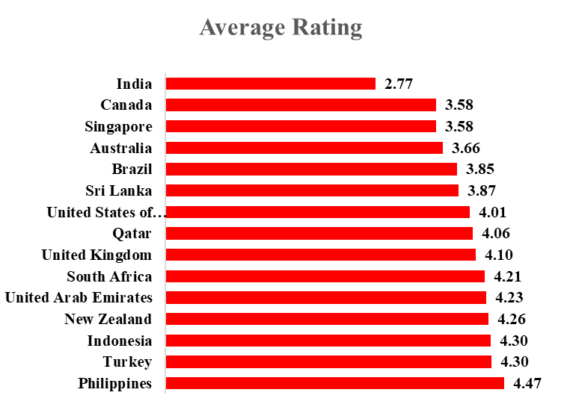
Country wise Average Raing
The Following Charts shows the average rating for each country.
The average rating for the entire data is 2.89
However, Philippines has the most average rating i.e. 4.47 and India has the least rating of 2.77.

Slide 9
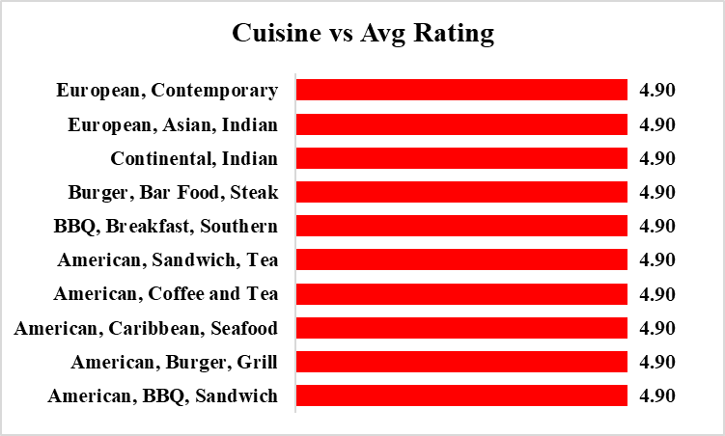
Top 10 Cuisines
The above chart highlights the ten cuisines with the highest average ratings

Slide 10
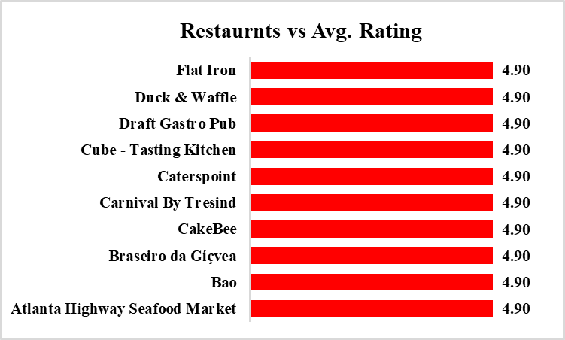
Top 10 Restaurants
The above chart highlights the ten restaurants with the highest average ratings

Slide 11
Country wise Restaurant Count
Plotted chart represents Country wise Restaurant Count
India accounted for the highest number of restaurants, making up 91.5% of the total compared to other countries.
Canada has the least with only 4 restaurants.

Slide 12
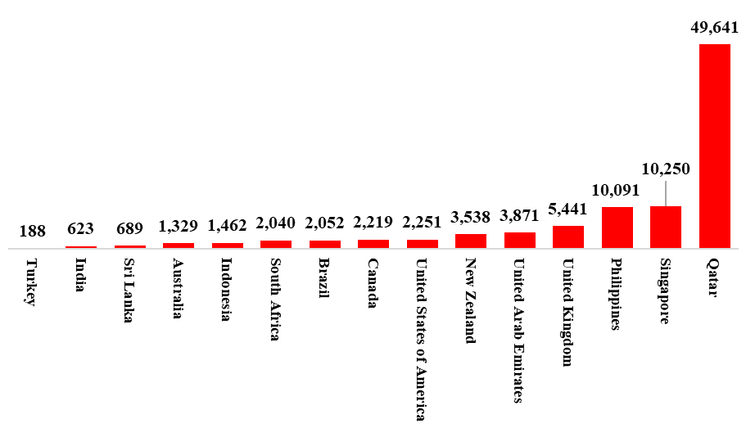
Country wise Average Cost for two
Plotted chart represents Average cost for 2 in INR for each country
Qutar accounted highest average cost for two of Rs.49,641
Turkey has the least with only Rs.188.

Slide 13
Suggestion of countries for expanding
Restaurants : Max 60 for market control & profitability
Per City : Max 5 for dominance & strong presence
Cost : Keep < ₹4000 to boost footfall
Ratings : Cities < 3.7 may signal low service but offer growth potential
Recommended countries and Cities
Australia - Flaxton, Paynesville, Montville.
Canada – Chatham-Kent, Consort, Vineland Station, Yorkton.
Indonesia – Tangerang.

Slide 14
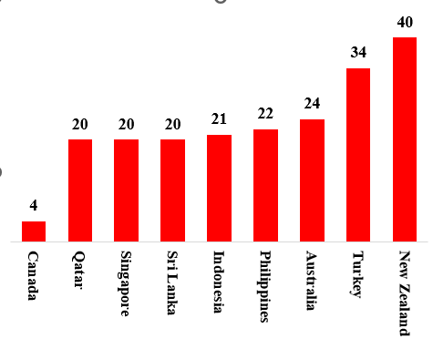
Visualization
Restaurant count
Country-wise restaurant distribution highlights ideal expansion opportunities, assesses competition, and supports data-driven growth decisions.
Canada has the least restaurant count.
New Zealand having the most Restaurant Count.

Slide 15
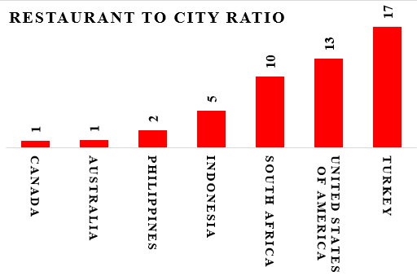
Visualization
City-to-restaurant ratio analysis aids in identifying ideal expansion countries, market opportunities, and strategic growth decisions.
Canada and Australia have the least ratio.
Turkey having the highest ratio.

Slide 16
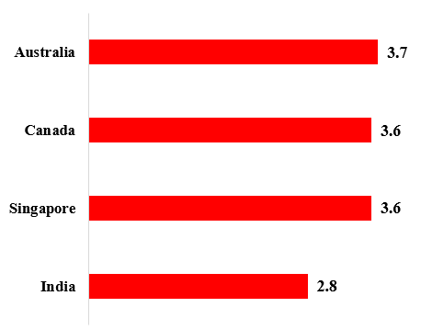
Visualization
Country vs Average rating
- Country-wise average rating analysis helps identify optimal expansion markets, assess competition and drive strategic growth decisions.
- India having the least Average rating .
- Australia having the most Average rating.

Slide 17
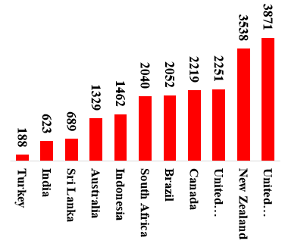
Visualization
Country vs Avg_cost_for_2
Country-wise average cost analysis helps identify ideal expansion markets, evaluate competition, and support strategic growth decisions.
United States of America is the most expensive
Turkey is quite affordable.

Slide 18
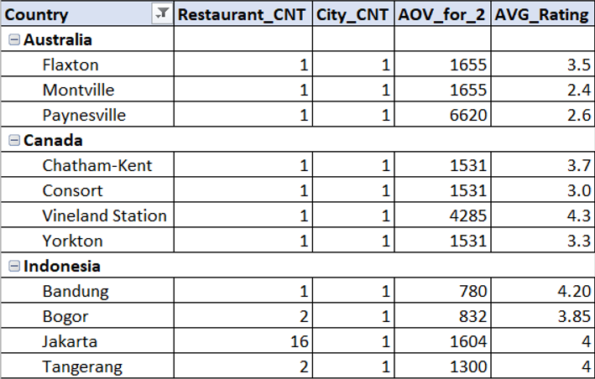
Visualization
City selection
Australia
Average order for 2 - 1350
Flaxton/Montville: 2000+
Paynesville: 6500
Canada
Order value for two: 2200+ Vineyard Station: 4500+
National rating: 3.5; some cities: ~3,
signaling demand for quality food.
Indonesia
Jakarta hosts 65% of restaurants (city-to-restaurant ratio: 5), while other cities average 2 per location.
Tangerang’s AOV for two: 1300; 4-star rating suggests better food could boost AOV.

Slide 19
Cuisine Selection
Australia | Canada | Indonesia
Pizza - Italian, American | Pizza - Italian, American, Chinese | Sushi, Japanese
Bar Food - Burger, Steak, Desserts | Mediterranean, Seafood | Indonesian, Sunda, Asian
Mediterranean, Seafood, Continental | Asian, Sushi, Tapas | Coffee, Tea
Modern Australian Breakfast |  | Italian, Desserts, Burger
Coffee, Tea
Adapting recommended cuisines to each country can boost customer feedback, improve ratings, and drive revenue growth, especially in markets with ratings near 4 or above.

Slide 20
Impact of Table booking feature on rating
Table booking boosts restaurant ratings.
Introducing table booking in Australia, Canada, and Indonesia boosts convenience, reliability, and ratings.
Majority of restaurants do not offer Table booking.

Slide 21
Impact of Online Delivery feature on rating
Average Rating
Online delivery improves ratings and customer satisfaction.
Introducing online delivery in Australia, Canada, and Indonesia boosts convenience, reliability, and ratings.
Majority of Restaurants do not offer online delivery

Slide 22
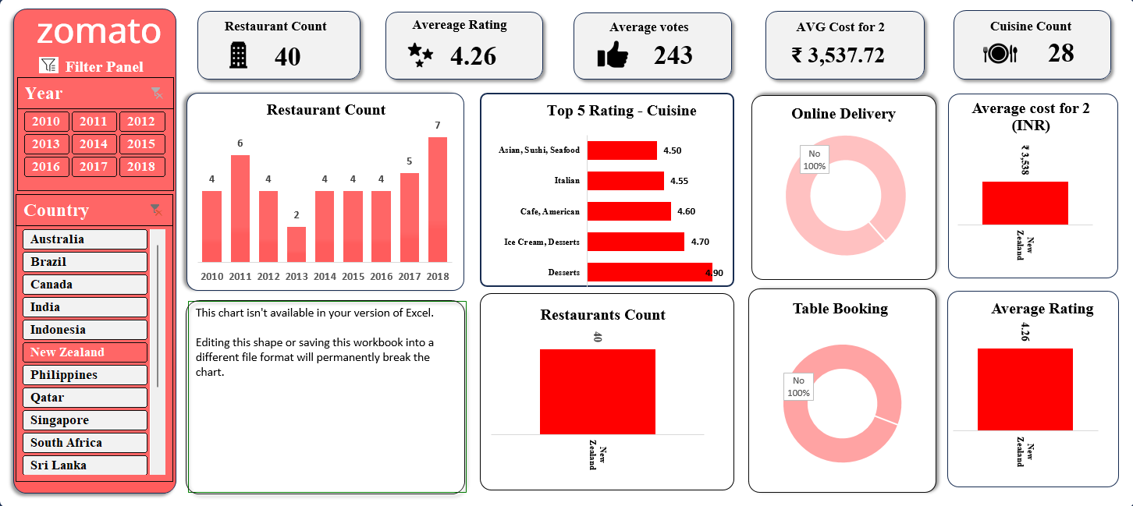
Dashboard

Slide 23
Conclusion
This analysis reveals strong global expansion potential. Targeting high-demand regions, aligning with demographics, and leveraging strengths ensures strategic growth. This approach boosts market presence, enhances dining experiences, and drives sustainable success.
Target underserved regions: Focus on countries with a high demand for restaurants but a limited presence, maximizing growth opportunities.
Optimize pricing strategy: Higher-priced restaurants tend to receive better ratings. Choosing a price range between 3–4 ensures financial stability while maintaining quality
Expand into untapped markets: Online delivery and table booking present significant growth potential, offering new revenue streams.
Enhance cuisine quality and pricing: Maintaining high-quality cuisine and selecting an appropriate price range can boost restaurant ratings and overall success.

Slide 24


