Slide 1

Email Anlayzer Presentation of project work By:- Priya Kumari : 2100460100085 Suhani Yadav : 2100460100109 Harsh Katiyar : 2100460100053 Anupam : 2100460100023 Harsh Kumar Gupta : 2200460109010
Under guidance of :-
Name of guide : neetu Kumari

Slide 2
Outlines
Introduction
Literature Survey
Inferences from Literature Survey
Comparative Analysis of Existing Systems
Problem Statement
Solution Approach
Methodology
Real-World Applications
Software and Hardware Requirements
Modules and Architectural Description
Project Progress Status
References

Slide 3
Introduction: Objective: To develop a Python Django-based web app to analyze email headers, check for spoofing and dns records, and scan URLs/attachments using the VirusTotal API with google gemini chatbot intergration.
Key Features:
Parse and extract sender details.
Analyze header information for spoofing elements.
Integrate threat analysis using VirusTotal API.
User-friendly interface for results visualization.

Slide 4
Literature Survey Tool A: Detects email spoofing through email headers.
Technique: SPF, DKIM, and DMARC validation.
Example: Tools like MXToolbox or Postmark.
Tool B: Scans URLs and attachments for threats.
Technique: Signature-based malware detection using VirusTotal or other static analysis tools.
Example: VirusTotal Scanner.
Tool C: Visualizes email headers for easier analysis.
Technique: Graphical visualization of email paths and server hops.
Example: Google’s Message Header Analyzer.

Slide 5
Inferences Drawn from Literature Survey
Tool A: Detects email spoofing through email headers.
Technique: SPF, DKIM, and DMARC validation.
Example: Tools like MXToolbox or Postmark.
Tool B: Scans URLs and attachments for threats.
Technique: Signature-based malware detection using VirusTotal or other static analysis tools.
Example: VirusTotal Scanner.
Tool C: Visualizes email headers for easier analysis.
Technique: Graphical visualization of email paths and server hops.
Example: Google’s Message Header Analyzer.

Slide 6
Comparative Analysis of Existing Systems
Feature | Tool A | Tool B | Tool C | Email Analyzer
DNS / Spoof Check | ✅ | ❌ | ✅ | ✅
Threat Analysis | ❌ | ✅ | ❌ | ✅
Header Parsing | ❌ | ❌ | ✅ | ✅
User-Friendly UI | ❌ | ✅ | ✅ | ✅

Slide 7
Problem Statement
Shortcomings of Existing Systems:
Lack of integration between email parsing and threat analysis.
Limited usability for non-technical users.
Proposed Solution:
Develop a unified tool combining email header parsing, spoof detection, dns check and threat analysis.

Slide 8
Solution Approach
Email Header Parsing:
Extract and analyze sender, recipient, and server details.
Spoof Check:
Validate SPF, DKIM, and DMARC records.
DNS Check:
Validate sender's domain through DNS lookups.
Frontend Development:
Create an interactive interface for result visualization.
Chatbot integration for any queries and help.

Slide 9
Tools:
Backend: Python, Django
API: VirusTotal, Google Gemini
Frontend: HTML, CSS, JavaScript
1 . Upload email file(.eml format).
4. Scan URLs/attachments with VirusTotal.
2. Parse and analyze data
5. Display results in the UI.
3. Check SPF/DKIM/DMARC records and other various headers.
Methodology

Slide 10
Real-World Applications
Benefits:
Enhanced email security for organizations.
Protection against phishing and malware attacks.
Target Users:
Cybersecurity teams.
Enterprises handling sensitive information.
Problem Solved:
Organizations wanting to analyze suspicious emails.

Slide 11
Software and Hardware Requirements
Software:
Python 3.x
Django Framework
VirusTotal API
Google Gimini API
Hardware:
RAM: 1–2 GB
CPU: Modern dual-core processor.
Storage: 20 GB free space for dependencies, database, and logs.

Slide 12
Modules and Architectural Description Modules:
Email Parser: Extract header data.
DNS / Spoof Check: Validate SPF, DKIM, DMARC And DNS Record
Threat Scanner: Interface with VirusTotal API. Chatbot : Google Gimini
Frontend: Display results.
Architecture:
Modular Django-based architecture with REST APIs.

Slide 13
Project Progress Status Completed:
Header parsing and spoof checking(Basic).
VirusTotal integration for threat analysis Chatbot for help and support. Pending: Header parsing and spoof checking(Robust).
Finalizing frontend UI.
Testing and debugging.

Slide 14
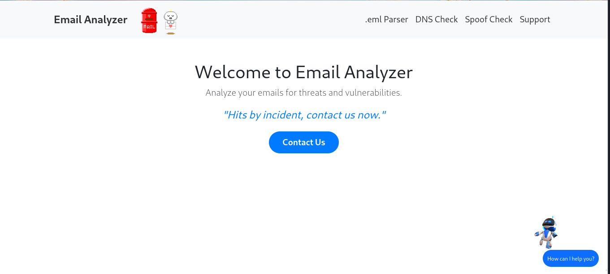
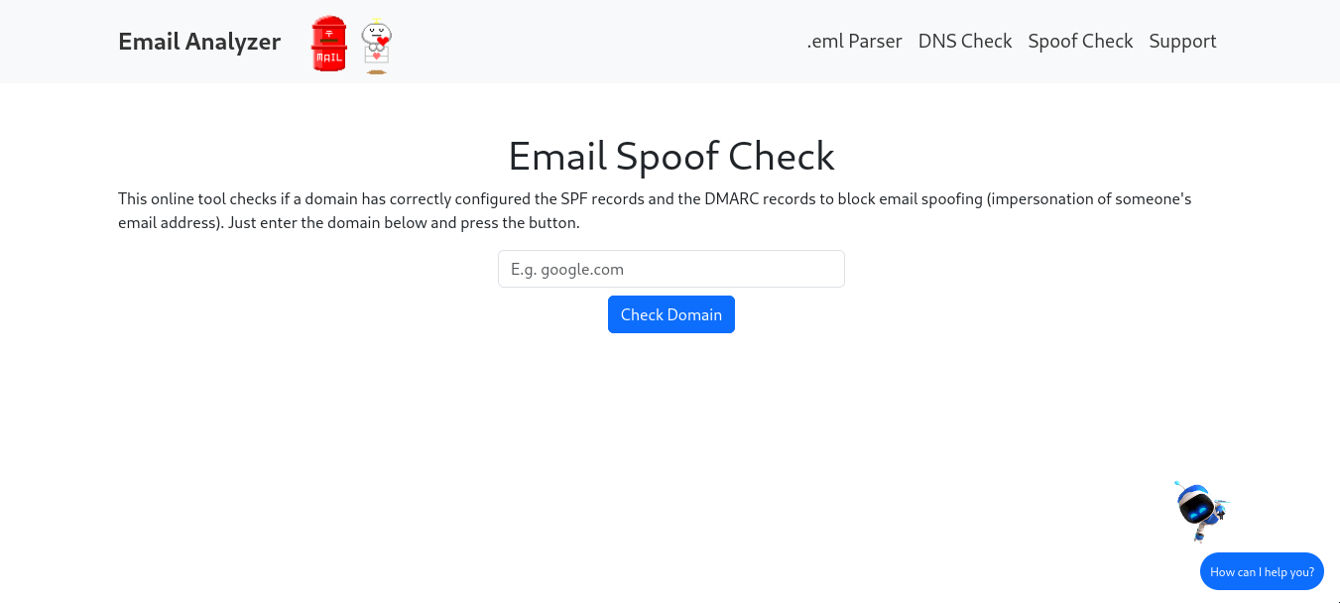
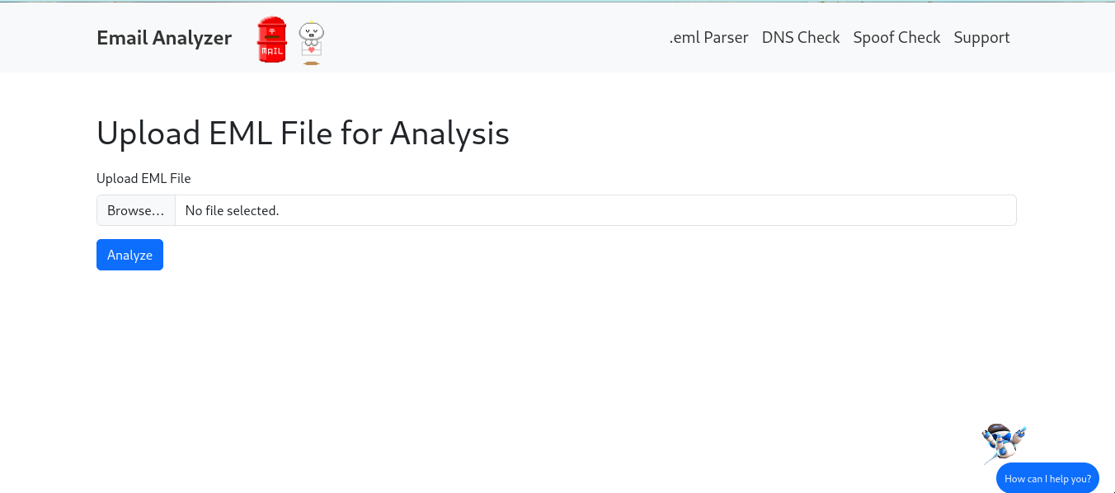
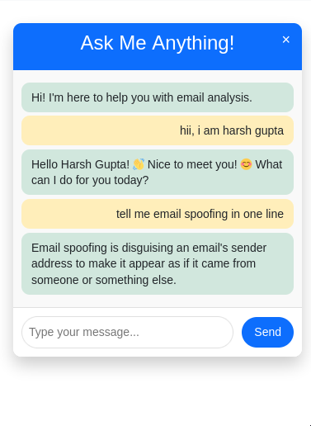
Snapshot of project progress status

Slide 15
Thank you

