Slide 1
AtliQ Contract Risk Analyzer
The contract isn't the problem. The missing memory around it is.
Rahul · Codebasics AI PM capstone · live prototype: atliq-contract-risk-analyzer-teal.vercel.app
Notes:
Hello, my name is Rahul. This is the video recording of the capstone project I worked on: the AtliQ Contract Risk Analyzer. In the next few minutes I will go through the problem I found, the prototype I created for the capstone, and the next steps. All the required artefacts are in the GitHub link.

Slide 2
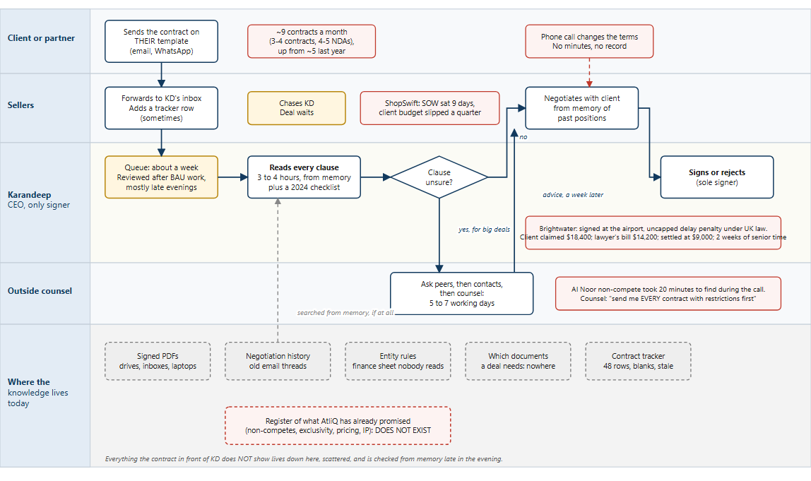
Today: one signer, reviewing from memory after BAU work
~9
contracts a month, one signer
3-4 h
per client contract, from memory
~1 week
in the queue; a deal waits for an evening
Notes:
To summarise at a high level: as of today, every contract at AtliQ is reviewed and signed by Karandeep. That's about nine documents a month: three or four client contracts, each taking about three to four hours, plus four or five NDAs. Karandeep does this in the late evening, after his regular work, and typically a contract waits about a week in the queue.

Slide 3
What we heard: past behaviour, not opinions
We asked | What came back | Source
Walk me through the last review | Harrington: $210k, their paper, three documents now. "A whole evening and I haven't started." 3 to 4 hours per client MSA, after BAU work in the late evening. | Queue meeting
What happened last time one went wrong? | Brightwater: signed at the airport, uncapped delay penalty, UK law. $9,000 settlement, $14,200 legal bill, two weeks of senior time. "I didn't even see it." | Post-mortem, 14 Apr
How do you check what AtliQ already promised? | Memory, asking co-founders, opening old contracts one by one. Al Noor took 20 minutes to find during a paid counsel call. "Is there a list?" Silence. | Counsel call, 25 Sep; client meeting
How many come in? | 3 to 4 contracts and 4 to 5 NDAs a month, seasonal; volume roughly doubled in a year. | Office hours
If this were handled perfectly? | One complete overview: every clause against policy, past projects and past clients in that region, nothing left grey, in under 5 minutes. The AI never signs. | Office hours
Notes:
Discovery followed The Mom Test: ask what happened last time, never pitch. The office hours with the client were the interview, and the dataset's own meeting notes confirmed it in Karandeep's words. Every line here is tagged evidence or assumption in the worksheet. Three answers shaped everything: the last failure, how past promises are checked, and what a perfect review would look like: every clause, in under five minutes, and the AI never signs.

Slide 4
Five whys: from "review takes too long" to the real problem
# | Why? | Answer
1 | Why hours? | Every contract arrives on the other side's template; every clause is judged fresh.
2 | Why his judgment? | Acceptability depends on context outside the document: past promises, past negotiations, entity, country.
3 | Why hard to apply? | None of it is written down: contracts scattered, history in old threads, a 2024 checklist. It lives in his head.
4 | Why only in his head? | No legal function ever existed; the knowledge grew over years of negotiating and nobody captured it.
5 | Why does memory fail now? | Volume doubled, four regions, multi-document bundles, old restrictions still bind, late-evening reviews under deadline.
What Karandeep said
"Contract review takes too long."
The real problem
AtliQ's contract knowledge, what it has promised, how it negotiates and what each deal needs, exists only in one person's memory. Review cannot be shared, delegated or made safe, and the risks that matter most are the ones the document in front of him does not show.
Notes:
When I started, I thought the problem was speed. But the real risk sits outside the contract Karandeep is reading: what AtliQ has already signed with other clients, and which entity should sign. None of it is written down; it lives in Karandeep's head, so nobody else can review for him. This has already caused problems with clients: Brightwater ended in a settlement, and ShopSwift slipped by a quarter.

Slide 5
Where AI helps, where rules do, and what waits
AI does the reading
Rules, not AI
1 Reads every clause: a type, a plain-English line, a verdict (fine, needs attention, conflict) and the quoted text.
2 Checks the deal against the obligations register, built once from the signed contracts and confirmed by Karandeep; a conflict is shown only with both clauses quoted.
3 Finds what AtliQ did on similar clauses before, shown as history, never policy.
4 Checks mutuality in both directions, including AtliQ's own paper.
5 Writes the brief with a suggested next step. A person decides.
Entity to country to law and courts; the documents each deal type needs; insurance and payment gaps. A lookup table cannot invent a rule (the facts it reads are extracted by the model and shown for checking), and the client said no fixed legal checklist exists, so it flags and never asserts.
Deferred, on purpose
Counter-proposal drafting, mailbox and WhatsApp intake, client payment-history checks. Each waits for a trigger: a data source, a measured need, or precedent proving useful. The client scoped freelancer and agency paper out; the mutuality and paperwork checks on it are kept as a stated extension.
Notes:
Opportunity mapping took the review apart into eight steps and asked, for each one, what AI should do, what plain rules should do, and what stays with a person. Three capabilities together are the review: reading every clause, checking against a register of existing commitments, and the entity, country and paperwork rules. I was deliberate about where not to use AI: matching an entity to a country and a law, or listing the documents a deal type needs, is a lookup table, and a lookup table cannot invent a rule; the model only extracts the facts the table reads, and those are shown for checking. Drafting counter-proposals, mailbox intake and a client-legitimacy check went to the roadmap. One thing the client said shaped all of this: no single sub-problem is the P0; a review is one judgment made of many checks.

Slide 6
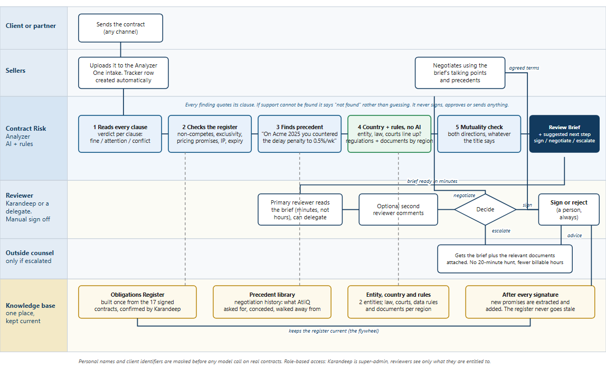
The solution: AI reviews, people approve, negotiate and sign
Five checks
1 Every clause, with a quote
2 Register of past promises
3 Precedent, as history
4 Entity, country, documents
5 Mutuality, both ways
Trust by design (HAX)
Says what it can and cannot do
Shows confidence per verdict
Progress steps, not a spinner
Every finding quotes its source
One-click override, with a reason
"Not found" instead of a guess
Never
Signs, approves or sends.
Gives legal advice.
Calls a contract "safe".
Sets a negotiation threshold.
Notes:
Because of the manual analysis required, I designed the analyzer around these memory gaps. In the to-be process, the seller uploads the draft and the analyzer runs five checks. Every clause gets a verdict, with the exact words quoted. The deal is checked against a register of what AtliQ has already promised, built from the seventeen signed contracts and confirmed by Karandeep. Past negotiations show up as history. Entity, country and paperwork are fixed rules; the model only pulls out the facts. It checks whether "mutual" is really mutual, including AtliQ's own vendor paper, which I kept in scope because the healthcare deals depend on it. For transparency, the summary brief clearly states that it is an AI-generated draft review, that it is not legal advice, and that a person takes the final decision.

Slide 7
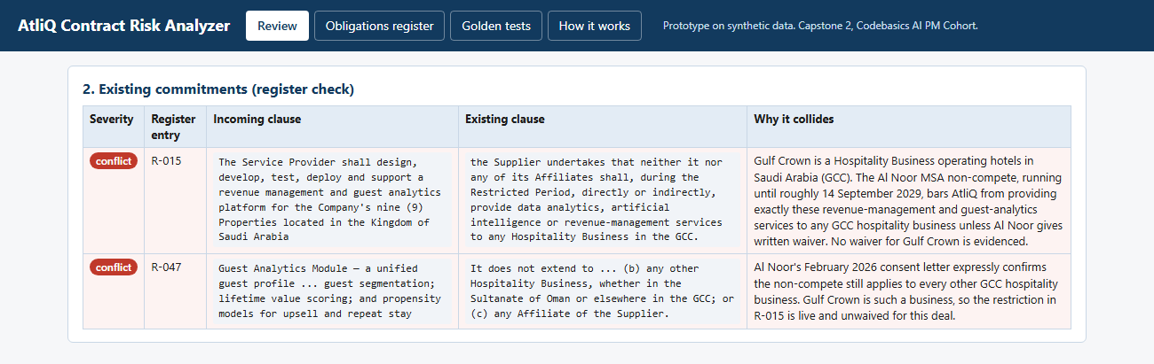
Walkthrough 1: the conflict nobody could find
20 min
94 s
escalate
to find Al Noor on a paid counsel call
for the analyzer to quote both clauses
suggested, with the package for counsel assembled
Notes:
Here's the live prototype, replaying a saved run. This is the client Gulf Crown, a hundred-and-forty-thousand-dollar hotel deal in Saudi. As per the records, in the queue meeting on the 22nd nobody could remember whether AtliQ had a restriction in the Gulf. The analyzer found it in about a minute and a half: Al Noor clause 12.1, quoted on both sides, binding affiliates, live until 2029. It suggests escalating, with the counsel package ready.

Slide 8
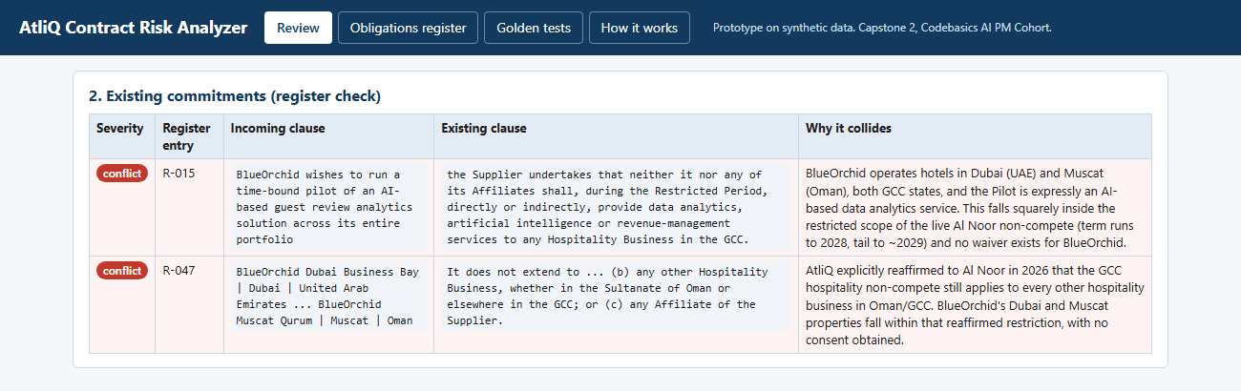
Walkthrough 2: the trap the seller missed, and so did I
The tracker said
The contract said
"by 5 Oct - want to start before Diwali. Jay: 'just India hotels I think'. TechSummit lead" (contract_tracker.csv, C-027)
Annexure B: BlueOrchid Dubai Business Bay, Orchid Residences Dubai Marina, BlueOrchid Muscat Qurum. Two GCC states. My own test expected "clean"; the model was right.
Notes:
Another example, the client BlueOrchid. On manual review it initially looked safe. The tracker note said "just India hotels I think", so ideally you would expect a clean result. The analyzer disagreed: Annexure B lists two Dubai properties and one in Muscat. It was right and I was wrong.

Slide 9
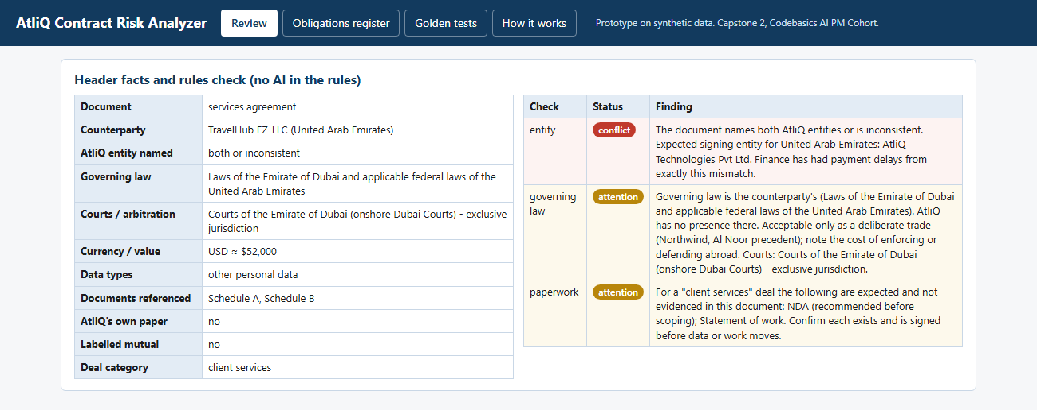
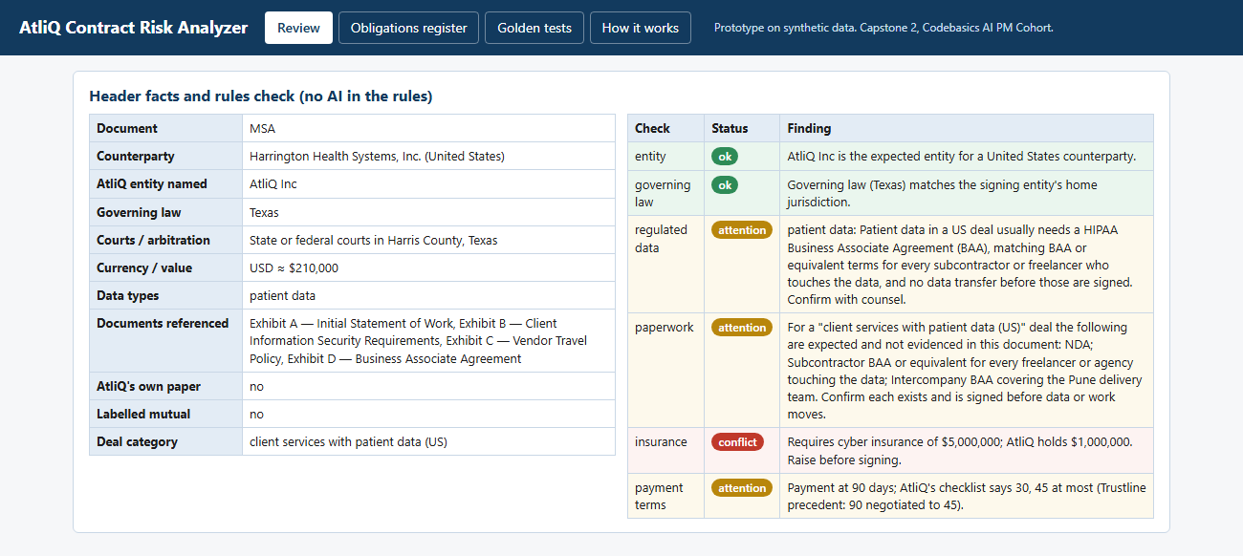
Walkthrough 3: rules, not AI, for entity, country and paperwork
TravelHub (Dubai)
Harrington Health (US, patient data)
AtliQ Inc named on a Middle East deal. The rules engine flags the entity conflict and the foreign governing law. The rule is fixed; the facts it reads are extracted by the model and shown for checking.
Documents expected for a US healthcare deal listed and the missing ones named; $5M cyber cover required against $1M held; "confirm with counsel" flag set.
Notes:
Two more. TravelHub put AtliQ's US entity on a Dubai deal; as per the notes, "because you're US-listed on LinkedIn", but the rules catch it. Harrington is US patient data: the missing subcontractor agreements are listed, and a five-million-dollar insurance demand is flagged against the one million AtliQ holds. All successfully caught and highlighted by the analyzer.

Slide 10
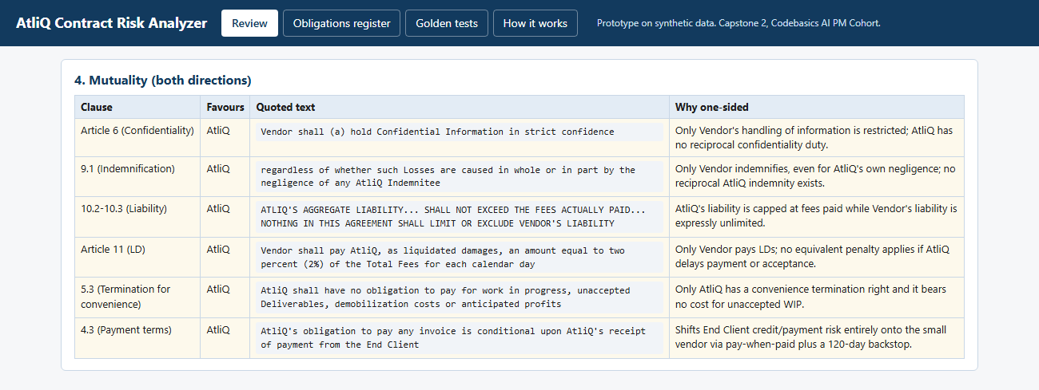
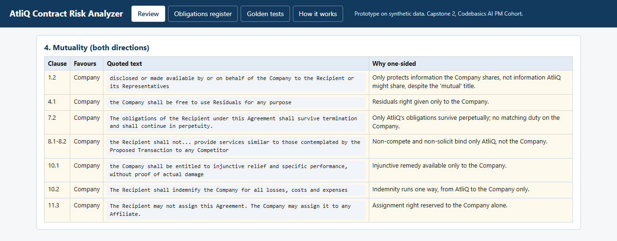
Walkthrough 4: fairness in both directions
Kriti: AtliQ's own template
FinServe: "our standard mutual NDA"
120-day pay-when-paid and unlimited vendor liability marked one-sided even though they favour AtliQ. Kriti is 12 people. Karandeep, on an earlier vendor: "I don't want our paper to be the thing I hate receiving."
One-sided clauses listed, and a non-compete inside the NDA that would bar the live Trustline work. Suggested step: negotiate, with that clause to push on.
Notes:
AtliQ's stated preference is for terms it would accept itself. The Kriti agreement is AtliQ's own paper going to a twelve-person agency, copied from a client draft. The analyzer marks the one-sided clauses against the agency even though they favour AtliQ: that is the mutuality check running on our own paper. FinServe sent what they called their standard mutual NDA. The analyzer lists the clauses that bind only AtliQ, and found a non-compete hidden inside it that would bar work for a live client. The client called the mutual label a trap that has backfired many times. Now it is a check.

Slide 11
North Star: reviewer time, 3 hours to under 30 minutes
3 h → <30 min
reviewer time per contract, brief opened to decision recorded
Layer | Metric | Target
North Star | Reviewer time per contract | About 3 h to under 30 min within 3 months of beta
Supporting | Days in queue, upload to decision | About a week to 1 working day
Trust signal | Override rate on the suggested next step | Under 25%; above 40% triggers a prompt and register review
Guardrail | Known conflicts missed; wrong-entity signatures; data incidents | 0, 0, 0; any instance pauses that check or rolls back (PRD 14.1)
User experience | Contracts decided before the client's deadline | 90% within 3 months of full release
Business | Outside-counsel spend on routine review | Down 30% in year one; baseline pending
Notes:
The measure I chose is Karandeep's own review time, tracked in the tool, coming down from about three hours to under thirty minutes, with zero missed conflicts and nothing signed under the wrong entity.

Slide 12
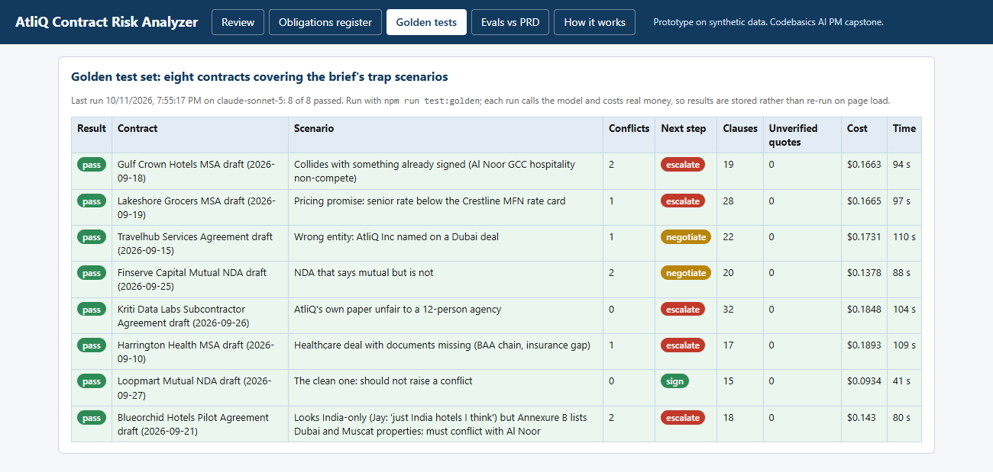
Evals: 8 of 8 trap contracts pass, quotes verified in code
8 / 8
trap contracts pass on Sonnet 5
203 of 203
quotes matched word for word; 0 forbidden phrases
$0.16
Estimated $0.15 per review before the build; measured $0.29 to $0.43 on the most capable model and $0.09 to $0.19 on Sonnet 5. The register and clause tables were bigger than estimated. The cost sheet was corrected from the measurement.
average per review, measured; ceiling $1.00
Notes:
In its current state, you can see that all eight test contracts pass. All 203 quotes match the contract word for word; where the model finds no supporting text it says "not found" instead of guessing. A review costs about sixteen cents.

Slide 13
Guardrails: mechanisms with an owner, not promises
Failure the client fears | Mechanism, and where it lives | Owner
Missed conflict (breach with an existing client) | Golden set with every known trap, re-run before any prompt or model change; conflict recall 100% is a launch blocker; register entries used only once confirmed | AI Product Manager
False alarms (people stop reading) | Severity labels; "possible conflict" (overlap depends on a fact outside the document) blocks "sign" but does not escalate on its own; false-alarm rate under 20%; low confidence shown as such | AI Product Manager
Invented clause, precedent or law | Every quote matched to the source in code; unmatched quotes flagged and counted; precedent shown with the deal named | Engineering lead
Legal advice or a "safe" verdict | Output filter flags and counts the phrasing, any hit is a kill-switch condition; mandatory label on every brief; next step is a field, never an action | Engineering lead
Unauthorised action | No email, no e-signature, no integration; the app cannot send or sign | Engineering lead
Leaked contract | Masking before model calls on real contracts; provider no-training terms; RBAC, Karandeep super-admin; encryption | Engg SME
Precedent treated as policy | History shown with the deal named; exceptions carried through; no thresholds hard-coded | AI Product Manager
Notes:
The client fears three failures: a missed conflict, which means breach; false alarms, which teach people to stop reading; and a leaked contract. Each has a mechanism. A golden test set that must pass at one hundred percent conflict recall before any prompt change ships. Severity labels and a false-alarm threshold: a possible conflict, where the overlap depends on a fact outside the document, blocks a sign suggestion but does not escalate on its own. Masking of personal names and identifiers before any model call on real contracts, no-training terms with the provider, and role-based access with Karandeep as super-admin. Above all: the system has no capability to send, sign or change a document. Accountability is a service level, not a sentiment: every uploaded contract reaches a human decision within one working day.

Slide 14
The ask: approve a shadow pilot with Karandeep
Decisions needed: shadow pilot with Karandeep as the only user, with two evals still open (clause-verdict agreement, injection resistance); a register confirmation session; the $100k counsel threshold.
Business case: about 10 reviewer hours a month returned, roughly Rs 50,000 a month against about Rs 500 of running cost, before counting counsel, incidents and lost deals; per review, so it scales with volume.
Roadmap: counter-proposal drafting from precedent, mailbox intake, client legitimacy check, when their triggers are met.
Live prototype: atliq-contract-risk-analyzer-teal.vercel.app · Code: github.com/myselfr7/atliq-contract-risk-analyzer
Notes:
So my ask is a shadow pilot: about two months, with the analyzer reviewing every real contract alongside Karandeep. If the analyzer agrees with Karandeep 85% of the time and misses no conflict, we move to a beta. If we hit the thirty-minute target, that's about ten hours a month back for Karandeep, around fifty thousand rupees at five thousand an hour, against about five hundred in running cost.

