Slide 1
TIC TAC TOE
By Varun singh

Slide 2

My name is Varun Singh
I am from Triller - Gurugram .
I have been working with concentrix for almost a year now .

Slide 3
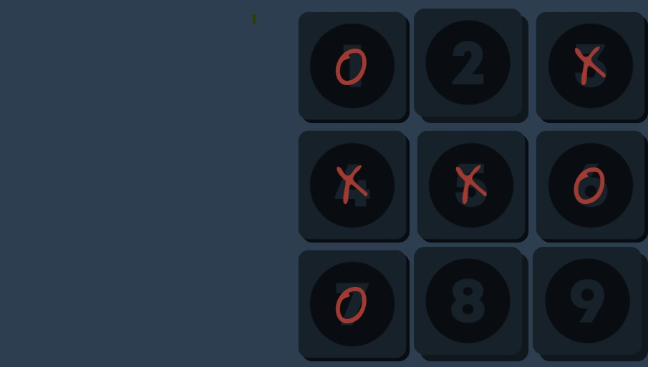
IDEA

Slide 4
Tic Tac Toe with voice commands.
A simple yet classic game played by almost
all with the voice commands to make
it easy to play for people with
motor disabilities .

Slide 5
Approach

Slide 6

Approach
I have a simplistic approach toward everything.
That have two steps only.
What i know ? Web technologies like HTML , CSS ,JavaScript.
What i need to know ?
How to make a tic tac toe game.
How can i turn the my voice into commands on a web browser.

Slide 7
Implementation

Slide 8
Implementation
Designed the User Interface.
Programmed the game logic.
Researched about voice commands , speech recognition & uttrence.
Implemented text to voice for computers voice.
& Speech utterance for voice commands
Step 1
Step 2
Step 3

Slide 9
Tools & technologies
HTML - To script the structure of the game.
CSS - To style the structure of the game.
JAVASCRIPT - To make the game function .
Annyang - A tiny JavaScript speech Recognition library that lets your users control your site with voice commands. Know more.
VSCODE- My favorite code editor IDE.

Slide 10
Links
GitHub - Tic Tac Toe
Game - https://myselfvarun.github.io/tic-tac-toe/
Demo Video - Video

Slide 11
Thank you

