Slide 1


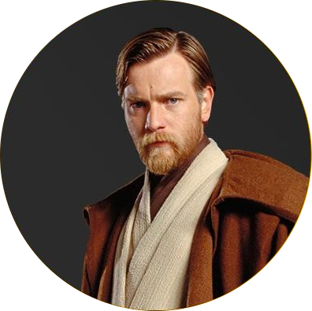






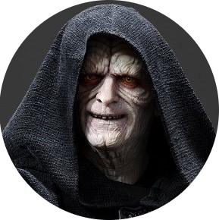


Who are the main Star Wars characters ?
Star Wars characters sorted by time screen for the first two trilogies according to imdb.com (12/2019).
I, II, III
IV, V, VI
1H
1H
Confederacy of Independent Systems / Galactic Empire
Galactic Republic / Rebel
Neutral

