Slide 1
National Industrial Gas Plant · Oman
Cylinder Operations,
Finally Under Control
One platform to track every cylinder from the warehouse to the customer, capture every sale, and know exactly who did what — across all your branches.
100%
0
24/7
Cylinder traceability, warehouse → customer
Untracked sales — every invoice is logged
Audit trail of every action
Web & Mobile · Multi-branch · Role-based access · Full audit log

Slide 2
Why this exists
The three leaks every cylinder business has
Missing cylinders
Cash leaks
No accountability
Between warehouse and customer, cylinders disappear — no one can say where, or whose route.
Hand-written invoices, cash collected but not recorded, debt no one can reconcile at month-end.
When something is wrong, no record of who changed it, when, or from where.
This platform closes all three — and proves it with data.

Slide 3
The Big Picture
Every cylinder, end to end
Warehouse
→
Loader hand-off
→
Salesman
→
Customer
→
Reconcile
A cylinder is never "lost in the system." Each step is recorded with who handled it, what was sold, and what came back.
No more "missing"
Cash clarity
Accountability
variances surface per route, not at month-end
every delivery is an invoice; debt tracked per customer
each step tied to a person and time, in the audit trail

Slide 4
What you get
Six capabilities, one system
Sales & Invoicing
Inventory & Logistics
Finance & Audit
Guided invoicing with correct totals & VAT, on phone or desktop.
Morning loads and daily reconciliation, route by route.
Debt, collections and write-offs — all with a paper trail.
User & Role control
Security
Multi-branch
5 roles, customizable permissions, branch-scoped access.
Strong passwords, multi-factor login, lockout on attacks.
One system, many branches, each seeing only its own data.

Slide 5
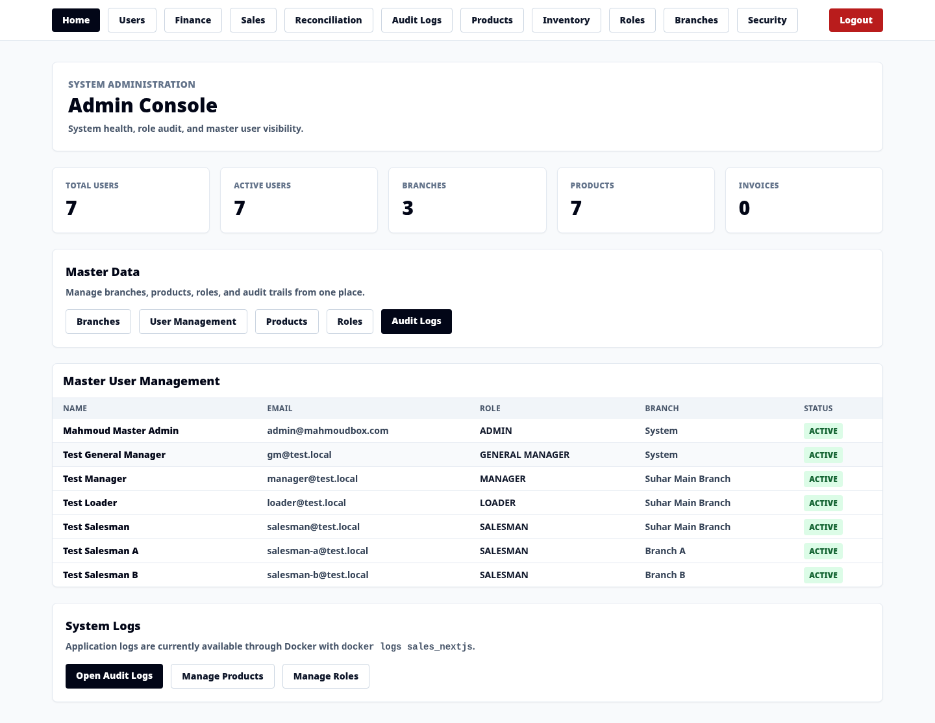
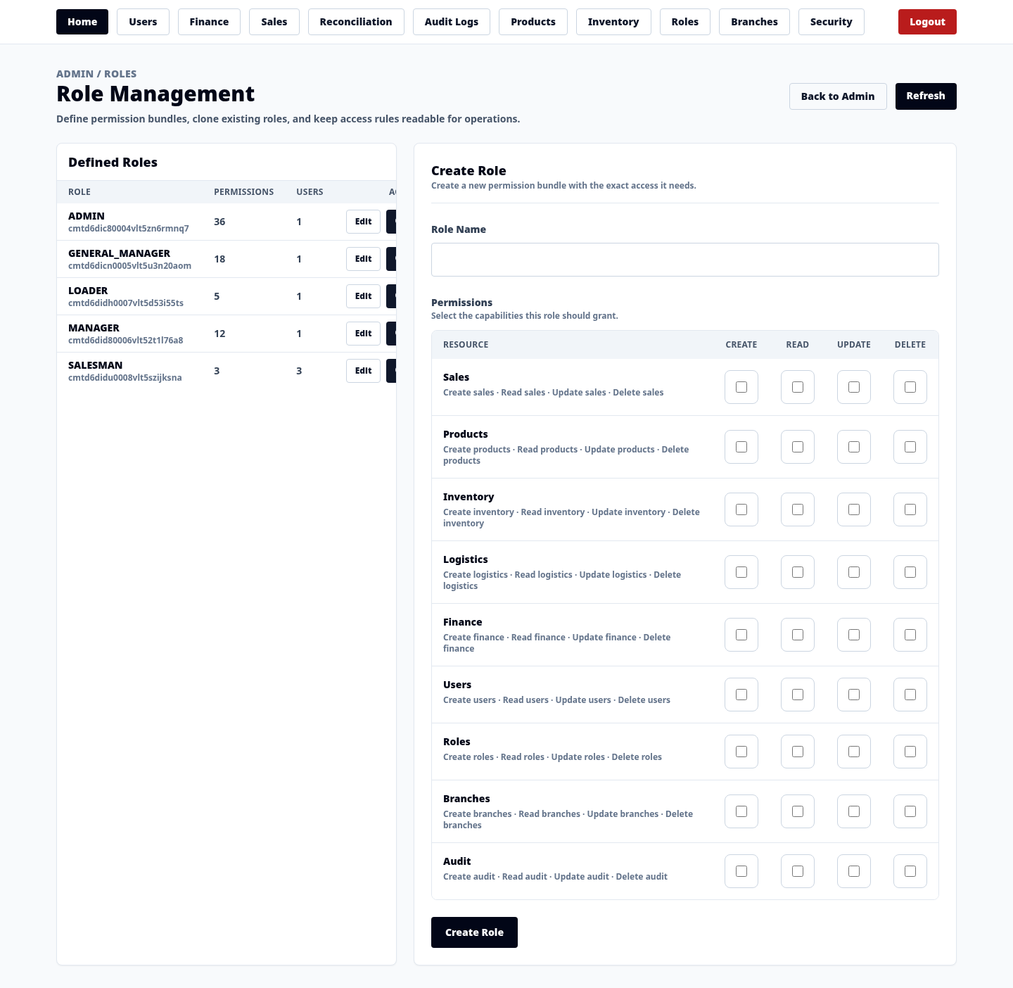
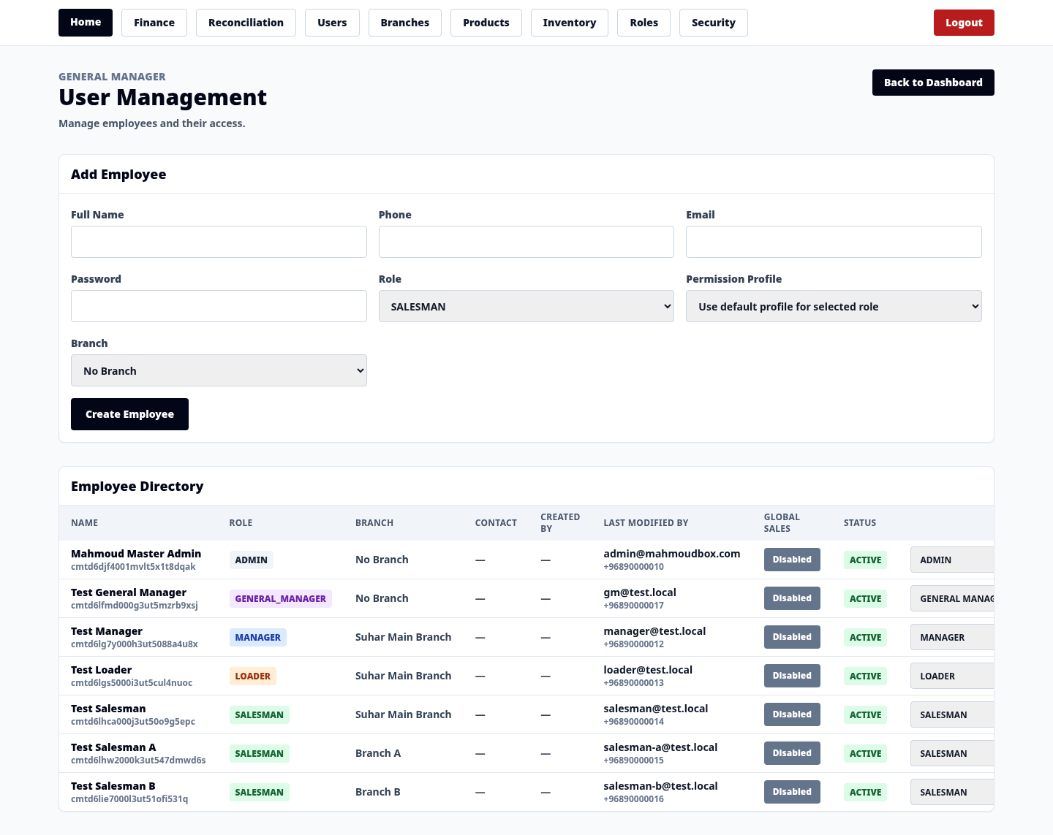
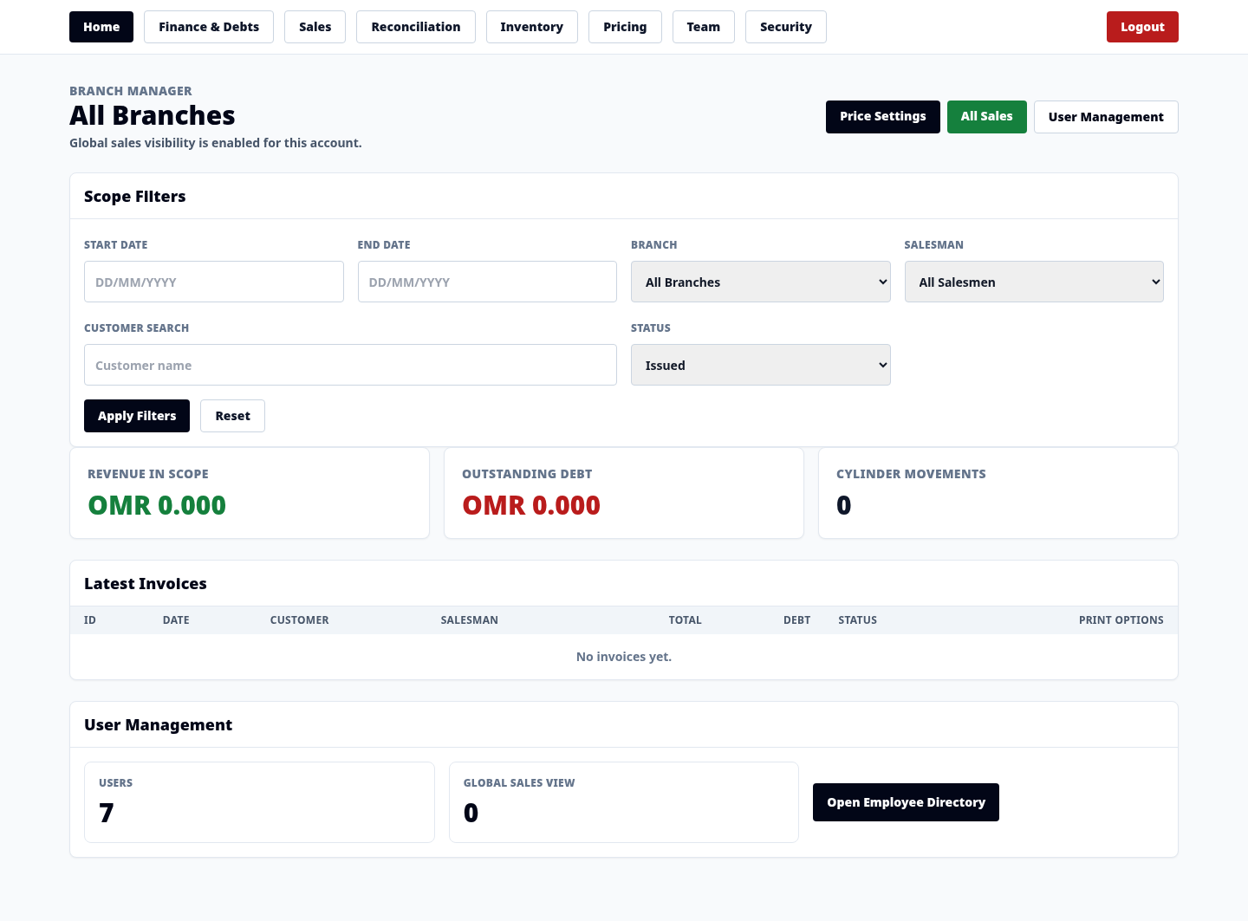
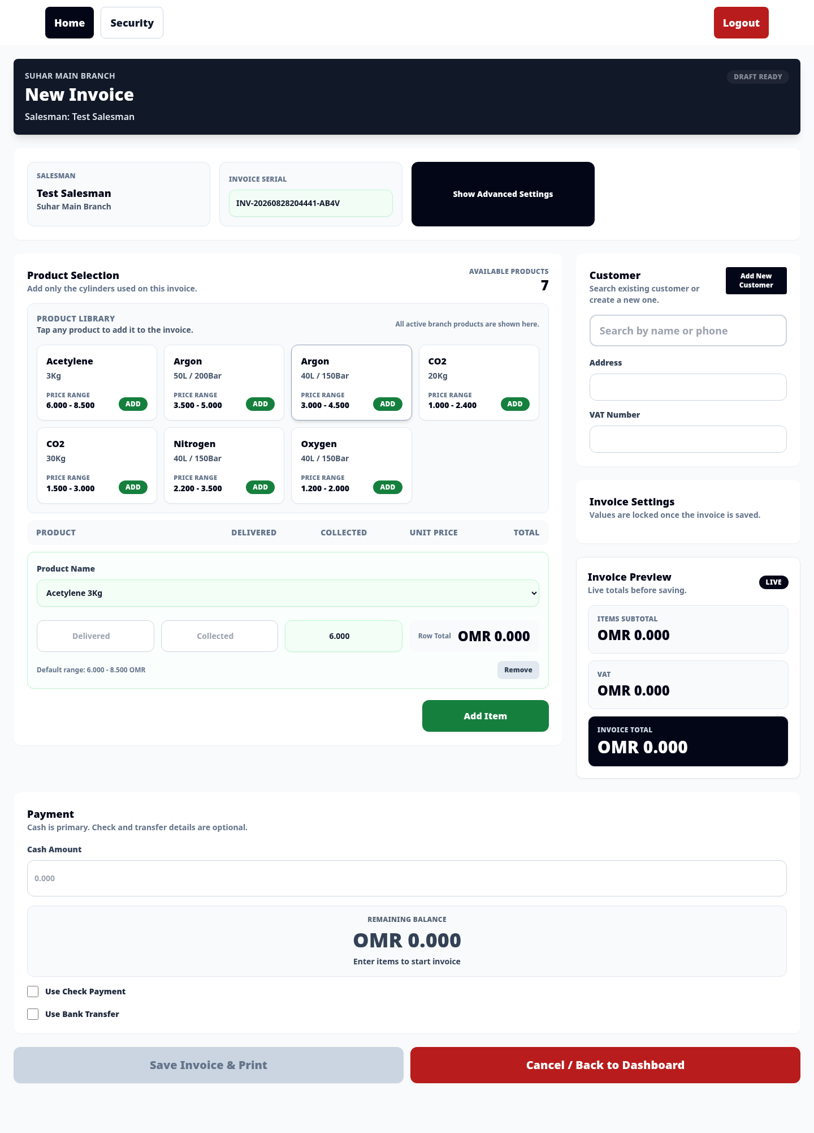
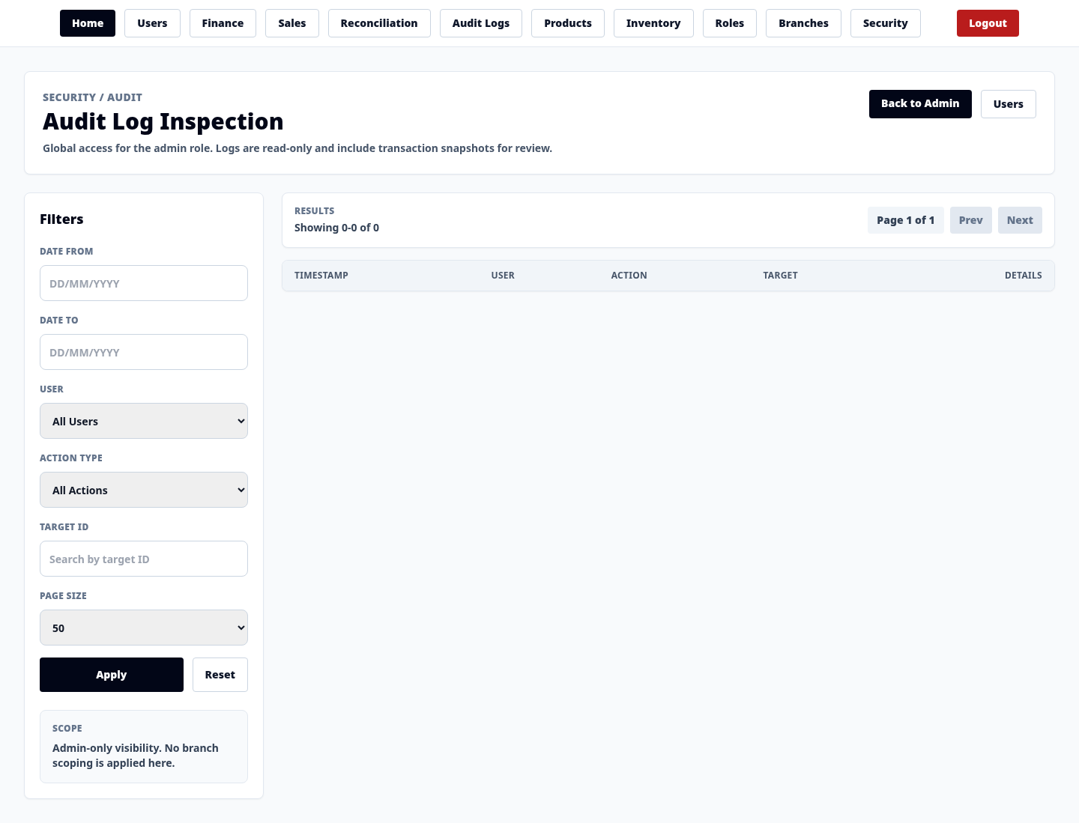
Inside the application
Real screens, real data

Slide 6
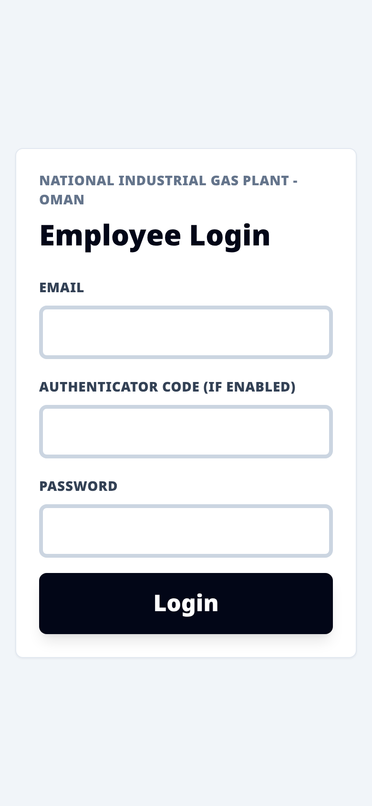
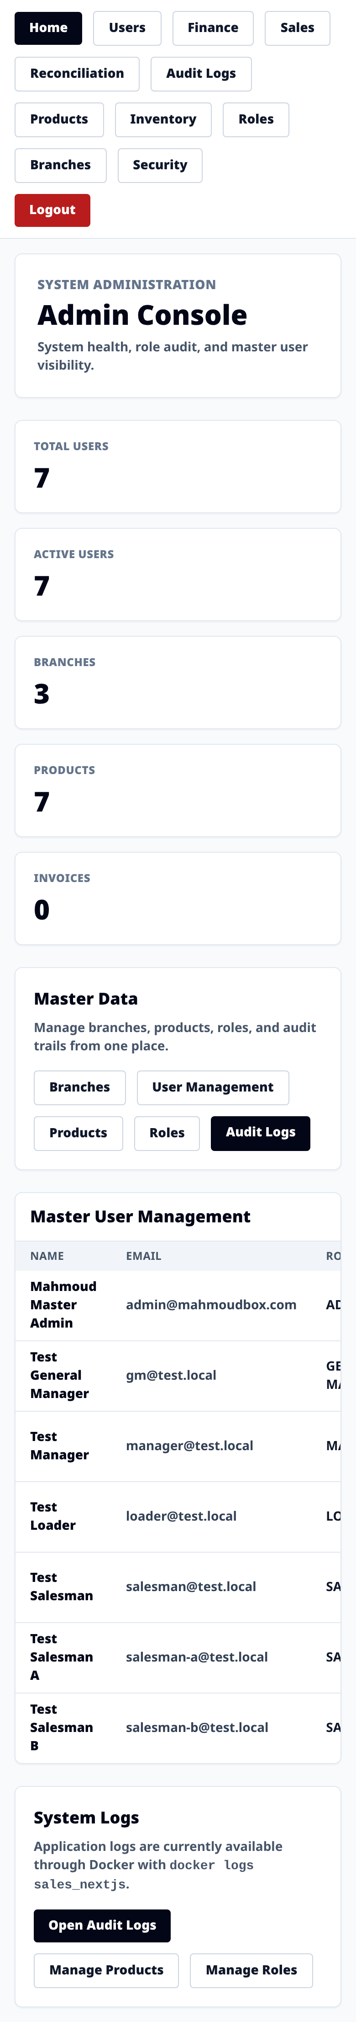
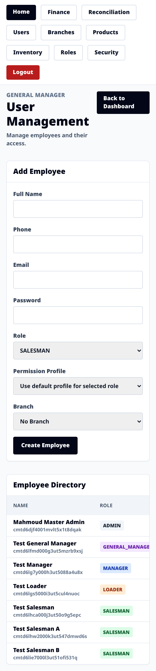
Mobile & Responsive
Your team uses it on the road
The same application, fully responsive — salesmen take orders and managers approve on their phones. No second app to build or maintain.

Slide 7
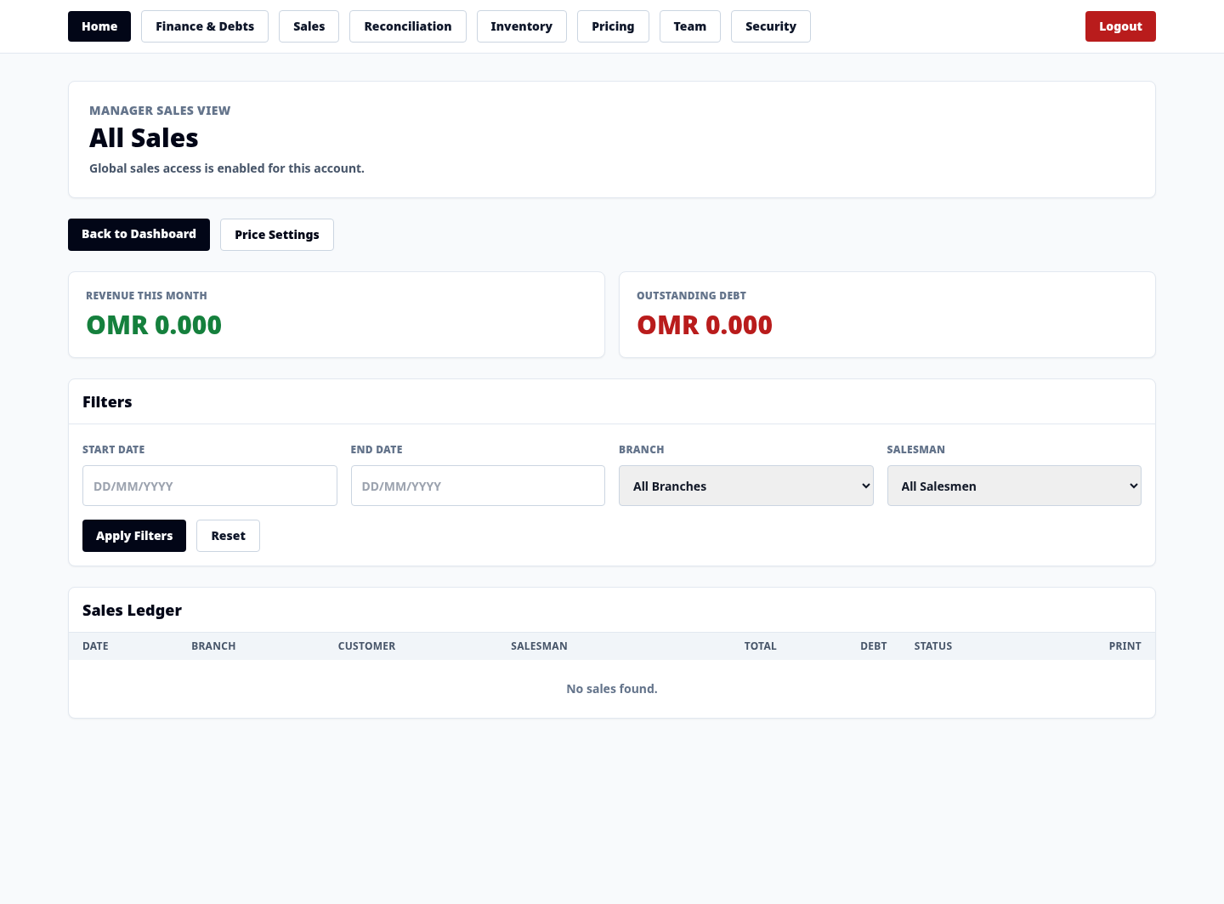
Capability · Sales
Sales & Invoicing
• BEFORE: invoices hand-written — totals and VAT don't add up; no record of who sold what
• NOW: guided invoicing with live accurate totals & VAT; every sale logged; managers see all branch sales

Slide 8
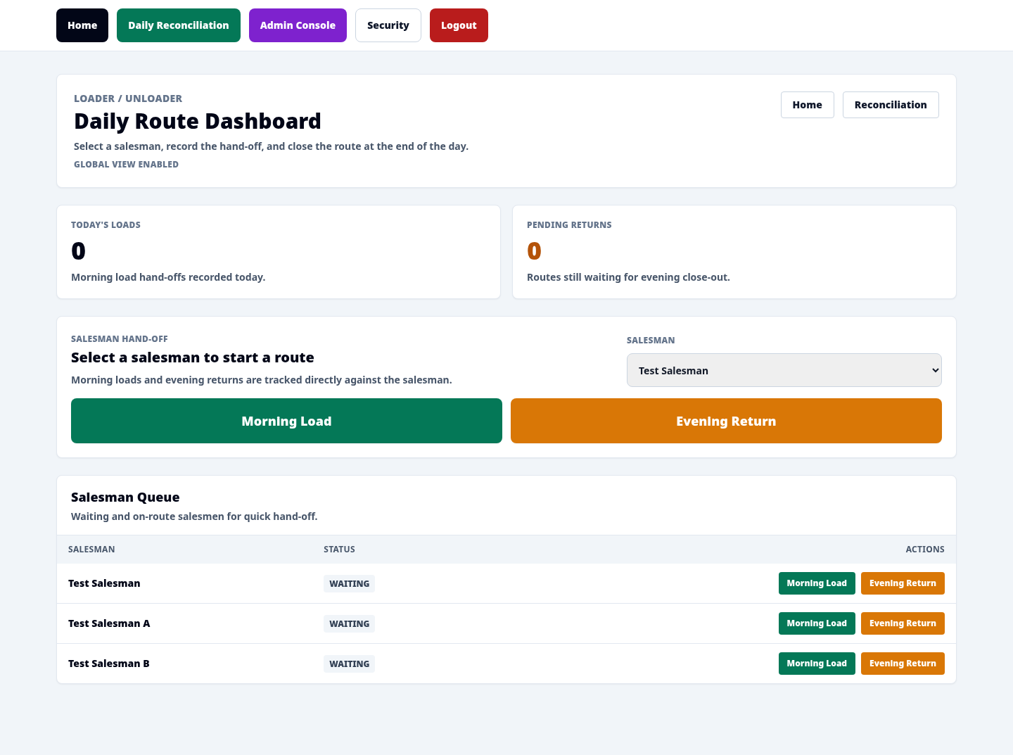
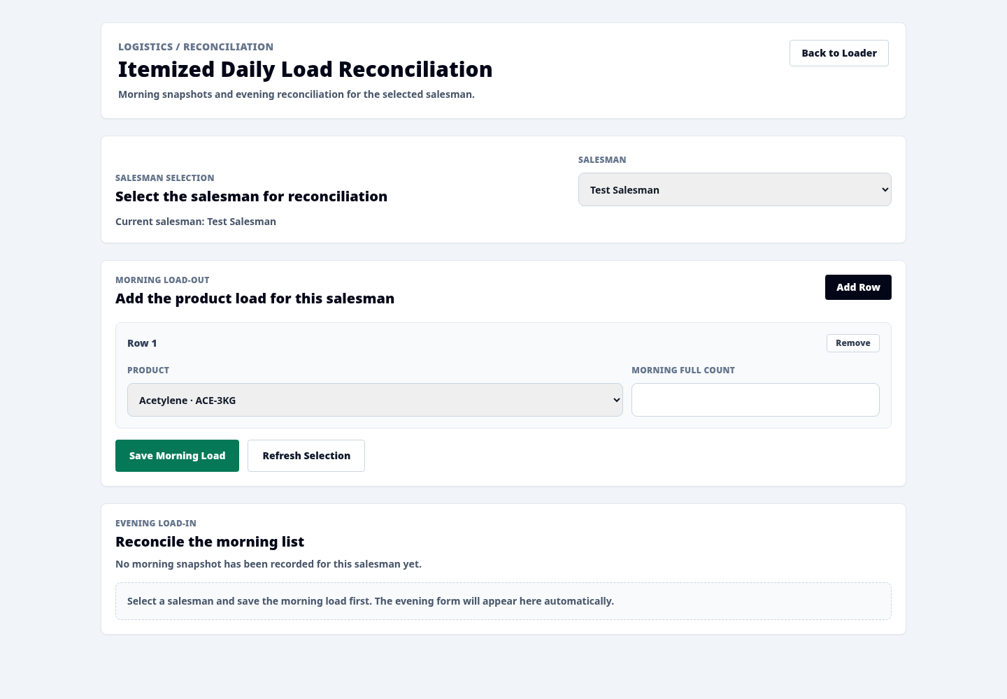
Capability · Logistics
Inventory & Reconciliation
• BEFORE: cylinders disappear; reconciliation late, by memory
• NOW: morning load recorded per salesman; evening match loaded vs invoiced; variances flagged per route

Slide 9
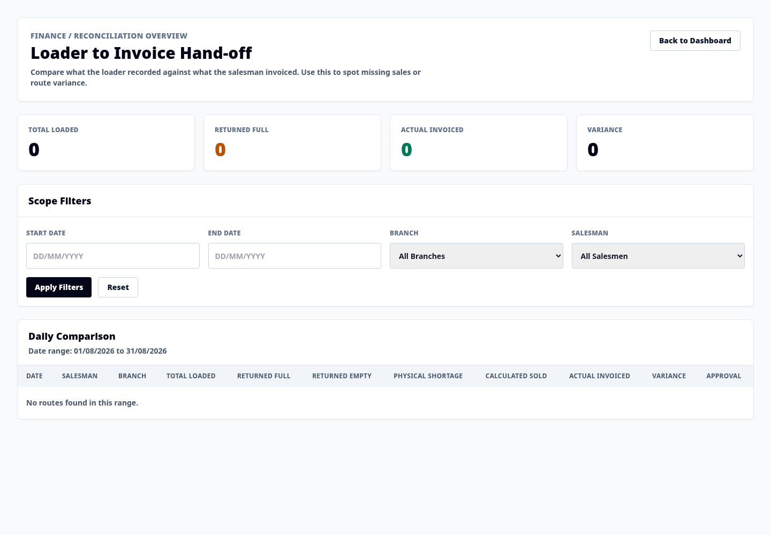
Capability · Finance
Finance & Receivables
• BEFORE: debt in notebooks; write-offs untraceable
• NOW: debt tracked per customer; write-offs need permission + audit; overview at a glance

Slide 10
Trust & Control
Who can see what — and it's all logged
Right access, per role
Protected by design
5 built-in roles plus customizable permissions. Branch data scoped automatically.
Strong password hashing, multi-factor login, lockout after failed attempts.
Every action is recorded
You stay in control
Create, change or delete — logs who, what, before/after, from where.
User directory shows who created and last changed each account.

Slide 11
Proof it works
Not just built — verified
Code quality
Production build
Type-check & lint pass with zero errors. 16 automated tests pass.
Builds and runs as a standalone server, ready to deploy.
Live tested
Real data
Protected screens require login; system reports its own health.
Screenshots are from a live working instance — not mockups.

Slide 12
What's next
Ready to run your branches on one screen
Next steps we recommend: automated tests on every update, a warehouse screen, bulk customer/product import, and exportable reports (reconciliation, debt aging, sales by cylinder).
Deployable today · Branch-scoped · Audited · Mobile-ready
National Industrial Gas Plant · Operations Platform

