Slide 1

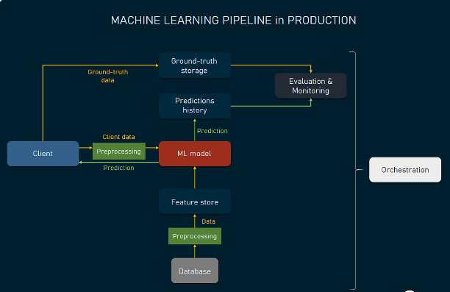
Building an AI Pipeline for Image Segmentation and Object Analysis
This project outlines steps to develop a comprehensive AI pipeline that can process input images, segment all objects, identify and classify them, and analyze their attributes, culminating in a detailed summary table.

Slide 2

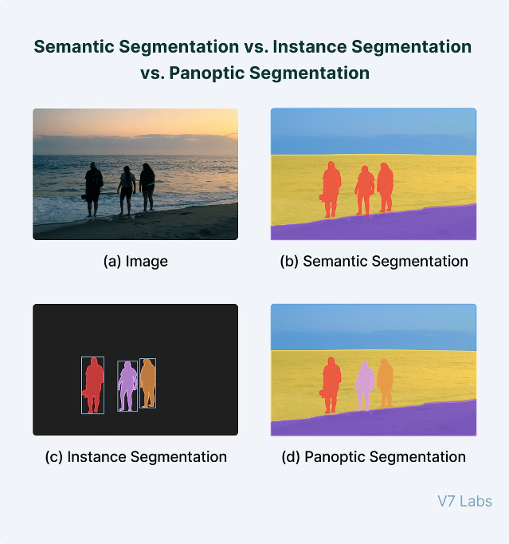
Image Segmentation
The first step is to implement a model or use a pre-trained model for image segmentation. This will separate the input image into distinct regions or segments, each corresponding to a separate object or component within the scene.

Slide 3

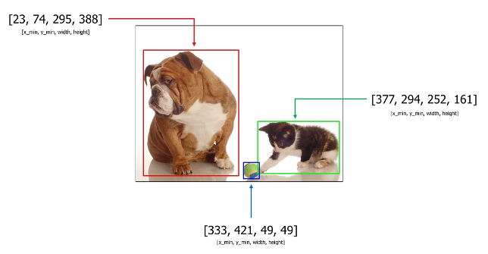
Object Detection and Classification
1
Identify Objects
Once the image is segmented, the next step is to identify and classify all objects within the segmented regions.
2
Classify Objects
Utilize object detection and classification models to recognize the various objects present in the image and categorize them accordingly.
3
Bounding Boxes
Draw bounding boxes around each detected object to delineate their spatial extents within the image.

Slide 4

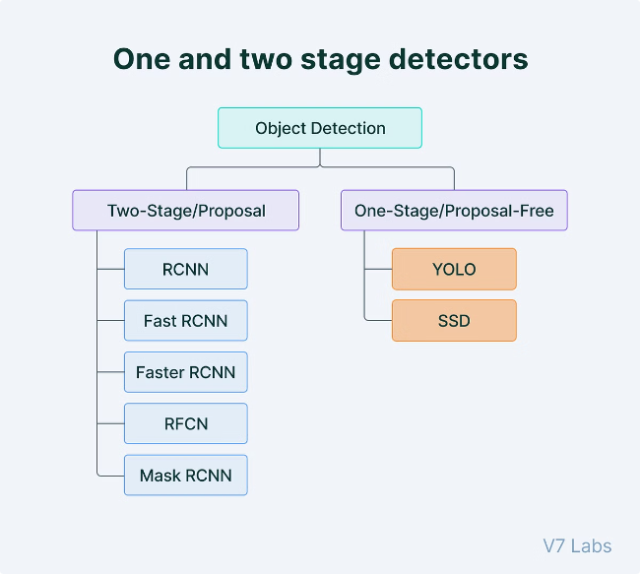
Object Detection and Classification
1
Object Identification
Detect and localize all the objects present in the image using object detection techniques.
2
Object Classification
Classify the detected objects into predefined categories using object recognition models.
3
Bounding Boxes
Draw tight-fitting bounding boxes around each identified object to delineate their spatial extents.

Slide 5


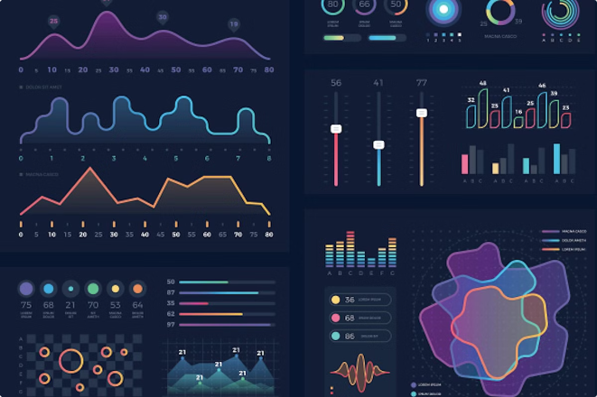


Output Summary
Summary Table
Generate a comprehensive summary table that maps all the detected objects, their classifications, and their analyzed attributes.
Mapped Data
Organize the extracted data and information about each object in a structured format for easy reference and analysis.
Detailed Report
Provide a detailed report that summarizes the entire image segmentation and object analysis pipeline, including insights and findings.

