Slide 1
AI Pipeline for Image Segmentation and Object Analysis
A streamlined AI-powered solution using Detectron2, Pytesseract, and Transformers to segment objects, extract text, and generate summaries from images.

Slide 2
Key Features
Object Segmentation
Text Extraction
Mask R-CNN detects and segments objects.
OCR with pytesseract extracts text from images.
Summarization
Streamlit UI
BART-large model generates summaries.
User-friendly interface for interactive results.

Slide 3
System Architecture
Image Upload
1
Start with an image file.
2
Object Segmentation
Detectron2 identifies and segments objects.
Text Extraction
3
pytesseract extracts text from the image.
4
Summarization
BART-large generates summaries based on detected objects and text.
Output
5
Organized output folder with segmented objects, summaries, and extracted text.

Slide 4
Output & Folder Structure
Output
Description
Segmented Image
Visualizations of segmented objects.
Whole Image Summary
Overall summary of the image content.
Extracted Text
Text extracted from the image.
Individual Object Images
Segmented images of individual objects.
Mapped Data
JSON file containing details about segmented objects and extracted text.

Slide 5




Streamlit UI Overview
Image Upload & Processing
Segmented Image Display
Image Summary
Object Analysis
Summarization and text extraction from the entire image.
Detailed results for each detected object, including class and confidence score.
Upload images and process in real-time.
View the image with object boundaries.

Slide 6
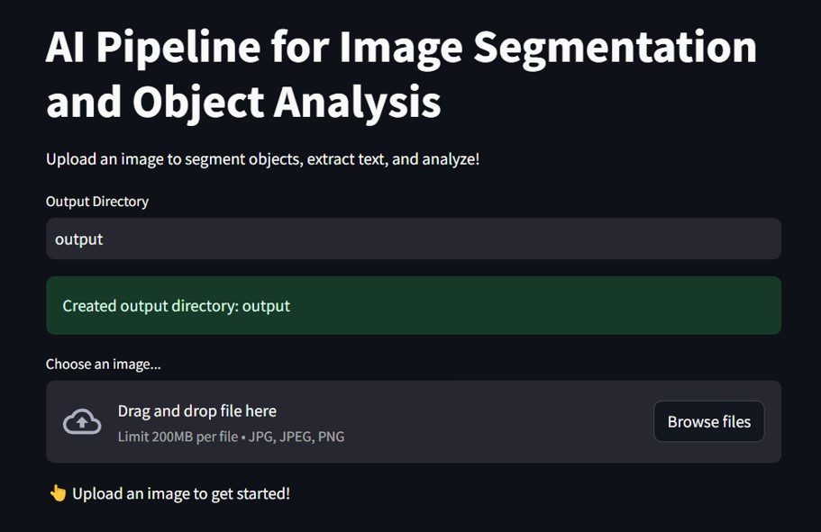
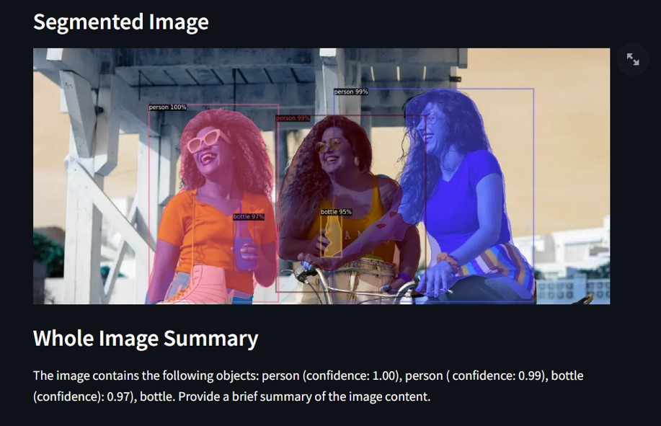
Streamlit UI Overview

Slide 7
Thank You!
Presented by Abhay Sharma

