Slide 1

M. Tech Thesis Presentation
Intrusion Detection System in
Wireless Sensor Network
Under the Supervision
of
Dr. Narottam Chand
Presented By
Department of Computer Science & Engineering
National Institute of Technology, Hamirpur
June, 2019
Atul Agarwal
14MI550

Slide 2
Outline
Introduction
Motivation
Problem Statement
Literature Review
Objectives
Proposed Method
Results
Conclusions and Future Scope of Work
Publications
References

Slide 3
Introduction
No of sensor nodes.
Features –
  Multi-hop wireless communication, deployment in hostile unprotected environment, auto-configuration & self-organization etc.
Attacks –
  Active (DoS, Ddos, Network jamming, warmhole, blackhole, sinkhole attacks).
  Passive (Traffic analysis, malfunctioning of a node, eavesdropping).
Application –
  Monitoring (environmental, structural, behavioral).
  Asset racking, Application in military to medical etc.

Slide 4
Introduction
Routing Protocols –
  Flat Routing-
    Sensor Protocol for Information via Negotiation (SPIN)
    Direct Diffusion (DD)
  Hierarchical Routing-
    Low-Energy Adaptive Clustering Hierarchy (Leach)
    Power Efficient Gathering in Sensor Information System (PEGASIS)
  Location Based Routing-
    Geographical Energy Aware Routing (GEAR)
    Greedy Perimeter Stateless Routing (GPSR)

Slide 5
Introduction - Attacks in WSN
Self-organization and auto-configuration in nature, distributed and decentralization, multi-hop communication, deployment in hostile unprotected environment, etc. are some characteristics which may expose this network to many security attacks.

Slide 6
Introduction - Attacks in WSN
Layers | Attacks
Application Layer | Data Corruption, Repudiation
Transport Layer | SYN Flooding, Session Hijacking
Network Layer | Hole Attacks, Byzantine, flooding, resource consumption
Data Link Layer | Traffic analysis, monitoring, disruption MAC (802.11)
Physical Layer | Jamming, interceptions, eavesdropping
Multi-layer Attack | DoS, impersonation, replay, man-in-the-middle

Slide 7
Introduction – Intrusion
An intrusion in any system is an attempt to unauthorized access of system’s data or resources.
This unauthorized access can be limited to only monitoring and analyzing traffic patterns or it can be an attempt to modify or alter the data packets.
An IDS basically monitors and analyzes the network traffic for any suspicious activity by any of the network node.

Slide 8
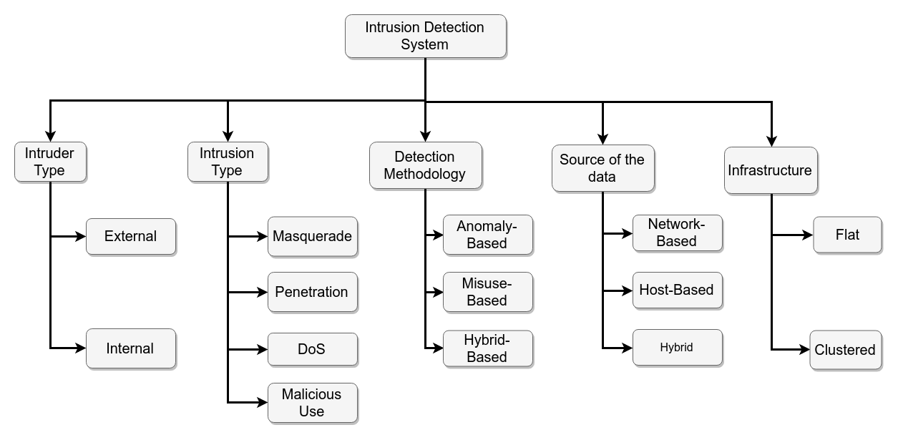
Introduction - IDS

Slide 9
Motivation
Application domain of WSN is very wide in the fields of medical to military and data plays very important role in every field.
Intrusion is any activity in a network, which is not authorized and affects network’s services, resources or data either passively or actively. Such activity if not prevented in the first line of defense in WSN security then IDS comes into play as the second line of defense. The network member nodes detects any suspicious behavior to detect intrusion.

Slide 10
Problem Statement
In order to provide protection to wireless sensor networks many solutions such as cryptographic and secure routing, key exchange and authentication are proposed. These methods are used to provide security from outside attack upto some level but these cannot eliminate all security attacks. To detect an inside attack Intrusion Detection System is introduced which can deal with wide range of attacks in WSN.

Slide 11
Literature Review
Paper | Method | Features | Limitations
A. Mehmood, A. Khanan, M. M. Umar, S. Abdullah, K. A. Z. Ariffin and H. Song, "Secure Knowledge and Cluster-Based Intrusion Detection Mechanism for Smart Wireless Sensor Networks," in IEEE Access, vol. 6, pp. 5688-5694, 2018. | Cluster-based IDS, uses knowledge base for storing patterns, inference engine | Traffic is monitored and any suspicious event generated by an attacker node is blocked by the CH. | KB-IDS puts a load on a single node inside the cluster, faster battery drainage for cluster head.
Jianjian D., Yang T., & Feiyue Y., "A Novel Intrusion Detection System based on IABRBFSVM for Wireless Sensor Networks," Procedia, Computer Science, vol. 131, pp. 1113–1121, 2018. | Improved AdaBoost-Radial basis function in Support Vector Machine | Detects DoS attack efficiently, improves network performance, short computation, high detection rate. | Only Focused on DoS attack, can;t detect multiple attacks
Jin X., Liang J., Tong W., Lu L., & Li Z, "Multi-agent trust-based intrusion detection scheme for wireless sensor networks," Computers & Electrical Engineering, vol. 59, pp. 262–273, 2017. | Uses trust values and multi- agent framework functioning, uses Mahalanobis distance. | Reduction in false positive rate, scalable system, fault tolerant, can detect multiple attacks at the same time | Trust value calculation and accuracy are calculated by Mahalanobis distance.

Slide 12
Literature Review
Paper | Method | Features | Limitations
Saeed A., Ahmadinia A., Javed A., & Larijani H., "Random Neural Network Based Intelligent Intrusion Detection for Wireless Sensor Networks," Procedia Computer Science, vol. 80, pp. 2372–2376, 2016. | Uses Random Neural Network, without any dedicated hardware. | Very effective in low-power WSN, detects any performance degradation anomaly attack, can also detect previously unknown attacks. | Computation time, energy consumption was high as compared to others at the cost of accuracy.
Sedjelmaci H., Senouci S. M., & Feham M., "An efficient intrusion detection framework in cluster-based wireless sensor networks," Security and Communication Networks, Willey Online Library, 2013. | 3 different detection frameworks- specification based, binary classification protocol, vote mechanism. | Detection rate was almost 100%. Time, energy consumed to detect was very low. | System was able to detect only blackhole, warmhole, flooding and selective forwarding attacks.
Wang S.-S., Ya, K.-Q., Wang S.-C., & Liu C.-W., “An Integrated Intrusion Detection System for Cluster-based Wireless Sensor Networks”, Expert Systems with Applications, vol. 38, issue 12, pp. 15234–15243, 2011. | 3 different IDS for heterogeneous WSN- For sink node, IDS has the learning capabilities, For Cluster head node, a Host based IDS, A simple and fast misuse IDS was proposed for SNs. | Can detect known, unknown attacks, avoids resource wasting, uses feedback mechanism. | Consumes high energy as it uses learning and feedback mechanism.

Slide 13
Objectives
Design an energy efficient IDS which consumes less time for computations with minimum performance overheads.
Proposed system should have high accuracy.
Compare the results of simulation with existing algorithms.

Slide 14
Proposed Work
Dataset-
  WSN-DS [44] dataset used in this approach helps in classification and detection of attack. This dataset consists of LEACH-clustering protocol normal activities with attacks of like blackhole, grayhole, scheduling, and flooding. These attacks are implemented on top of LEACH protocol.
  This work uses WSN-DS dataset to train our neural network which contains 374661 observations on different attacks on top of LEACH. Each vector of the dataset contains 19 features.
  The dataset contains data about Grayhole attack, Blackhole attack, Scheduling attack, Flooding attack together with normal behaviour of network in LEACH protocol.

Slide 16
Proposed Work
Neural Network-
  A NN classifier consists of number of neurons units, arranged in layers. Each layer takes some input vector and gives output by applying a non-linear function. This output works as input to next layer in feed-forward manner.
  To train this neural network one feature Attack Type is used as label. Out of other remaining 18 features, 14 features has been used to get the best result out of training.
  Neural Network working model can be described in following 6 steps:

Slide 17
Neural Network
Analyze the Dataset
Prepare the dataset
Create the Model
Compile the Model
Fit the Model
Evaluate the Model

Slide 18
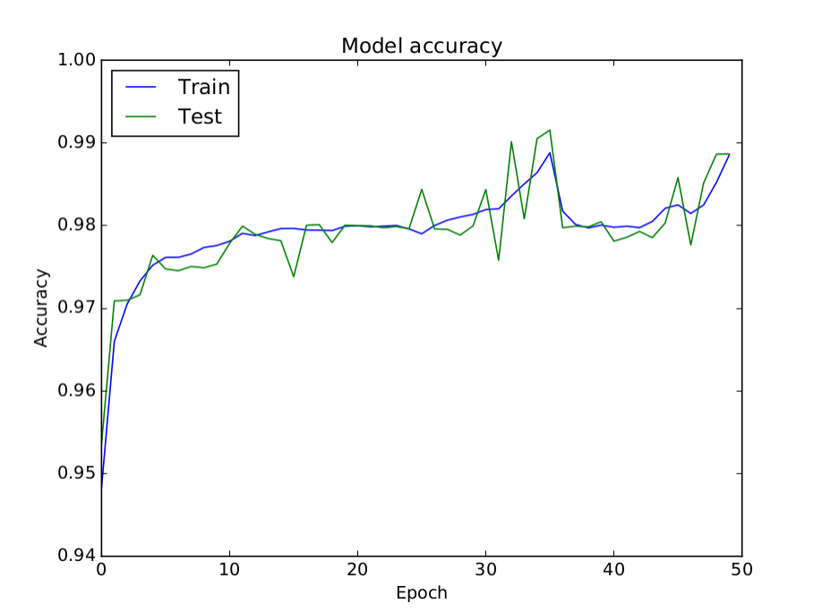
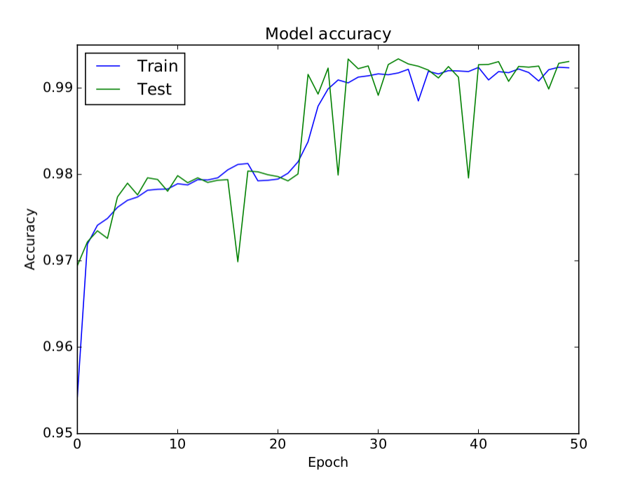
Results and Conclusions
Figure 1: Accuracy with 2 hidden layer
Figure 2: Accuracy with 3 hidden layer

Slide 19
Future Scope of Work
Currently, proposed system is only able to cope with 4 types of attack. This research work can be extended by generating and collecting more data of different attack categories.
Number of observation vector of attacks can be more to detect any attack more accurately by training the neural network and adding more hidden layers.
Dataset creation can have more features by observing/monitoring the Sensor nodes behavior closely.
The proposed approaches uses only feed forward network for classification, back-propagation algorithm can be implemented to achieve more accuracy.

Slide 20
Publications
A. Agarwal and N.C. Kaushal, “A Study of Intrusion Detection System in Wireless Sensore Network,” 4th International Conference on Internet of Things and Connected Technologies (ICIoTCT), 2019.

Slide 21
References
[1] A. Mehmood, A. Khanan, M. M. Umar, S. Abdullah, K. A. Z. Ariffin and H. Song, "Secure Knowledge and Cluster-Based Intrusion Detection Mechanism for Smart Wireless Sensor Networks," in IEEE Access, vol. 6, pp. 5688-5694, 2018.
[2] Nannan Lu, Yanjing Sun, Hui Liu, and Song Li, "Intrusion Detection System Based on Evolving Rules for Wireless Sensor Networks," in Journal of Sensors, vol. 2018, Article ID 5948146, 8 pages, 2018.
[3] Saeed A., Ahmadinia A., Javed A., & Larijani H., "Random Neural Network Based Intelligent Intrusion Detection for Wireless Sensor Networks" in Procedia computer Science, Vol. 80, pp. 2372–2376, 2016.
[4] L. Sheeba, "A Brief survey on Intrusion Detection System for WSN", in International Journal of Computer Trends and Technology (IJCTT), vol. 40, No. 3, October 2016.

Slide 22
References
[5] Padmalaya Nayak, V. Bhavani and B. Lavanya, "Impact of Black Hole and Sink Hole Attacks on Routing Protocols for WSN", in International Journal of Computer Applications (IJCA), vol. 116, No. 4, pp. 42-46, April 2015.
[6] D. He, C. Chen, S. Chan, J. Bu and L. T. Yang, "Security Analysis and Improvement of a Secure and Distributed Reprogramming Protocol for Wireless Sensor Networks," in IEEE Transactions on Industrial Electronics, vol. 60, no. 11, pp. 5348-5354, Nov. 2013.
[7] Weizhi Meng, Wenjuan Li, Lam-For Kwok, "EFM: Enhancing the performance of signature-based network intrusion detection systems using enhanced filter mechanism”, Elsevier, computers & security, vol. 43, June 2014, pp.189-204

Slide 23
Thank You

