Slide 1
Presentation
暂无内容。
暂无内容。

Slide 2
Outline of This Chapter
1. Optimal Selection Intensities [2.]
2. Effects of Population Structure [3.]
3. Asymptotic Response from Mutation

Slide 3
1 Optimal Selection Intensities for Maximizing Long-term Response
1. Optimal Selection Intensities [2.]
2. Effects of Population Structure [3.]
3. Asymptotic Response from Mutation

Slide 4
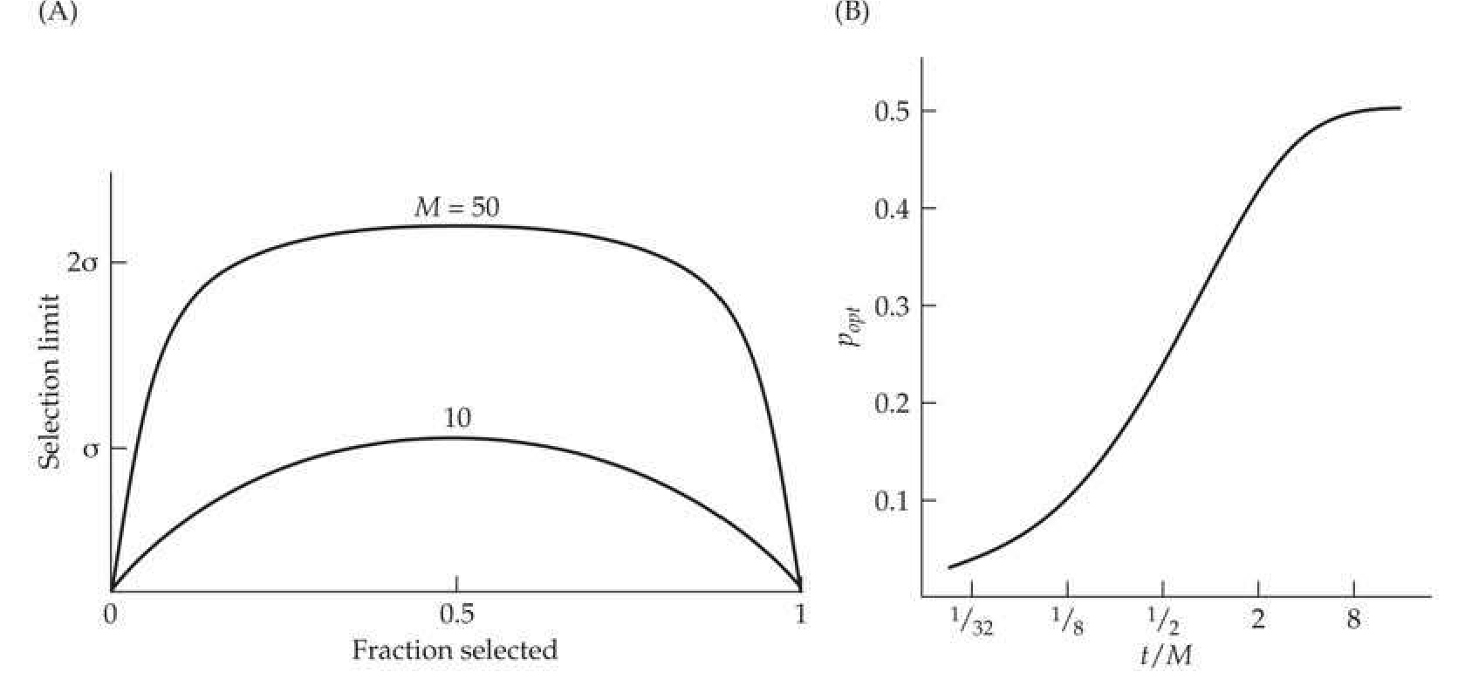
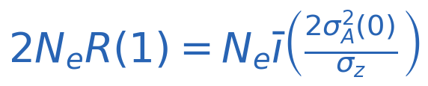
Tradeoff between Selection Intensity and Drift
暂无内容。
• Robertson's selection limit (Equation 26.15b) becomes Ultimate response depends on $N_e \bar{\imath}$.
• Decreasing $p$ (the
• Figure 26.5A shows the selection limit vs. $p$ for $M = 10$ and $M = 50$; the peak is flat-topped at $p \approx 0.5$.

Slide 5
Experimental Support and Impact of $N_e$ Reduction
$N$ | $\bar{\imath}$ | $N_e$ | $N_e/N$ | $2N_e R(1)$
25 | 0.8 | 20.0 | 0.80 | 161
10 | 1.4 | 6.2 | 0.62 | 87
5 | 1.8 | 2.6 | 0.52 | 47
• Madalena & Robertson (1975): Drosophila bristle selection; saving 10/25 gave a more extreme limit than 5/25.
• Similar results in Tribolium egg-laying and mouse postweaning weight (Ruano et al. 1975; Hanrahan et al. 1973).
• Using $N = pM$ as $N_e$ overestimates true $N_e$; stronger selection further reduces $N_e/N$.
• Table 26.4 quantifies this reduction:

Slide 6
Optimal Proportion as a Function of $t/M$
暂无内容。
• Optimal proportion $p_{\text{opt}}$ depends on $t/M$ (Figure 26.5B).
• For $t/M \le 0.2$, observed and predicted rank orders agree well (Ruano et al. 1975; Frankham 1977).
• Discrepancies at larger $t/M$ may arise from major alleles or uncorrected $N_e$ estimates.
• Unequal sex ratios: optimal response when both sexes are scored and selected with the same proportions.

Slide 7
2 Effects of Population Structure on Long-term Response
1. Optimal Selection Intensities [2.]
2. Effects of Population Structure [3.]
3. Asymptotic Response from Mutation

Slide 8
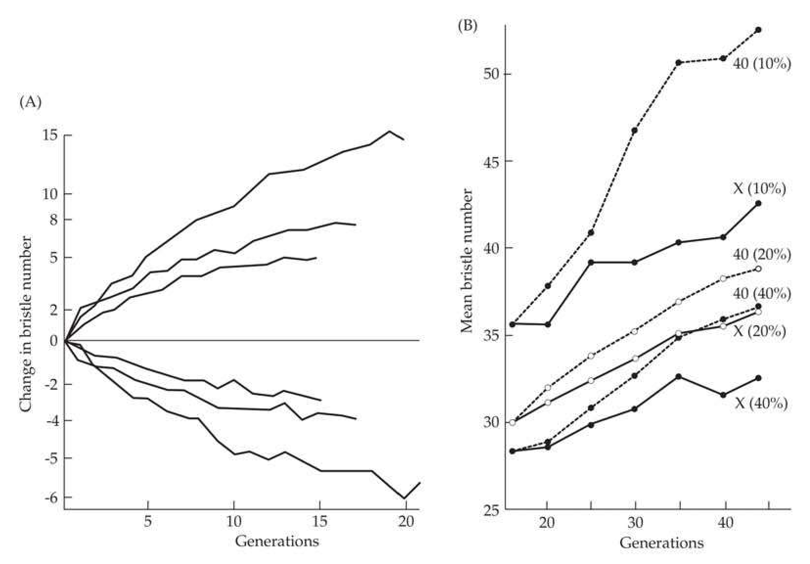
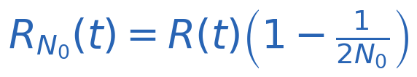

Founder Effects and Population Bottlenecks
暂无内容。
• $Lines founded from a single pair show $ 30$
• Bottlenecks after many generations of selection can still reduce response (Jones et al. 1968, Figure 26.6B).
• With weak selection (infinitesimal model):
• With strong selection on a major allele, loss probability depends on $p_0$ and $N_0$:

Slide 9
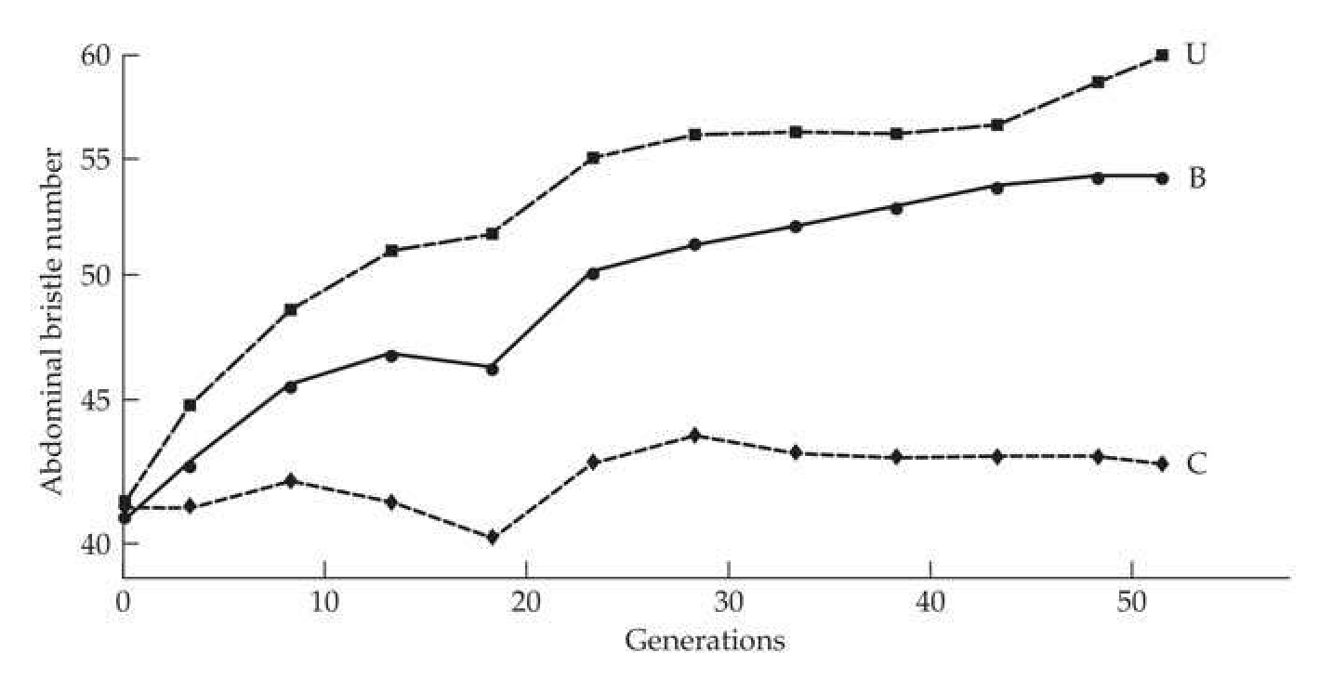
Founder Effects: Experimental Results
暂无内容。
• Frankham (1980): bottlenecked lines ($N_0=2$) had limits $0.69-0.72$ of the non-bottlenecked value, close to the predicted $0.75$.
• Skibinski & Shereif (1989): lines from the central part of the distribution showed larger total response, suggesting higher heterozygosity at major loci.
• Rare favorable alleles of large effect contribute little to $\sigma_A^2(0)$ but can greatly influence response if fixed.
• Prolonged lab breeding before selection may eliminate rare alleles, making response resemble the infinitesimal model (Zhang & Hill 2005a).

Slide 10
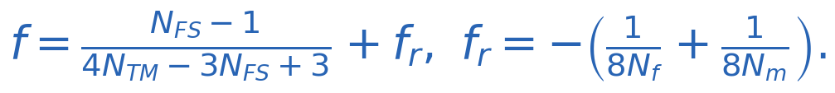
Population Subdivision
暂无内容。
• Crossing $k$ lines of size $N$ gives the same limit as a single line of size $kN$, provided no among-line selection.
• With nonadditive variance, subdivision can increase the limit (e.g., favorable recessives become homozygous).
• Wright's shifting-balance theory: local inbreeding facilitates accumulation of epistatic combinations.
• Caballero et al. (1991) showed full-sib mating after selection increases fixation of recessives without harming additive alleles:

Slide 11
Within-family Selection
暂无内容。
• Selecting the best male and female from each full-sib family gives $N_e \approx 2N$ (zero among-family variance).
• Single-generation response: $R_{wFS}(1) = \bar{\imath} h_{wFS}^2 \sigma_{wFS}$ with $h_{wFS}^2 = (\sigma_A^2/2)/\sigma_{wFS}^2$.
• If additive variance dominates environmental variance, $\widetilde{R}_{wFS} / \widetilde{R}_{\text{mass}} \ge \sqrt{2}$.
• Additional advantages:
• No cumulative reduction in $N_e$ from selection ($Q=0$ in Eq. 26.6c).
• Robust to large common-family environmental variance.
• Less affected by negative gametic-phase disequilibrium.

Slide 12
3 Asymptotic Response Due to Mutational Input
1. Optimal Selection Intensities [2.]
2. Effects of Population Structure [3.]
3. Asymptotic Response from Mutation

Slide 13
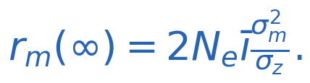
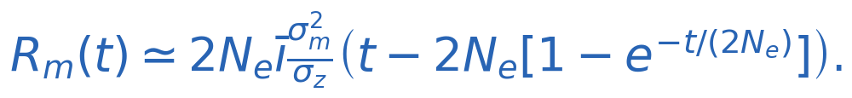
Infinitesimal Model: Variance and Response
暂无内容。
• Expected additive variance at generation $t$:
• Variance from mutation alone: $\sigma_{A,m}^2(t) \simeq 2N_e\sigma_m^2 [1 - e^{-t/(2N_e)}]$.
• Asymptotic rate of response:
• Cumulative mutational response:

Slide 14
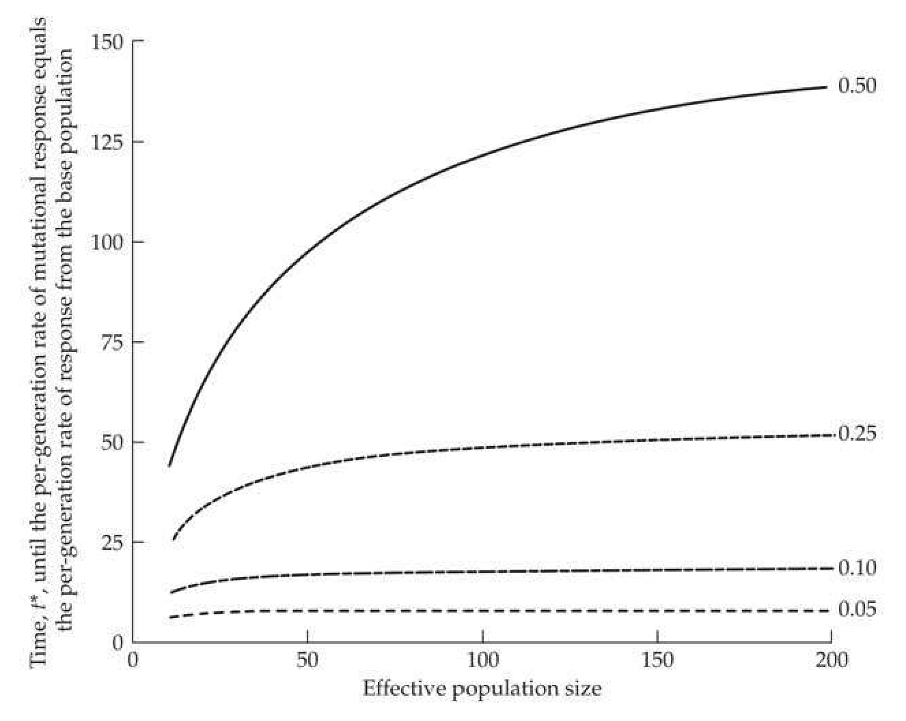
When Does Mutation Outweigh Initial Variation?
• Solution: $t^* = 2N_e \ln(1+\Psi)$, with $\Psi = \frac{h^2}{(1-h^2)2N_e h_m^2}$, $h_m^2 = \sigma_m^2/\sigma_E^2$.
• Typical $h_m^2 \approx 0.005$; then $t^* \simeq 200h^2/(1-h^2)$ when $\Psi \ll 1$.
• Example: $h^2 = 0.25$ gives $t^* \approx 67$ generations, but this is an upper bound.
• Figure 26.8 shows weak dependence on $N_e$; the approximation overestimates $t^*$ for small $N_e$.

Slide 15
Example 26.5: Yoo's Drosophila Experiment
• Parameters: $\sigma_E^2 \simeq 4$, $\sigma_z^2 \simeq 5$, $h^2 \simeq 0.2$, $\bar{\imath} \simeq 1.4$, $N_e \simeq 60$, $h_m^2 = 0.001$.
• Computed $t^* = 135$ generations, longer than the 80 generations observed.
• At generation 60, mutation contributes $\approx 0.13$ bristles/generation, initial variation $\approx 0.38$; total predicted $0.51$.
• Observed rate $0.3$ bristles/gen is lower, suggesting opposing natural selection and/or major alleles altering the dynamics.
• With major alleles, initial variance declines faster, so mutation could account for a larger

Slide 16
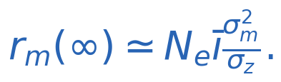
General Mutational Models and Asymptotic Rate
• For additive mutants with symmetric effects:
• With dominance, $\sigma_m^2 = 2\mu E[\alpha^2(1+k)^2]$; for complete dominance, $\sigma_m^2 = 8\mu E[\alpha^2]$, and
• For recessive alleles, response scales as $\sqrt{N_e\bar{\imath}}$ and is not predictable from $\sigma_m^2$ alone.
• The house-of-cards model and pleiotropic fitness effects can bound long-term response, often reducing predicted gains.

