Slide 1
Dynamic (n-level) Hierarchy
Planning and hierarchy composition split into separate stages, with hierarchy depth chosen by the model
10/10
Hanoi tasks solved optimally
(2-level: 8/10)
7.1x
fewer output tokens
than the 2-level pipeline
0
correction rounds needed
(2-level: 55)
12
max hierarchy depth built
(2-level: fixed at 2)
It solves hanoi_11 and hanoi_12, which the 2-level pipeline cannot: there, the 2-level pipeline burns 15 replans and ~90k output tokens and executes zero moves.
gpt-5.5 · reasoning effort low · max 8,192 output tokens/call · replan budget 15 · 1 run per cell · baselines 2026-07-06/07, dynamic 2026-08-07

Slide 2
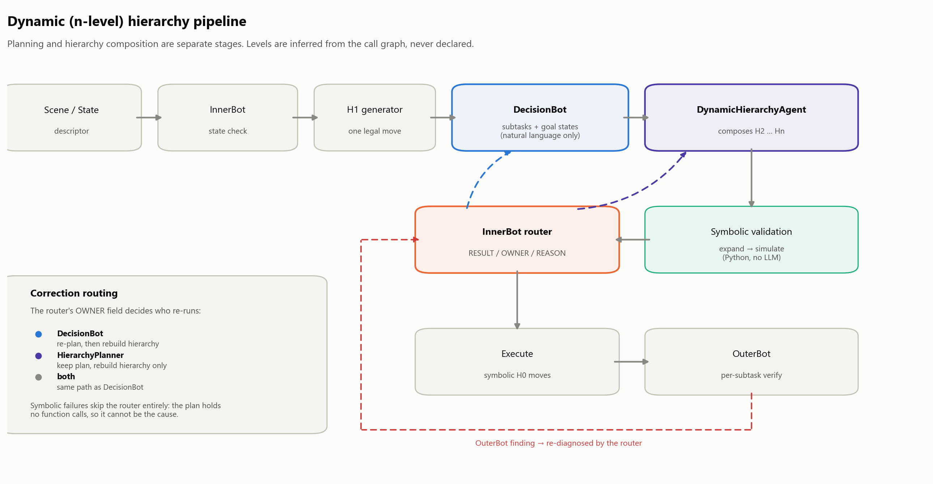
Architecture
The DecisionBot is shown no composed actions and never given a call format, so it cannot emit a solution.

Slide 3
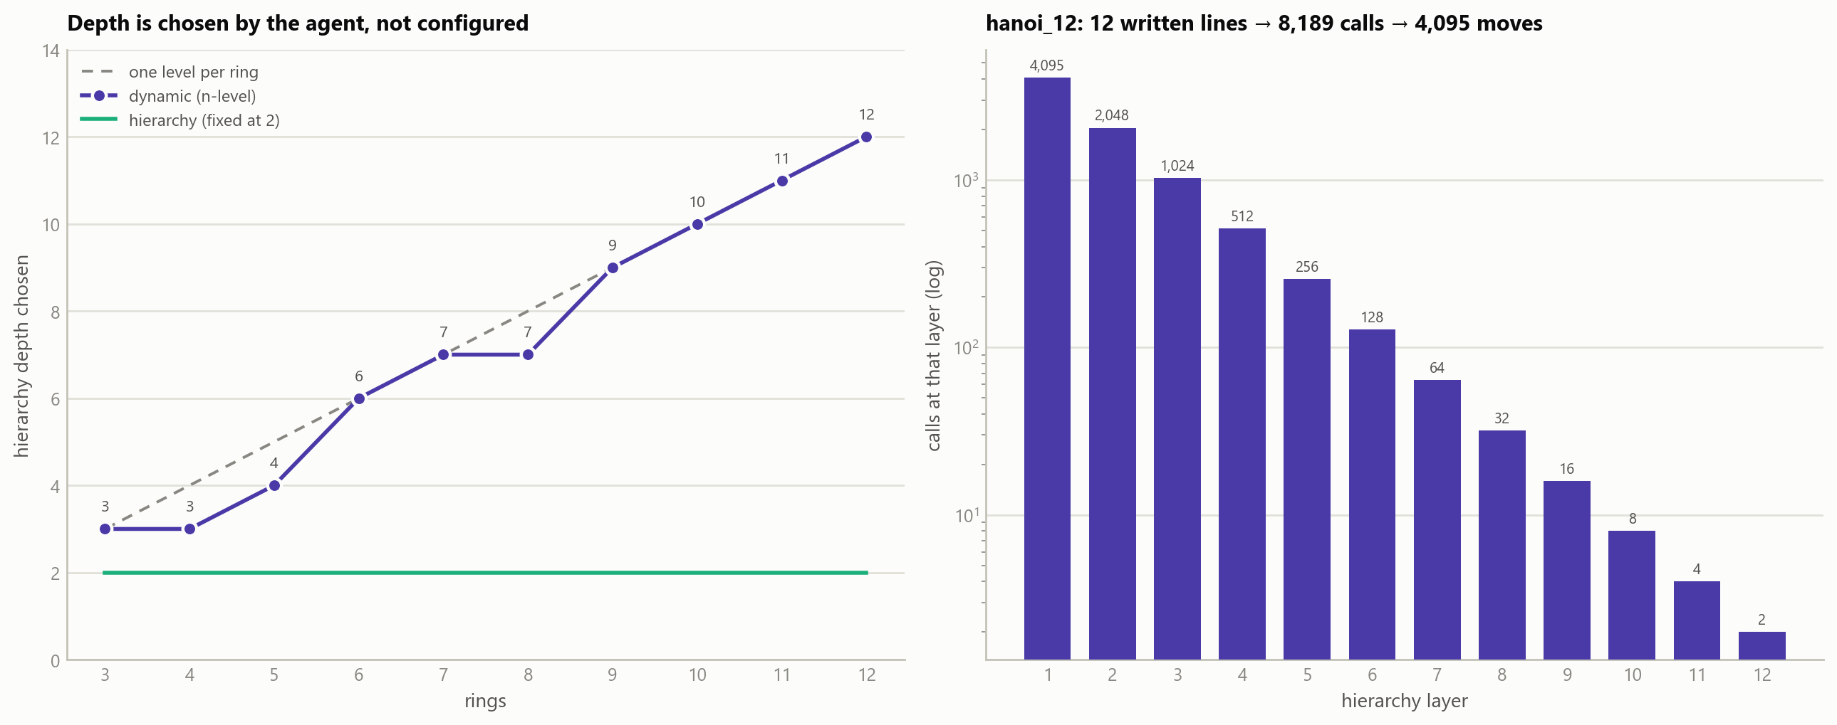
How many layers? The model decides.
No level count is configured anywhere. One call emits the whole hierarchy; depth is inferred from the call graph afterwards.
level(primitive) = 0, level(f) = 1 + max(level of callees). The model never labels a level; cycles and unresolvable callees are rejected.
Given free rein it built exactly one function per layer in all 10 tasks — a straight chain — rediscovering Hanoi's recursion from an abstract example that never mentions towers.

Slide 4
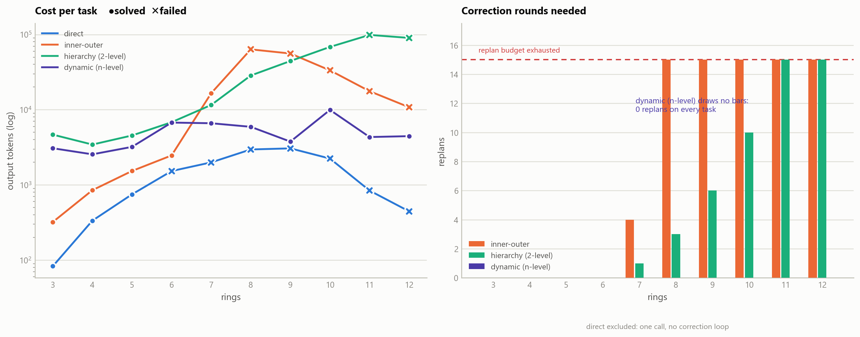
Against the baselines
gpt-5.5 at reasoning effort low in every arm. Cell values are output tokens; every solve was optimal.
 | solved | out-tok | calls | replans
direct | 3/10 | 14,239 | 10 | 0
inner-outer | 5/10 | 202,744 | 174 | 79
hierarchy (2-level) | 8/10 | 360,929 | 338 | 50
dynamic (n-level) | 10/10 | 50,582 | 123 | 0
ceiling | n=5 → 7 → 10 → 12+
The n-level arm is the only step in that sequence that is not a capability-for-cost trade — it is cheaper on every individual task, not just in aggregate.

Slide 5
Why it works — and what is not settled
One cause, three effects
Not yet settled
2-level forbids H2 → H2, so the response must contain all 2ⁿ−1 moves.
hanoi_12 = 4,095 calls ≈ 30k tokens against an 8,192 cap. It cannot fit.
n-level writes 12 lines; Python expands them to 4,095 moves.
· Fewer tokens — mechanical.
· Zero replans — 1,023 hand-written moves means 1,023 chances to slip; 12 structural lines means 12. The 2-level replan curve (1→3→6→10→15) tracks sequence length, not difficulty.
· Fewer calls — each 2-level replan regenerates the whole pipeline, so 16 rounds costs ~80 calls, not 16.
It is notation, not intelligence: at hanoi_11–12 the 2-level pipeline spent 90–99k tokens across 16 attempts and executed zero moves. Reasoning intensity was comparable in both (325 vs 290 reasoning tokens per call).
· n=1 per cell. Two dynamic runs differed up to 3.4× on per-task tokens (hanoi_11: 14,749 vs 4,331), driven by subtask count. Solve rate and aggregate are robust; per-task tokens are noisy.
· Baseline columns are month-old runs — drift uncontrolled. Reasoning effort is now matched; run date is not.
· No max-tokens control arm. "Does the baseline survive at 32,768?" is unanswered.
· Hanoi flatters this. Perfectly recursive, so compression is near-maximal. It went pure depth, zero breadth — untested on a domain where several distinct sub-skills matter.
Next: fresh baseline + max-tokens control, n≥3 reps, then a domain seam for non-Hanoi puzzles.

