Slide 1

Online Food Reseravation

Slide 2
What’s Special ?
Use Data base (SQL)
Chat function
Realtime update

Slide 3
Functions
Order food
Create Profile
Edit profile
Add food
Chat

Slide 4
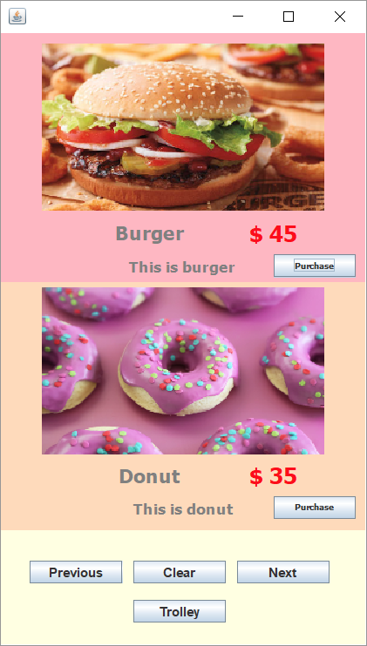
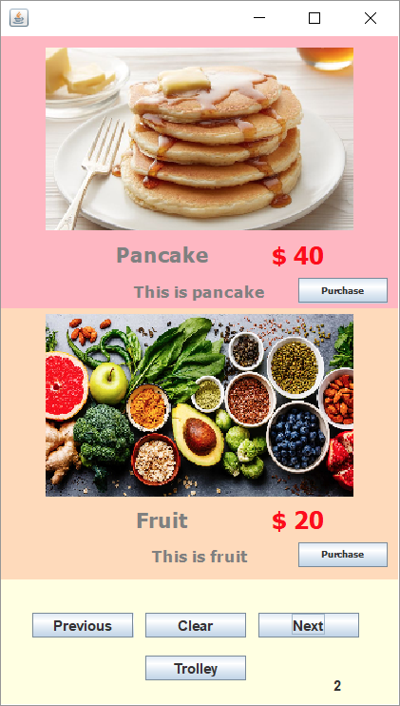
Order Food
Information is stored in the server
Can increment, decrement, and cancel order

Slide 5
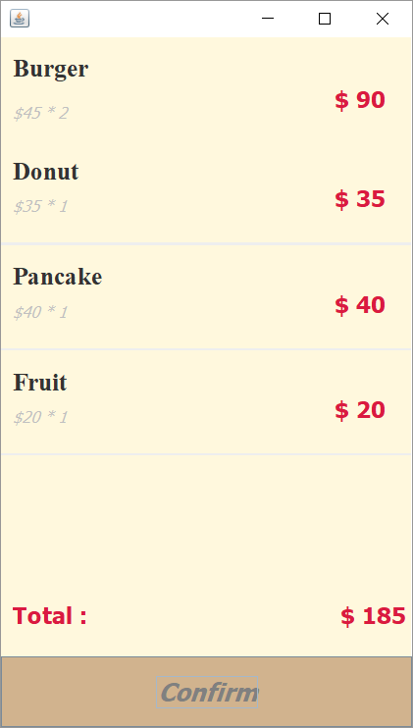
Place Order
Send order and price to server

Slide 6
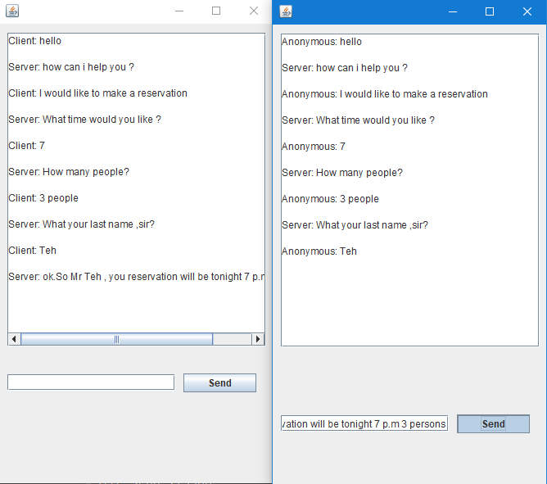
Chat
It can send sentence.
Server based.

Slide 7
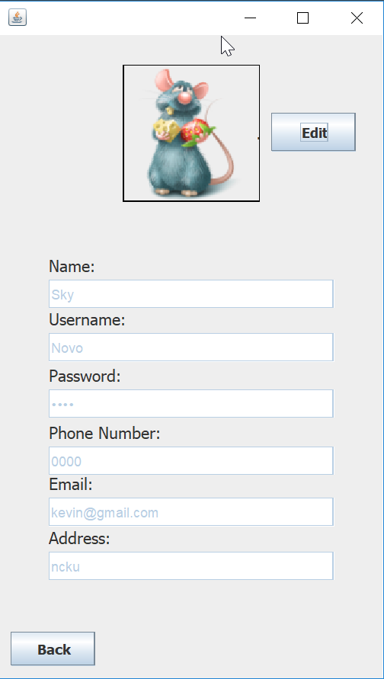
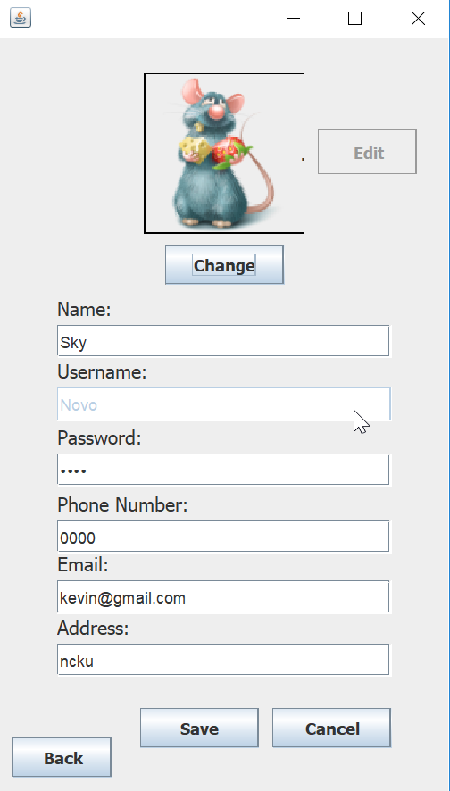
Create and Edit Profile
Stores basic information
Could be edited later
Supports picture
Data will be uploaded to server

Slide 8
That’s it ! Thank you !

