Slide 1
Dota Planet
Yi Xiao, Jianfeng Sun, Jiahong Weng

Slide 2
Overview
Full features of website
Store, Video, Gallery
Optimizations
Scaling Experiment
Future work

Slide 3
Social plugin
We also apply Facebook login to facilitate user register their account
Using Facebook like and share to get more people know our website

Slide 4
Store
Products(:description, :category,:quantity,:price)
Carts(has_many lineitems)
LineItems(belongs_to cart, product,order)
Orders(has_many lineitems, belongs_to User)
Users(:has_many orders)
Comments(:belongs_to product,:comment)

Slide 5
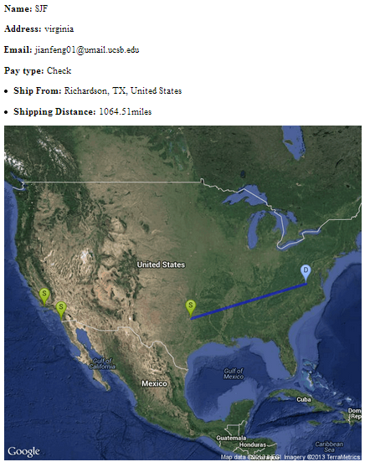
Order

Slide 6
Video
Three kinds of video: Commentary, Contest, Tutorial
Share audio commentary
Make Comment

Slide 7
Gallery

Slide 8
Optimizations
Caching
Page cache :utilizing HTTP headers(Etag and last_modified) to pull the response content directly from browser cache for product show page
Fragment cache: Using or store index page to cache each entries in the list

Slide 9
Optimization(Cont)
Normalization vs Denormalization
Non-First Normal Form (Products) First Normal Form(Comments)
Product_id | Comments
1 | Comment
 | Good items
 | Good price
2 | Comment
 | Fast shipping
Product_id | Comment
1 | Good items
2 | Fast shipping
1 | Good price

Slide 10
Scaling Experiment
Setup:
1. 8 Servers(m1.small), 1 Database(m1.xlarge), 1 Load Balancer
Each session contain 7 requests(critical path)
2. Master-Slave mechanism to replicate the database
Experiment:
(a)Denormalization (b)Normalization
1 server(200 sessions), 2 servers(400 sessions), 4 servers(800 sessions), 8 servers(1600 sessions)
Increase rate(session/s) until reply status 5xx turns up

Slide 11
Scaling Experiment
Number of server | Max Rate(Denormalization) | Max Rate(Normalization)
1 | 7 | 5
2 | 13 | 10
4 | 26 | 19
8 | 55 | 34

Slide 12
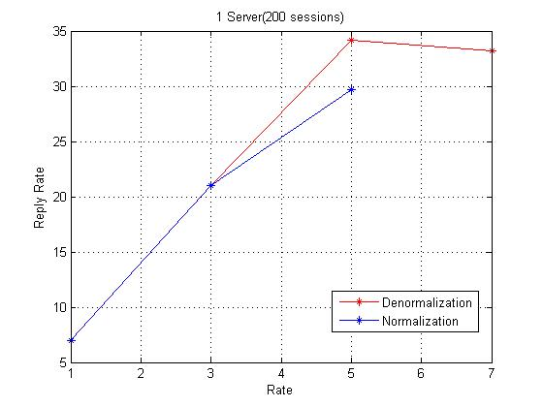
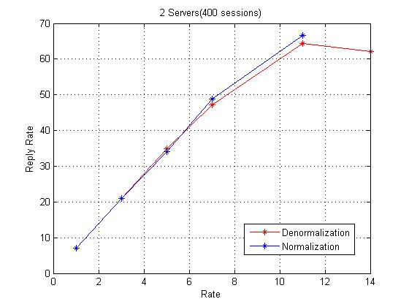
Scaling Experiment

Slide 13
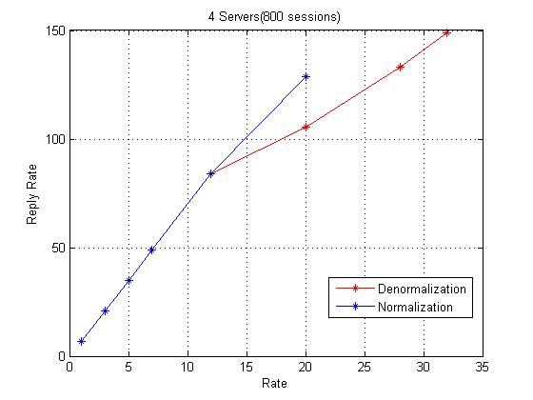
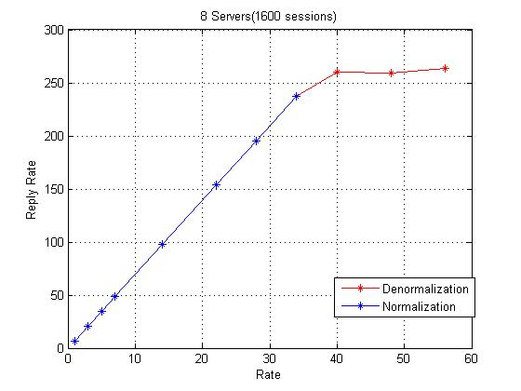
Scaling Experiment

Slide 14
Scaling Experiment
Conclusion:
Denormalization seems to be better than Normalization
Load Balancer is not always stable(Out of service?)
Different time period, different results.

Slide 15
Future Work
NoSQL database
Add audio sharing to critical path
Further scaling

