Slide 1
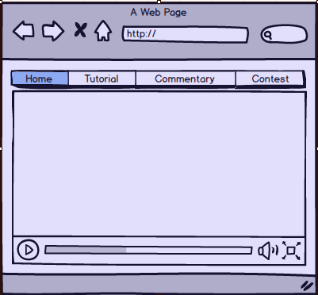
Videos:
Home Page

Slide 2
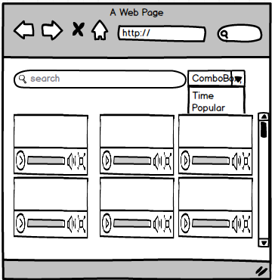
Videos:
Tutorial

Slide 3
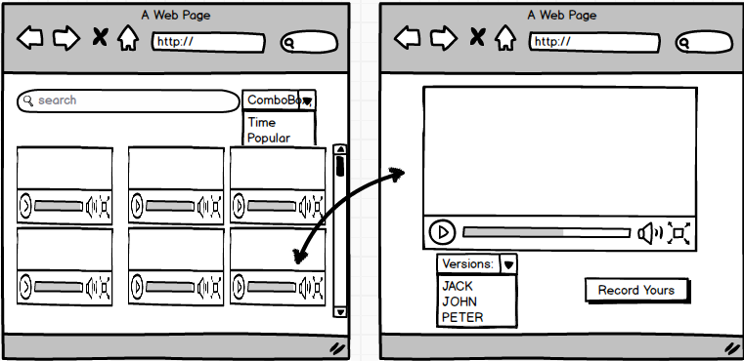
Videos:
Watch Commentary Video

Slide 4
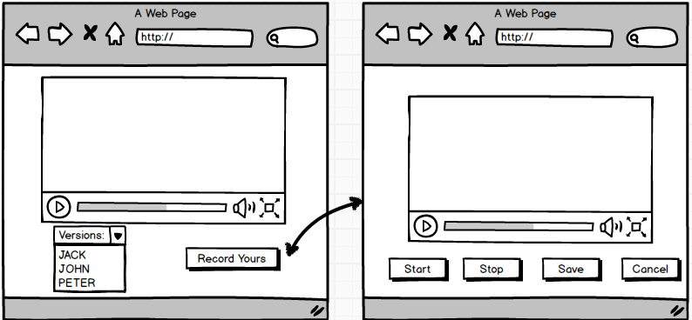
Videos:
Record Commentary

Slide 5
Videos:
Contest Video

