Slide 1
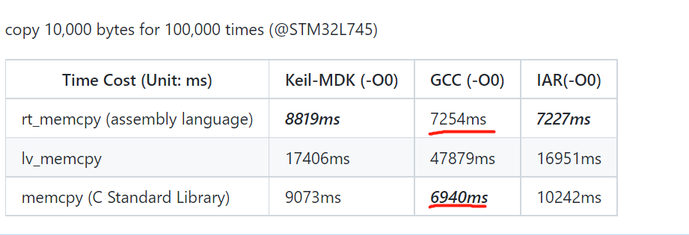

Slide 2
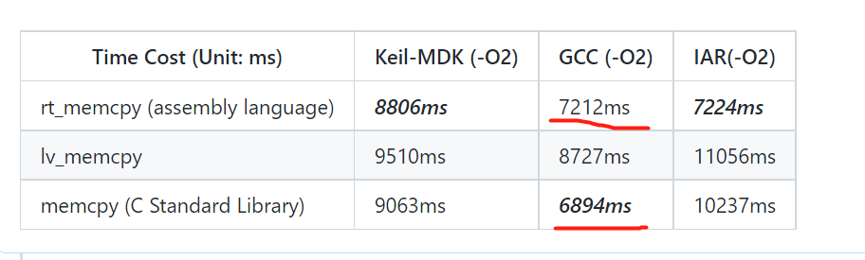

Slide 3
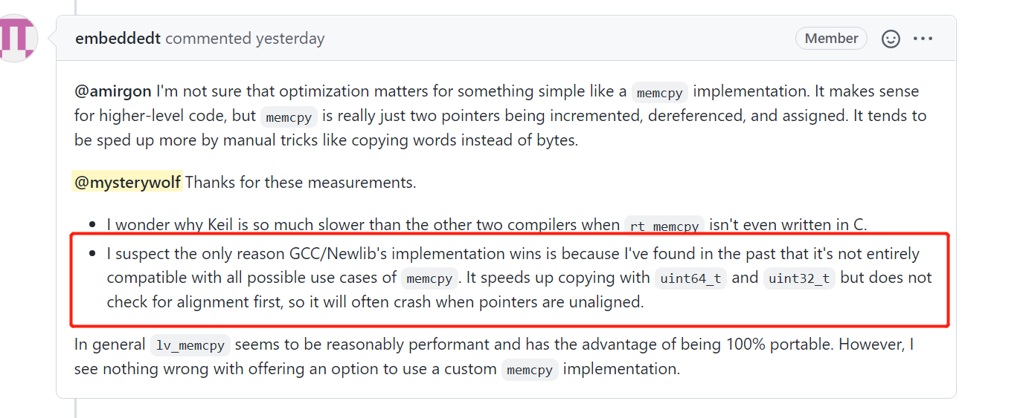
https://github.com/lvgl/lvgl/issues/2790#issuecomment-980479598

