Slide 1
MEDICAL STORE MANAGEMENT (PROJECT MEDIMART)
-BY TEAM 8: CODE ELITE

Slide 2
GROUP MEMBERS
Sweety Gupta
Omkar Patil
Prathamesh Mehare
Under The Guidance of
Tavishi Suvarna
Siddarth Tandale

Slide 3
INTRODUCTION
This ppt discusses about medical store management at regional level stores that are independent from health facilities.
The project consists of simple interface between the User and the Operator.
Our aim is to build a low cost and efficient medical store app .
This project involves proper handling of billing section, supplier and employee profile and stock details

Slide 4
INTRODUCTION
This project consists of various aspects of C language such as array, strings, function, pointer, structure and file handling
This system has been created with the intention of enlightening the technology at village level.
This project reduces the manual work by calculating the bill of the customer and also being updated with the stock available in the shop.
It also helps by recording the data of the Employee profile and also Supplier data.

Slide 5
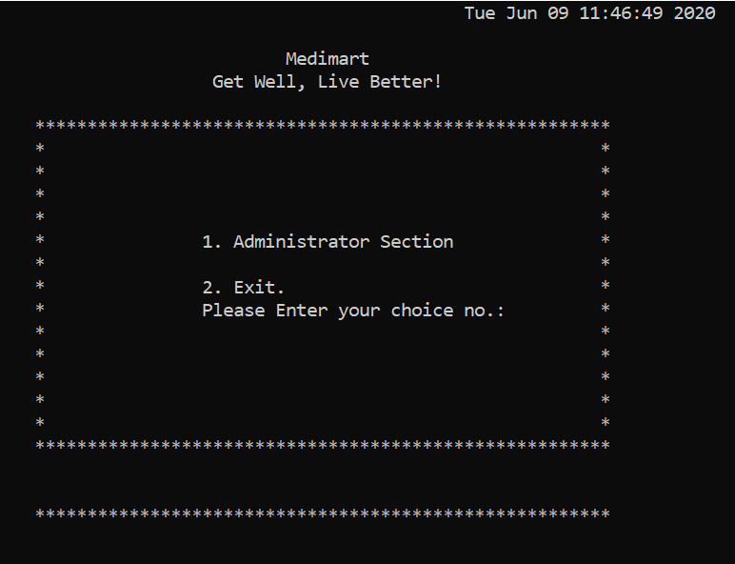
ABOUT THE PROJECT
Main Section :
Administration Section
Exit

Slide 6
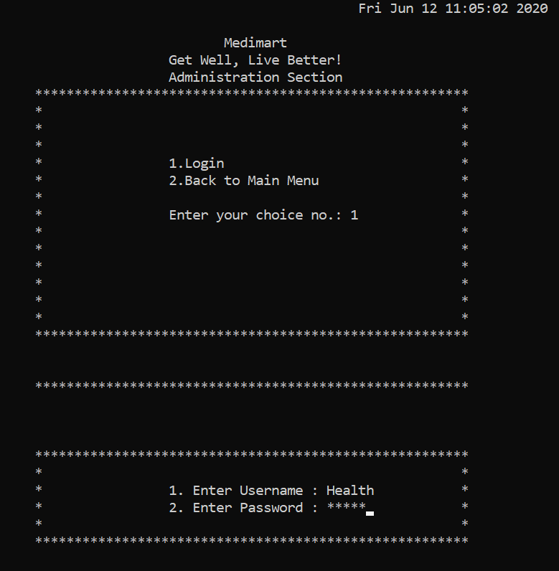
ABOUT THE PROJECT
Administration Section :
Login Section:
In this section, we will ask
the user to input User name and
Password.
On success, the page will
direct to Main Section.
On failure, the cursor will
direct to current page

Slide 7
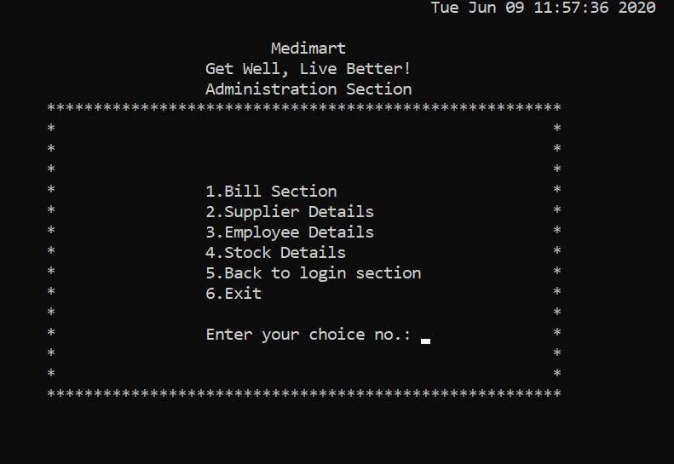
ABOUT THE PROJECT
Administration Section :
Bill Section
Supplier Details
Employee Details
Stock Details
Back to login
Exit

Slide 8
ABOUT THE PROJECT
Billing Section :
This section is used to calculate the total bill of the purchase made by the customer.
It includes inputting the name of the medicine available in our stock which we save in our file. After inputting the name, the price of the medicine will display .
Then we will input the quantity of the medicine to be purchased. Then, it will display the amount of purchase. We can continue, until the purchase is over and then we will calculate the total.

Slide 9
ABOUT THE PROJECT
Billing Section :
We will also get to know, while inputting the quantity, if the required quantity is not available, then it will display quantity not available.
In this way, we can calculate the bill of the purchase made by the customer in easy manner.

Slide 10
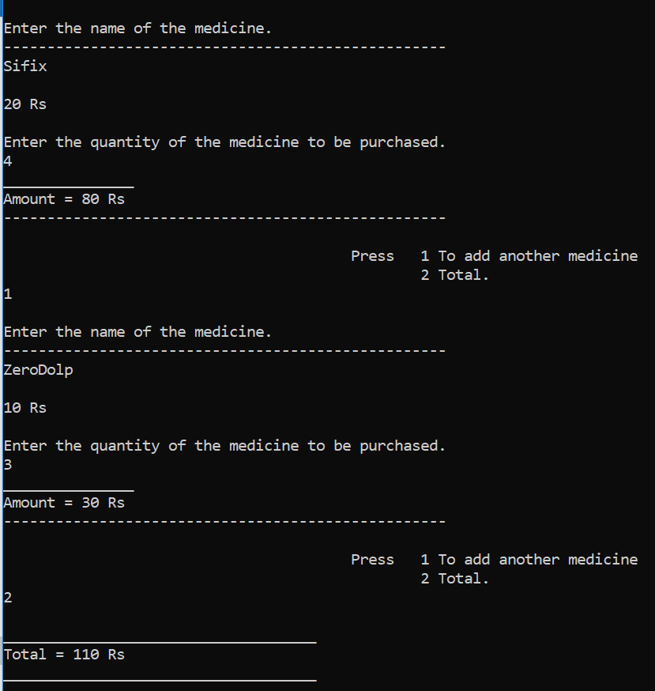
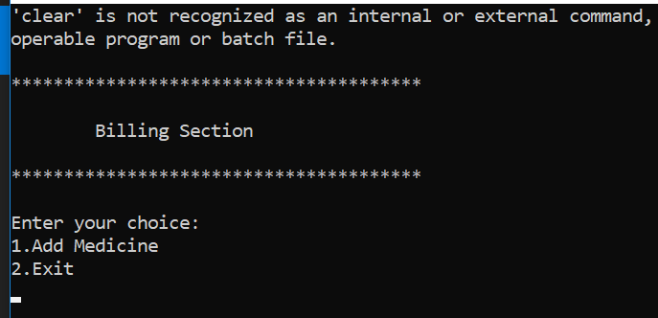
ABOUT THE PROJECT
Billing Section :

Slide 11
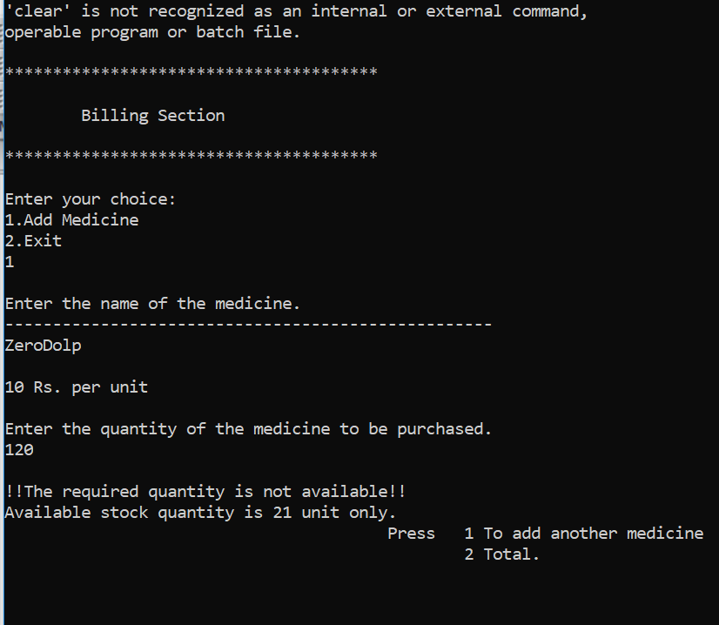
ABOUT THE PROJECT
Billing Section :

Slide 12
ABOUT THE PROJECT
Supplier Section :
View Info:
This section is used to view the information of all the current suppliers we business with.
It gives their Name, field name, field code, contact number, email address and address through file handling.
In this way, we can access our suppliers easily.

Slide 13
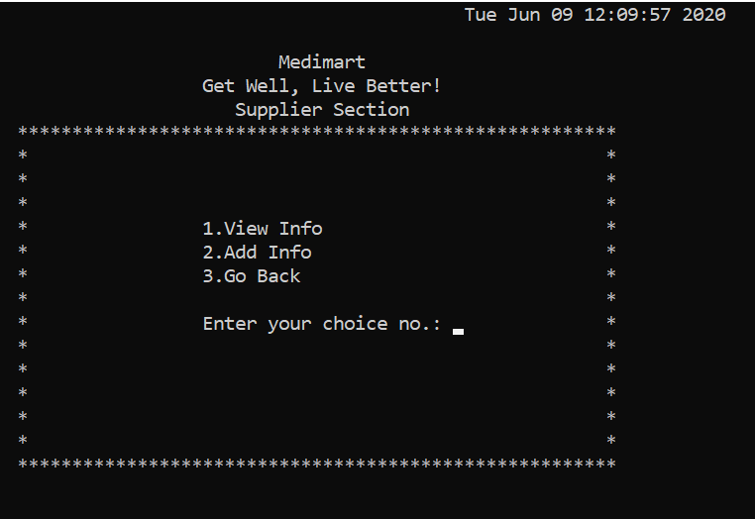
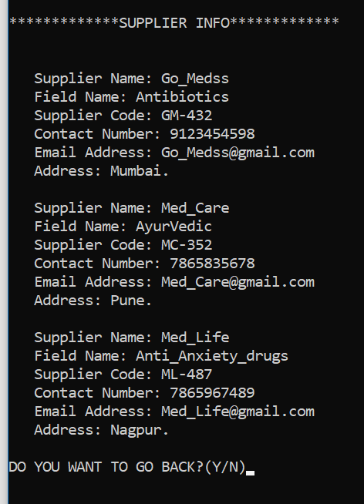
ABOUT THE PROJECT
Supplier Section :

Slide 14
ABOUT THE PROJECT
Supplier Section :
Add Info:
This section is used to add the information of the new suppliers we deal with.
It includes adding all their information mentioned above to current existing file .
We can add as many as profiles we need. After adding, we can see access their information in view info section.

Slide 15
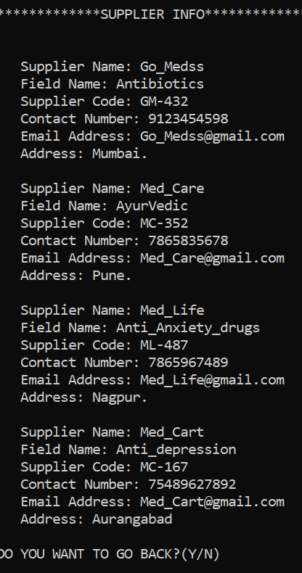
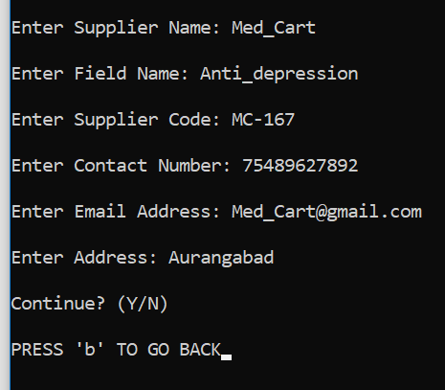
ABOUT THE PROJECT
Supplier Section :
Add Info:

Slide 16
ABOUT THE PROJECT
Employee Section :
View Profile:
This section is used to view the profile of all the employees currently working in our shop.
It gives their Name, Age, Salary, mobile number, email address and address through a file and displays on the screen.
We can access them anytime.

Slide 17
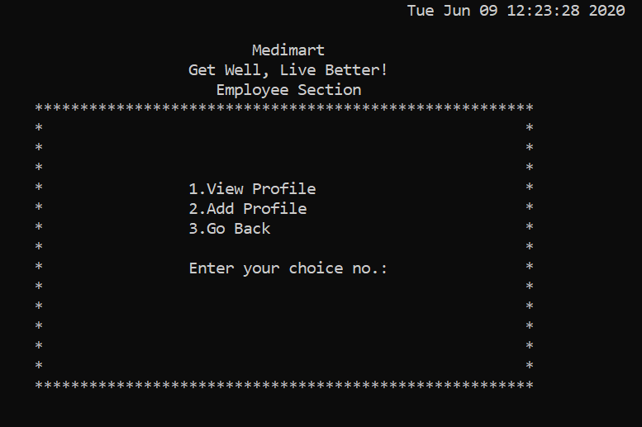
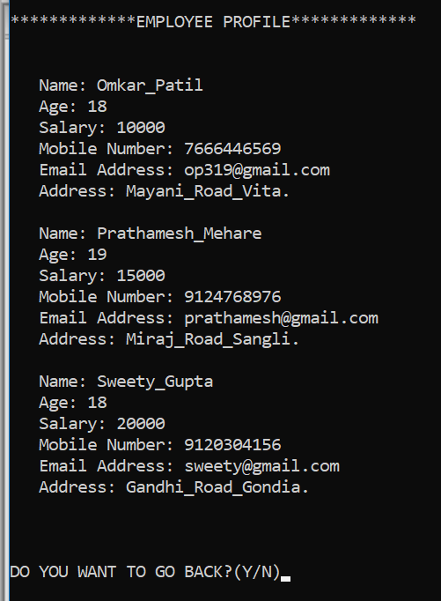
ABOUT THE PROJECT
Employee Section :
View Profile:

Slide 18
ABOUT THE PROJECT
Employee Section :
Add Profile:
This section is used to add the information of the new employee who will work at shop.
It includes adding all their information mentioned above to current existing file.
We can add as many as profiles we need. After adding, we can see their profile in view profile section.

Slide 19
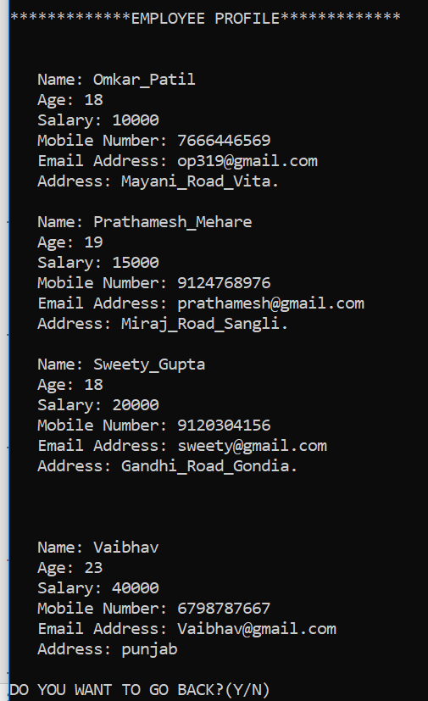
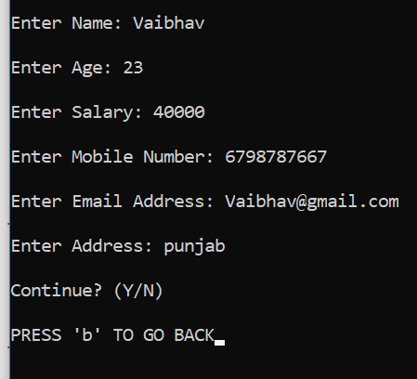
ABOUT THE PROJECT
Employee Section :
Add Profile:

Slide 20
ABOUT THE PROJECT
Stock Section :
View Items:
This section is used to view the information of all the medicines currently available in our shop.
It shows all their information such as Medicine ID, Name, Quantity, Price, Box Number and Expiry Date through a file and displays on the screen.
We can access them anytime.

Slide 21
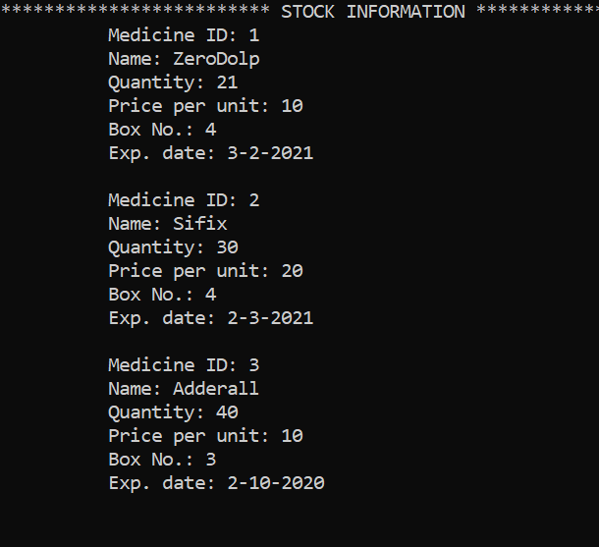
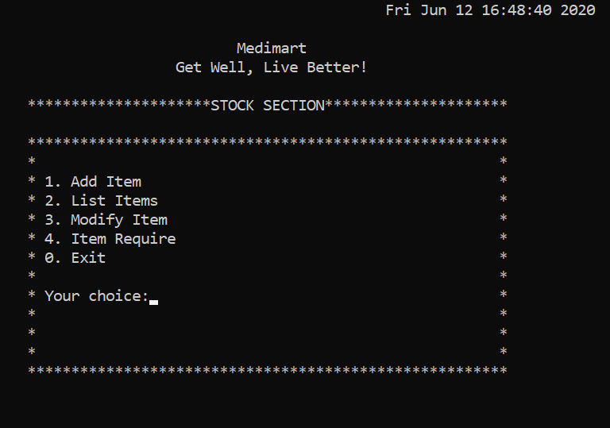
ABOUT THE PROJECT
Stock Section :
View Items:

Slide 22
ABOUT THE PROJECT
Stock Section :
Add Item:
This section is used to add the information of the new medicines that we add to our stock.
It includes adding all their information such as Medicine ID, Name, Quantity, Price, Box Number and Expiry Date to current existing file .
We can add as many medicines info as we need. After adding, we can see access their information in view info section.

Slide 23
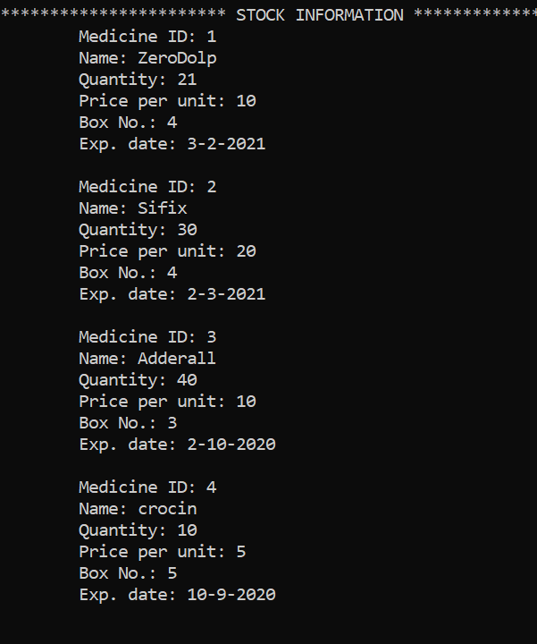
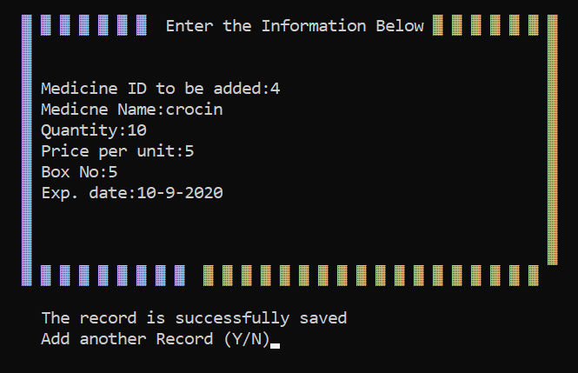
ABOUT THE PROJECT
Stock Section :
Add Item:

Slide 24
ABOUT THE PROJECT
Stock Section :
Modify Item:
This section is used to modify the previously saved information of the medicines of our stock. We will either modify or replace the medicine information.
It renews all their information such as Name, Quantity, Price, Box Number and Expiry Date to current existing file .
We can modify as many medicines info as we need. After modifying, we can see access their information in view info section.

Slide 25
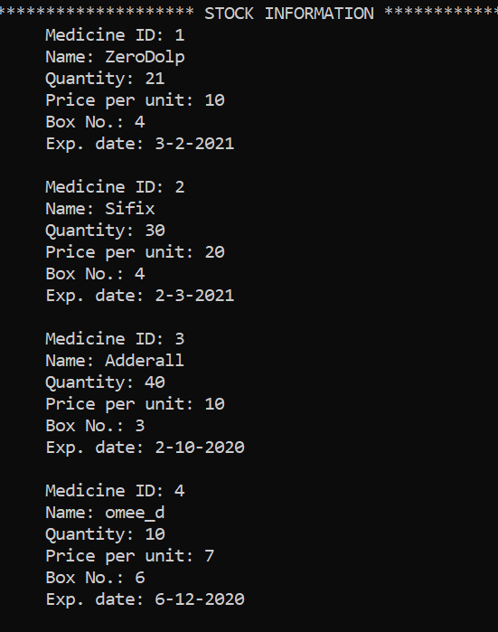
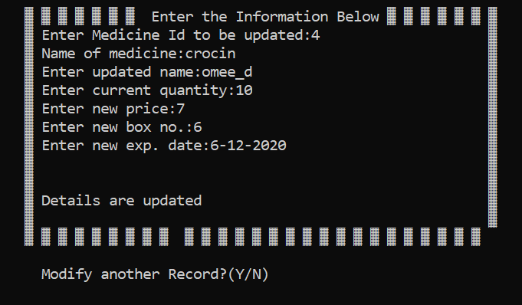
ABOUT THE PROJECT
Stock Section :
Modify Item:

Slide 26
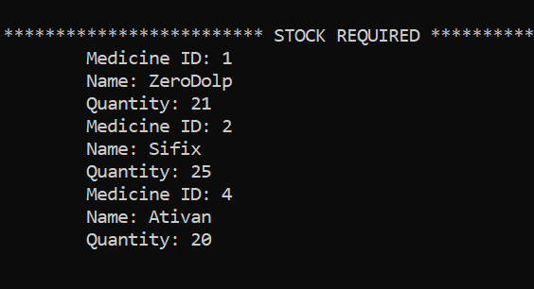
ABOUT THE PROJECT
Stock Section :
Required Item:
In this section, we will update the medicine when it is reached below a certain quantity, so that we can add it to our stock.

Slide 27
Modes of Operation
Keypad

Slide 28
This is the basic version of our project. Our proposal for updated version may include :
Managing Attendance of Employee.
Updating Daily Sale.
We are ready to develop the application as per client’s request.

Slide 29
THANK YOU

