Slide 1
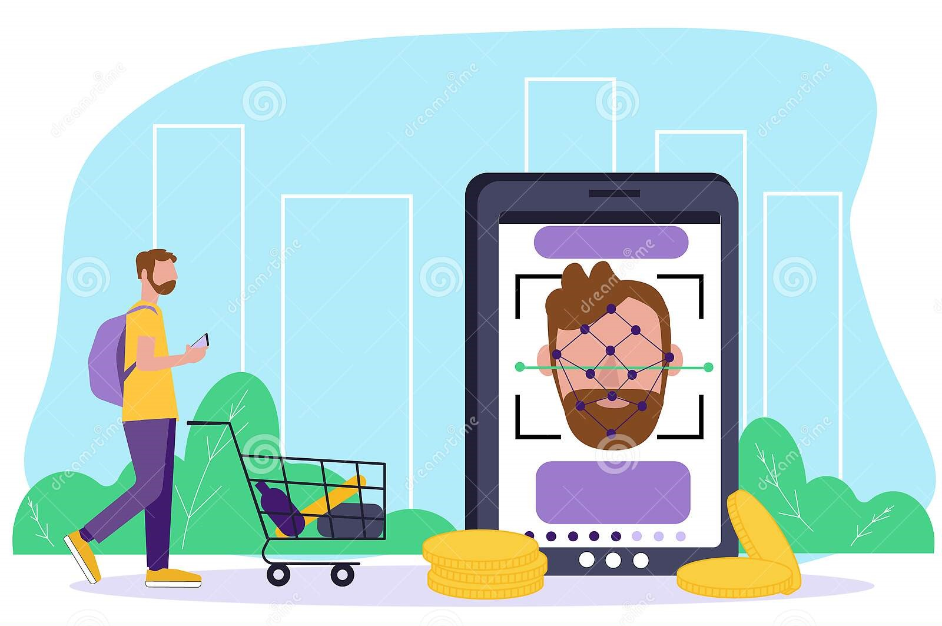

VIVEKANAND EDUCATION SOCIETY INSTITUTE OF TECHNOLOGY (MUMBAI UNIVERSITY)
Group Members :
Jai Malani D7A - 44
Kusum Rohra D7A - 57
Khushboo Dalwani D7A - 12
Khushboo Dhingra D7A - 18
Facial Identity
A future payment method
Domain : Product design and Development.
Mentor: Mrs. Mannat Daultani

Slide 2
Index
Introduction
Literature Survey
Problem statement
Block diagram of the proposed system
Methodology employed
Expected output
Conclusion
References

Slide 3
Introduction
Debit/credit cards, UPI, Net Banking Through OTP
Existing system
A category of biometric software that maps and stores an individual’s face features mathematically.
What is face recognition?
Handling cards and remembering long passwords
Need of face recognition

Slide 4
Literature Survey
SOURCE | OBJECTIVES | ADVANTAGES | LIMITATIONS
Thales Group (Apple) | Lowest time duration for recognition​ Highest security in recognition. | More convenient and quicker than Touch ID Face ID uses machine learning, so that it can learn from changes to your face over time. | It was criticized in 2017 because of its inability to differentiate between individual Chinese faces. ​ May not differentiates between twins.
Thales Group (Microsoft) | Transparency ​Non-discrimination​ Accountability​ Notice and surveillance​ Lawful surveillance | Easy to use​ Built-in-security​ Flexible deployment | Tools had high error rates in identifying darker skin women compared to lighter skin men.
Thales Group (Amazon) | User verification.​ Cataloguing ​ People counting Public safety. | Searchable image and video libraries.​ Unsafe content detection.​ Celebrity Recognition.​ Text detection. | Newsweek reported that this technology falsely identified 28 members of US Congress as people arrested for crimes.

Slide 5

Lacuna of existing System & Problem Statement
Existing System
Proposed System
Multiple steps required for checkout.
Complex process for recovery.
Cards, E-wallets frauds.
Hard to adopt for most people.
Checkout in single step.
No recovery required.
Minimized frauds.
Feasible for everyone with advanced security.

Slide 6
Flow chart
Log in/Sign up
Registration Successful
Registration
Forget Password
Log in
Sign up
Try Again(max 3)
Enter PIN
Enter Amount
Camera Pops
Recognized Face
Face not captured
Regenerate password
Payment Successful
Payment Unsuccessful

Slide 7




Methodology
Web pages are designed in HTML, CSS.
Image is captured through camera
Face co-ordinates are verified from the stored co-ordinates in database
If co-ordinates matches payment is successful

Slide 8




Expected Output
If is recognized then
else

Slide 9
Conclusion
Facial recognition software can pick a person out of a crowd, but the vending machine at work can’t recognize a dollar with a bent corner. And so it is our future.
Fastest & simplest method with advanced security for payment methods.

Slide 10
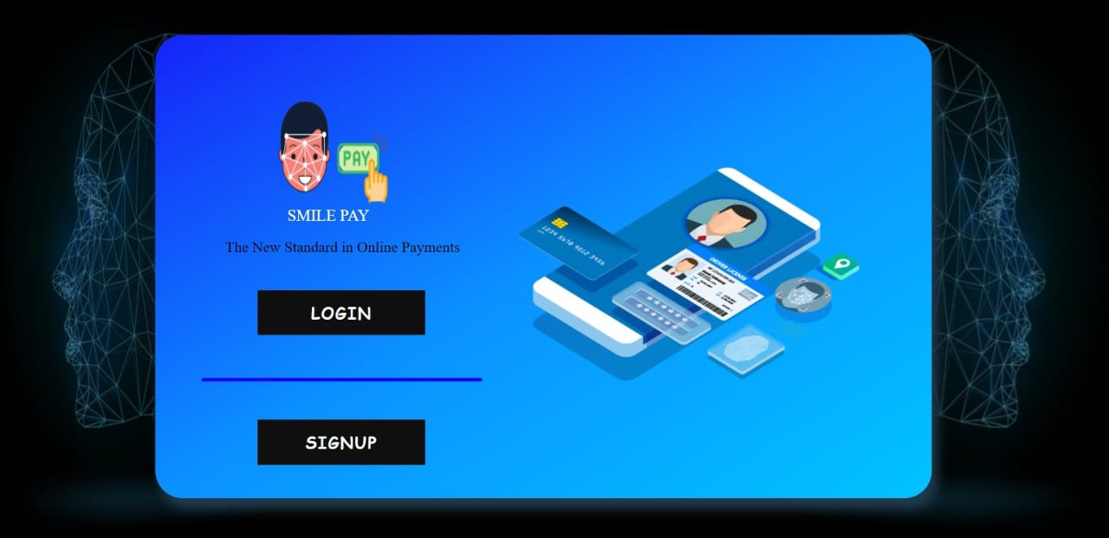
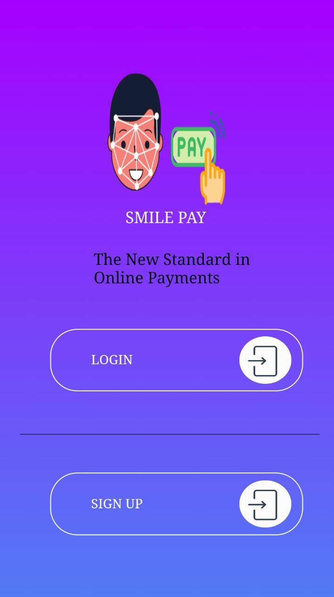
Implementation
Desktop View
Mobile View

Slide 11
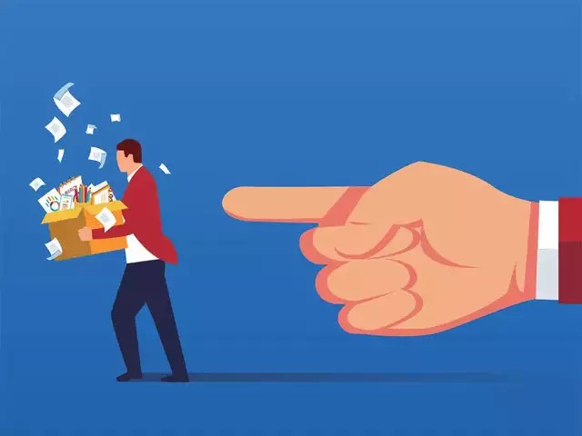
References
Nielsen Norman group
https://www.nngroup.com/articles/face-recognition-pay/
Microsoft Azure
https://azure.microsoft.com/en-in/services/cognitive-services/face/
CNBC
https://www.cnbc.com/2020/06/10/amazon-bans-police-use-of-facial-recognition-technology-for-one-year.html
Face Pay
https://facepay.co.in/about.html

