Slide 1


Project Title:
Password Generator
(C Programming)

Slide 2
Project Title: Password Generator
Semester: Summer 2025
Section: 64(B)
Department: Computer Science & Technology
Programme: BSc in Computer Science & Technology
Course: Structured Programming Language Lab
Course Code: CSE0613102
Faculty: Anika Bushra
Submission Date: 04-09-2025
Team Members:
Swagato Pandith (2252081040)
Shahariyer Nafis (2252081041)
Sumaiya Jannat Kuasha (2252081042)
Mymuna Sultana (2252081077)

Slide 3
Introduction
● Passwords are essential for protecting data and online accounts.
● Weak or reused passwords increase the risk of hacking.
● A password generator helps create strong, random, and secure passwords.
● Strong passwords are difficult for attackers to guess or crack.
● Using a generator saves time and avoids human bias in choosing passwords
.
● It enhances online security by preventing identity theft and data breaches.
● Password generators often include features like length customization and symbol inclusion.
● They reduce the chances of using predictable patterns (like birthdays or names).

Slide 4
Project Objective
✔ To design a program that generates strong and random passwords
✔ Ensure that passwords include a mix of:
● Uppercase letters (A–Z)
● Lowercase letters (a–z)
● Numbers (0–9)
● Special characters (!, @, #, …)
✔ Provide users with customizable password length

Slide 5
Tools and Language Used
● Programming Language: C
● Compiler: Code::Blocks IDE
● Libraries Used:
- stdio.h
- stdlib.h
- time.h
Methodology :
Steps of implementation:
Input desired password length from user.
Use random number generation function (rand()).
Select characters from different sets (letters, numbers, symbols).
Combine them into a password string.
Display the generated password to the user.

Slide 6
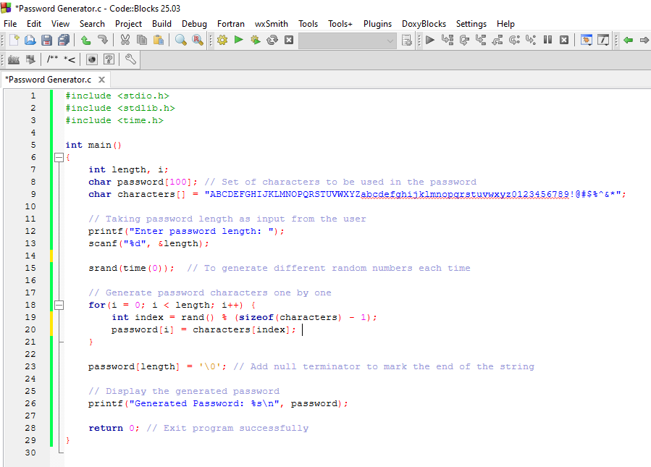
Implementation Code :

Slide 7
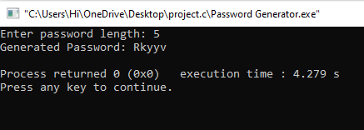
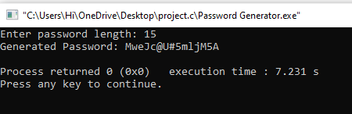
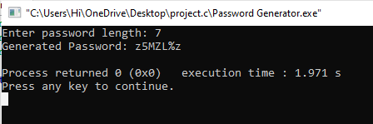
Output Example:

Slide 8
Advantages:
● Generates strong and unique passwords.
● Saves time compared to manual password creation.
● Reduces chances of hacking or brute-force attacks.
● Ensures use of uppercase, lowercase, numbers, and special characters.
● Provides customizable password length based on user’s need.
● Easy to use and user-friendly program.
● Works offline (no internet required).
● Randomization ensures different passwords every time.

Slide 9
Limitations :
● User might find it difficult to remember very strong/random passwords.
● Does not store passwords (user has to copy/save it manually).
● Limited character set (can be expanded further for stronger security).
● Cannot prevent password theft if user stores it insecurely.
● If length is too small, password may still be weak.
● Currently generates only one password at a time.

Slide 10
Conclusion :
In conclusion, this project demonstrates how C programming can be effectively used to solve real-life problems like generating secure passwords. With the help of built-in libraries such as stdio.h, stdlib.h, and time.h, we successfully created a program that produces strong, unique, and random passwords within seconds.
This system not only saves time compared to manual password creation but also strengthens the security of personal and professional accounts by minimizing the chances of hacking or brute-force attacks. The flexibility to choose password length and the inclusion of different character types make it practical for users with varying needs.
Although the program has some limitations—such as not storing passwords and generating only one password at a time—it still provides an excellent foundation for developing more advanced password management systems in the future. With further improvement, it can be expanded to include features like multiple password generation, secure storage, and stronger character sets.
Overall, this project reflects the power and simplicity of the C language in building useful security tools and highlights how even a beginner-level program can contribute to solving critical problems in today’s digital world.

Slide 11


