Slide 1
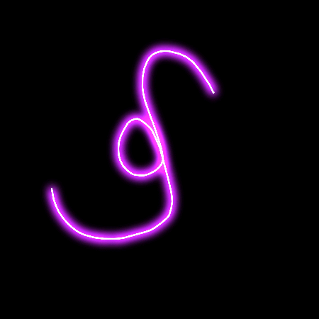
Orisha Pele
Governed by Ausar(+)Irete/Maat(+) Hetep IrosunMeji
The Modern Divination Implement
For
Initiates
Beyond 4 Cowries
SwamiG Institute © 2025 swamiginstitute.com Email baba@swamiginstitute.com

Slide 2



Governed by Ausar(+)Irete/Maat(+) Hetep IrosunMeji
This recently inspire divination implement is only for those initiated into The 1st Hand of Ifa, Warriors or IIekes. Iyawo can start here also. Additionally, the newly initiated or seekers of enlightenment should continue to perfect their understanding of Obi, or other Obi divination systems.
This Orisha Pele or Obi Pele which can be refer to as ‘Clink’ (because of the sound it makes when divining) is named personally after the character or your orisha. ObiDina, ObiSanya, ObiDeye, ObiGbemi,ObiYemi.....etc and serves four(4) functions;
Four Cowrie
Clink meets all the requirements of a Four Cowrie Divination System. Similar to Obi, provides 5 responses to yes/no question. Often cast on a casting surface.
Odu Ifa( Iyawo Only)
Clink meets all the requirements generating Odu for the Iyawo and Awo alike. This is accomplished from the orientation and arrangement of the casting elements. Here the 256 Odu can be accessed.
Obi
This meets all the requirement for casting Obi. This has four elements each with two sides. Obi typically are cast directly on the ground.
Obi Abata
Clink meets all the requirements of an Obi Abata Divination. Each element has dot color arrangement conforming to 9 responses of Obi Abata.
SwamiG Institute © 2025 swamiginstitute.com Email baba@swamiginstitute.com

Slide 3
Governed by Ausar(+)Irete/Maat(+) Hetep IrosunMeji
Obi/4Cowrie
Clink meets all the requirement for casting Obi. Clink has four elements each with two sides. Obi typically are cast directly on the ground.
Oyeku
No
Okana
Doubtful
Ejife
Definitely
Etawa Probably
Ogbe
Yes
Four Cowrie
Clink meets all the requirements of a Four Cowrie Divination System. Similar to Obi, provides 5 responses to yes/no question. Often cast on a casting surface.
SwamiG Institute © 2025 swamiginstitute.com Email baba@swamiginstitute.com

Slide 4
Governed by Ausar(+)Irete/Maat(+) Hetep IrosunMeji
Obi Abata
Clink meets all the requirements of an Obi Abata Divination. Each element has dot color1 or dot color2 conforming to 9 responses of Obi Abata.
1 | All Dots( 2blue&2Red) | Ogbe | Justice; Righteousness (Obatala)
2 | 3 dot(1 blue & 2 red) | Akita | Success after hardship; controversy(Aganyu/Babalu Aye)
3 | 3 dot(2 blue & 1 red) | Obita | Home situation and environment(Oshun/Ochoosi)
4 | 2 dot(1 blue&1 red) | Ejire | Stability, peaceful development upliftment
5 | 2 dot blue | Eros | Love; Marriage (Oshun)
6 | 2 dot red | Akoran | Stability, peaceful development uplifment
7 | 1 dot blue | Aje | Finance; Material Money(Yemojah)
8 | 1 dot red | Ilera | Health or triumph(Shango)
9 | No dots | Oyeku | Transformation; rebirth(Oya)
SwamiG Institute © 2025 swamiginstitute.com Email baba@swamiginstitute.com

Slide 5
Governed by Ausar(+)Irete/Maat(+) Hetep IrosunMeji
System
Obi | Ejife | Oyeku | Etawa | Ogbe | Ejife | Ejife | Etawa | Etawa | Ejife
4Cowrie | Ejife | Oyeku | Etawa | Ogbe | Ejife | Ejife | Etawa | Etawa | Ejfe
Abata | Obge | Ejire | Obita | Ejire | Eros | Akoran | Aje | Ilera | Oyeku
SwamiG Institute © 2025 swamiginstitute.com Email baba@swamiginstitute.com

Slide 6
Governed by Ausar(+)Irete/Maat(+) Hetep IrosunMeji
Peace initiate,
Feel free to ‘Clink’ 300-500 times to see which mechanics works best for you. Document your
Findings and enjoy the hearth of Ifa Isese with this implement generated to meet the changing
needs in the diaspora.
Your SwamiG
SwamiG Institute © 2025 swamiginstitute.com Email baba@swamiginstitute.com

