Slide 1
SignalRisk
Real-time Fraud Decision Engine
Technical & Product Overview
March 2026

Slide 2
Product Vision
Real-time fraud intelligence for emerging markets
Combined telco + device + behavioral signals in a single API
<200ms p99 decision latency
Purpose-built for wallet & carrier billing fraud

Slide 3
Problem Statement
$32B+ annual fraud in emerging market digital payments
Mobile wallet fraud growing 45% YoY
No dedicated carrier billing fraud solution exists
Western solutions lack telco signals & local patterns

Slide 4
Solution Overview
For Developers
For Analysts
REST API + SDKs
Single API call for risk decisions
<100KB web SDK footprint
Webhook callbacks for async results
16-page analyst dashboard
Case management with SLA tracking
Rule editor with custom DSL
Real-time WebSocket live feed

Slide 5
System Architecture
SignalRisk — 15 Microservices
Clients (Web SDK / Mobile SDK / REST API)
|
v
+-------------------+ +--------------------+
| auth-service |----->| event-collector |
| (RS256 JWT) | | (API key auth) |
+-------------------+ +--------------------+
|
Kafka KRaft
|
v
+----------------------------------------------------------+
| decision-service |
| +-----------+ +-----------+ +-----------+ +-----------+ |
| | device | | velocity | | behavioral| | network | |
| | intel | | service | | analytics | | intel | |
| +-----------+ +-----------+ +-----------+ +-----------+ |
| +-----------+ +-----------+ |
| | telco | | graph | 21 DSL Rules Evaluated |
| | intel | | intel | Score: 0-100 |
| +-----------+ +-----------+ |
+----------------------------------------------------------+
| |
v v
+-------------------+ +--------------------+
| case-service | | webhook-service |
| (SLA tracking) | | (HMAC callbacks) |
+-------------------+ +--------------------+

Slide 6
Decision Engine Pipeline
6 parallel signal fetches (device, velocity, behavioral, network, telco, graph)
21 DSL rules evaluated per decision (10 base + 5 stateful + 3 sequence + 3 graph)
Score thresholds: >=70 BLOCK | 40-69 REVIEW | <40 ALLOW
Circuit breaker pattern: 3 failures -> 30s OPEN state
Graceful degradation: signal timeout = null, decision continues
Decision cache: Redis-backed with 5-second TTL

Slide 7
Stateful Fraud Detection
Typed entity model: customer, device, and IP as first-class entities
Prior-decision memory with 30-day lookback (50ms timeout + circuit breaker)
Entity profiles with durable state (auto-updated on each decision)
Sequence detection: 3 patterns (login->payment, failed*3->success, device_change->payment)
Graph enrichment: fraud ring scoring via Neo4j traversals
Feature snapshots for ML-ready data export

Slide 8
Closed-Loop Fraud Cycle
+------------------+
| Payment Event |
+--------+---------+
|
v
+------------------+ +---------------------+
| Decision Engine |------->| Webhook Callback |
| (21 DSL Rules) | | (HMAC-SHA256) |
+--------+---------+ +---------------------+
|
v
+------------------+
| Case Created |
| (BLOCK/REVIEW) |
+--------+---------+
|
v
+------------------+ +---------------------+
| Analyst Labels |------->| Kafka STATE_LABELS |
| (fraud / legit) | | (feedback topic) |
+--------+---------+ +---------------------+
|
v
+------------------+
| Watchlist Update |
| (deny/allow/watch)|
+--------+---------+
|
v
+------------------+
| Next Decision |<--- Entity checked against watchlist
| BLOCK if denied | at decision time (closed loop)
+------------------+

Slide 9
Multi-Tenancy & Security
5-Layer Tenant Isolation
Security Controls
JWT tenant context (RS256 asymmetric)
PostgreSQL Row-Level Security (RLS)
Redis key namespace isolation
Kafka partition-based tenancy
WebSocket room-based isolation
RS256 JWT with JWKS endpoint
DB-backed operator login (bcrypt)
HMAC-SHA256 webhook signatures
JWT denylist (fail-closed on Redis down)
Rate limiting (Redis Lua script)

Slide 10
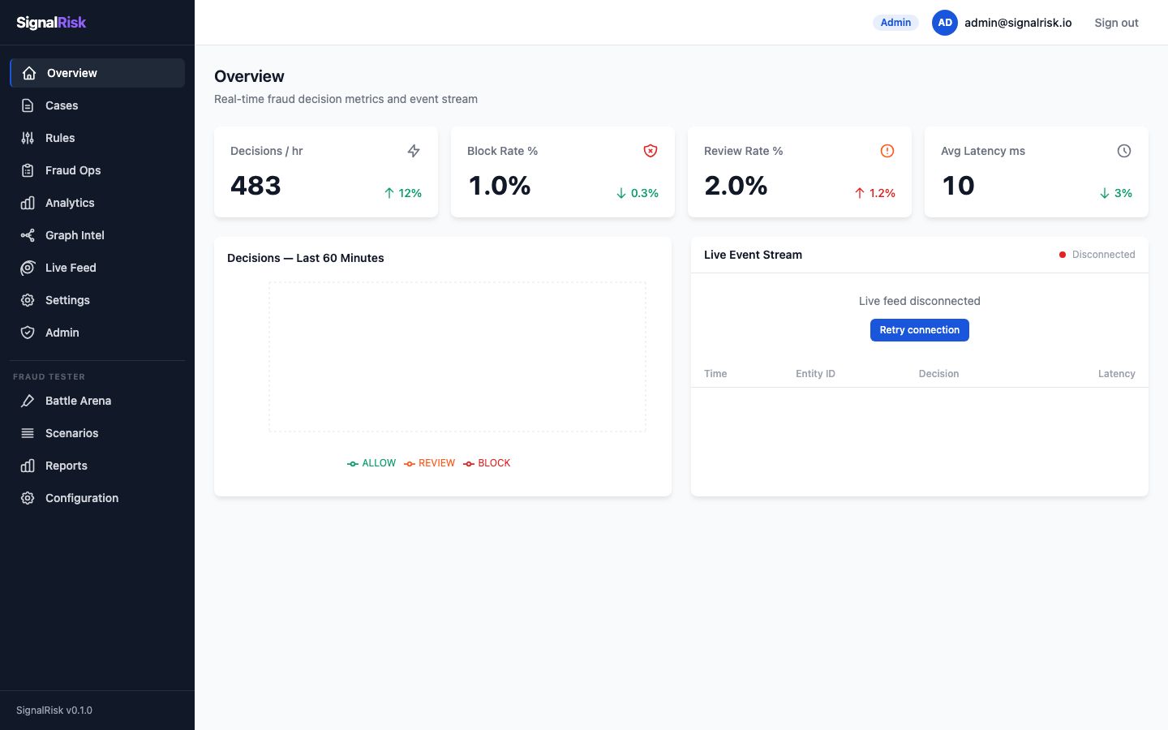
Dashboard & UX
Real-time fraud monitoring dashboard with KPI cards, decision trends, and live event stream

Slide 11
Integration Model
Step 1: Install SDK (5 minutes)
Step 2: Evaluate Risk (1 API call)
Step 3: Act on Decision (ALLOW / REVIEW / BLOCK)
Time to value: 24 hours from signup to production
Available channels: Web SDK + Mobile SDK + REST API + Webhooks

Slide 12
Quality & Testing
Category | Count | Status
Unit Tests | 934+ | All passing (71 suites)
E2E Tests | 78 | 3 Playwright projects
Quality Gates | G1-G8 | All defined & enforced
FraudTester Scenarios | 9+ | 5 AI agents
DSL Rules | 21 | 10 base + 5 stateful + 3 seq + 3 graph

Slide 13
Production Readiness
9-step execution plan — all 8 core steps complete
Production maturity Level 4/5 (8.2/10 readiness score)
39+ sprints delivered from scratch (single developer)
15 database migrations + 16 Architecture Decision Records
All P0 critical fixes applied and verified
Full closed-loop fraud cycle operational end-to-end

Slide 14
Key Metrics & KPIs
Metric | Target | Current
Decision p99 latency | <500ms | ~82ms
Throughput | 5,000 req/s | 5,200 req/s
Availability | 99.9% | -- (staging)
True Positive Rate | >85% | ~91%
False Positive Rate | <5% | ~2%
E2E Suite Duration | <60s | ~38s

Slide 15
Competitive Advantages
Capability | SignalRisk | Evina | Sift | Sardine
Telco Signals | Yes | Yes | No | No
Device Intel | Yes | No | Partial | Yes
Behavioral | Yes | No | Yes | Yes
Emerging Market Focus | Yes | Partial | No | No
Single API | Yes | No | No | No

Slide 16
Technology Stack
Backend
Frontend & Infra
NestJS (Node.js 20)
PostgreSQL 16 + Row-Level Security
Redis 7 (cache + state)
Kafka KRaft (event streaming)
Neo4j 5 (graph database)
React 18 + Vite + Zustand
TailwindCSS
Docker Compose (19 containers)
Kubernetes + Helm ready
GitHub Actions CI/CD

Slide 17
Deployment Architecture
Docker Compose: 4 infra + 15 app containers
4-stage Dockerfile with ~28s build time
Kubernetes Helm chart with Horizontal Pod Autoscaler
Scalability path: 5M -> 50M -> 500M+ events/month
Multi-AZ deployment ready
ArgoCD GitOps pipeline for production deployments

Slide 18
Roadmap & Next Steps
Level 5 closure: staging validation + evidence refresh
ML scoring service integration (gRPC sidecar)
Neo4j causal clustering for production graph workloads
Kubernetes production deployment with autoscaling
Advanced analytics + ML-based scoring models
Mobile SDK enhancements for React Native & Flutter

Slide 19
Team & Governance
7 workstreams (Alpha through Golf) — cross-functional ownership
10 automated skills for development workflows
Quality gates G1-G8 enforced per sprint exit
Evidence-based sprint exit process with artifact generation
Architecture Decision Records (ADR-001 through ADR-016)
Definition of Done checklist enforced per pull request

Slide 20
Questions?
github.com/mytechsonamy/SignalRisk

