Slide 1
Video Presentation link:
https://youtu.be/mdoCU_RP350?si=6hdmLyg5NbP0QvDJ

Slide 2

A1: Conceptual Architecture
Group 9
Xavier Awadalla (Team Leader)
Christopher Gil (Presenter)
Aaron Rivest
Craig Tylman (Presenter)
Sam Tylman
Felix Xing
https://www.scummvm.org https://github.com/scummvm/scummvm

Slide 3
Team member roles:
Xavier Awadalla: Team Leader, Division of responsibilities, Abstract, Platform backends.
Aaron Rivest: File Management Component & “Running a Game” Sequence Diagram
Christopher Gil: Video Presenter. Box-arrow diagram of Conceptual Architecture, GUI/Launcher Component, OS Abstraction, Concurrency
Craig Tylman: Slides creator/presenter, Misc. Integrations, “Adding a Game” Sequence Diagram, general cleanup & proofreading.
Felix Xing: Audio Component, Engine component, graphics Component, LAN component.
Sam Tylman: Introduction & Overview, System Evolution, History of ScummVM and how it can continue to evolve, Conclusion.

Slide 4
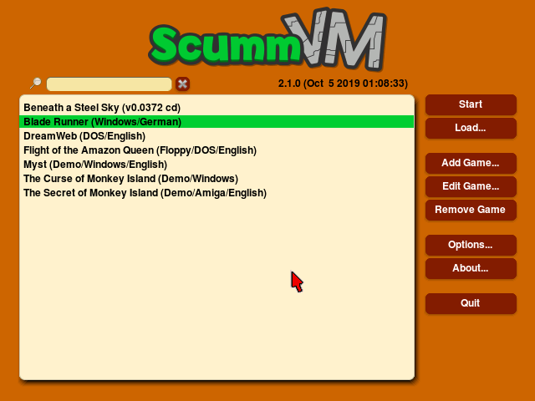
What is it?
Script Creation Utility for Maniac Mansion Virtual Machine
Launched in 2001
Cross-platform interpreter for point-and-click adventure games
This presentation will focus on the software’s conceptual architecture, as well as its evolution, use cases, and more

Slide 5
Evolution
Originally designed to emulate the SCUMM engine by LucasArts
Support for new game engines were added one by one
Integration with ResidualVM allowed for emulation of 3D games
Support for niche devices like Nintendo DS and Raspberry Pi
Ever-growing number of settings, tools, and other config options

Slide 6
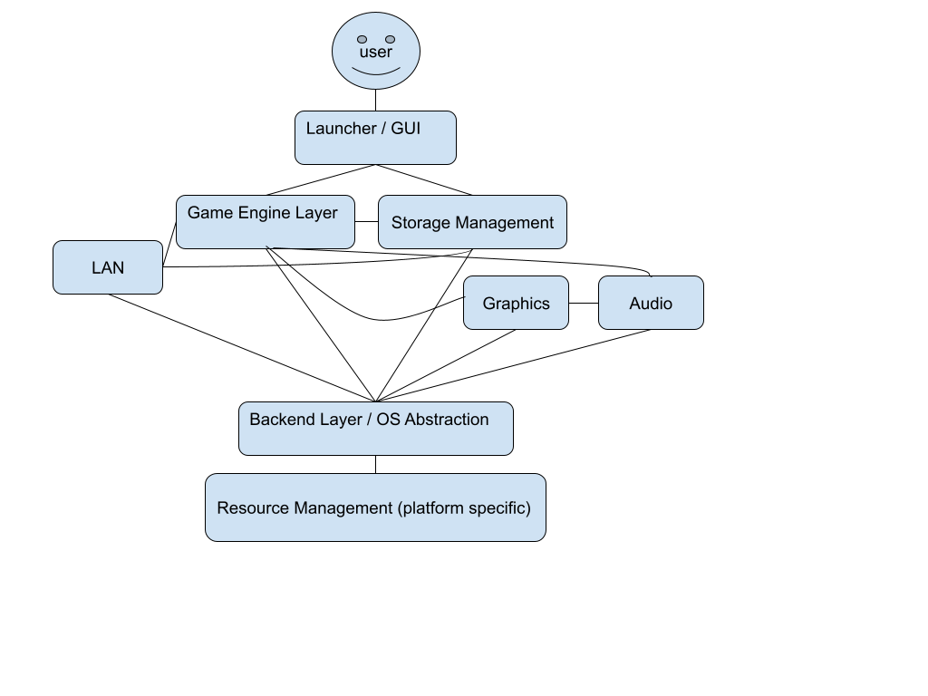
Conceptual architecture
Layered architectural style consisting of multiple interpreter engines for OS abstraction
Consists of many components each dedicated to a specific task

Slide 7
Components
GUI / Launcher
How users interact with the software
User-friendly and highly functional
Build with ‘widgets’ via C++
Game Engines
Multiple exist for different types of games
Reads external game data and interprets it in an OS-abstracted way with support for extra customization
Storage
Games can be read and loaded from any regular directory
Data and config are stored by the software in a dedicated folder
Support for cloud saving via most major services

Slide 8
Components
Graphics & Audio
Renders graphics with SDL and OpenGL
Support for shaders, upscaling, and custom renderers
Customizable MIDI playback for games that use it
OS Abstraction
Allows for multi-platform support without major code rewrites
Essentially a virtual machine
Platform-specific backends for graphics, I/O, etc

Slide 9
Concurrency
Launcher has minimal concurrency, mostly on a single thread that responds to events as they happen
Most games are also single-threaded as they were designed for much older hardware
The original Scumm Engine was able to simulate multitasking
The actual virtual machine supports automatic cooperative threading

Slide 10
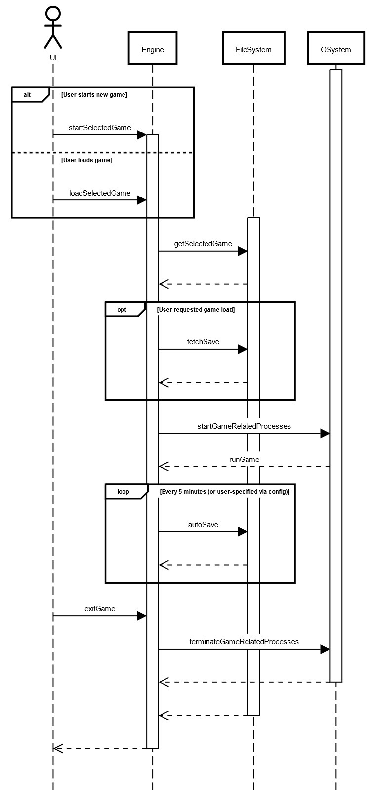
Use case: Running a game
Activated from the launcher
Loads existing data, if exists
Support for auto-saving and save states
Can be closed at any time

Slide 11
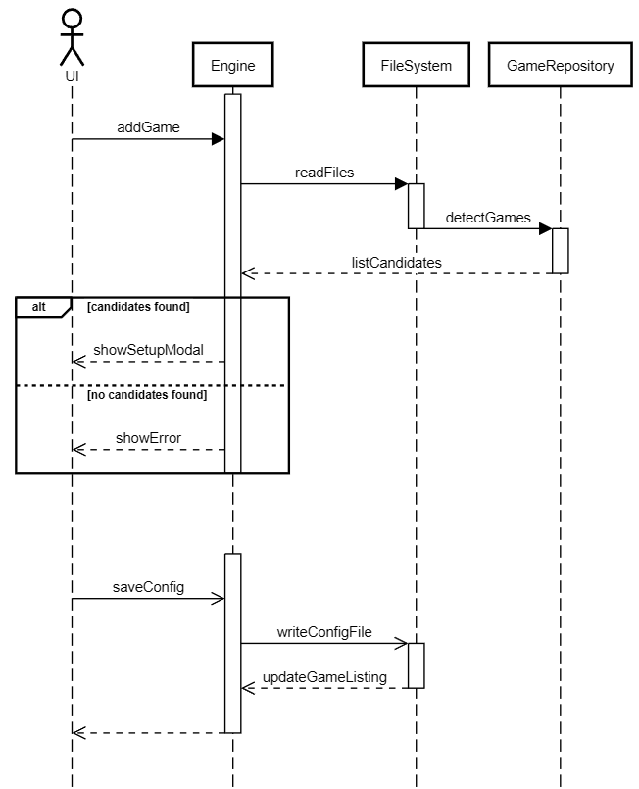
Use case: Adding a new game
User is prompted to upload a folder from their device
ScummVM searches for valid games by checking a large internal repository
Settings can be changed on a per-game basis, including custom key bindings

Slide 12

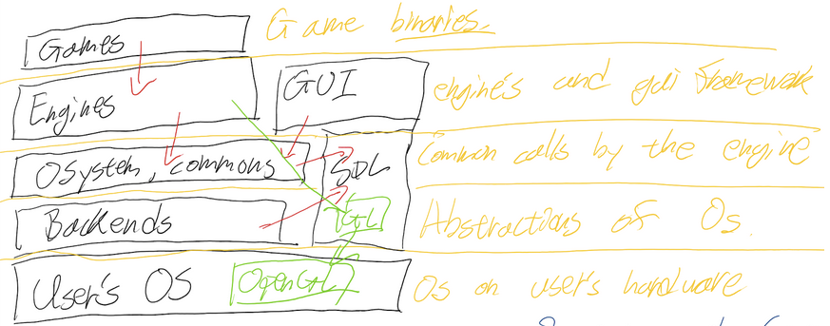
Limitations & Lessons learned
ScummVM has incomplete documentation.
A great number of components, a great amount of work to split.
Our derivation process changed the more we learned about ScummVM.

Slide 13
In conclusion
ScummVM is cool :)
It has far exceeded its original purpose
Great architecture that simplifies the process of adding support for new games and platforms
Can be seen as a tool for game preservation
Open-source and well documented

Slide 14

Thank you!

