Slide 1
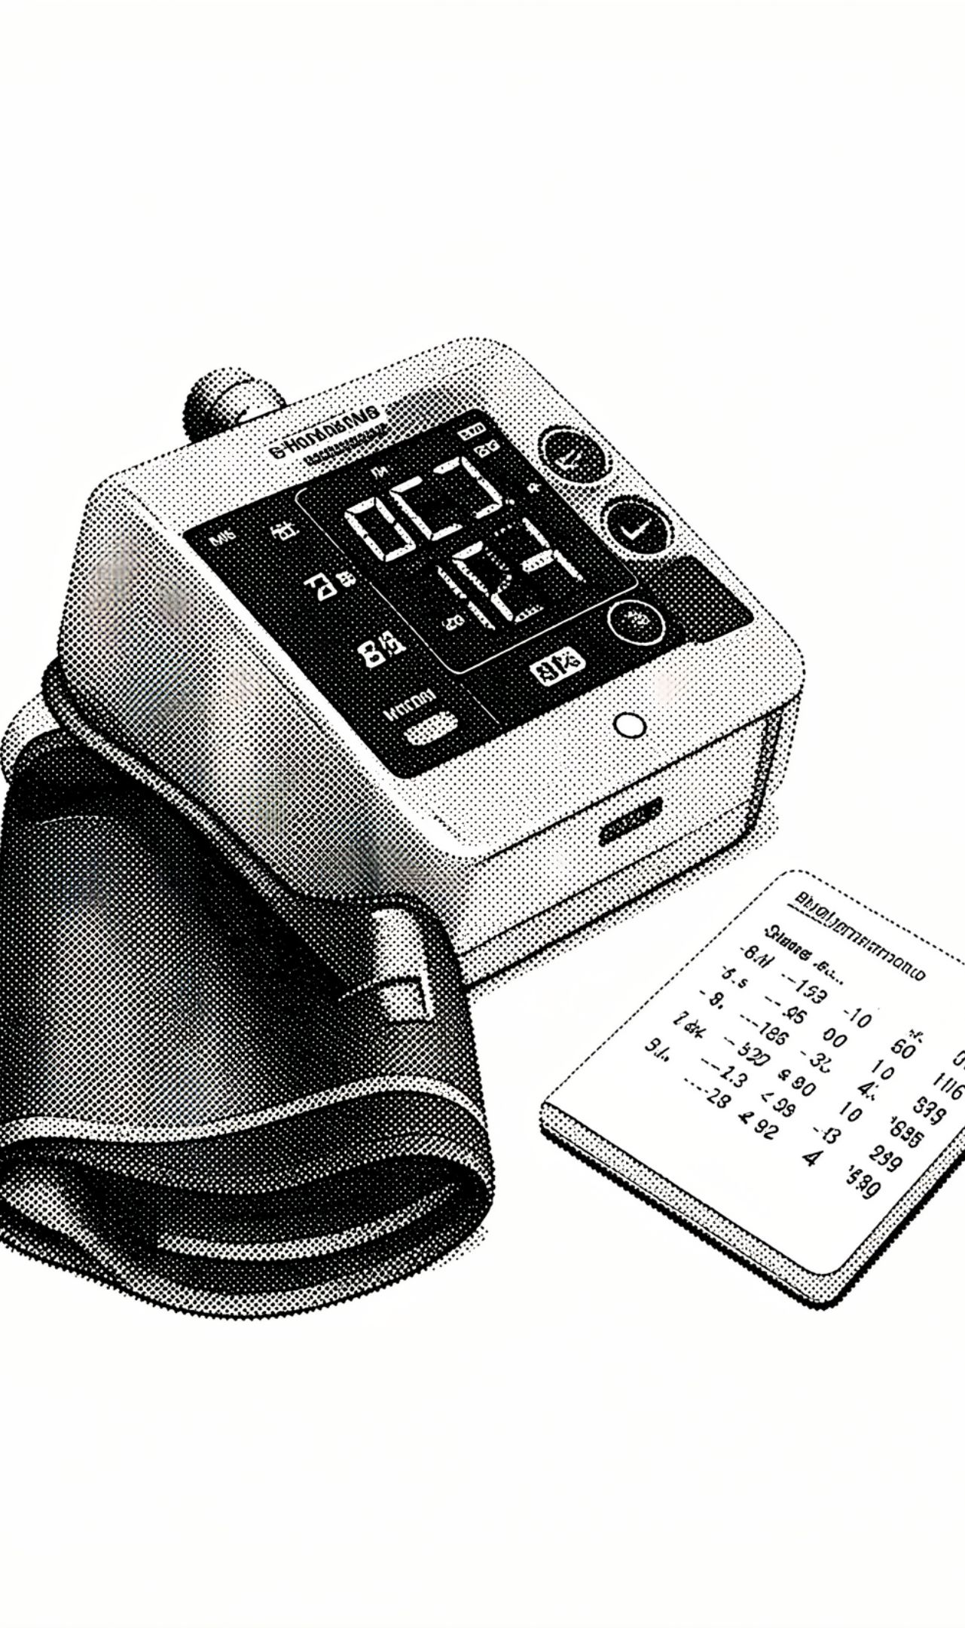
HAPPIEST HEALTH 2026
Hypertension
Digital Twin
AI-powered proof of concept
TEAM: 24PA1A4520 · TEAM LEADER: BUSI MYTHILI · VISHNU INSTITUTE OF TECHNOLOGY
EDUCATIONAL PROTOTYPE — NOT CLINICALLY VALIDATED

Slide 2
01 · PROBLEM
Tracking blood pressure over time is still fragmented.
01
02
03
Readings
Digital view
Prototype
Blood-pressure readings can be difficult to track consistently over time.
Organize readings, show trends and surface rule-based alerts.
Combine a patient dashboard, database and machine-learning estimate.

Slide 3
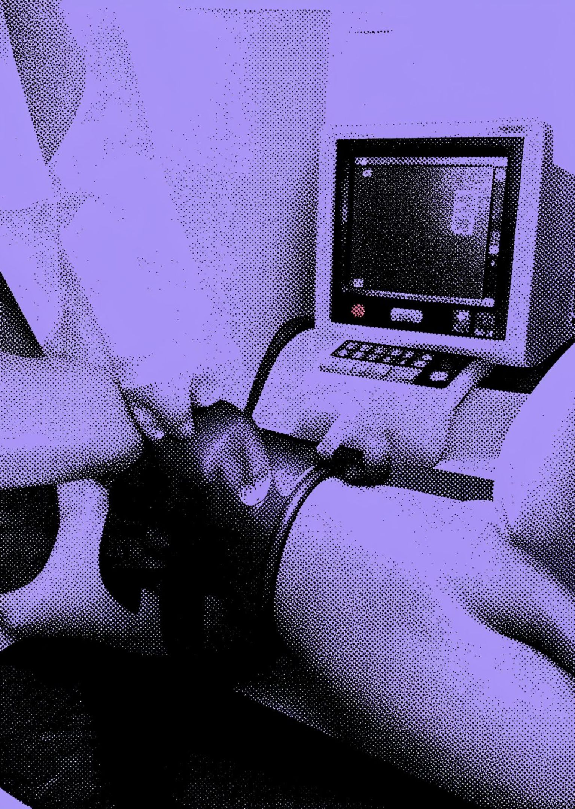
02 · HEALTHCARE USE CASE
A virtual patient profile becomes a readable care journey.
The prototype organizes readings and returns a statistical estimate only.

Slide 4
03 · ARCHITECTURE
From NHANES files to a profile-based elevated-BP estimate.
01
02
03
04
NHANES files
Merge / cleaning
Random Forest
Saved model
Source files enter the training workflow.
Data are prepared for modeling.
Training pipeline creates the model.
Model is loaded by the application.
05
06
Flask app
Dashboard
Profiles produce an elevated-BP estimate.
SQLite stores profiles, readings and alerts; results are displayed.
BP READINGS → CATEGORY AND TREND LOGIC → RULE-BASED ALERTS.

Slide 5
04 · TECHNICAL STACK
One compact stack connects data preparation, modeling and the dashboard.
1
2
3
Application
Persistence
Data
Python and Flask
HTML/CSS/JavaScript dashboard
SQLite persistence
Patient profiles, readings and alerts
pandas and NumPy
NHANES source files in training workflow
4
Modeling
scikit-learn Random Forest pipeline
Preprocessing and imputation

Slide 6
05 · AI / ML TARGET
Boundary of the model
elevated_bp
It is not a hypertensive-crisis prediction or clinical diagnosis.
BP CATEGORY AND ALERTS ARE SEPARATE FROM THE PROFILE-BASED MODEL SCORE.
SBP >= 130 OR DBP >= 80
The training workflow estimates this binary dataset label from profile features.

Slide 7
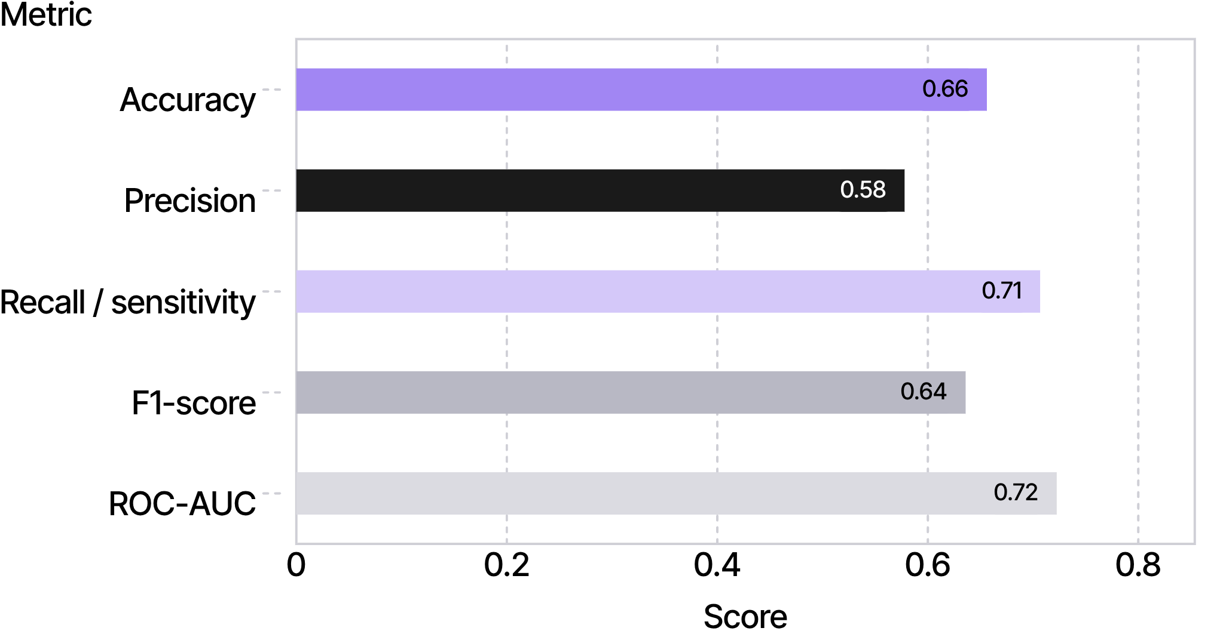
06 · HOLD-OUT TEST
Recall leads the hold-out profile, while ROC-AUC remains moderate.
HOLDOUT_METRICS.CSV
HIGHEST
Recall / sensitivity: 0.7067
ACCURACY 0.6561 · PRECISION 0.5779 · F1-SCORE 0.6359 · ROC-AUC 0.7225

Slide 8
07 · CONFUSION MATRIX + CROSS-VALIDATION
Evaluation is consistent enough to inspect, but remains preliminary.
CONFUSION_MATRIX.CSV
FIVE-FOLD CV F1
0.6247 ± 0.0085
Actual / predicted | 0 | 1
0 | 571 | 352
1 | 200 | 482
FIVE-FOLD CV ROC-AUC
0.7189 ± 0.0123
RESULTS DEPEND ON THE DATASET AND EVALUATION SETUP.

Slide 9
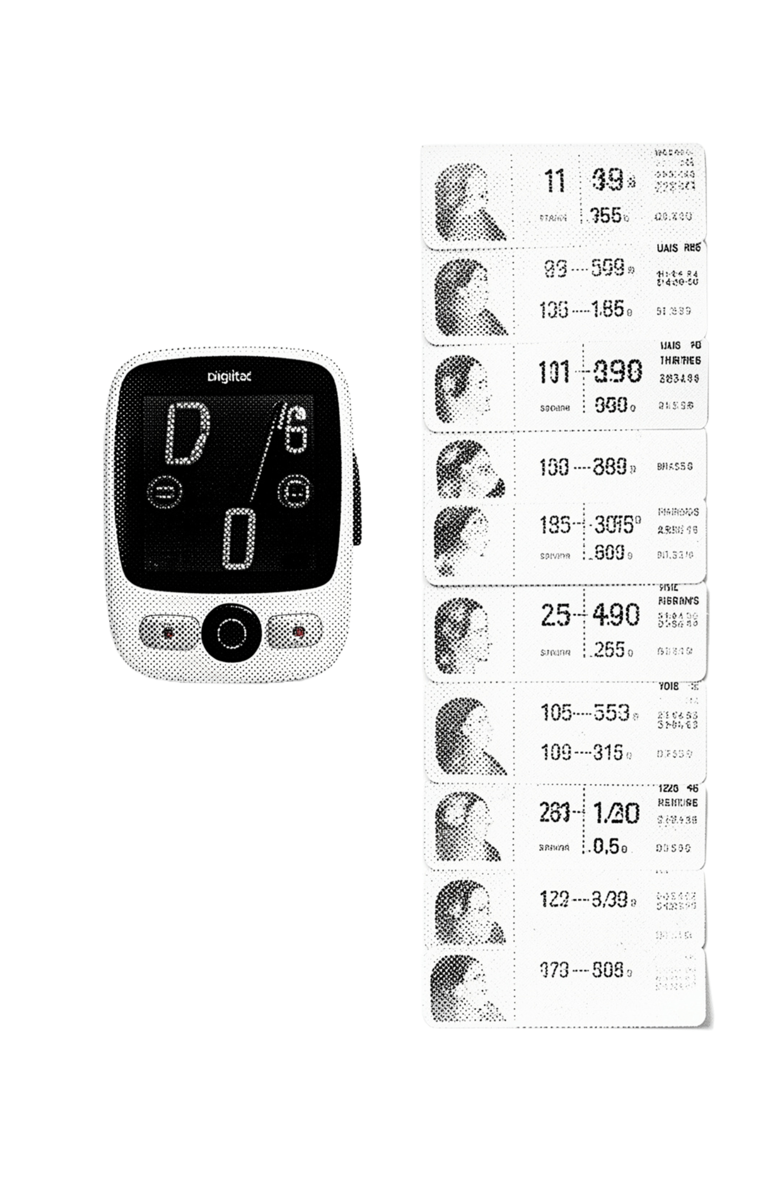
08 · PROTOTYPE DEMONSTRATION
Switch profiles, record readings, then inspect the changing history.
01
02
Switch
Record
Choose a virtual patient and review profile scores.
Add systolic/diastolic BP and optional heart rate.
03
04
Review
Respond
History updates with timeline and trend summaries.
Alerts can be demonstrated and acknowledged.
THE SCORE DEPENDS ON PROFILE FEATURES, NOT ONLY THE LATEST BP READING.

Slide 10
09 · SOFTWARE VALIDATION
Every reported software check passed.
Covered areas
41/41
Model loading
Data handling
Database operations
Trends and alerts
INCLUDE EVALUATION_REPORT.TXT AND TEST_REPORT.TXT IN THE REPOSITORY.
CHECKS PASSED
Passing software tests does not establish clinical validity or patient safety.

