Slide 1



CIPLA LTD

Slide 2

Reservation Summary
Entity | Reservations | Guest Volume | Room Nights | Reservation Value
Cipla Digital Health Ltd | 1 | 1 | 14 | ₹ 58800.00
Cipla Foundation | 10 | 10 | 11 | ₹ 41471.00
Cipla Health Ltd | 187 | 195 | 345 | ₹ 1454482.00
CIPLA LTD | 1815 | 1987 | 5818 | ₹ 17129836.00
M K HAMIED FOUNDATION | 2 | 3 | 7 | ₹ 29800.00
MEDISPRAY LABORATORIES PVT.LTD - Goa | 26 | 33 | 135 | ₹ 538459.00

Slide 3
Top Cities with ADR(Entity Wise)
Entity | City | Reservations | ADR
Cipla Digital Health Ltd | Mumbai | 1 | ₹ 4200.00
Cipla Foundation | Mumbai | 4 | ₹ 4800.00
Cipla Health Ltd | Mumbai | 15 | ₹ 6450.00
CIPLA LTD | Indore | 143 | ₹ 2409.04
M K HAMIED FOUNDATION | Nagpur | 1 | ₹ 3750.00
MEDISPRAY LABORATORIES PVT.LTD - Goa | Mumbai | 8 | ₹ 4812.50

Slide 4
Top Properties with ADR(Entity Wise)
Entity | Property | Reservations | ADR
Cipla Digital Health Ltd | Krishna Palace Hotel Mumbai | 1 | ₹ 4200.00
Cipla Foundation | Krishna Palace Hotel Mumbai | 3 | ₹ 4400.00
Cipla Health Ltd | Hotel Home In (By Amrik Sukhdev) | 11 | ₹ 3393.00
CIPLA LTD | Cipla Guest House - Goa | 111 | ₹ 0.00
M K HAMIED FOUNDATION | Ibis Chennai City Centre | 1 | ₹ 7300.00
MEDISPRAY LABORATORIES PVT.LTD - Goa | ibis Thane | 5 | ₹ 5100.00

Slide 5
Customer Feedback
Entity | Reservations | Feedback Received | Average Ratings for Hotel | Average Ratings for GH
Cipla Digital Health Ltd | 1 | 0 | None | None
Cipla Foundation | 10 | 0 | None | None
Cipla Health Ltd | 187 | 1 | None | None
CIPLA LTD | 1815 | 5 | None | None
M K HAMIED FOUNDATION | 2 | 0 | None | None
MEDISPRAY LABORATORIES PVT.LTD - Goa | 26 | 0 | None | None

Slide 6
Traveller Profile
Entity | Guest Volume with <2000 Rate Band | Guest Volume with 2000-5000 Rate Band | Guest Volume with >5000 Rate Band
Cipla Digital Health Ltd | 0 | 1 | 0
Cipla Foundation | 1 | 8 | 1
Cipla Health Ltd | 8 | 145 | 42
CIPLA LTD | 405 | 1072 | 510
M K HAMIED FOUNDATION | 0 | 2 | 1
MEDISPRAY LABORATORIES PVT.LTD - Goa | 4 | 21 | 8

Slide 7
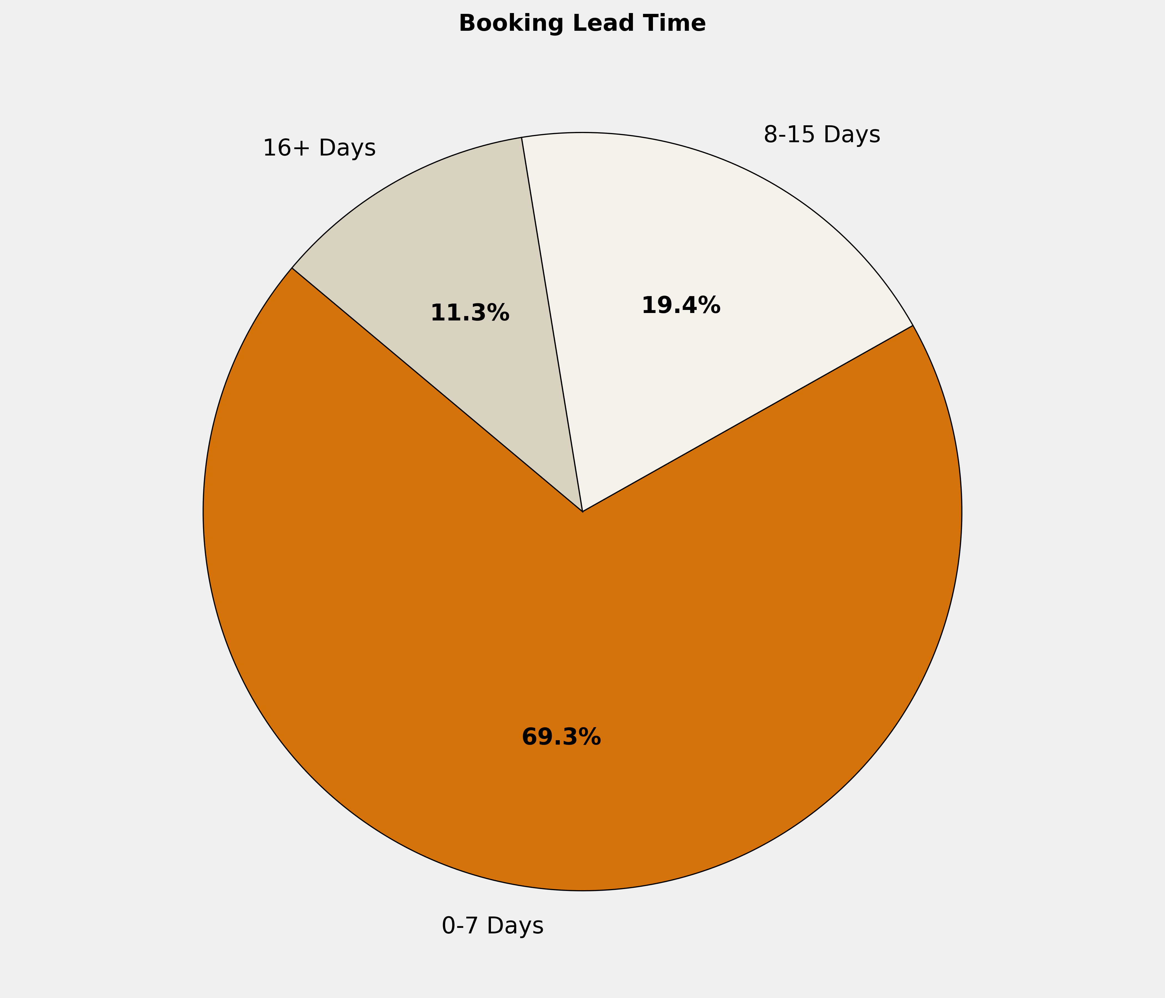
Booking Lead Time
🔹 69.3% of the bookings are made in 0-7 Days. More structured booking planning can optimize costs, ensure availability, and enhance the overall booking experience.

Slide 8
Top 10 Cities by Bookings
City | Reservations | Room Nights | Reservation Value | ADR
Mumbai | 159 | 579 | ₹ 3408101.00 | ₹ 6640.30
Indore | 158 | 749 | ₹ 2026346.00 | ₹ 2569.43
Hyderabad | 134 | 316 | ₹ 1976991.00 | ₹ 6100.51
Goa | 131 | 1112 | ₹ 323160.00 | ₹ 709.29
Amritsar | 110 | 177 | ₹ 624891.00 | ₹ 4208.67
Bengaluru | 106 | 327 | ₹ 1377084.00 | ₹ 5427.19
Pune | 86 | 278 | ₹ 890969.00 | ₹ 4257.79
Cochin | 84 | 146 | ₹ 590805.00 | ₹ 4537.36
Kurkumbh | 71 | 262 | ₹ 0.00 | ₹ 0.00
New Delhi And NCR | 65 | 96 | ₹ 649196.00 | ₹ 7061.71

Slide 9
Top 10 Properties by Bookings
Property | Reservations | Room Nights | Reservation Value | ADR
Cipla Guest House - Goa | 111 | 1020 | ₹ 0.00 | ₹ 0.00
Cipla Indore Plant Guest House | 66 | 354 | ₹ 0.00 | ₹ 0.00
Cipla Kurkumbh - Unit 1 | 66 | 244 | ₹ 0.00 | ₹ 0.00
ibis Mumbai Vikhroli | 48 | 209 | ₹ 1130073.00 | ₹ 5507.82
Avasa Hotel - Hyderabad | 43 | 148 | ₹ 1039500.00 | ₹ 7058.14
Fairfield By Marriott Amritsar | 34 | 40 | ₹ 145800.00 | ₹ 3729.41
Cipla Plant Guest House - Baddi | 30 | 195 | ₹ 0.00 | ₹ 0.00
Hotel Prime Square,Daund | 28 | 159 | ₹ 280400.00 | ₹ 2374.29
Radisson Blu Hotel Amritsar | 23 | 32 | ₹ 133580.00 | ₹ 5025.22
Ibis Kochi City Centre | 22 | 35 | ₹ 124465.00 | ₹ 3539.91

Slide 10
Reservation Summary – Last 3 Months
Entity | January Reservations | January Room Nights | January Reservation Value | February Reservations | February Room Nights | February Reservation Value | March Reservations | March Room Nights | March Reservation Value
Cipla Cancer And Aids Foundation | 0 | 0 | 0.00 | 11 | 21 | 81000.00 | 0 | 0 | 0.00
Cipla Digital Health Ltd | 0 | 0 | 0.00 | 0 | 0 | 0.00 | 1 | 14 | 58800.00
Cipla Foundation | 20 | 32 | 128350.00 | 14 | 28 | 91050.00 | 10 | 11 | 41471.00
Cipla Health Ltd | 156 | 285 | 1372309.00 | 164 | 286 | 1326441.00 | 187 | 345 | 1454482.00
CIPLA LTD | 2064 | 6591 | 21659298.00 | 2251 | 6495 | 21390645.00 | 1815 | 5818 | 17129836.00
GOLDEN CROSS PHARMA PVT LTD | 0 | 0 | 0.00 | 2 | 2 | 0.00 | 0 | 0 | 0.00
M K HAMIED FOUNDATION | 0 | 0 | 0.00 | 7 | 15 | 106800.00 | 2 | 7 | 29800.00
MEDISPRAY LABORATORIES PVT.LTD - Goa | 14 | 30 | 73803.00 | 21 | 166 | 262250.00 | 26 | 135 | 538459.00
MEDISPRAY LABORATORIES PVT.LTD - SATARA | 1 | 3 | 0.00 | 0 | 0 | 0.00 | 0 | 0 | 0.00

Slide 11
Thank You

