Slide 1



CIPLA LTD

Slide 2

Reservation Summary
Entity | Reservations | Guest Volume | Room Nights | Reservation Value
Cipla Foundation | 9 | 10 | 20 | ₹ 81050.00
Cipla Health Ltd | 203 | 215 | 407 | ₹ 1956210.00
CIPLA LTD | 1044 | 1114 | 2117 | ₹ 8872688.00
Cipla Pharma And Life Sciences Limited (COI) | 43 | 43 | 61 | ₹ 299399.00
CIPLA PHARMACEUTICALS LIMITED | 1 | 1 | 1 | ₹ 4000.00
M K HAMIED FOUNDATION | 2 | 2 | 4 | ₹ 28199.00
MEDISPRAY LABORATORIES PVT.LTD - Goa | 20 | 22 | 56 | ₹ 208270.00
Okasa Pharma Private Limited | 1 | 1 | 1 | ₹ 30400.00

Slide 3
Top Cities with ADR(Entity Wise)
Entity | City | Reservations | ADR
Cipla Foundation | Mumbai | 9 | ₹ 4713.89
Cipla Health Ltd | New Delhi And NCR | 16 | ₹ 6571.88
CIPLA LTD | Mumbai | 110 | ₹ 6312.71
Cipla Pharma And Life Sciences Limited (COI) | New Delhi And NCR | 4 | ₹ 7285.00
CIPLA PHARMACEUTICALS LIMITED | Mangalore | 1 | ₹ 4000.00
M K HAMIED FOUNDATION | Mumbai | 1 | ₹ 4400.00
MEDISPRAY LABORATORIES PVT.LTD - Goa | Coimbatore | 4 | ₹ 7409.75
Okasa Pharma Private Limited | New Delhi And NCR | 1 | ₹ 30400.00

Slide 4
Top Properties with ADR(Entity Wise)
Entity | Property | Reservations | ADR
Cipla Foundation | Krishna Palace Hotel - Grant Road | 3 | ₹ 4733.33
Cipla Health Ltd | Sayaji Hotel Indore | 5 | ₹ 4400.00
CIPLA LTD | Adiva Residency Beacon, Mumbai | 36 | ₹ 4625.00
Cipla Pharma And Life Sciences Limited (COI) | Hotel Sahara Star | 3 | ₹ 7166.67
CIPLA PHARMACEUTICALS LIMITED | Goldfinch Hotel Mangaluru | 1 | ₹ 4000.00
M K HAMIED FOUNDATION | Krishna Palace Hotel - Grant Road | 1 | ₹ 4400.00
MEDISPRAY LABORATORIES PVT.LTD - Goa | Ibis Coimbatore City Centre | 4 | ₹ 7409.75
Okasa Pharma Private Limited | Taj Mahal New Delhi | 1 | ₹ 30400.00

Slide 5
Customer Feedback
Entity | Reservations | Feedback Received | Average Ratings for Hotel | Average Ratings for GH
Cipla Foundation | 9 | 3 | 3.333333 | None
Cipla Health Ltd | 203 | 7 | 4.000000 | None
CIPLA LTD | 1044 | 67 | 3.652830 | 4.125000
Cipla Pharma And Life Sciences Limited (COI) | 43 | 5 | 3.850000 | None
CIPLA PHARMACEUTICALS LIMITED | 1 | 0 | None | None
M K HAMIED FOUNDATION | 2 | 0 | None | None
MEDISPRAY LABORATORIES PVT.LTD - Goa | 20 | 1 | None | None
Okasa Pharma Private Limited | 1 | 0 | None | None

Slide 6
Traveller Profile
Entity | Guest Volume with <2000 Rate Band | Guest Volume with 2000-5000 Rate Band | Guest Volume with >5000 Rate Band
Cipla Foundation | 0 | 8 | 2
Cipla Health Ltd | 4 | 148 | 63
CIPLA LTD | 30 | 895 | 189
Cipla Pharma And Life Sciences Limited (COI) | 0 | 25 | 18
CIPLA PHARMACEUTICALS LIMITED | 0 | 1 | 0
M K HAMIED FOUNDATION | 0 | 1 | 1
MEDISPRAY LABORATORIES PVT.LTD - Goa | 3 | 14 | 5
Okasa Pharma Private Limited | 0 | 0 | 1

Slide 7
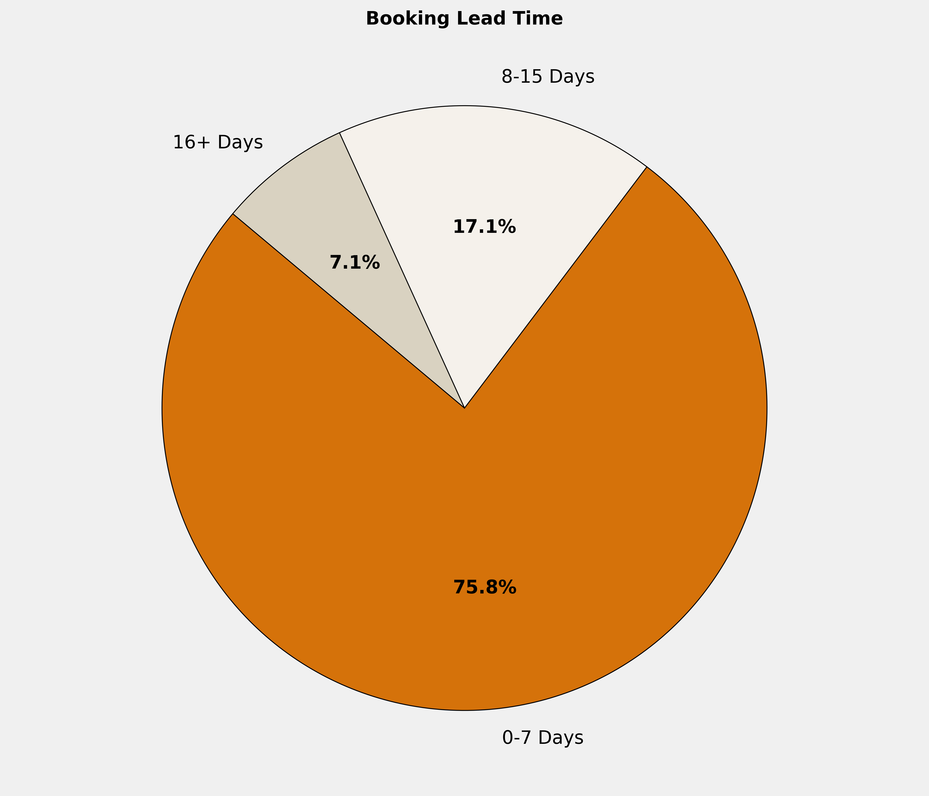
Booking Lead Time
🔹 75.8% of the bookings are made in 0-7 Days. More structured booking planning can optimize costs, ensure availability, and enhance the overall booking experience.

Slide 8
Top 10 Cities by Bookings
City | Reservations | Room Nights | Reservation Value | ADR
Mumbai | 140 | 383 | ₹ 2086979.00 | ₹ 6302.10
Bengaluru | 69 | 194 | ₹ 1422849.00 | ₹ 6872.74
New Delhi And NCR | 60 | 103 | ₹ 527068.00 | ₹ 6530.63
Hyderabad | 38 | 63 | ₹ 375779.00 | ₹ 5764.58
Chennai | 37 | 100 | ₹ 421750.00 | ₹ 4979.79
Pune | 34 | 53 | ₹ 264940.00 | ₹ 5405.18
Cochin | 33 | 66 | ₹ 253198.00 | ₹ 3915.12
Indore | 30 | 51 | ₹ 213889.00 | ₹ 4399.63
Ahmedabad | 29 | 59 | ₹ 236900.00 | ₹ 3993.97
Kolkata | 27 | 51 | ₹ 235220.00 | ₹ 4662.59

Slide 9
Top 10 Properties by Bookings
Property | Reservations | Room Nights | Reservation Value | ADR
Adiva Residency Beacon, Mumbai | 40 | 76 | ₹ 262000.00 | ₹ 4612.50
Krishna Palace Hotel - Grant Road | 24 | 97 | ₹ 406800.00 | ₹ 4475.00
Ibis Mumbai Vikhroli | 19 | 84 | ₹ 475096.00 | ₹ 5875.42
Radisson Blu Hotel New Delhi Dwarka | 12 | 18 | ₹ 96000.00 | ₹ 6000.00
Ibis Kochi City Centre | 11 | 26 | ₹ 76700.00 | ₹ 2950.00
Ibis Coimbatore City Centre | 10 | 27 | ₹ 165784.00 | ₹ 5589.70
Grand Vijayawada by GRT Hotels | 9 | 20 | ₹ 79000.00 | ₹ 3950.00
KPM TRIPENTA HOTEL | 9 | 16 | ₹ 62400.00 | ₹ 3900.00
Radisson Blu Marina Hotel Connaught Place | 9 | 16 | ₹ 112000.00 | ₹ 8611.11
Sayaji Hotel Indore | 9 | 14 | ₹ 55600.00 | ₹ 4311.11

Slide 10
Reservation Summary – Last 3 Months
Entity | September Reservations | September Room Nights | September Reservation Value | October Reservations | October Room Nights | October Reservation Value | November Reservations | November Room Nights | November Reservation Value
Cipla Digital Health Ltd | 1 | 1 | 7840.00 | 0 | 0 | 0.00 | 0 | 0 | 0.00
Cipla Foundation | 22 | 37 | 100035.00 | 26 | 112 | 252140.00 | 9 | 20 | 81050.00
Cipla Health Ltd | 209 | 430 | 1854498.00 | 200 | 452 | 2064973.00 | 203 | 407 | 1956210.00
CIPLA LTD | 1033 | 2113 | 8561692.00 | 1049 | 1975 | 8364987.00 | 1044 | 2117 | 8872688.00
Cipla Pharma And Life Sciences Limited (COI) | 34 | 56 | 264488.00 | 15 | 19 | 87024.00 | 43 | 61 | 299399.00
CIPLA PHARMACEUTICALS LIMITED | 4 | 8 | 27399.00 | 1 | 2 | 6000.00 | 1 | 1 | 4000.00
GOLDEN CROSS PHARMA PVT LTD | 1 | 10 | 0.00 | 4 | 60 | 0.00 | 0 | 0 | 0.00
M K HAMIED FOUNDATION | 4 | 5 | 21600.00 | 1 | 2 | 23400.00 | 2 | 4 | 28199.00
MEDISPRAY LABORATORIES PVT.LTD - Goa | 20 | 47 | 216200.00 | 8 | 49 | 59727.00 | 20 | 56 | 208270.00
MEDISPRAY LABORATORIES PVT.LTD - SATARA | 2 | 6 | 0.00 | 4 | 37 | 51000.00 | 0 | 0 | 0.00
Okasa Pharma Private Limited | 0 | 0 | 0.00 | 0 | 0 | 0.00 | 1 | 1 | 30400.00
Sitec Labs Limited | 4 | 14 | 42564.00 | 0 | 0 | 0.00 | 0 | 0 | 0.00

Slide 11
Thank You

