Slide 1



Capri Global Capital Ltd

Slide 2

Reservation Summary
Entity | Reservations | Guest Volume | Room Nights | Reservation Value
Capri Global Capital Ltd | 3 | 4 | 5 | ₹ 8364.00
Capri Global Housing Finance Ltd | 5 | 6 | 12 | ₹ 26615.00

Slide 3
Top Cities with ADR(Entity Wise)
Entity | City | Reservations | ADR
Capri Global Capital Ltd | Palanpur | 1 | ₹ 2750.00
Capri Global Housing Finance Ltd | Bundi | 1 | ₹ 1650.00

Slide 4
Top Properties with ADR(Entity Wise)
Entity | Property | Reservations | ADR
Capri Global Capital Ltd | Hotel Ramkrishna | 1 | ₹ 1047.00
Capri Global Housing Finance Ltd | Hotel Rallentino | 1 | ₹ 1965.00

Slide 5
Customer Feedback
Entity | Reservations | Feedback Received | Average Ratings for Hotel | Average Ratings for GH
Capri Global Capital Ltd | 3 | 1 | 1.000000 | None
Capri Global Housing Finance Ltd | 5 | 0 | None | None

Slide 6
Traveller Profile
Entity | Guest Volume with <2000 Rate Band | Guest Volume with 2000-5000 Rate Band | Guest Volume with >5000 Rate Band
Capri Global Capital Ltd | 3 | 1 | 0
Capri Global Housing Finance Ltd | 3 | 3 | 0

Slide 7
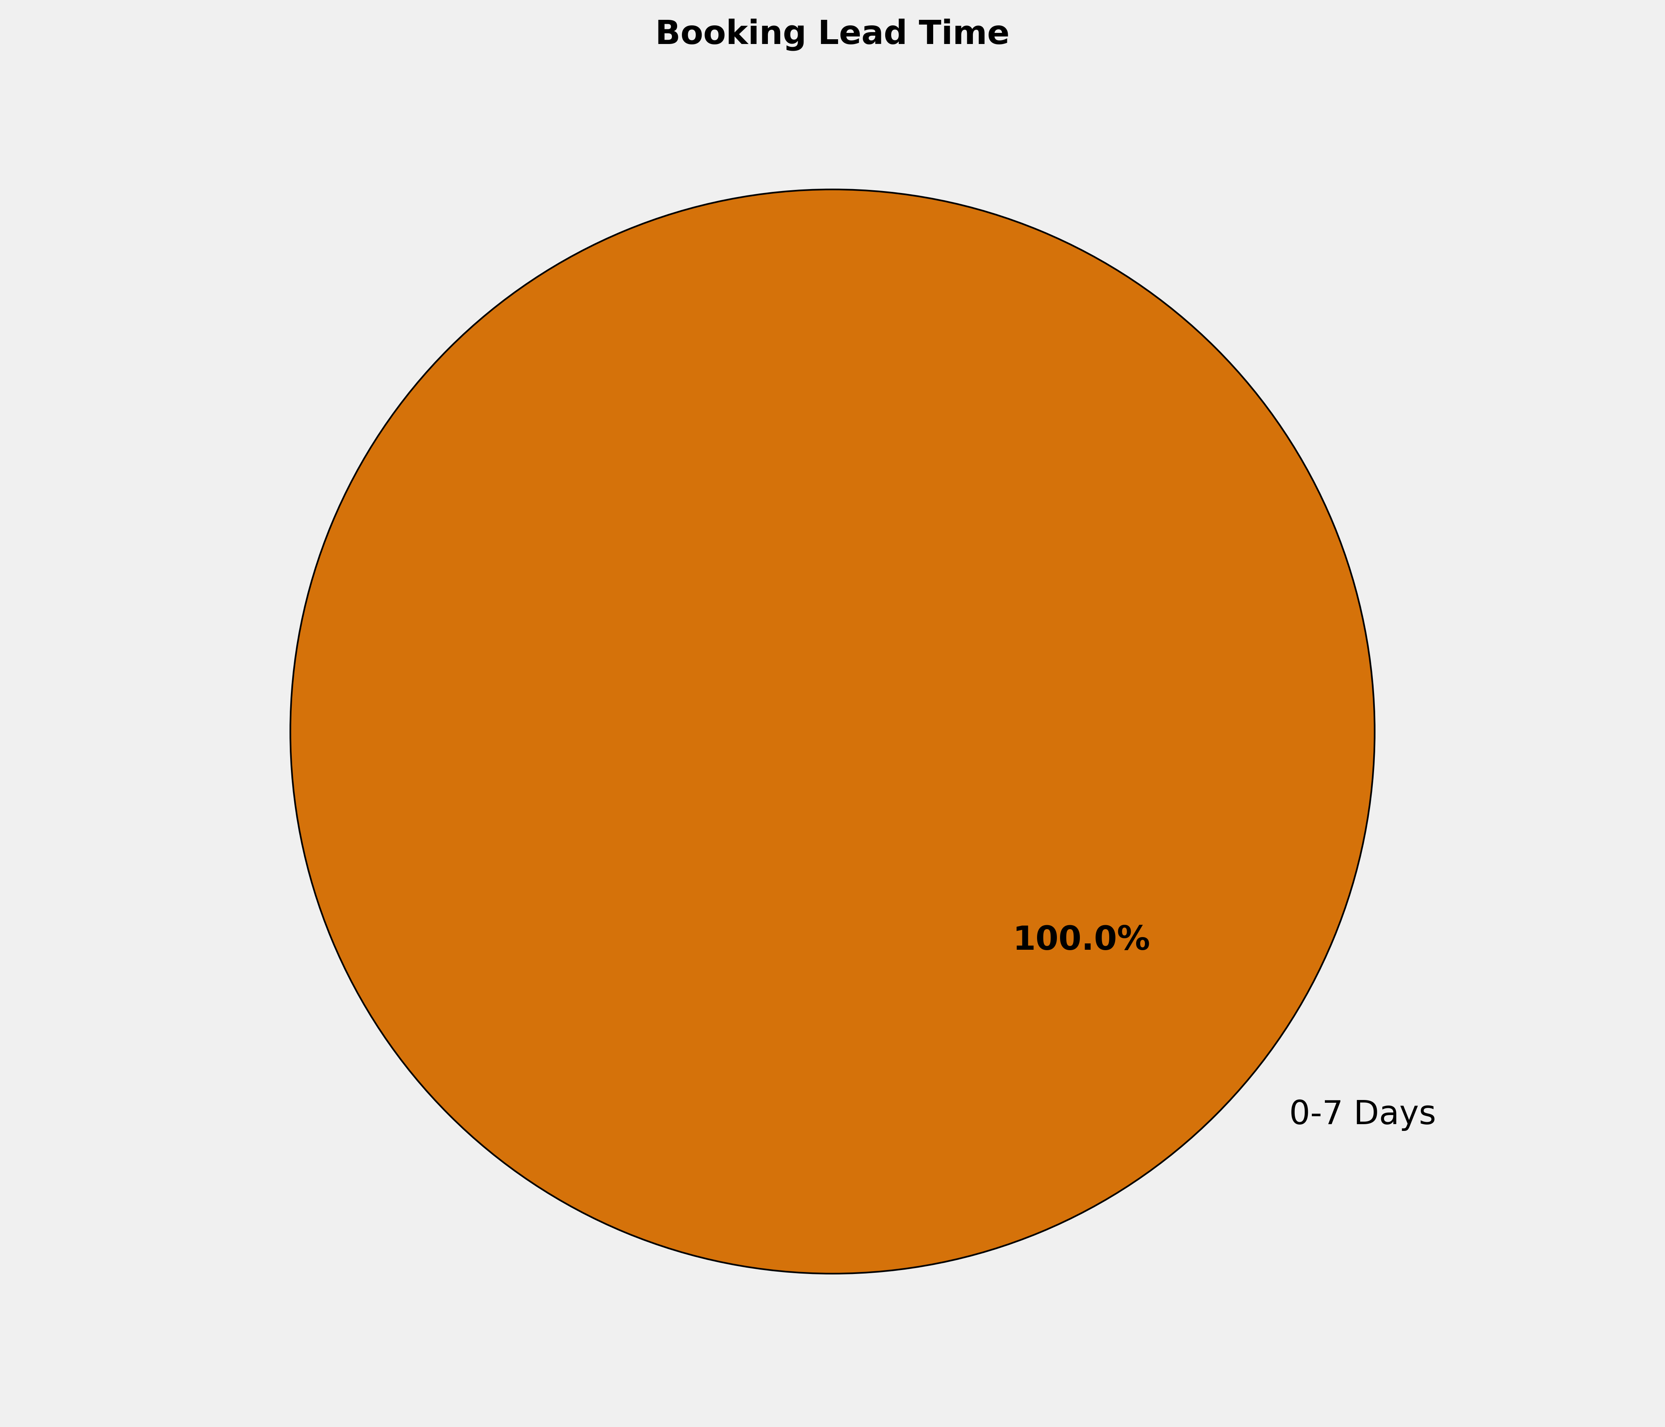
Booking Lead Time
🔹 100.0% of the bookings are made in 0-7 Days. More structured booking planning can optimize costs, ensure availability, and enhance the overall booking experience.

Slide 8
Top 10 Cities by Bookings
City | Reservations | Room Nights | Reservation Value | ADR
Tonk | 1 | 1 | ₹ 2000.00 | ₹ 2000.00
Palanpur | 1 | 1 | ₹ 2750.00 | ₹ 2750.00
Noida | 1 | 8 | ₹ 20000.00 | ₹ 2500.00
Kota | 1 | 1 | ₹ 1965.00 | ₹ 1965.00
Bundi | 1 | 1 | ₹ 1650.00 | ₹ 1650.00
Bijainagar | 1 | 1 | ₹ 1000.00 | ₹ 1000.00
Bhilwara | 1 | 2 | ₹ 3520.00 | ₹ 1760.00
Betul | 1 | 2 | ₹ 2094.00 | ₹ 1047.00

Slide 9
Top 10 Properties by Bookings
Property | Reservations | Room Nights | Reservation Value | ADR
Lijoy Hotel & Restra | 1 | 1 | ₹ 1650.00 | ₹ 1650.00
Hotel Ramkrishna | 1 | 2 | ₹ 2094.00 | ₹ 1047.00
Hotel Rallentino | 1 | 1 | ₹ 1965.00 | ₹ 1965.00
Hotel N Chandra-Bijainagar | 1 | 1 | ₹ 1000.00 | ₹ 1000.00
Hotel El Lujo | 1 | 1 | ₹ 2750.00 | ₹ 2750.00
HOTEL DWARKA PALACE | 1 | 1 | ₹ 2000.00 | ₹ 2000.00
Golden Tree | 1 | 8 | ₹ 20000.00 | ₹ 2500.00
Amit Palace Hotel | 1 | 2 | ₹ 3520.00 | ₹ 1760.00

Slide 10
Reservation Summary – Last 3 Months
Entity | October Reservations | October Room Nights | October Reservation Value | November Reservations | November Room Nights | November Reservation Value | December Reservations | December Room Nights | December Reservation Value
Capri Global Capital Ltd | 0 | 0 | 0.00 | 0 | 0 | 0.00 | 3 | 5 | 8364.00
Capri Global Housing Finance Ltd | 0 | 0 | 0.00 | 0 | 0 | 0.00 | 5 | 12 | 26615.00

Slide 11
Thank You

