Slide 1



Fcm Travel Solutions India Pvt. Ltd.

Slide 2

Reservation Summary
Entity | Reservations | Guest Volume | Room Nights | Reservation Value
Fcm Travel Solutions India Pvt. Ltd | 44 | 45 | 69 | ₹ 304079.00

Slide 3
Top Cities with ADR(Entity Wise)
Entity | City | Reservations | ADR
Fcm Travel Solutions India Pvt. Ltd | Hyderabad | 61 | ₹ 5191.60

Slide 4
Top Properties with ADR(Entity Wise)
Entity | Property | Reservations | ADR
Fcm Travel Solutions India Pvt. Ltd | SAROVAR PORTICO AHMEDABAD | 3 | ₹ 3827.00

Slide 5
Customer Feedback
Entity | Reservations | Feedback Received | Average Ratings for Hotel | Average Ratings for GH
Fcm Travel Solutions India Pvt. Ltd | 44 | 1 | 4.800000 | None

Slide 6
Traveller Profile
Entity | Guest Volume with <2000 Rate Band | Guest Volume with 2000-5000 Rate Band | Guest Volume with >5000 Rate Band
Fcm Travel Solutions India Pvt. Ltd | 0 | 31 | 14

Slide 7
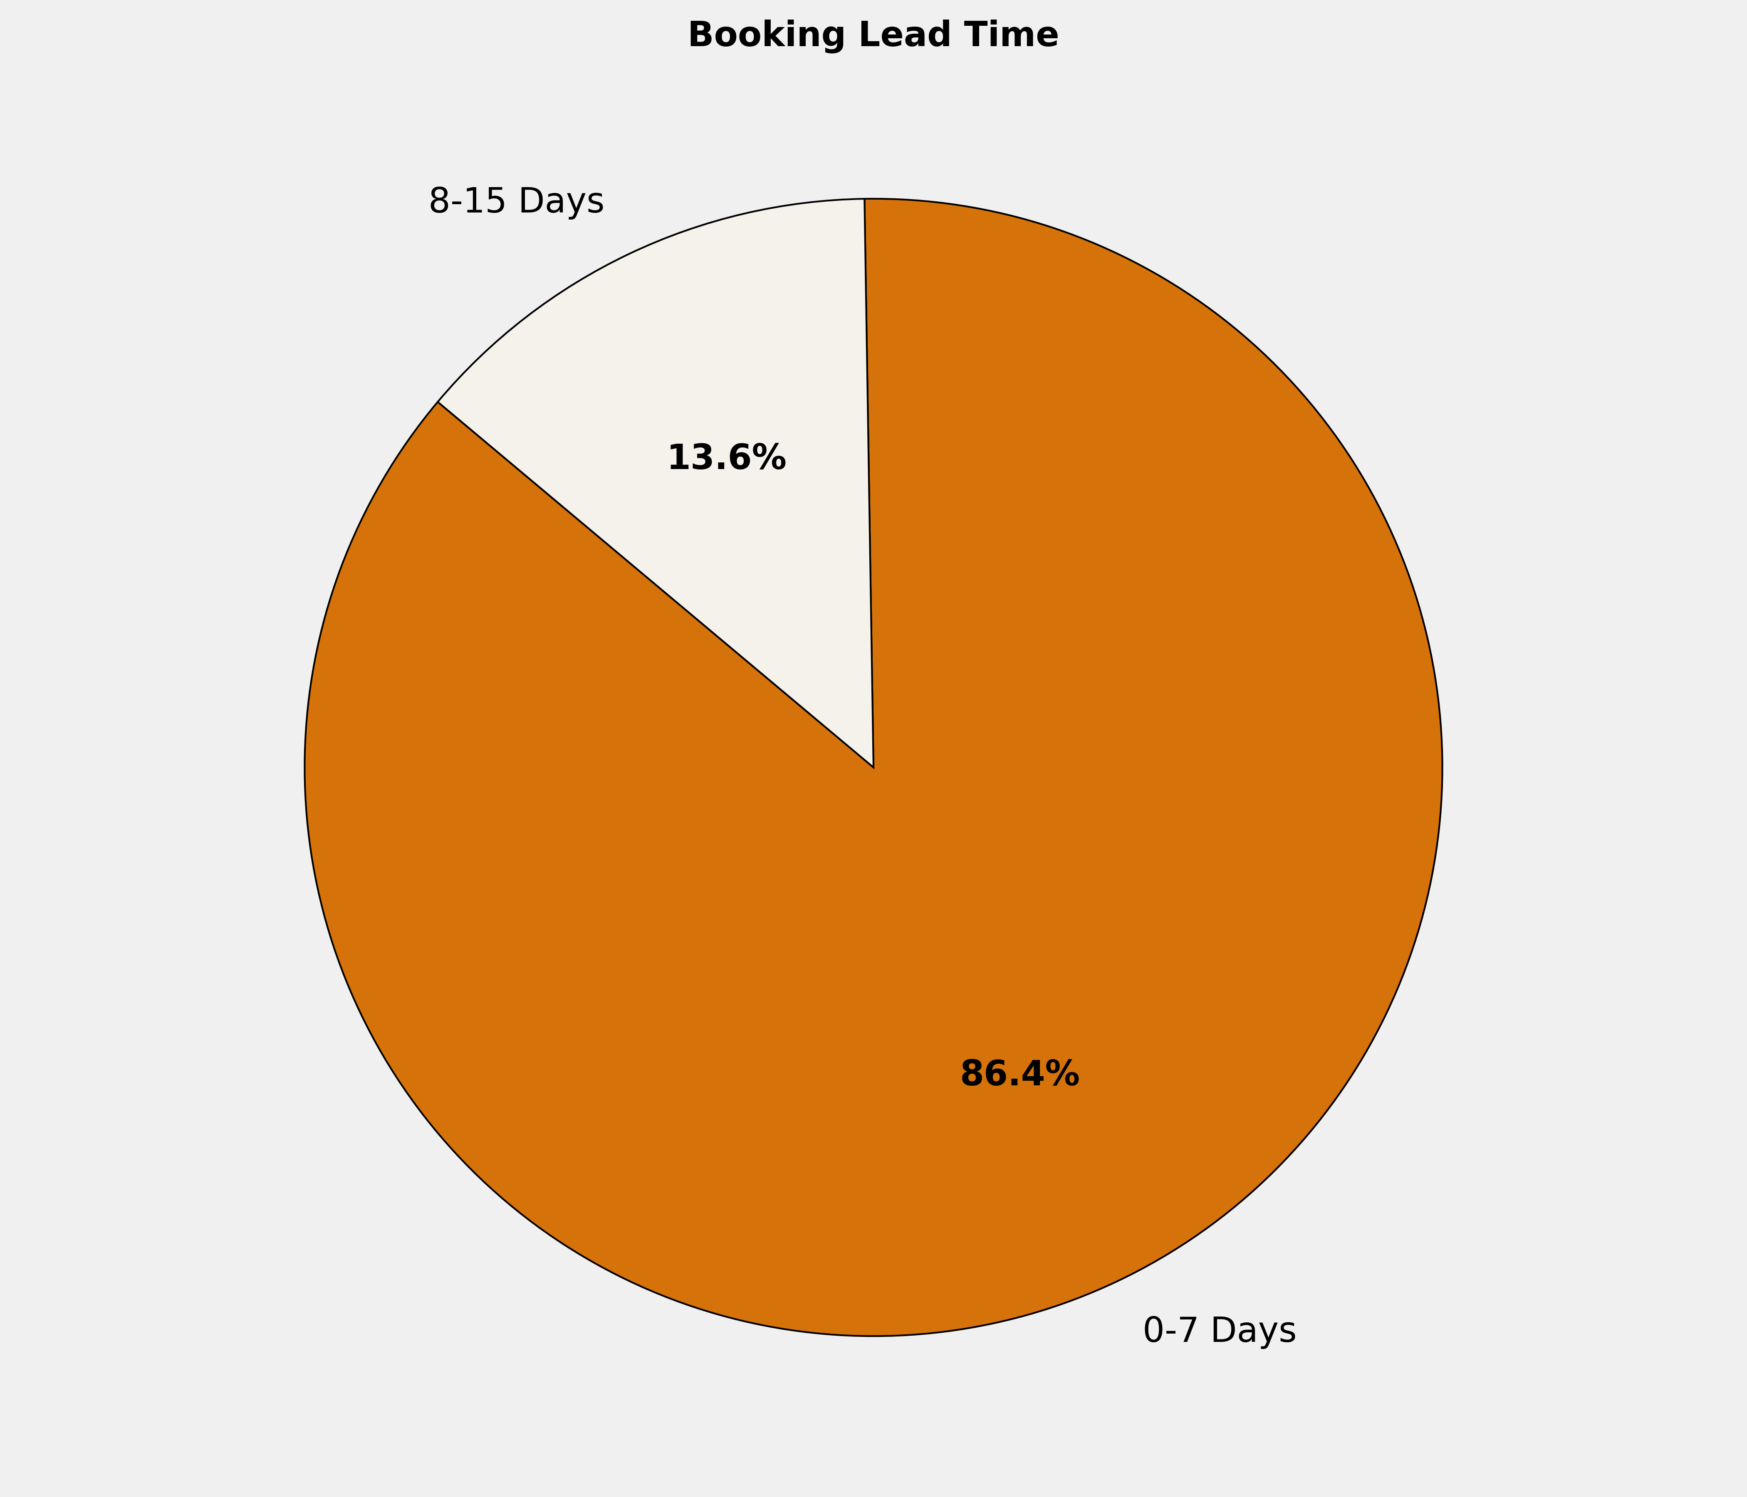
Booking Lead Time
🔹 86.4% of the bookings are made in 0-7 Days. More structured booking planning can optimize costs, ensure availability, and enhance the overall booking experience.

Slide 8
Top 10 Cities by Bookings
City | Reservations | Room Nights | Reservation Value | ADR
New Delhi And NCR | 9 | 11 | ₹ 67596.00 | ₹ 6362.89
Bengaluru | 6 | 10 | ₹ 47291.00 | ₹ 4688.83
Hyderabad | 5 | 7 | ₹ 25674.00 | ₹ 3894.80
Chennai | 4 | 8 | ₹ 29559.00 | ₹ 3754.20
Kozhikode | 4 | 4 | ₹ 14600.00 | ₹ 3650.00
Ahmedabad | 2 | 5 | ₹ 18744.00 | ₹ 3849.00
Jabalpur | 2 | 4 | ₹ 15486.00 | ₹ 4212.00
Jodhpur | 2 | 2 | ₹ 6780.00 | ₹ 3390.00
Jaipur | 1 | 1 | ₹ 5149.00 | ₹ 5149.00
Hubli | 1 | 3 | ₹ 9888.00 | ₹ 3296.00

Slide 9
Top 10 Properties by Bookings
Property | Reservations | Room Nights | Reservation Value | ADR
Hotel Hyson Heritage Kozhikode | 4 | 4 | ₹ 14600.00 | ₹ 3650.00
Fortune Select JP Cosmos | 3 | 5 | ₹ 28435.00 | ₹ 5701.67
Citadel Sarovar Portico Bengaluru | 2 | 4 | ₹ 15656.00 | ₹ 3914.00
Deccan Serai Hotel | 2 | 2 | ₹ 9360.00 | ₹ 4680.00
Hampshire Plaza Hotel | 2 | 3 | ₹ 12314.00 | ₹ 4057.00
Regent Grand | 2 | 3 | ₹ 15450.00 | ₹ 5150.00
TAJ PALACE NEW DELHI | 2 | 2 | ₹ 21528.00 | ₹ 10764.00
Zone By The Park-Jodhpur | 2 | 2 | ₹ 6780.00 | ₹ 3390.00
Holiday Inn Kolkata Airport, an IHG Hotel | 1 | 1 | ₹ 4782.00 | ₹ 4782.00
GOKULAM PARK SABARI | 1 | 1 | ₹ 3090.00 | ₹ 3090.00

Slide 10
Reservation Summary – Last 3 Months
Entity | May Reservations | May Room Nights | May Reservation Value | June Reservations | June Room Nights | June Reservation Value | July Reservations | July Room Nights | July Reservation Value
Fcm Travel Solutions India Pvt. Ltd | 2 | 2 | 6800.00 | 1 | 1 | 1281.00 | 44 | 69 | 304079.00

Slide 11
Thank You

