Slide 1



Fcm Travel Solutions India Pvt. Ltd

Slide 2

Reservation Summary
Month | Reservations | Room Nights | Reservation Value
May 2024 | 2 | 2 | 6800.00
June 2024 | 1 | 1 | 1281.00
July 2024 | 44 | 69 | 304079.00

Slide 3
Customer Feedback
Month | Reservations | Feedback Received | Average Ratings for Hotel | Average Ratings for GH
April 2024 | 2 | 0 | None | None
May 2024 | 1 | 0 | None | None

Slide 4
Traveller Profile
Month | Guest Volume with <2000 Rate Band | Guest Volume with 2000-5000 Rate Band | Guest Volume with >5000 Rate Band
April 2024 | 118 | 439 | 2
May 2024 | 111 | 479 | 2
June 2024 | 126 | 480 | 1
July 2024 | 184 | 490 | 3

Slide 5
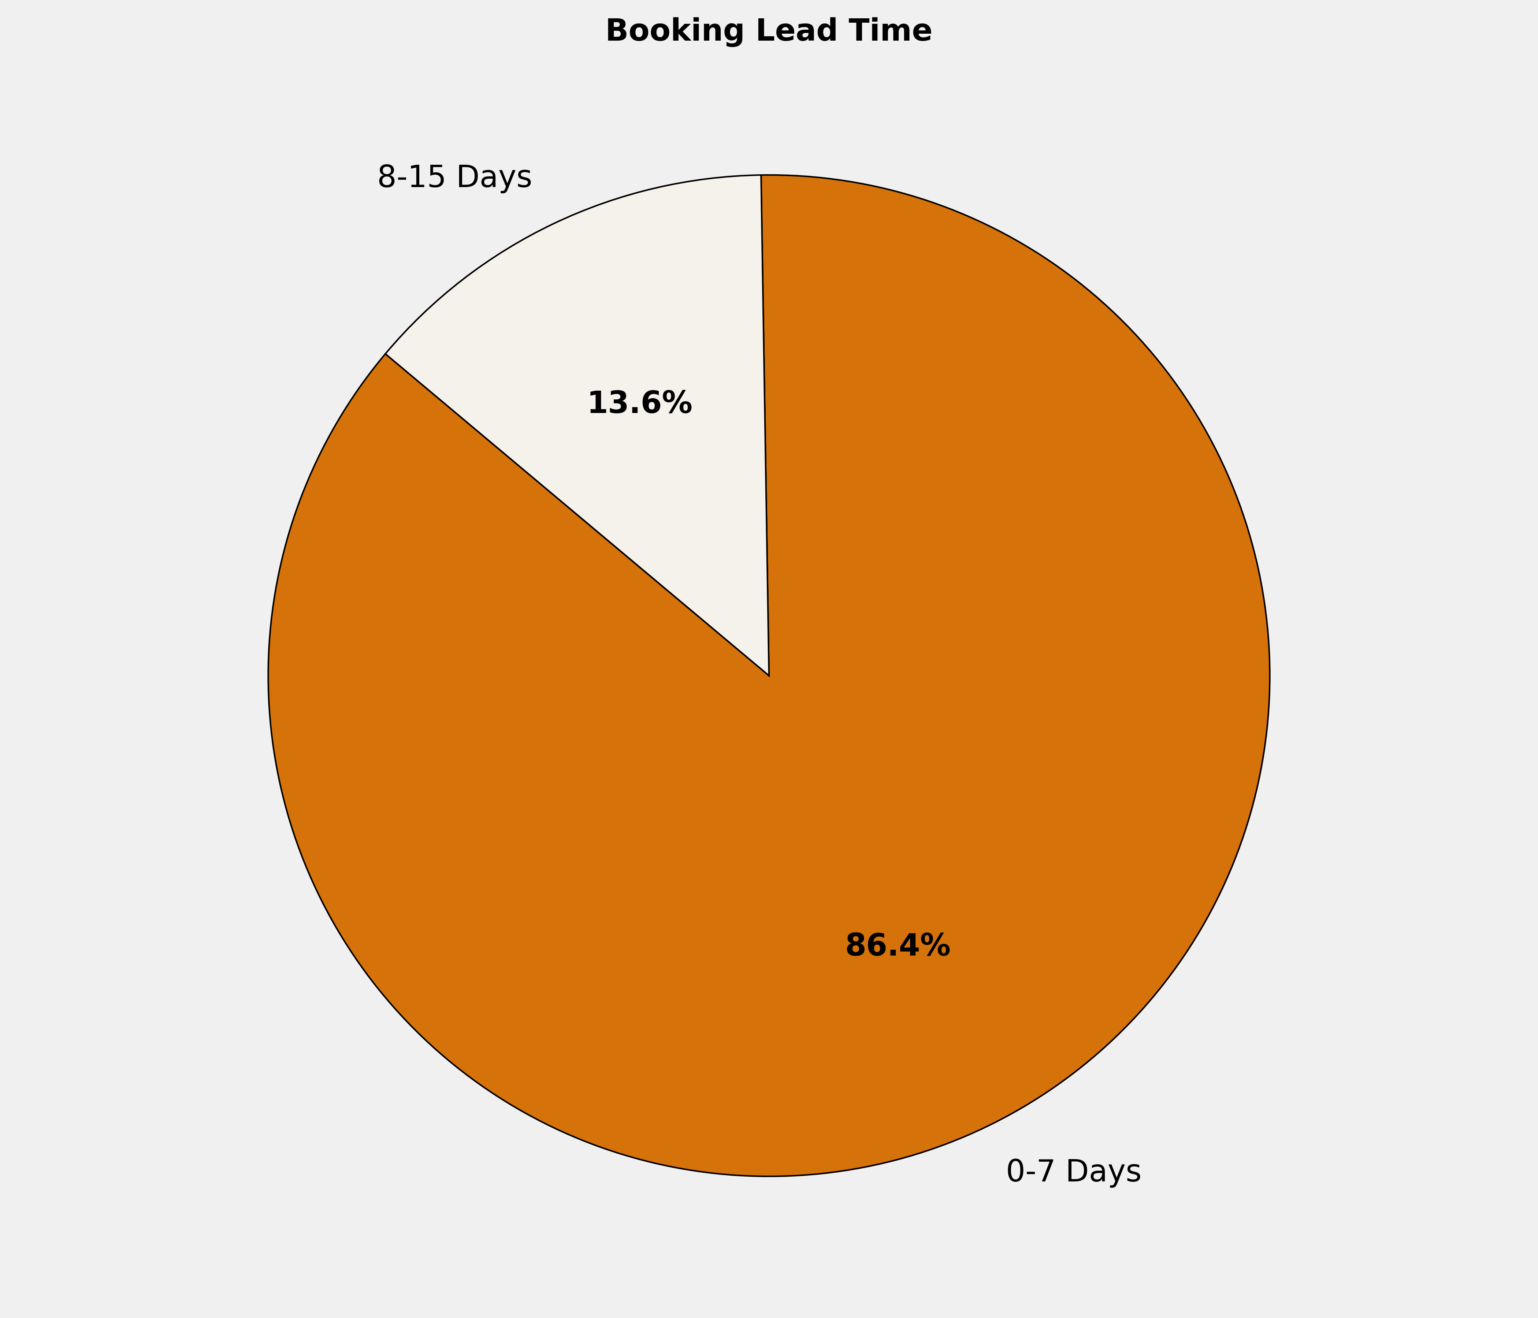
Booking Lead Time
🔹 86.4% of the bookings are made in 0-7 Days. More structured booking planning can optimize costs, ensure availability, and enhance the overall booking experience.

Slide 6
Top 10 Cities by Bookings
City | Reservations | Room Nights | Reservation Value | ADR
New Delhi And NCR | 9 | 11 | ₹ 67596.00 | ₹ 6362.89
Bengaluru | 6 | 10 | ₹ 47291.00 | ₹ 4688.83
Hyderabad | 5 | 7 | ₹ 25674.00 | ₹ 3894.80
Chennai | 4 | 8 | ₹ 29559.00 | ₹ 3754.20
Kozhikode | 4 | 4 | ₹ 14600.00 | ₹ 3650.00
Jodhpur | 2 | 2 | ₹ 6780.00 | ₹ 3390.00
Jabalpur | 2 | 4 | ₹ 15486.00 | ₹ 4212.00
Ahmedabad | 2 | 5 | ₹ 18744.00 | ₹ 3849.00
Agra | 1 | 3 | ₹ 8499.00 | ₹ 2833.00
Bhiwadi | 1 | 3 | ₹ 9978.00 | ₹ 3326.00

Slide 7
Top 10 Properties by Bookings
Property | Reservations | Room Nights | Reservation Value | ADR
Hotel Hyson Heritage Kozhikode | 4 | 4 | ₹ 14600.00 | ₹ 3650.00
Fortune Select JP Cosmos | 3 | 5 | ₹ 28435.00 | ₹ 5701.67
Deccan Serai Hotel | 2 | 2 | ₹ 9360.00 | ₹ 4680.00
Citadel Sarovar Portico Bengaluru | 2 | 4 | ₹ 15656.00 | ₹ 3914.00
Hampshire Plaza Hotel | 2 | 3 | ₹ 12314.00 | ₹ 4057.00
Regent Grand | 2 | 3 | ₹ 15450.00 | ₹ 5150.00
TAJ PALACE NEW DELHI | 2 | 2 | ₹ 21528.00 | ₹ 10764.00
Zone By The Park-Jodhpur | 2 | 2 | ₹ 6780.00 | ₹ 3390.00
TAJ THE TREES MUMBAI | 1 | 1 | ₹ 12313.00 | ₹ 12313.00
The Ashtan Sarovar Portico | 1 | 1 | ₹ 5459.00 | ₹ 5459.00

Slide 8
Grade Wise Bookings
Grade | Reservations | Room Nights | Reservation Value | ADR
Guest | 41 | 64 | ₹ 280693.00 | ₹ 4700.93
NA | 3 | 5 | ₹ 23386.00 | ₹ 4618.67

Slide 9
Thank You

